Slide 1
Chapter 12
The Real Numbers and Their Representation

Slide 2
Chapter 12: The Real Numbers and Their Representation
12.1 Rational Numbers and Decimal Representation
12.2 Irrational Numbers and Decimal Representation
12.3 Applications of Decimals and Percents

Slide 3
Section 12-1
Rational Numbers and Decimal Representation

Slide 4
Rational Numbers and Decimal Representation
Define and identify rational numbers.
Write a rational number in lowest terms.
Add, subtract, multiply, and divide rational numbers in fraction form.
Solve carpentry problem using operations with fractions.
Apply the density property and find arithmetic mean.

Slide 5
Rational Numbers and Decimal Representation
Convert a rational number in fraction form to a decimal number.
Convert a terminating or repeating decimal to a rational number in fraction form.

Slide 6
Definition: Rational Numbers
Rational Numbers =
{x | x is a quotient of two integers, with denominator not equal to 0}

Slide 7
Lowest Terms
A rational number is said to be in lowest terms if the greatest common factor of the numerator (top number) and the denominator (bottom number) is 1. Rational numbers are written in lowest terms by using the fundamental property of rational numbers (see next slide).

Slide 8
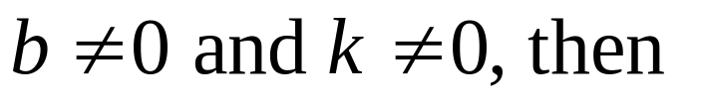
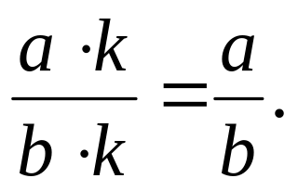
Fundamental Property of Rational Numbers
If a, b, and k are integers with

Slide 9
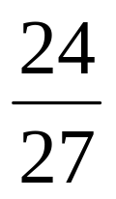
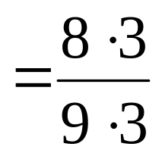
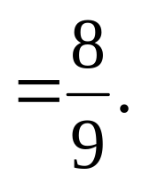
Example: Writing a Fraction in Lowest Terms
Write in lowest terms.
Solution

Slide 10
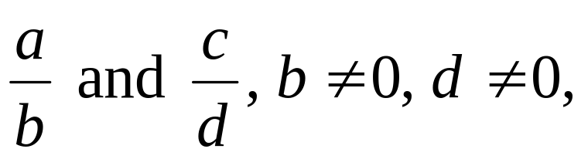
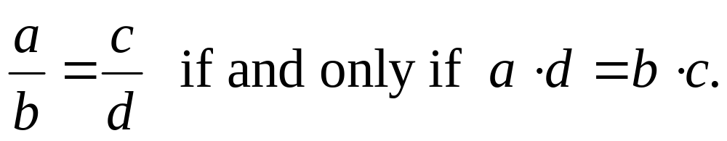
Cross-Product Test for Equality of Rational Numbers
For rational numbers
a and d are called the “extremes.”
b and c are called the “means.”

Slide 11
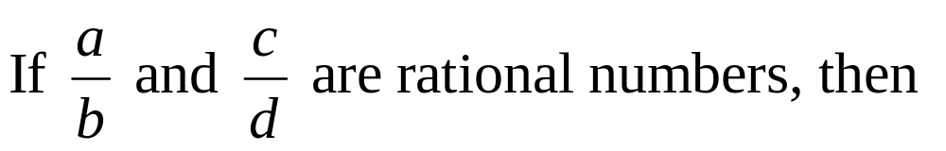
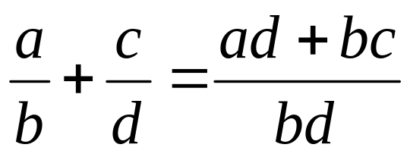
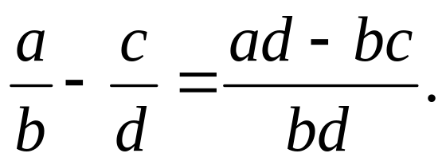
Adding and Subtracting Rational Numbers
and

Slide 12
Adding and Subtracting Rational Numbers
In practical problems involving addition and subtraction of rational numbers, fractions are usually rewritten with the least common multiple of their denominators, called the least common denominator.

Slide 13
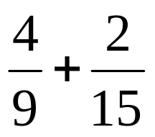
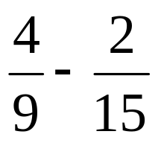

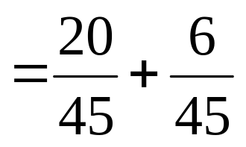
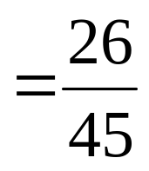

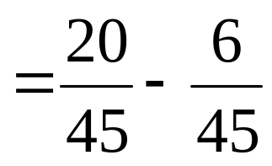
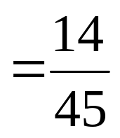
Example: Adding and Subtracting Rational Numbers
Perform each operation.
a) b)
Solution
a)
b)

Slide 14
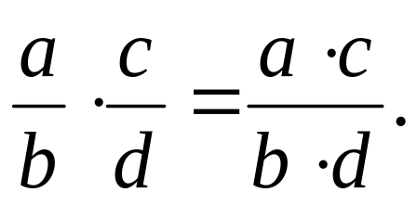
Multiplying Rational Numbers

Slide 15
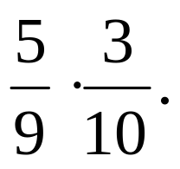
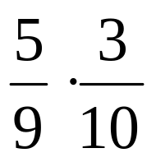
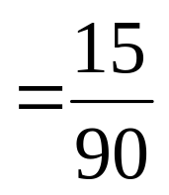
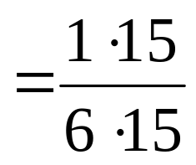
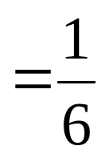
Example: Multiplying Rational Numbers
Find the product
Solution

Slide 16
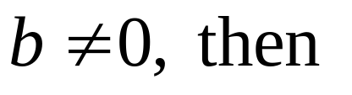
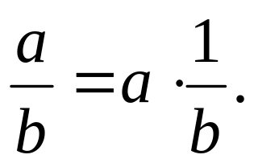
Definition of Division
If a and b are real numbers with

Slide 17
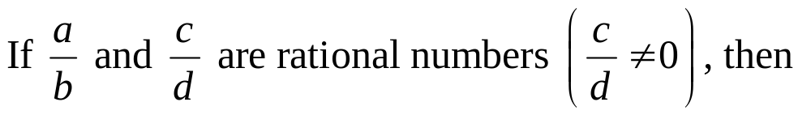
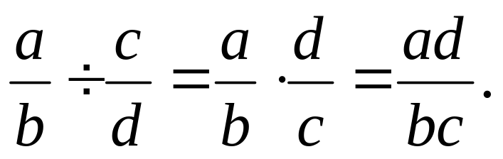
Dividing Rational Numbers

Slide 18
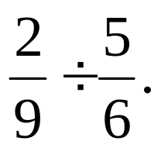
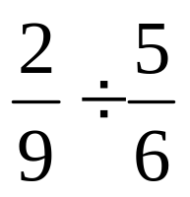
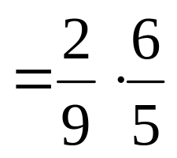
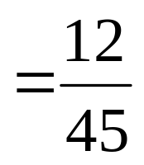
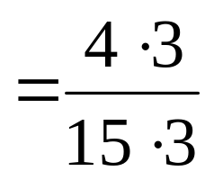
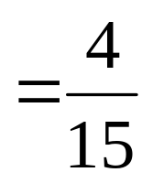
Example: Dividing Rational Numbers
Find the quotient
Solution

Slide 19

Example: Applying Operations with Fractions to Carpentry
A carpenter has a board 72 inches long that he must cut unto 10 pieces of equal length. This will require 9 cuts.
a) If each cut causes a waste of inch, how many inches of actual board will remain after the cuts?
b) What will the length of each of the resulting pieces be?
Continued

Slide 20
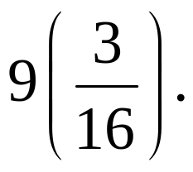
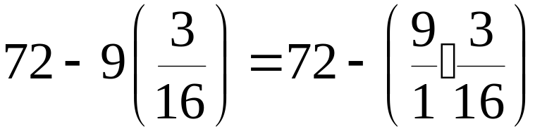
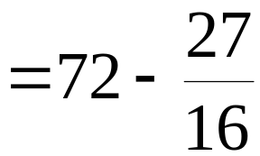
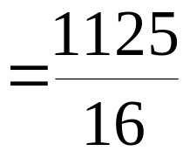
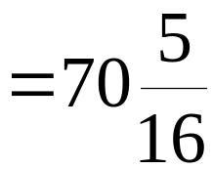
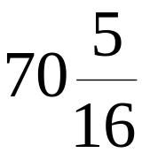
Example: Applying Operations with Fractions to Carpentry
Solution
a) We start with 72 inches and must subtract nine
times. We represent this by
Thus, inches of actual board will remain.
Continued

Slide 21
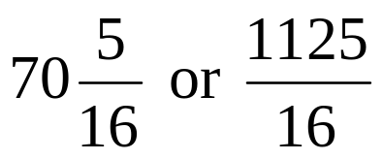
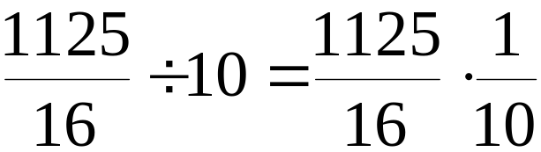
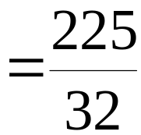
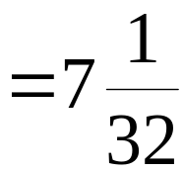
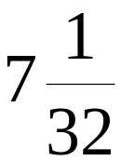
Example: Applying Operations with Fractions to Carpentry
Solution
b) The inches of board from part (a) will be divided into 10 pieces of equal length.
Each piece will measure inches.

Slide 22
Density Property of Rational Numbers
If r and t are distinct rational numbers, with r < t, then there exists a rational number s such that
r < s < t.
This leads to the conclusion that there are infinitely many rational numbers between two distinct rational numbers.

Slide 23
Arithmetic Mean
To find the arithmetic mean, or average, of n numbers, we add the numbers and then divide the sum by n. For two numbers, the number that lies halfway between them is their average.

Slide 24
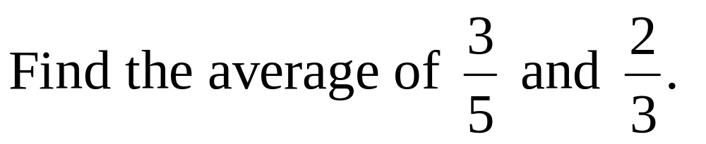
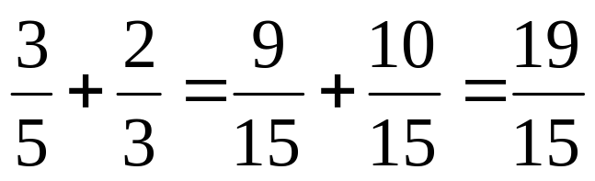
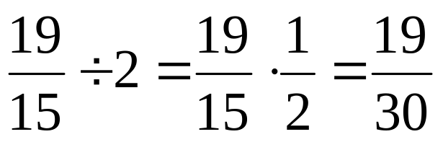
Example: Finding an Arithmetic Mean (Average)
Solution
Add the fractions.
Divide the sum by 2 to get the answer.

Slide 25

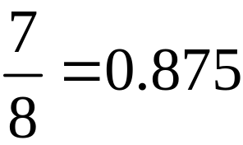
Converting a Rational Number in Fraction Form to a Decimal Number
A rational number in the form a/b can be expressed as a decimal most easily by entering it into a calculator.
For example, to write as a decimal, enter 7, enter the operation of division, enter 8, and then press the equals key to find the following equivalence:

Slide 26
Decimal Form of Rational Numbers
Any rational number can be expressed as either a terminating (stops) decimal or a repeating (reoccurring block of numbers) decimal.

Slide 27
Criteria for Terminating and Repeating Decimals
A rational number, in lowest terms, results in a terminating decimal if the only prime factor of the denominator is 2 or 5 (or both).
A rational number, in lowest terms, results in a repeating decimal if a prime other than 2 or 5 appears in the prime factorization of the denominator.

Slide 28
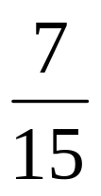
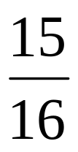
Example: Determining Whether a Decimal Terminates or Repeats
Without dividing, determine whether the decimal form of the given rational number terminates or repeats.
a) b)
Solution
a) Repeats; there is a factor of 3 in the denominator.
b) Terminates; the denominator is 2⁴.

Slide 29
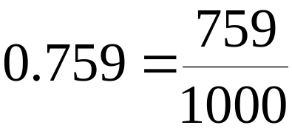



Example: Writing Decimals as Quotients of Integers
Write each decimal as a quotient of integers.
a) 0.759 b) 7.8
Solution
a)
b)

