Slide 1
Chapter 12
The Real Numbers and Their Representation

Slide 2
Chapter 12: The Real Numbers and Their Representation
12.1 Rational Numbers and Decimal Representation
12.2 Irrational Numbers and Decimal Representation
12.3 Applications of Decimals and Percents

Slide 3
Section 12-2
Irrational Numbers and Decimal Representation

Slide 4


Irrational Numbers and Decimal Representation
Understand how irrational numbers differ from rational numbers in their decimal representations.
Follow the proof that is an irrational number.
Use a calculator to find square roots.
Apply the product and quotient rules for square roots.
Rationalize a denominator.
Understand the relevance of the irrational numbers π, , and e in mathematics.

Slide 5
Definition: Irrational Numbers
Irrational Numbers
{x | x is a number represented by a nonrepeating, nonterminating decimal}

Slide 6
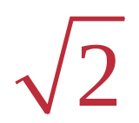
Irrationality of
The proof of this fact is a proof by contradiction.
We need to consider:
1. When a rational number is written in lowest terms, the greatest common factor of its numerator and denominator is 1.
2. If an integer is even, then it has 2 as a factor and may be written in the form 2k, where k is an integer.
3. If a perfect square is even, then its square root is even.

Slide 7
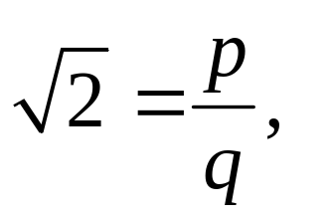

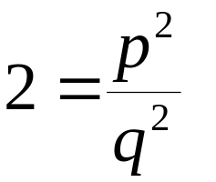

Irrationality of (Proof)
Statement: is an irrational number.
Proof: Assume that is a rational number. Then, by definition, for some integers p and q.
Furthermore, assume that is written in lowest terms, so the greatest common factor of p and q is 1.

Slide 8

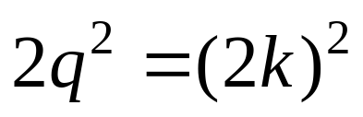
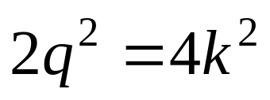
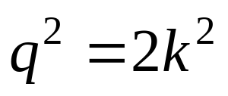
Irrationality of (Proof)
From the last equation, we see that 2 is a factor of p², so p² is even and so is p. Since p is even it can be written as 2k for some integer k.
Replace p with 2k.
Since 2 is a factor of q², q² and also q must be even.

Slide 9

Irrationality of (Proof)
This leads to a contradiction: p and q cannot both be even because they would have a common factor of 2, although it was assumed that their greatest common factor was 1.
Therefore, since the original assumption that is rational led to a contradiction, it must be that is irrational.

Slide 10
Operations with Square Roots
Multiplication, division, addition and subtraction with square roots will be covered on the next several slides.

Slide 11
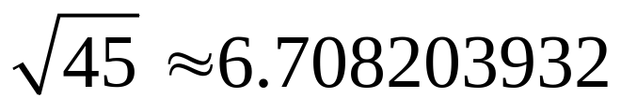
Example: Using a Calculator to Approximate Square Roots
Use a calculator to verify
Solution
Use a calculator, such as the ones found on smartphones, to verify the approximation. Depending on the mode, fewer or more digits may be displayed, and because of different rounding procedures, final digits may differ slightly.

Slide 12
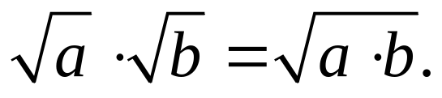
Product Rule for Square Roots
For nonnegative real numbers a and b,

Slide 13
Conditions for a Simplified Square Root Radical
1. The number under the radical (radicand) has
no factor (except 1) that is a perfect square.
2. The radicand has no fractions.
3. No denominator contains a radical.

Slide 14
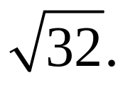
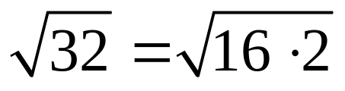
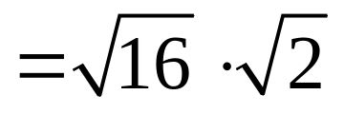
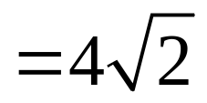
Example: Simplifying a Square Root Radical (Product Rule)
Simplify
Solution

Slide 15
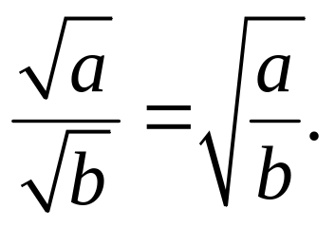
Quotient Rule for Square Roots
For nonnegative real numbers a and positive real numbers b,

Slide 16
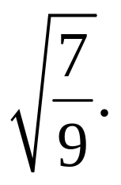
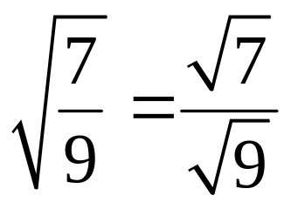
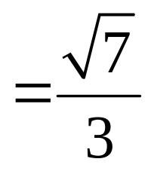
Example: Simplifying a Square Root Radical (Quotient Rule)
Simplify
Solution

Slide 17
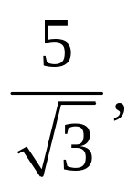
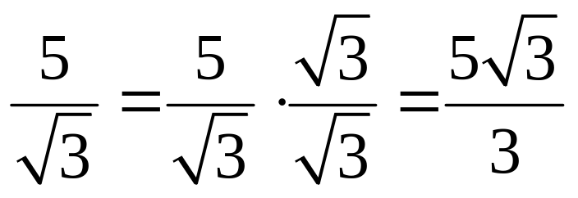
Rationalizing a Denominator
Given to arrive at an equivalent expression
with no radical in the denominator, we use a procedure called rationalizing the denominator shown below.
Simplified form

Slide 18
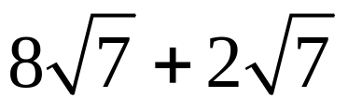
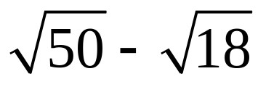
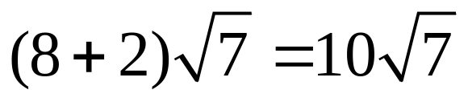
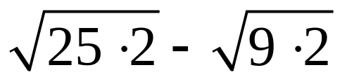
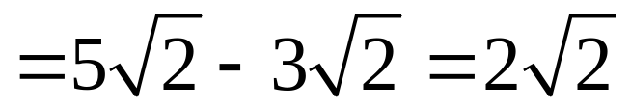
Example: Adding and Subtracting Square Root Radicals
Add or subtract as indicated.
a) b)
Solution
a)
b)

Slide 19
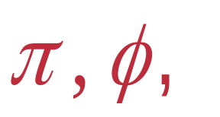
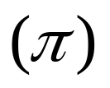
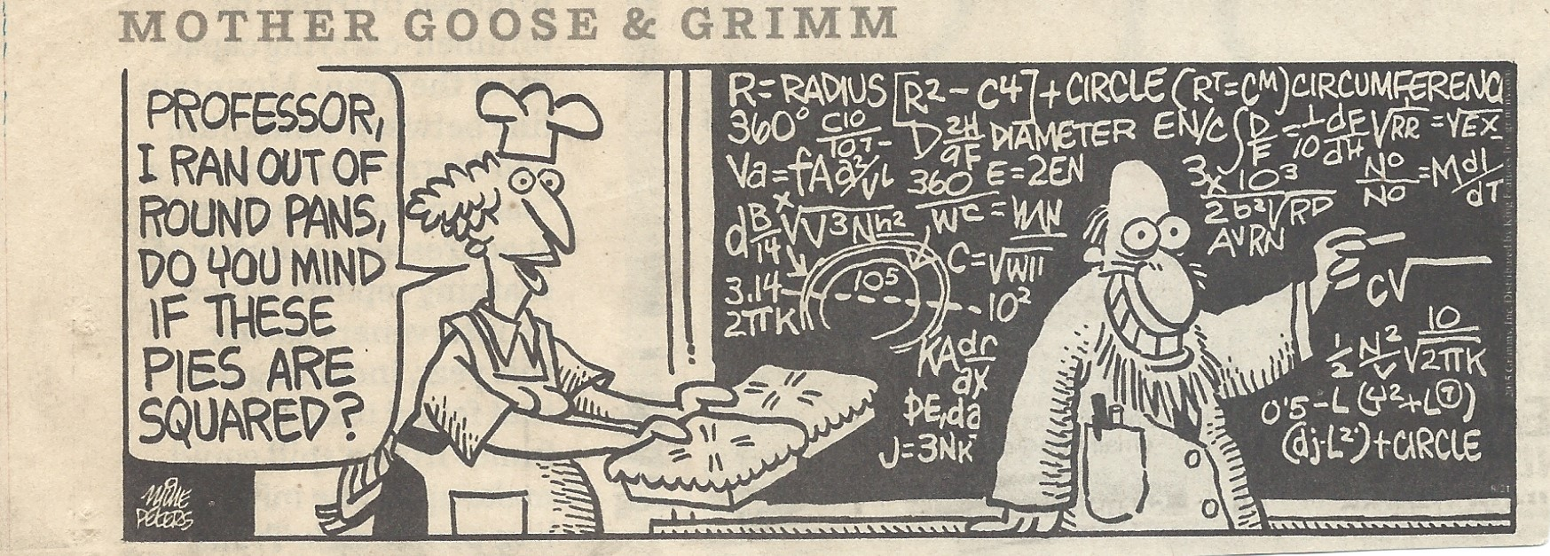

The Irrational Numbers and e
Pi
Pi represents the ratio of the circumference of a circle to its diameter.

Slide 20
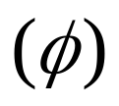
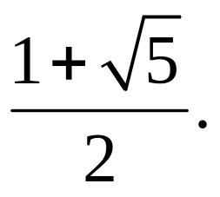
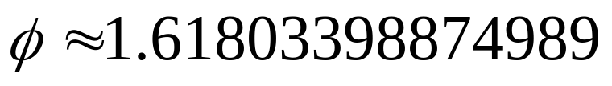
The Irrational Numbers and e
Phi
Phi is the Golden Ratio and has exact value

Slide 21

The Irrational Numbers and e
e
e is a fundamental number is our universe. It is the base of the natural exponential and natural logarithmic functions.

