Slide 1
Chapter 12
The Real Numbers and Their Representation

Slide 2
Chapter 12: The Real Numbers and Their Representation
12.1 Rational Numbers and Decimal Representation
12.2 Irrational Numbers and Decimal Representation
12.3 Accuracy, Precision, Error and Measuring Instruments

Slide 3
Section 12-3
Application of Decimals and Percents

Slide 4
Accuracy, Precision, Error and Measuring Instruments
Determine the significant digits of a number.
Find the precision and greatest possible error of a measurement.
Determine the relative error and percent error of a measurement.
Determine an appropriate approximation of measurement calculations.
Read a ruler.
Find the distance and midpoint of a line segment.

Slide 5
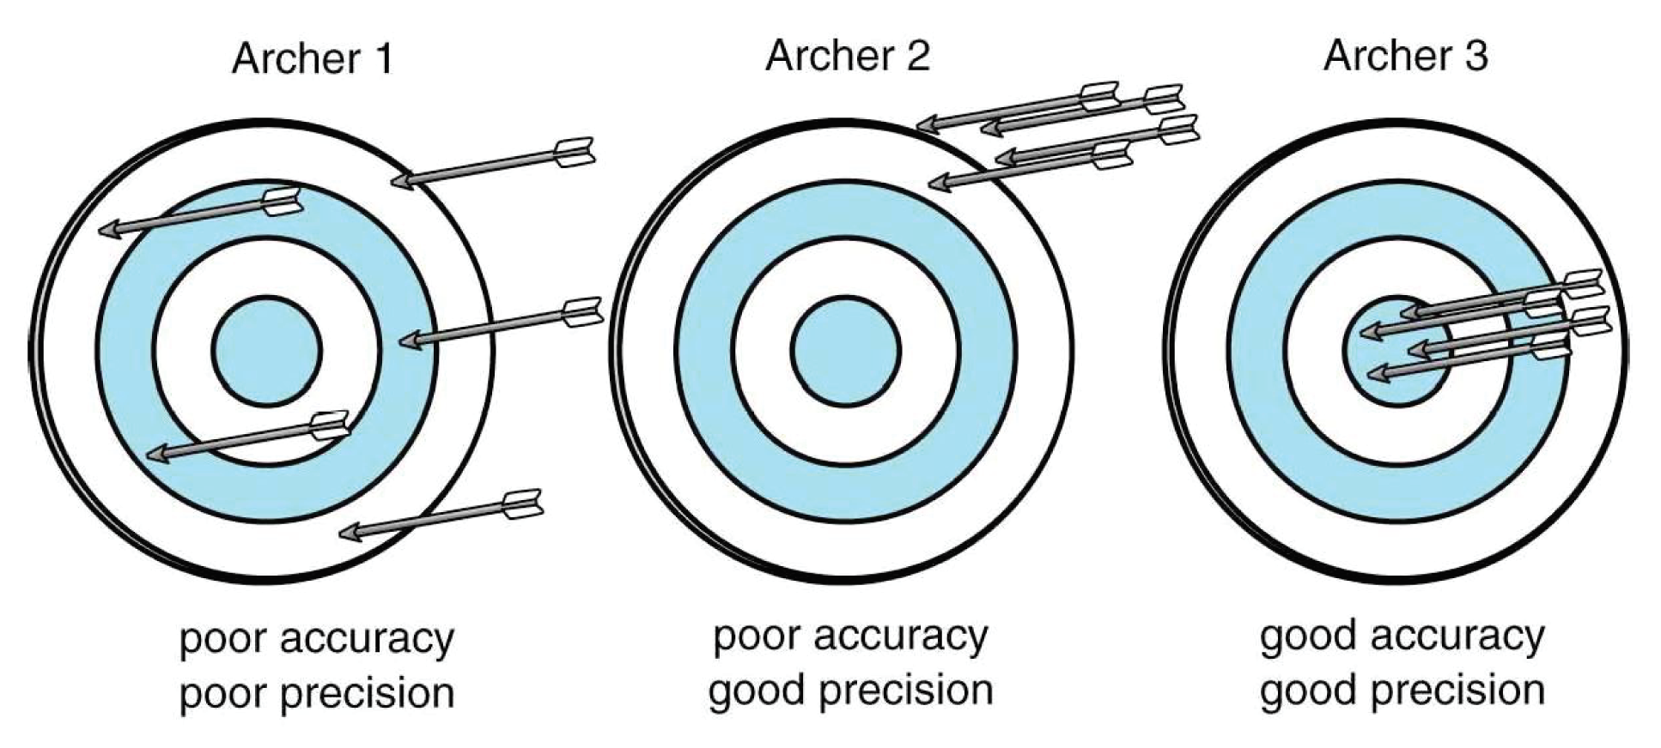
Determine the significant digits of a number
Accuracy – how close the measured value is to the correct value.
Precision – the degree to which the process gets consistent results.

Slide 6
Determine the significant digits of a number
One indicator of precision is the number of significant digits.
To determine the significant digits of a number:
For whole numbers: Start with the leftmost nonzero digit. Count each digit (excluding zeros) through the rightmost nonzero digit. | Significant digits: 200 has 1 significant digit 28 has 2 significant digits 1,230 has 3 significant digits 2,005 has 4 significant digits
For decimals and mixed decimals: Start with the leftmost nonzero digit. Count each digit through the last digit. | 0.007 has 1 significant digit 2.0 has 2 significant digits 1.20 has 3 significant digits 0.01234 has 4 significant digits

Slide 7
Determine the significant digits of a number
Indicate the number of significant digits in the following:
5,205 4 significant digits
12,000 2 significant digits
0.003 1 significant digit
0.0105 3 significant digits
3.02 3 significant digits

Slide 8
Find the precision and greatest possible error of a measurement.
Precision is based on the place value or significant digits of a measure.
The greatest possible error or a measurement is half of the precision of the measurement.
To find the precision and greatest possible error of a measurement:
Determine the precision of the measurement. The greatest possible error is one-half the precision. | Find the greatest possible error of a measurement of 1¾ ft. Precision: ¼ ft. ½( ¼ ) = 1/8 ft.

Slide 9
Find the precision and greatest possible error of a measurement.
Find the greatest possible error of the measurements.
2 5/8 inches | 3.5 cm
2 5/8 inches - 1/8 inch precision ½ ( 1/8 ) = 1/16 inch maximum error | 3.5 cm - Precision = 0.1 cm 0.5 (0.1) = 0.05cm maximum error

Slide 10
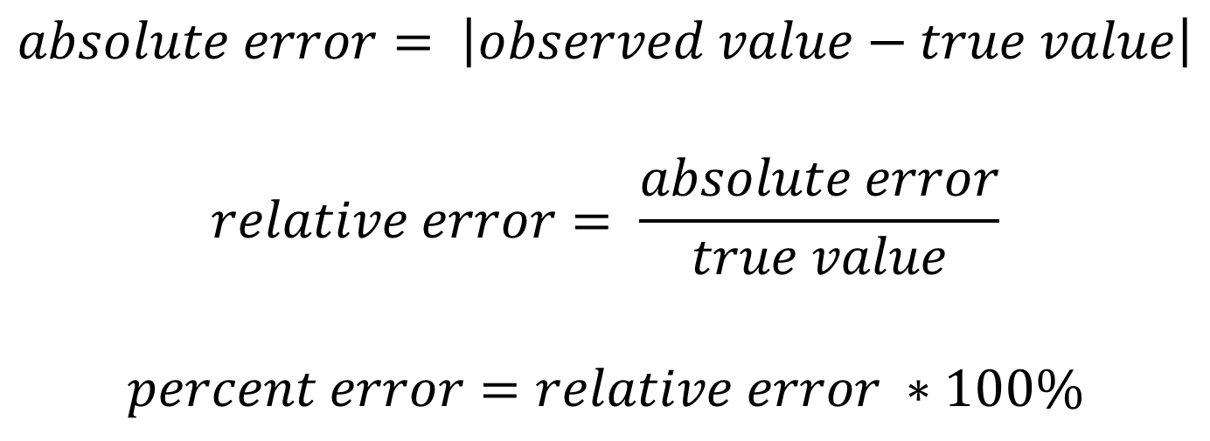
Determine the relative error and percent error of a measurement.
$$absolute error= \left|observed value−true value\right|$$
$$relative error= \frac{absolute error}{true value}$$
$$percent error=relative error ∗100\%$$

Slide 11
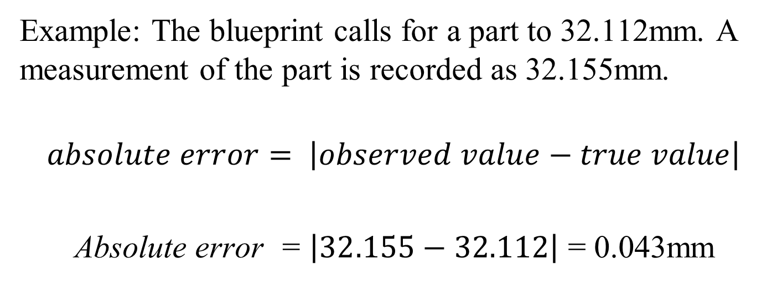
Determine the relative error and percent error of a measurement.
Example: The blueprint calls for a part to 32.112mm. A measurement of the part is recorded as 32.155mm.
$$absolute error= \left|observed value−true value\right|$$
Absolute error = $\left|32.155−32.112\right|$ = 0.043mm

Slide 12
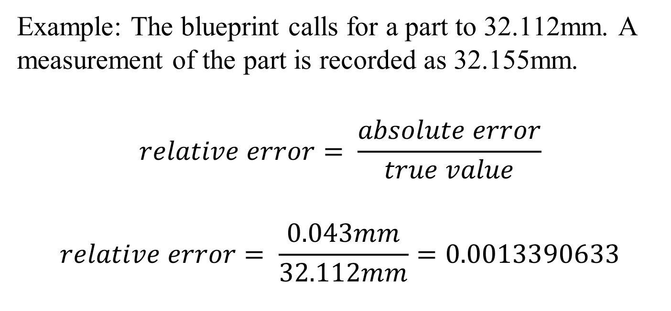
Determine the relative error and percent error of a measurement.
Example: The blueprint calls for a part to 32.112mm. A measurement of the part is recorded as 32.155mm.
$$relative error= \frac{absolute error}{true value}$$
$$relative error= \frac{0.043mm}{32.112mm}=0.0013390633$$

Slide 13
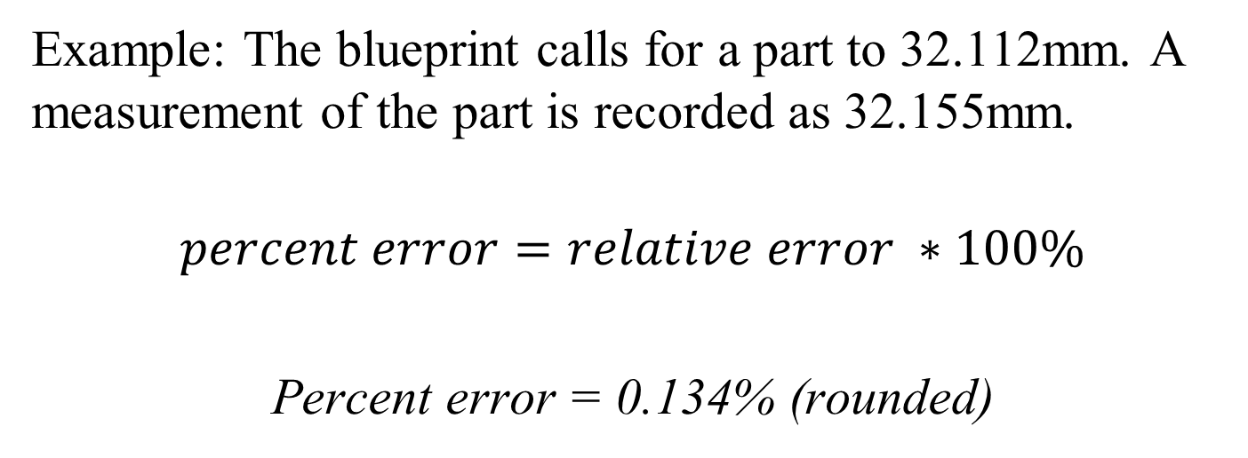
Determine the relative error and percent error of a measurement.
Example: The blueprint calls for a part to 32.112mm. A measurement of the part is recorded as 32.155mm.
$$percent error=relative error ∗100\%$$
Percent error = 0.134% (rounded)

Slide 14
Determine an appropriate approximation of measurement calculations.
To round the sum or difference of measurements of different precisions:
If necessary, change all the measurements to a common unit of measure.
Add or subtract common units of measure.
Round the result to have the same precision as the least precise measurement.

Slide 15
Determine an appropriate approximation of measurement calculations.
Add the measurements: 12.5 m, 38 cm, 2.9m, 43.25cm.
If necessary, change all the measurements to a common unit of measure.
12,500cm, 38cm, 2,900cm, 43.25 cm

Slide 16
Determine an appropriate approximation of measurement calculations.
Add the measurements: 12.5 cm, 38 cm, 2.9m, 43.25cm.
If necessary, change all the measurements to a common unit of measure.
12,500cm, 38cm, 2,900cm, 43.25 cm
Add or subtract common units of measure.
Round the result to have the same precision as the least precise measurement.

Slide 17
Determine an appropriate approximation of measurement calculations.
Add the measurements: 12.5 cm, 38 cm, 2.9m, 43.25cm.
Add or subtract common units of measure.
12,500
38.0
2,900
+ 43.25
16,212.25cm

Slide 18
Determine an appropriate approximation of measurement calculations.
Add the measurements: 12.5 cm, 38 cm, 2.9m, 43.25cm.
Round the result to have the same precision as the least precise measurement.
16,212.25cm rounds 16.21225m which rounds to 16.2m

Slide 19
Determine an appropriate approximation of measurement calculations.
To round the quotient or product of measurements of different accuracy:
Multiply or divide the measurements (same units)
Round the product or quotient to have the same number of significant digits as the measurement with the fewest significant digits.

Slide 20
Determine an appropriate approximation of measurement calculations.
Multiply the measurements: (150m)(105m)(50m)
Multiply or divide the measurements (same units)
(150m)(105m)(50m)=787 500m³
Round the product or quotient to have the same number of significant digits as the measurement with the fewest significant digits.
50m has the fewest signinficant digits – one
787 500m³ ≈ 800 000m³

Slide 21
Read a ruler

Slide 22
Read a ruler

Slide 23
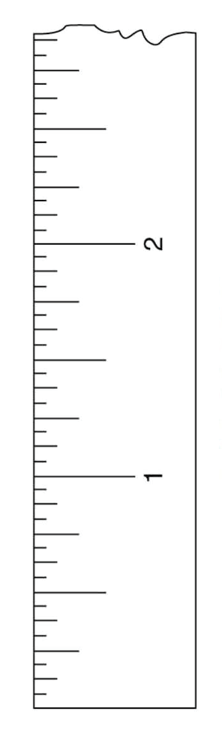

Find the distance and midpoint of a line segment.
To find the distance between two points on a line:
Determine the coordinate for each point.
$$\frac{3}{8}, 2\frac{1}{2}$$

Slide 24
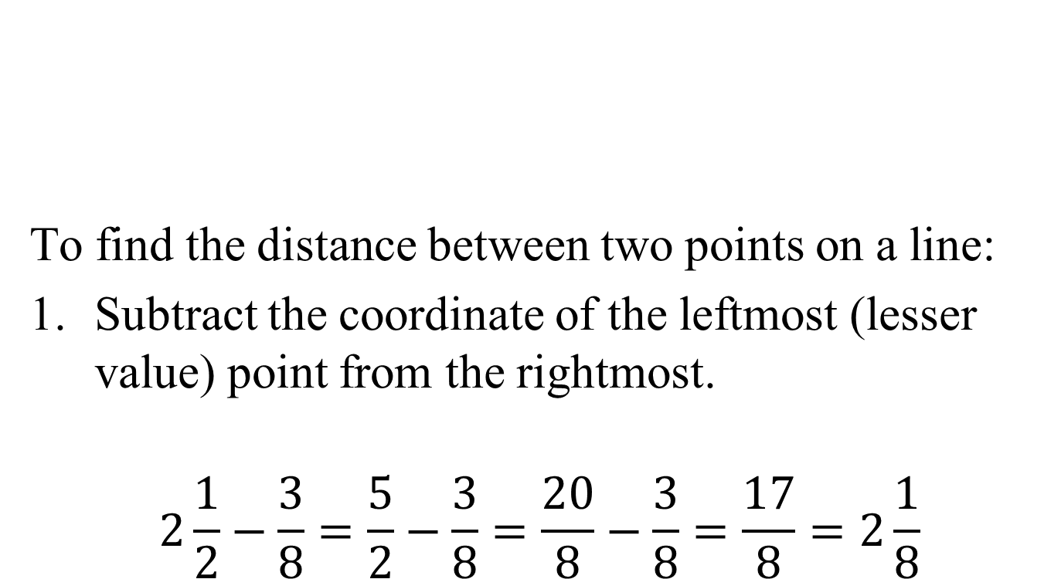
Find the distance and midpoint of a line segment.
To find the distance between two points on a line:
Subtract the coordinate of the leftmost (lesser value) point from the rightmost.
$$2\frac{1}{2}−\frac{3}{8}=\frac{5}{2}−\frac{3}{8}=\frac{20}{8}−\frac{3}{8}=\frac{17}{8}=2\frac{1}{8}$$

Slide 25
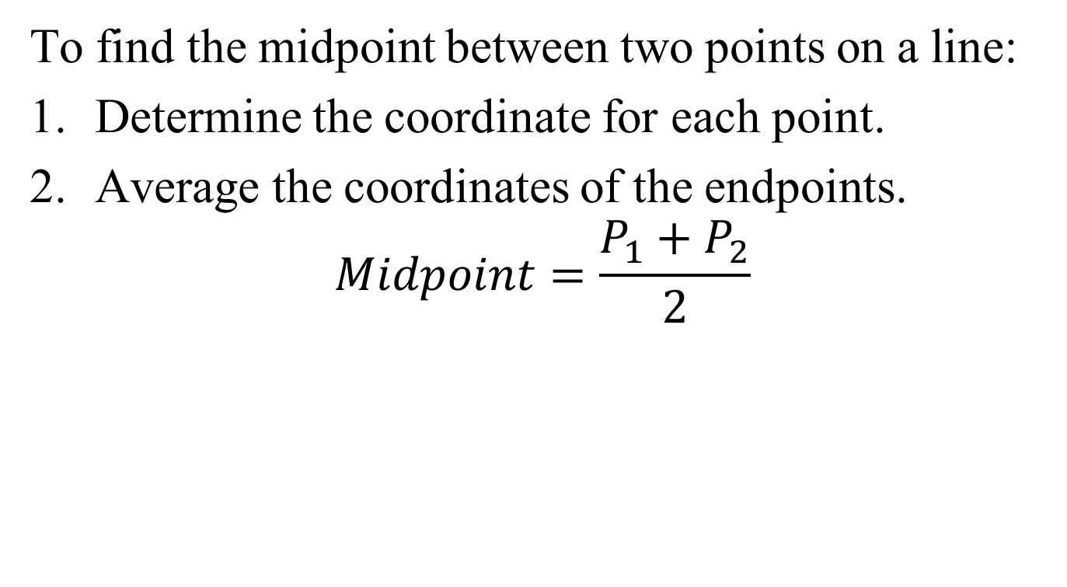
Find the distance and midpoint of a line segment.
To find the midpoint between two points on a line:
Determine the coordinate for each point.
Average the coordinates of the endpoints.
$$Midpoint=\frac{P_{1}+P_{2}}{2}$$

Slide 26
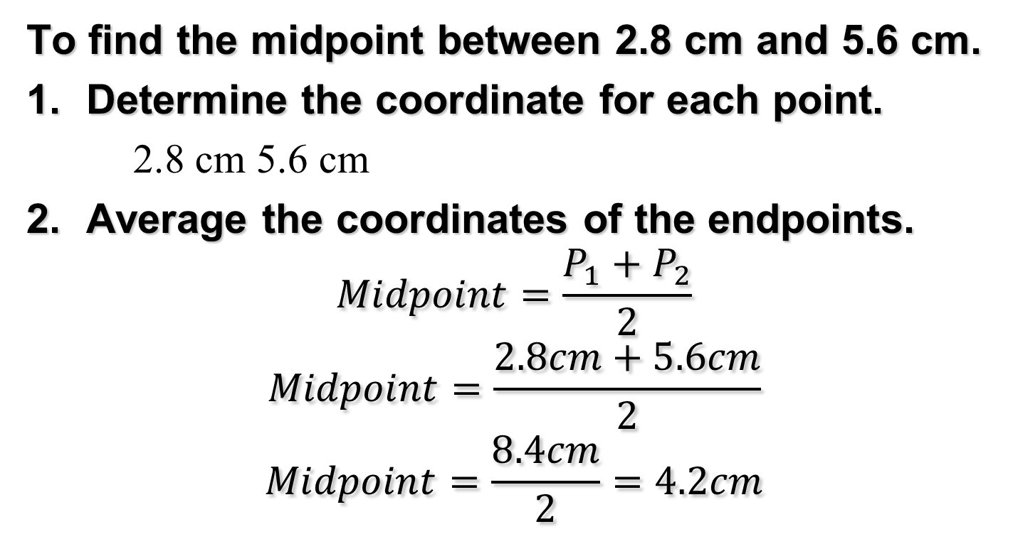
Find the distance and midpoint of a line segment.
To find the midpoint between 2.8 cm and 5.6 cm.
Determine the coordinate for each point.
2.8 cm 5.6 cm
Average the coordinates of the endpoints.
$$Midpoint=\frac{P_{1}+P_{2}}{2}$$
$$Midpoint=\frac{2.8cm+5.6cm}{2}$$
$$Midpoint=\frac{8.4cm}{2}=4.2cm$$

