Slide 1
Chapter 12
The Real Numbers and Their Representation

Slide 2
Chapter 6: The Real Numbers and Their Representation
12.1 Rational Numbers and Decimal Representation
12.2 Irrational Numbers and Decimal Representation
12.3 Applications of Decimals and Percents

Slide 3
Section 12-3
Application of Decimals and Percents

Slide 4
Application of Decimals and Percents
Perform operations of arithmetic with decimal numbers.
Round whole numbers and decimals to a given place value.
Perform computations using percent.
Convert among forms of fractions, decimals, and percents.
Find percent increase and percent decrease.
Apply formulas involving fractions and decimals from the allied health industry.

Slide 5
Operations with Decimals
Operations by hand will be detailed but the use of a calculator is suggested.

Slide 6
Addition and Subtraction of Decimals
To add or subtract decimal numbers, line up the decimal points in a column and perform the operation.

Slide 7
Example: Adding and Subtracting Decimal Numbers
Find each of the following.
a) 0.51 + 2.8 + 10.42 b) 13.2 – 7.614
Solution
a) 0.51
2 .8
+ 10 .42
13 .73
b) 13.200
– 7 .614
5 .586
Attach zeros.

Slide 8
Multiplication of Decimals
To multiply decimals, multiply in the same manner as integers are multiplied. The number of decimal places to the right of the decimal point in the product is the sum of the numbers of places to the right of the decimal points in the factors.

Slide 9
Division of Decimals
To divide decimals, move the decimal point to the right the same number of places in the divisor and dividend so as to obtain a whole number in the divisor. Divide in the same manner as integers are divided. The number of decimal places to the right of the decimal point in the quotient is the same as the number of places to the right in the dividend.

Slide 10



Example: Multiplying and Dividing Decimal Numbers
Find each of the following.
a) b)
Solution
a)
so with 5 decimal places: 27.28014
b) 5.13
37 189.94

Slide 11
Rounding Decimals
Since all digits may not be needed in a practical problem, it is common to round a decimal to the necessary number of decimal places.

Slide 12
Rounding a Decimal
Step 1 Locate the place to which the number is being rounded.
Step 2 Look at the next digit to the right of the place to which the number is being rounded.
Step 3A If this digit to the right is less than 5, replace it and all digits following it with zeros. Do not change the digit in the place to which the number is being rounded.

Slide 13
Rounding a Decimal
Step 3B If this digit is 5 or greater, replace it and all digits following it with zeros, but also add 1 to the digit in the place which the number is being rounded. (If adding 1 to a 9, replace the 9 with 0 and add 1 to the next digit to the left. If that next digit is also 9, repeat this procedure, and so on, to the left.)

Slide 14
Example: Rounding Numbers
Round 5.1763 to the nearest hundredth.
Solution
The digit 7 is in the hundredths place. To round, note the 6 in the thousandths place. We drop the digits after the 7 and increase the 7 by 1.
Answer: 5.18

Slide 15
Converting Between Decimals and Percents
To convert a percent to a decimal, drop the percent symbol (%) and move the decimal point two places to the left, inserting zeros as placeholders if necessary.
To convert a decimal to a percent, move the decimal point two places to the right, inserting zeros as placeholders if necessary, and attach a percent symbol (%).

Slide 16
Example: Converting Percents to Decimals
Convert each percent to a decimal.
a) 47% b) 5.6%
Solution
a) 0.47
b) 0.056

Slide 17
Example: Converting Decimals to Percents
Convert each decimal to a percent.
a) 0.457 b) 1.8
Solution
a) 45.7%
b) 180%

Slide 18
Converting a Fraction to a Percent
To convert a fraction to a percent, convert the fraction to a decimal, and then convert the decimal to a percent.

Slide 19



Example: Converting Fractions to Percents
Convert to a percent.
Solution

Slide 20
Examples Involving Percents
The next few slides show examples involving percents.

Slide 21
Example: Finding a Percent of a Number
Find 15% of 80.
Solution
The word “of ” means to multiply.
(15%)(80) = (0.15)(80) = 12

Slide 22
Example: Finding What Percent One Number is of Another
What percent of 120 is 18?
Solution
We let 0.01x represent “what percent.”
(0.01x)(120) = 18
1.2x = 18
x = 15
So 18 is 15% of 120.

Slide 23
Example: Finding a Number of Which a Given Number is a Given Percent
40 is 80% of what number?
Solution
40 = 0.80x
x = 50
So 40 is 80% of 50.

Slide 24
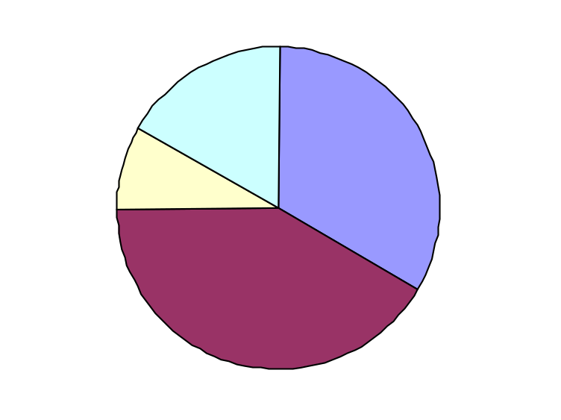
Application: Interpreting Percents From a Graph
Below is a graph of Jackson’s typical 24-hour day. Use the graph to determine the amount of time he spends each day on video games.
Other
18.1%
School
32%
Video Games 8.3%
Sleep 41.6%

Slide 25
Application: Interpreting Percents From a Graph
Solution
According to the graph, 8.3% of the 24 hours was spent on video games.
This is (0.083)(24) = 1.992 or about 2 hours.

Slide 26
Finding Percent Increase or Decrease
1. To find the percent increase from a to b, where b > a, subtract a from b, and divide this result by a. Convert to a percent.
2. To find the percent decrease from a to b, where b < a, subtract b from a, and divide this result by a. Convert to a percent.

Slide 27
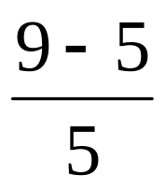
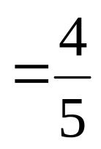

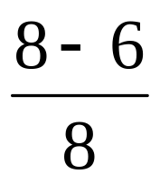
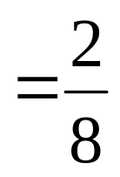

Example: Solving Problems about Percent Change
The percent increase from $5 to $9 is:
The percent decrease from 8 sales to 6 sales is:

Slide 28
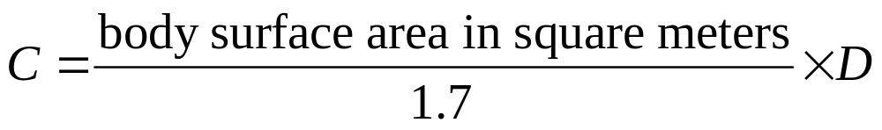
Example: Determining a Child’s Dose of a Drug
If D represents the usual dose of a drug, the corresponding child’s dose, C, is calculated by the following formula:
Determine the approximate dose for a child weighing 40 pounds if the usual adult dose is 50 milligrams. (Source: Hegstad, Lorrie N., and Wilma Hayek. Essential Drug Dosage Calculations, 4th ed. Prentice Hall, 2001.)

Slide 29
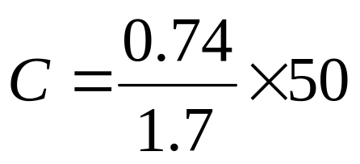

Example: Determining a Child’s Dose of a Drug
Solution
The body surface area of a child weighing 40 pounds is 0.74 m². Apply the formula.
The child’s dose is 22 milligrams.

