Slide 1
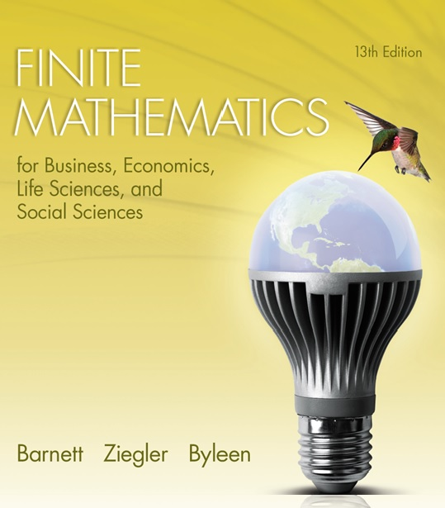
Chapter 10
Games and Decisions
Section 1
Strictly Determined Games

Slide 2
Learning Objectives for Section 10.1
Strictly Determined Games
The student will be able to distinguish between strictly determined and nonstrictly determined games.
The student will be able to find saddle values, optimal strategies, and value of the game for strictly determined games.

Slide 3
10.1 Strictly Determined Games
Game theory is a relatively new branch of mathematics designed to help people who are in conflict situations determine the best course of action out of several possible choices. It has applications in the business world, warfare and political science. The pioneers of game theory are John von Neumann and Oskar Morgenstern. In 1944, a Nobel Prize in Economic Science was presented to John Nash, John Harsanin, and Reinhard Setten for their work in game theory. The life of Nash was popularized in the movie “A Beautiful Mind.”

Slide 4
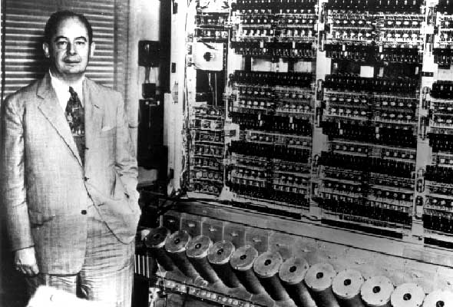
John von Neumann
1903-1957

Slide 5
John von Neumann
(continued)
“Von Neumann's awareness of results obtained by other mathematicians and the inherent possibilities which they offer is astonishing. Early in his work, a paper by Borel on the minimax property led him to develop ... ideas which culminated later in one of his most original creations, the theory of games.”
“In game theory von Neumann proved the minimax theorem. He gradually expanded his work in game theory, and with co-author Oskar Morgenstern, he wrote the classic text Theory of Games and Economic Behaviour (1944).”

Slide 6
Two-Person Zero-Sum
Matrix Game
A matrix game is played repeatedly.
Player R tries to maximize winnings.
Player C tries to minimize losses.
R chooses (plays) any one of m rows.
C chooses (plays) any one of n columns.
Negative entries in the payoff matrix indicate a win for C, and positive entries indicate a win for R. R’s win is C’s loss, and vice versa.

Slide 7
Saddle Points
Player R’s strategy will be to choose the row that has the largest minimum value.
Player C’s strategy will be to select the column with the smallest maximum value.
A point that satisfies both of these criteria is called a saddle point.

Slide 8
Strictly Determined Matrix Games
A matrix game is strictly determined if it has a saddle point. In a strictly determined game, optimal strategies are
R should choose any row containing a saddle point.
C should choose any column containing a saddle point.
A saddle point is called the value of a strictly determined game. The game is said to be fair if its value is zero.

Slide 9
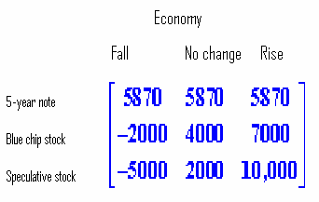
Example
Suppose you have $10,000 to invest for a period of 5 years. After some investigation and advice from a financial counselor, you arrive at the following game matrix where
you (R) are playing against the economy (C).

Slide 10
Example
(continued)
Each entry in the matrix is the expected payoff after 5 years for an investment of $10,000 in the corresponding row designation, with the future state of the economy in the corresponding column section.
The economy is regarded as a rational player who can make decisions against the investor – in any case, the investor would like to do the best possible irrespective of what happens to the economy.
Find saddle points and optimal strategies for each player.

Slide 11
Example
(continued)
The procedure for locating saddle points is as follows:
Place a circle around the minimum value in each row (it may occur in more than one place.)
Place squares around the maximum value in each column (it may occur in more than one place.)
Any entry with both a circle and a square around it is a saddle point.

Slide 12
Example
(continued)
R’s strategy:
circle the lowest number in each row (worst case scenario.)
choose the row with the highest minimum value.

Slide 13
Example
(continued)
C’s strategy:
Put a square around the greatest value of each column.
Choose the column with the lowest of these values

Slide 14
Example
(continued)
The first and second entries in row 1 are both saddle points. C (the economy) can either fall or have no change. In either case the gain of R is the corresponding loss to the economy. The value of the game is 5870, and since this value is not equal to zero, the game is considered to be not fair.

