Slide 1
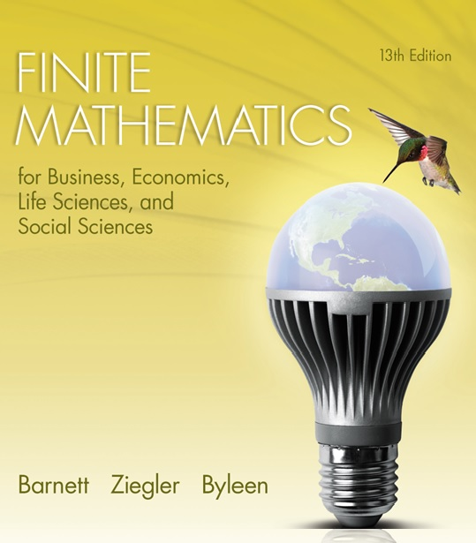
Chapter 10
Games and Decisions
Section 2
Mixed-Strategy Games

Slide 2

Learning Objectives for Section 10-2
Mixed Strategy Games
The student will be able to find the expected value of a mixed strategy game.
The student will be able to solve 2 2 matrix games.
The student will be able to identify recessive rows and columns in order to convert larger matrices to a 2 2 matrix game.

Slide 3

9.2 Mixed Strategy Games
In this section, we look at non-strictly determined games. For these type of games the payoff matrix has no saddle points.

Slide 4
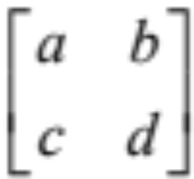
Non-Strictly Determined
Matrix Games
A matrix game is given by the game matrix M =
A strategy is a row or column matrix consisting of a probability distribution (collection of weights) which corresponds to how frequently each move is to be played.
For example, if R’s strategy is the probability row matrix
P = [p₁ p₂] = [ 1/4 3/4 ],
then R would choose row one 1/4 of the time, and row two 3/4 of the time.

Slide 5
Pure and Mixed Strategies
If one of the elements in P or Q is 1 and the other is 0, the strategy is called a pure strategy. This is the case in strictly determined games in which there is a saddle point. R always picks the same row and C always picks the same column.
If a strategy is not a pure strategy, it is called a mixed strategy.
P = [0 1] is a pure strategy, and R would play row two every play. On the other hand, P = [1/4 3/4] is a mixed strategy, indicating that R plays row one with probability 1/4 and row two with probability 3/4.

Slide 6
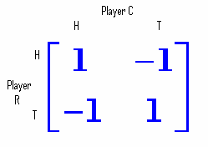
Penny Matching Game
Two players R and C each have a penny , and they simultaneously choose to show one side of their coin
(H = heads, T = tails).
If the pennies match, R wins (C loses) 1 cent. If the pennies do not match, R loses (C wins) 1 cent. In terms of a game matrix, we have

Slide 7
Penny Matching Game
(continued)
Determination of Strategy
Because there is no saddle point for the penny-matching game, there is no pure strategy for R. We will assign probabilities corresponding to the likelihood that R will choose row 1 or row 2. Similarly, probabilities will be found for C’s likelihood of choosing column 1 or column 2. The strategy will be to choose the row with a probability that will yield the largest expected value.

Slide 8
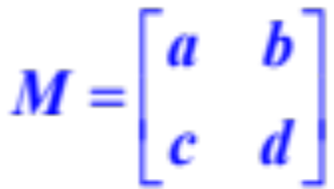
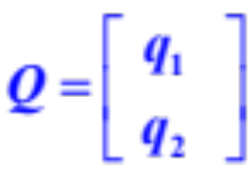
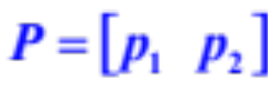
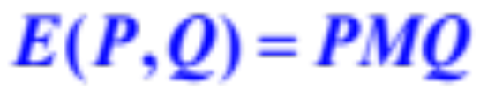
Expected Value of a
Matrix Game
For the matrix game
and strategies
for R and C, respectively, the expected value of the game for R is given by

Slide 9
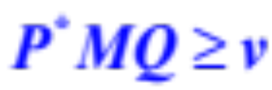
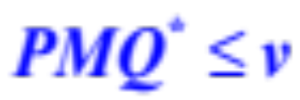
Fundamental Theorem of
Game Theory
For every m n matrix game M there exist strategies P* and Q* for R and C, respectively, and a unique number v such that
for every strategy Q of C and
for every strategy P of R. That is, R and C have optimal strategies in any m n matrix game.
The number v is the value of the game. If v = 0, the game is said to be fair.

Slide 10

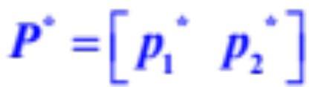
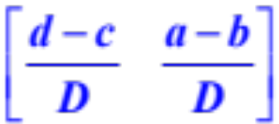
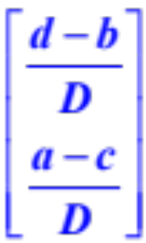
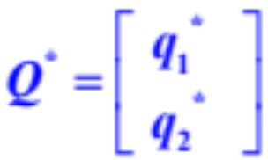
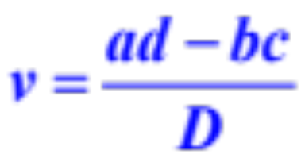

Solution to a 2 2 Non-strictly
Determined Matrix Game
For the non-strictly determined game
the optimal strategies P* and Q* and the value of the game are given by
=
=
where

Slide 11

Penny Problem
Solution
1. Identify a, b, c, d: a = 1, b = -1, c = -1, d = 1.
2. Find D = (a + d) - (b + c) = 4 (not zero)
3. The value of the game is
v = 0, so it is a fair game

Slide 12
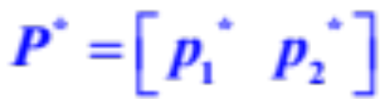
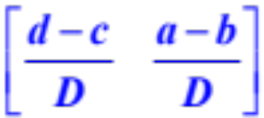

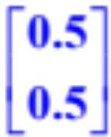
Penny Problem
Solution (continued)
4. Find
= = [ 0.5 0.5]
5. Find = =
6. Find the expected value of game: E(P,Q) = PMQ = 0.

Slide 13
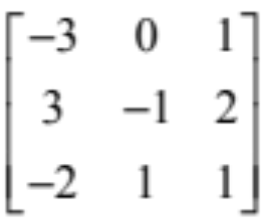
Recessive Rows and Columns
Some strictly determined and nonstrictly determined higher-dimensional matrix games may be reduced to lower-dimensional games because intelligent players would never play certain rows or columns. Consider the following matrix game:
M =

Slide 14
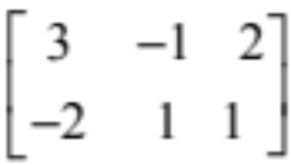
Recessive Rows and Columns
(continued)
M has no saddle value, so is not strictly determined. From R’s point of view, row 1 should never be played, because each element of row 3 is greater than or equal to the corresponding element of row 1. So we delete row 1 to obtain
M =

Slide 15
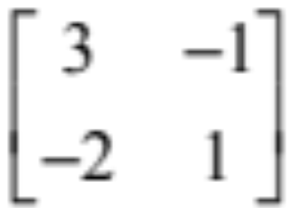
Recessive Rows and Columns
(continued)
Now from C’s point of view, column 3 should never be played, because each element of column 2 is less than or equal to the corresponding element of
column 3. So we delete column 3 to obtain
M₂ =
The game is now 2 2 and can be solved using the formulas derived previously.

