Slide 1
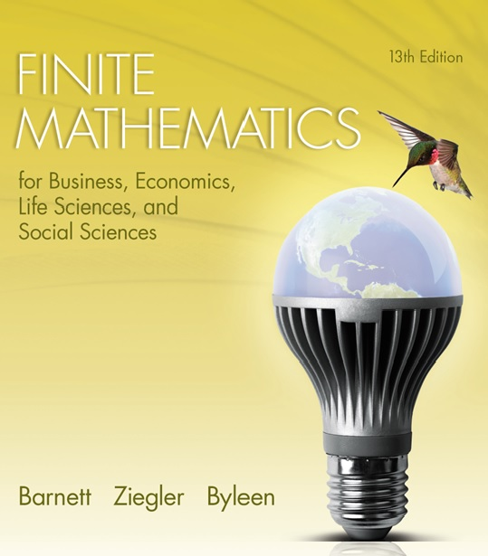

Chapter 10
Games and Decisions
Section 3
Linear Programming and 2 2 Games: A Geometric Approach

Slide 2
Learning Objectives for Section 10-3
Linear Programming
and 2 2 Games:
A Geometric Approach
Student will be able to solve 2 2 games using linear programming and the geometric approach.

Slide 3
10.3 Linear Programming and 2 2 games:
A Geometric Approach
This section will introduce the method of solving a non-strictly determined matrix game geometrically. All games without recessive rows and columns can be converted into linear programming problems. The method applies to a matrix game M that has all positive payoffs.

Slide 4
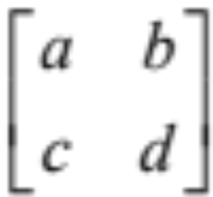
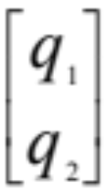
Development of
Linear Programming Equations
We know that R wants to maximize the expected value of the game, which is E(P,Q) = PMQ for R’s strategy P = [p₁ p₂],
Q’s strategy Q = , and payoff matrix M =
Using this fact and assuming a, b, c, d are all positive, we can derive the formulas (see text) :
y = 1/v = x₁ + x₂ where x₁ = p₁/v and x₂ = p₂/v
ax₁ + cx₂ > 1
bx₁ + dx₂ > 1,
x₁, x₂> 0
and we want to minimize y so as to maximize v.

Slide 5
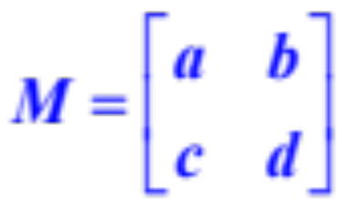
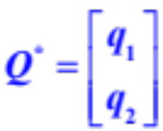

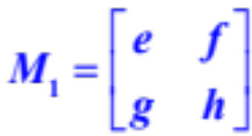
Procedure
Given the non-strictly determined matrix game M, free of recessive rows and columns,
to find
and v, proceed as follows:
Step 1. If M is not a positive matrix, add a suitable positive constant k to each element of M to get a new matrix M₁
If v₁ is the value of game M₁, then the value of the original game M is given by v = v₁ – k

Slide 6
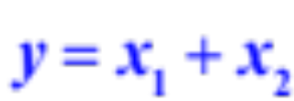
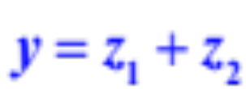
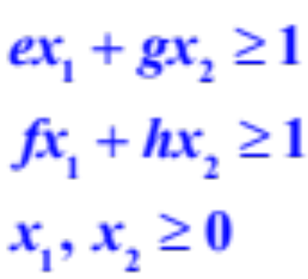
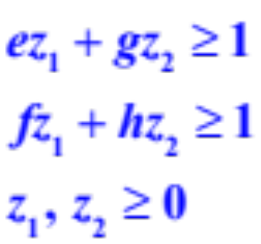
Procedure
(continued)
Step 2. Set up the two corresponding linear programming problems:
A) Minimize
subject to :
B) Maximize
subject to:

Slide 7
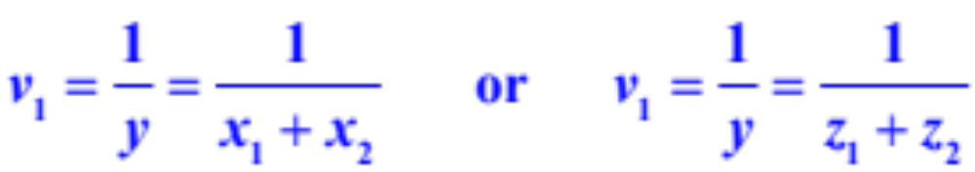
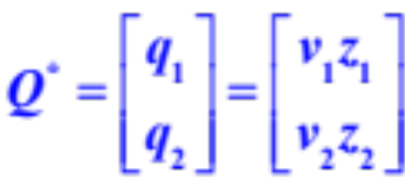
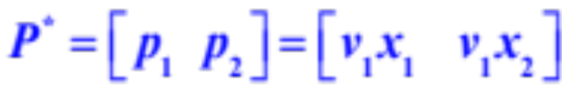

Procedure
(continued)
Step 3. Solve each linear programming problem geometrically.
Step 4. Use the solutions from step 3 to find the value v₁ for game M_{1,} and the optimal strategies and value v for the original game M:
Step 5. Check.

Slide 8
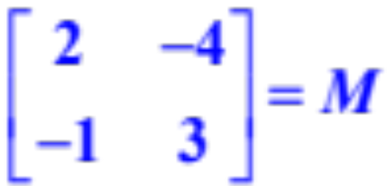
Example
For the payoff matrix M
find the optimal strategies for the two players.

Slide 9
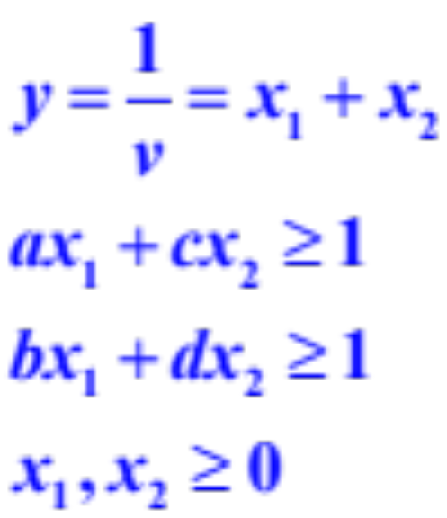
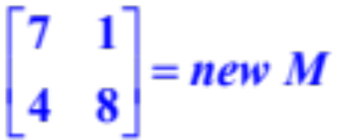
Example
(continued)
Add 5 to each entry of M to make all values positive:
Minimize y subject to the given constraints:

Slide 10
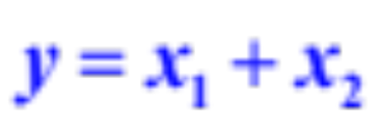
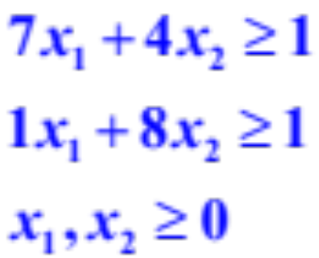
Example
(continued)
Substitute the values for a, b, c, d into the inequalities

Slide 11
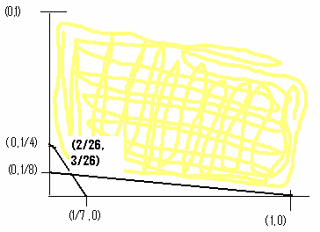
Solve the Linear Programming Problem
If we test the corner points of the region below in the objective function y = x₁ + x₂ we find that the minimum value is at the point (2/26, 3/26)

Slide 12
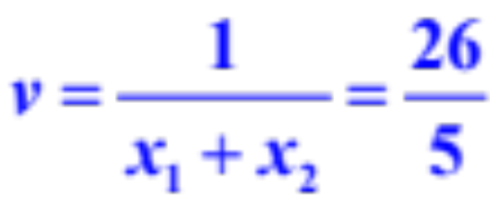
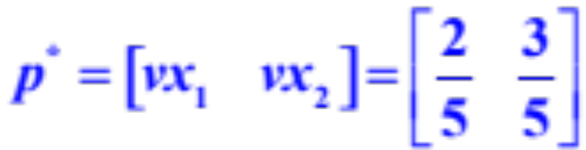
Value of the Game and Optimal Strategy – First Player
The value of the game is given by the equation
The value of the original game is 26/5 – 5 = 1/5
This is the probability matrix for R:

Slide 13
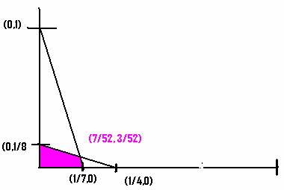
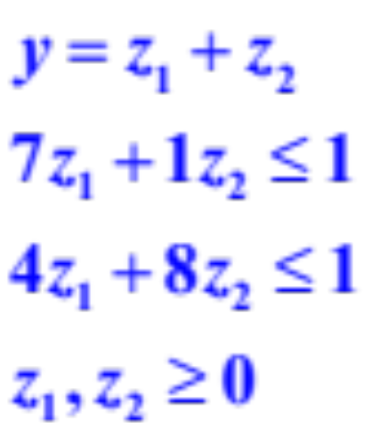
Solve the Second Linear Programming Problem
If we test the corner points of the region in the objective function y = z₁ + z₂, we find the maximum value is at
(7/52, 3/52)

Slide 14
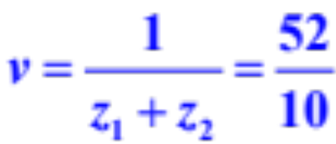
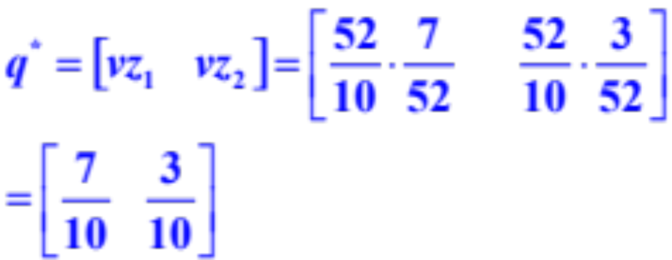
Value of the Game and Optimal Strategy – Second Player
The value of the game is given by the equation
The value of the original game is 52/10 – 5 = 1/5
This is the probability matrix for C:

