Slide 1
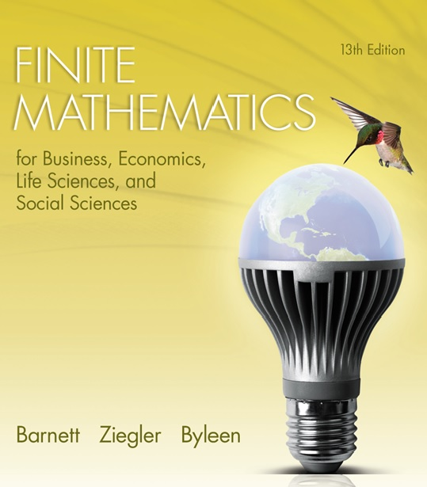
Chapter 10
Games and Decisions
Section 4
Linear Programming and m × n Games: Simplex Method and the Dual Problem

Slide 2
Learning Objectives for Section 10-4
Simplex Method and the Dual Problem
The student will be able to solve m × n games using linear programming and the Simplex Method.
The student will also be able to solve the dual problem using the Simplex Method.

Slide 3
Linear Programming and m × n Games
Simplex Method and the Dual Problem
In this section, the process of solving 2 × 2 matrix games will be generalized to solving m × n matrix games. The procedure will be essentially the same as the process for the 2 × 2 case, but the solution of the linear programming problem will incorporate the simplex method and the dual.

Slide 4
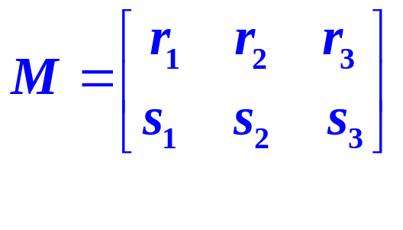
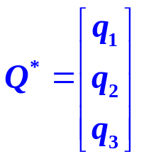

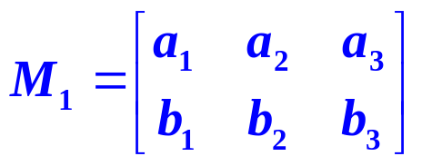
Procedure
Given the non-strictly determined matrix game M, free of recessive rows and columns,
to find
and v, proceed as follows:
Step 1. If M is not a positive matrix, add a suitable positive constant k to each element of M to get a new matrix M_{1.}
If v₁ is the value of game M₁, then the value of the original game M is given by v = v₁ – k.

Slide 5


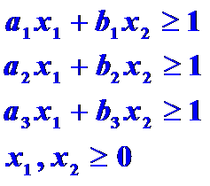
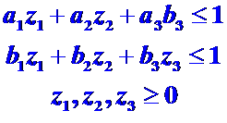
Procedure
(continued)
Step 2. Set up the two linear programming problems (maximization problem is always the dual of the minimization problem).
A) Minimize
subject to :
B) Maximize
subject to:

Slide 6
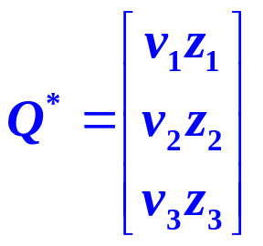
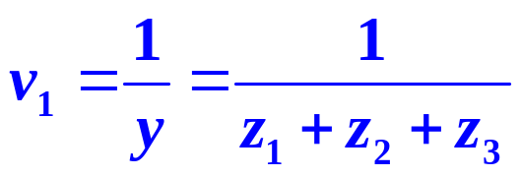
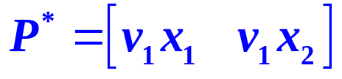
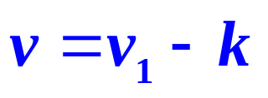
Procedure
(continued)
Step 3. Solve the maximization problem (B), the dual of (A), using the simplex method as modified in section 5.5. [You will automatically obtain the solution of the minimization problem (A) as well by following this process.]
Step 4. Use the solutions from the third step to find the value v₁ of game M_{1,} and the optimal strategies and value
Step 5. Find v for the original game M.

Slide 7
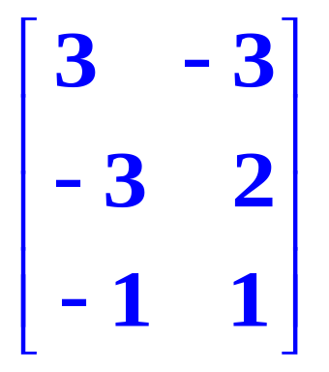
Example
Suppose that an investor wishes to invest $10,000 in long and short term bonds, as well as in gold, and he is concerned about inflation. After some analysis he estimates that the return (in thousands of dollars) at the end of a year will be indicated in the following payoff matrix:
Inflation rate
up 3% down 3%
gold
long term bonds
short-term bonds

Slide 8
Example
Assume that fate is a very good player that will attempt to reduce the investor’s return as much as possible. Find the optimal strategies for both the investor and fate. What is the value of the game?

Slide 9
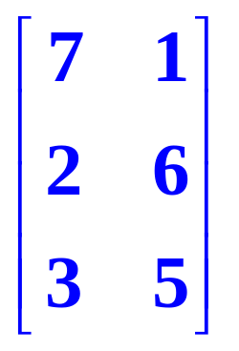
Example
(continued)
Assume that fate is a very good player that will attempt to reduce the investor’s return as much as possible. Find the optimal strategies for both the investor and fate. What is the value of the game?
Step 1. We start with the payoff matrix and need to make all entries positive. so we choose to add a constant k = 4 to each entry:

Slide 10
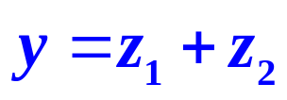

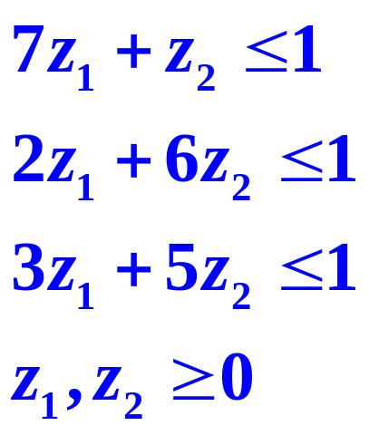
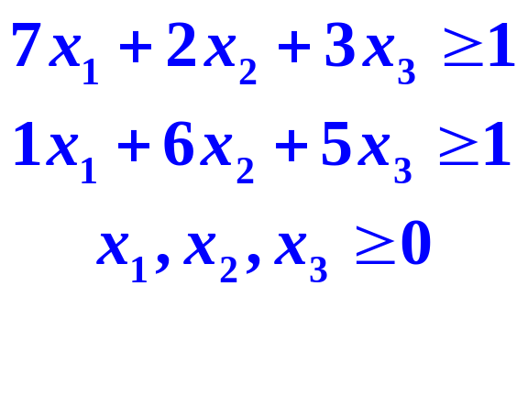
Example
(continued)
Step 2. Write the corresponding linear programming problems:
Minimize
subject to
Maximize
subject to

Slide 11
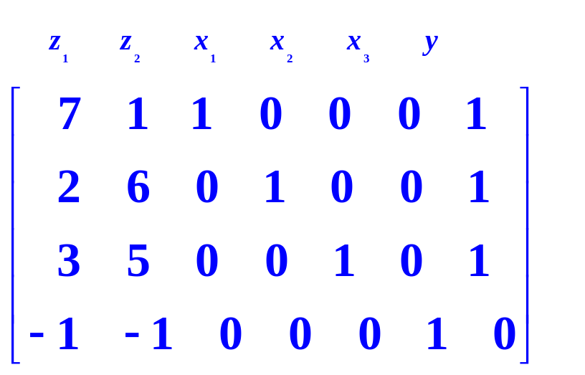
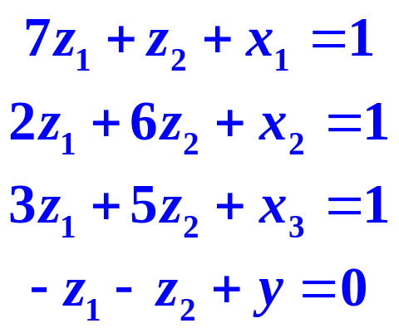
Example
(continued)
Step 3. Introduce slack variables (recall that slack variables are needed to transform inequalities to equalities) and form the simplex tableau to solve the second linear programming problem.

Slide 12
Example
(continued)
Since the most negative indicator in the fourth row appears in each of the first two columns, we can choose either of these as a pivot column. Choose the first column. We find the first row is the pivot row. Use row operations to pivot on 7.

Slide 13
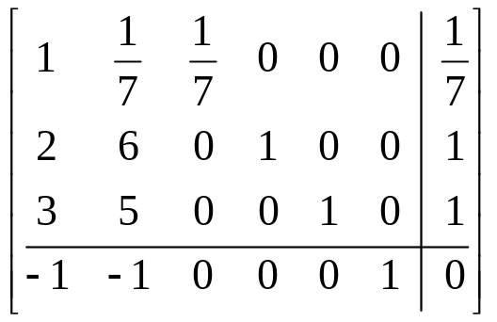
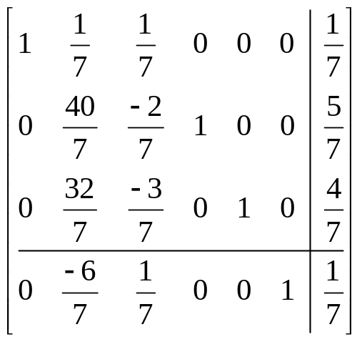
Example
(continued)
1/7 R₁ -> R₁
The only negative element in the fourth row is in the second column, so that is our pivot column. Our pivot row is 2 so we will pivot on 40/7.
(-2)R₁ +R₂ -> R₂
(-3)R₁+R₃ -> R₃
R₁+R₄ -> R₄

Slide 14
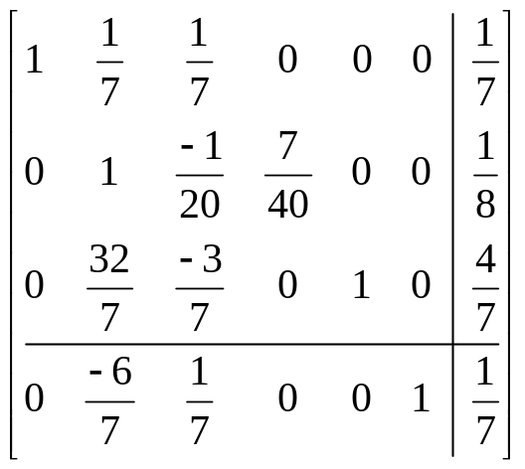
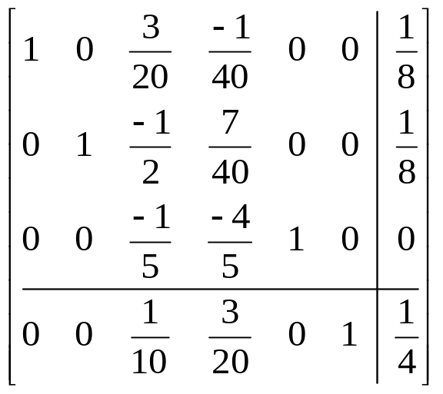
Example
(continued)
(7/40)R₂ -> R₂
Max y = z₁+z₂
= 1/8 + 1/8 = 1/4.
v₁ = 1/y =1/(1/4) = 4.
v = v₁- k = 0
Solution to the dual is read from the fourth row: x₁ = 1/10, x₂ = 3/20,
x₃ = 0, so the
Min y = x₁+x₂+x₃ = 1/4
(-1/7)R₂ + R₁->R₁
(-32/7)R₂+R₃-> R₃
(6/7)R₂+R₄->R₄

Slide 15
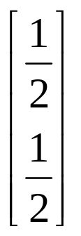
Example
Solution
After performing the steps, the final solution is displayed below. The value of the game is zero, which means it is a fair game.
P* = [v₁x₁ v₁x₂ v₁x₃]= [2/5 3/5 0]
Q* =

