Slide 1
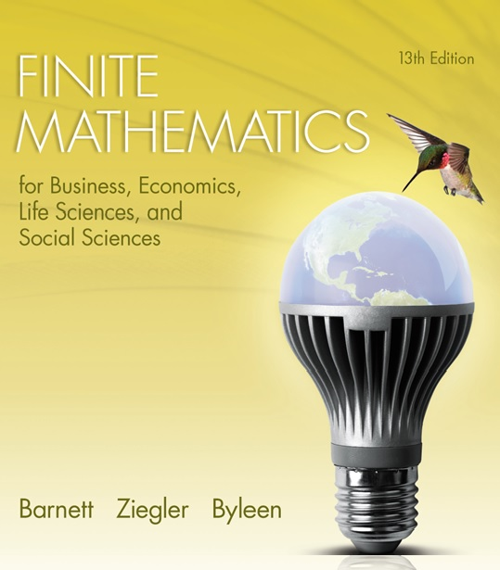
Chapter 10
Games and Decisions
Section R
Review

Slide 2
Chapter 10 Review
Important Terms, Symbols, Concepts
10.1 Strictly Determined Matrix Games
  Any m × n matrix A may be considered a two-person zero-sum game in which player R chooses any of the rows and player C chooses any of the columns. We call the matrix A a payoff matrix or game matrix, and we refer to the entries of A as payoff values. Positive payoff values indicate a win for R, and negative values a win for C.

Slide 3
Chapter 10 Review
10.1 Strictly Determined Matrix Games (continued)
  We assume the fundamental principle of game theory, namely that
    A matrix game is played repeatedly
    Player R tries to maximize winning.
    Player C tries to minimize losses.

Slide 4
Chapter 10 Review
10.1 Strictly Determined Matrix Games (continued)
  A saddle value is a payoff value that is simultaneously a row minimum and a column maximum.
  If a payoff matrix has saddle values x and y, then x = y.
  A matrix game is said to be strictly determined if it has a saddle value.
  In a strictly determined game, optimal strategies are:
    R should choose any row containing a saddle value
    C should choose any column containing a saddle value.

Slide 5
Chapter 10 Review
10.1 Strictly Determined Matrix Games (continued)
  A saddle value is called the value of a strictly determined game.
  A game is fair if its value is 0.
  If a matrix game has no saddle value, then it is said to be nonstrictly determined.

Slide 6
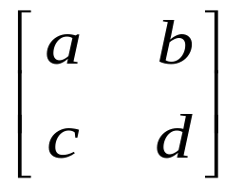
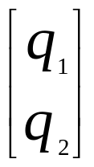
Chapter 10 Review
10.2 Mixed Strategy Games
  Given the payoff matrix M =
    R’s strategy is a probability row matrix
    P = [p₁ p₂], p₁>0, p₂ > 0, p₁+p₂ = 1
    C’s strategy is a probability column matrix Q =
    If one of the elements of P (or Q) is 1 and the other is 0, the strategy is called a pure strategy; otherwise it is called a mixed strategy.

Slide 7
Chapter 10 Review
10.2 Mixed Strategy Games (continued)
  The expected value of a matrix game for R, denoted E(P,Q), is the 1 × 1 matrix product PMQ.
  The fundamental theorem of game theory guarantees that R and C have optimal strategies in any m × n matrix game.
  If P* and Q* are optimal strategies for R and C, then the expected value of the game for R is
  E(P*,Q*) = P*MQ* = v.

Slide 8
Chapter 10 Review
10.2 Mixed Strategy Games (continued)
  The number v is the value of the game. If v = 0, the game is said to be fair.
  Finding the optimal strategies P* and Q*, and the corresponding value v, is called solving the game. The triplet (v, P*, Q*) is called a solution of the game.
  For any 2 x 2 nonstrictly determined matrix game there are formulas (in terms of the entries of M) for P*, Q*, and v that solve the game.

Slide 9
Chapter 10 Review
10.2 Mixed Strategy Games (continued)
  A row of a payoff matrix is a recessive row if there exists another row, called a dominant row, such that each element of the dominant row is greater than or equal to the corresponding element of the recessive row.
  A column of a payoff matrix is a recessive column is there exists another column, called a dominant column, such that each element of the dominant column is less than or equal to the corresponding element of the recessive column.

Slide 10
Chapter 10 Review
10.2 Mixed Strategy Games (continued)
  Because player R would never choose a recessive row, and player C would never choose a recessive column, a recessive row or column may be deleted from a payoff matrix without affecting the optimal strategy of either player.

Slide 11
Chapter 10 Review
10.3 Linear Programming and 2x2 Games: Geometric Approach
  Optimal strategies of a matrix game do not change if a constant value k is added to each payoff. If v is the value of the original game, then v+k is the value of the new game.
  Any 2 × 2 nonstrictly determined matrix game can be solved by converting the matrix game to two linear programming problems, each of which can be solved geometrically.

Slide 12
Chapter 10 Review
10.4 Linear Programming and m x n Games: Simplex Method and the Dual Problem
  Any nonstrictly determined m × n matrix game can be solved by converting it to a pair of linear programming problems, one the dual of the other, which can be solved by the simplex method of section 6.3.

