Slide 1
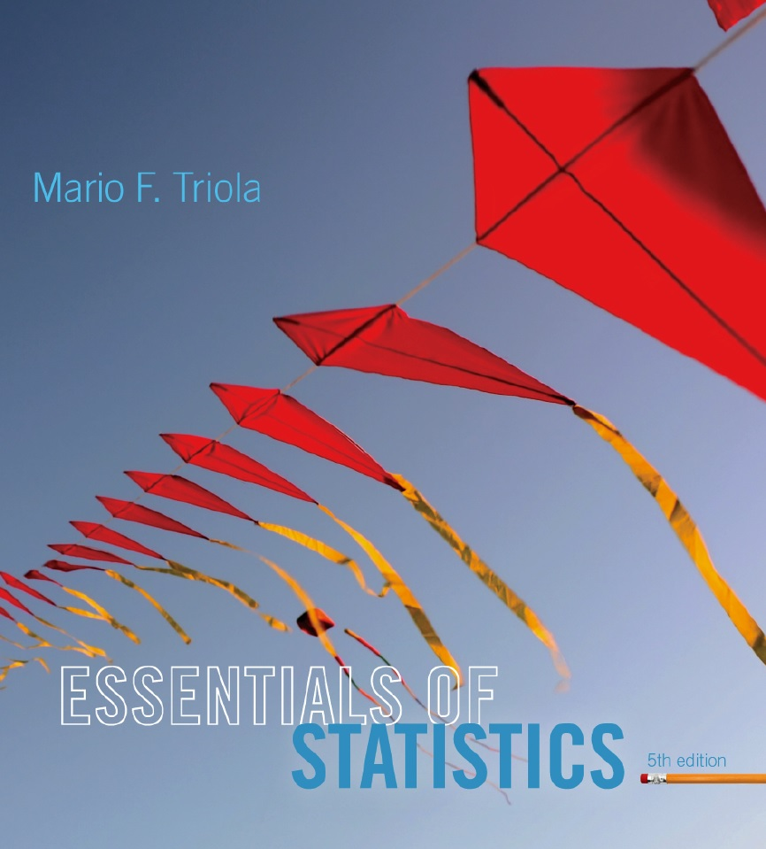
Lecture Slides
Essentials of Statistics
5th Edition
and the Triola Statistics Series
by Mario F. Triola

Slide 2
Preview
Polls, studies, surveys and other data collecting tools collect data from a small part of a larger group so that we can learn something about the larger group.
This is a common and important goal of statistics: Learn about a large group by examining data from some of its members.

Slide 3
Preview
In this context, the terms sample and population have special meaning. Formal definitions for these and other basic terms will be given here.
In this chapter, we will look at some of the ways to describe data.

Slide 4
Chapter 1
Introduction to Statistics
1-1 Review and Preview
1-2 Statistical and Critical Thinking
1-3 Types of Data
1-4 Collecting Sample Data

Slide 5
Data
Data -
Collections of observations, such as measurements, genders, or survey responses

Slide 6
Statistics
Statistics -
The science of planning studies and experiments, obtaining data, and then organizing, summarizing, presenting, analyzing, interpreting, and drawing conclusions based on the data

Slide 7
Population
Population -
The complete collection of all measurements or data that are being considered

Slide 8
Census versus Sample
Census -
Collection of data from every member of a population
Sample -
Subcollection of members selected from a population

Slide 9
Example
The Gallup corporation collected data from 1013 adults in the United States. Results showed that 66% of the respondents worried about identity theft.
The population consists of all 241,472,385 adults in the United States.
The sample consists of the 1013 polled adults.
The objective is to use the sample data as a basis for drawing a conclusion about the whole population.

