Slide 1
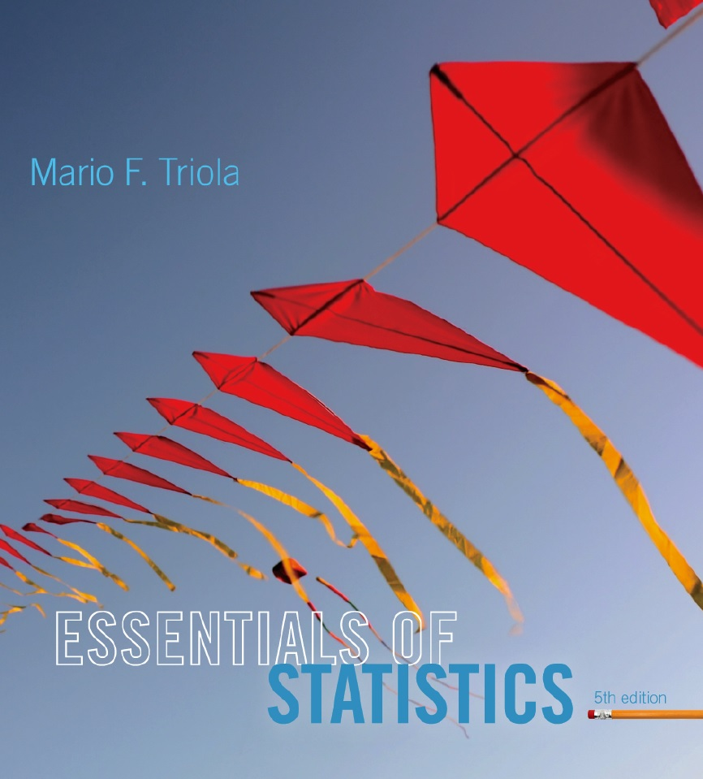
Lecture Slides
Essentials of Statistics
5th Edition
and the Triola Statistics Series
by Mario F. Triola

Slide 2
Chapter 1
Introduction to Statistics
1-1 Review and Preview
1-2 Statistical and Critical Thinking
1-3 Types of Data
1-4 Collecting Sample Data

Slide 3
Key Concept
This section provides an overview of the process involved in conducting a statistical study:
Prepare
Analyze
Conclude

Slide 4
Prepare - Context
What do the data mean?
What is the goal of the study?

Slide 5
Prepare - Source of the Data
Is the source objective?
Is the source biased?
Be vigilant and skeptical of studies from sources that may be biased.

Slide 6
Prepare - Sampling Method
Does the method chosen greatly influence the validity of the conclusion?
Voluntary response (or self-selected) samples often have bias (those with special interest are more likely to participate).
Other methods are more likely to produce good results.

Slide 7
Analyze – Graph and Explore
Every analysis should begin with appropriate graphs (Chapter 2).

Slide 8
Analyze – Apply Statistical Methods
Later chapters describe important statistical methods.
With technology, good analysis does not require strong computational skills, but it does require using common sense and paying attention to sound statistical methods.

Slide 9
Conclude – Statistical Significance
Statistical significance is achieved in a study when we get a result that is very unlikely to occur by chance.

Slide 10
Conclude - Practical Significance
State practical implications of the results.
Common sense might suggest that the finding does not make enough of a difference to justify its use or to be practical.

Slide 11
Example
In a test of the Atkins weight loss program, 40 subjects had a mean weight loss of 4.6 pounds after one year.
Using formal methods of statistical analysis, we can conclude the diet appears to be effective.

Slide 12
Example - continued
However, although 4.6 pounds is statistically significant, using common sense, it does not seem very worthwhile.

Slide 13
Potential Pitfalls – Misleading Conclusions
Concluding that one variable causes the other variable when in fact the variables are only correlated or associated together.
Two variables that may seemed linked, are smoking and pulse rate.
We cannot conclude the one causes the other. Correlation does not imply causality.

Slide 14
Potential Pitfalls - Small Samples
Conclusions should not be based on samples that are far too small.
Example: Basing a school suspension rate on a sample of only three students

Slide 15
Potential Pitfalls - Loaded Questions
If survey questions are not worded carefully, the results of a study can be misleading.
97% yes: “Should the President have the line item veto to eliminate waste?”
57% yes: “Should the President have the line item veto, or not?”

Slide 16
Potential Pitfalls - Order of Questions
Questions are unintentionally loaded by such factors as the order of the items being considered.
Would you say traffic contributes more or less to air pollution than industry? Results: traffic - 45%; industry - 27%
When order reversed.
Results: industry - 57%; traffic - 24%

Slide 17
Potential Pitfalls - Nonresponse
Occurs when someone either refuses to respond to a survey question or is unavailable.
People who refuse to talk to pollsters have a view of the world around them that is markedly different than those who will let pollsters into their homes.

Slide 18
Potential Pitfalls - Missing Data
Can dramatically affect results.
Subjects may drop out for reasons unrelated to the study.
Example - People with low incomes are less likely to report their incomes.
Example – U.S. Census suffers from missing people (tend to be homeless or low income).

Slide 19
Potential Pitfalls - Precise Numbers
Because as a figure is precise, many people incorrectly assume that it is also accurate.
A precise number can be an estimate, and it should be referred to that way.

Slide 20
Potential Pitfalls - Percentages
Misleading or unclear percentages are sometimes used.
Example – Continental Airlines ran an ad claiming “We’ve already improved 100% in the last six months” with respect to lost baggage.
Does this mean Continental made no mistakes?

