Slide 1
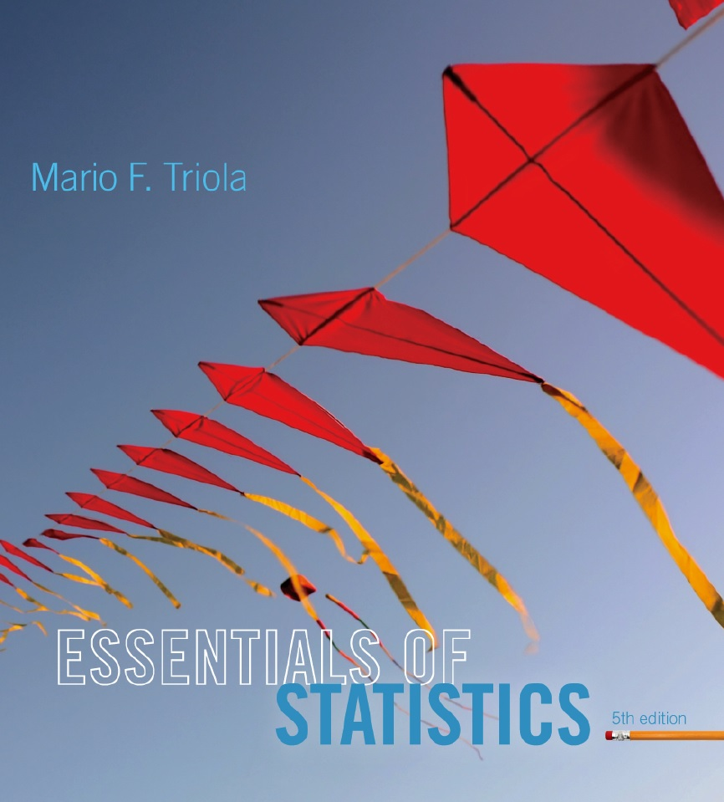
Lecture Slides
Essentials of Statistics
5th Edition
and the Triola Statistics Series
by Mario F. Triola

Slide 2
Chapter 1
Introduction to Statistics
1-1 Review and Preview
1-2 Statistical and Critical Thinking
1-3 Types of Data
1-4 Collecting Sample Data

Slide 3
Key Concept
If sample data are not collected in an appropriate way, the data may be so completely useless that no amount of statistical torturing can salvage them.
The method used to collect sample data influences the quality of the statistical analysis.
Of particular importance is the simple random sample.

Slide 4
Basics of Collecting Data
Statistical methods are driven by the data that we collect. We typically obtain data from two distinct sources: observational studies and experiment.

Slide 5
Observational Study
Observational study
observing and measuring specific characteristics without attempting to modify the subjects being studied.

Slide 6
Experiment
Experiment
apply some treatment and then observe its effects on the subjects (subjects in
experiments are called experimental units)

Slide 7
Example
The Pew Research Center surveyed 2252 adults and found that 59% of them go online wirelessly.
This an observational study because the adults had no treatment applied to them.

Slide 8
Example
In the largest public health experiment ever conducted, 200,745 children were given the Salk vaccine, while another 201,229 children were given a placebo.
The vaccine injections constitute a treatment that modified the subjects, so this is an example of an experiment.

Slide 9
Simple Random Sample
Simple Random Sample
A sample of n subjects is selected in such a way that every possible sample of the same size n has the same chance of being chosen.

Slide 10
Random Sample
Random Sample
Members from the population are selected in such a way that each individual member in the population has an equal chance of being selected.

Slide 11
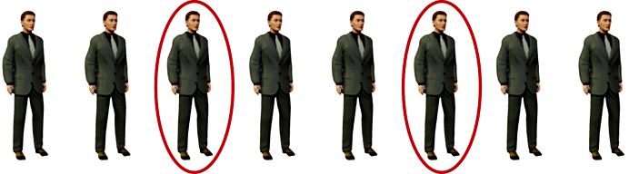
Systematic Sampling
Select some starting point and then select every kth element in the population.

Slide 12
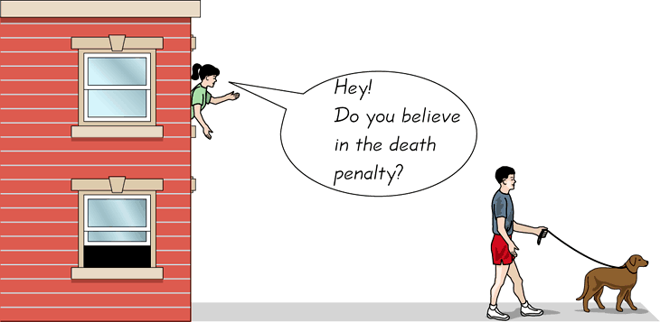
Convenience Sampling
Use results that are easy to get.

Slide 13
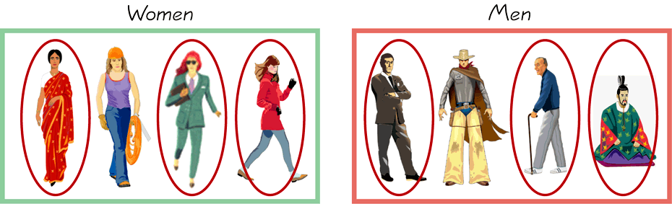
Stratified Sampling
Subdivide the population into at least two different subgroups that share the same characteristics, then draw a sample from each subgroup (or stratum).

Slide 14
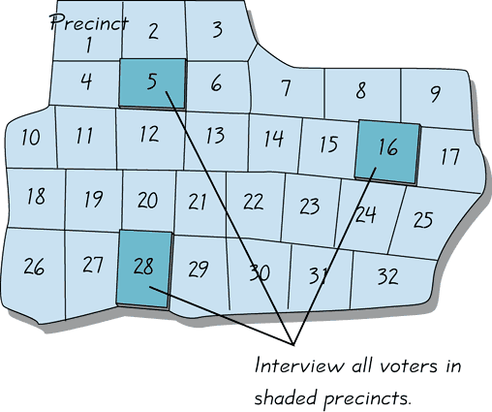
Cluster Sampling
Divide the population area into sections (or clusters). Then randomly select some of those clusters. Now choose all members from selected clusters.

Slide 15
Multistage Sampling
Collect data by using some combination of the basic sampling methods.
In a multistage sample design, pollsters select a sample in different stages, and each stage might use different methods of sampling.

Slide 16
Methods of Sampling - Summary
Random
Systematic
Convenience
Stratified
Cluster
Multistage

Slide 17
Beyond the Basics of Collecting Data
Different types of observational studies and experiment design.

Slide 18
Types of Studies
Cross-sectional study
  Data are observed, measured, and collected at one point in time.
Retrospective (or case control) study
  Data are collected from the past by going back in time (examine records, interviews, and so on …).
Prospective (or longitudinal or cohort) study
  Data are collected in the future from groups sharing common factors (called cohorts).

Slide 19
Design of Experiments
Randomization
is used when subjects are assigned to different groups through a process of random selection. The logic is to use chance as a way to create two groups that are similar.

Slide 20
Design of Experiments
Replication
is the repetition of an experiment on more than one subject.
  Samples should be large enough so that the erratic behavior that is characteristic of very small samples will not disguise the true effects of different treatments.
  It is used effectively when there are enough subjects to recognize the differences from different treatments.

Slide 21
Design of Experiments
Replication
Use a sample size that is large enough to let us see the true nature of any effects, and obtain the sample using an appropriate method, such as one based on randomness.

Slide 22
Design of Experiments
Blinding
is a technique in which the subject doesn’t know whether he or she is receiving a treatment or a placebo.
Blinding allows us to determine whether the treatment effect is significantly different from a placebo effect, which occurs when an untreated subject reports improvement in symptoms.

Slide 23
Design of Experiments
Double-Blind
Blinding occurs at two levels:
(1) The subject doesn’t know whether he or she is receiving the treatment or a placebo.
(2) The experimenter does not know whether he or she is administering the treatment or placebo.

Slide 24
Design of Experiments
Confounding
occurs in an experiment when the experimenter is not able to distinguish between the effects of different factors.
Try to plan the experiment so that confounding does not occur.

Slide 25
Controlling Effects of Variables
Completely Randomized Experimental Design
assign subjects to different treatment groups through a process of random selection.
Randomized Block Design
a block is a group of subjects that are similar, but blocks differ in ways that might affect the outcome of the experiment.

Slide 26
Controlling Effects of Variables
Matched Pairs Design
compare exactly two treatment groups using subjects matched in pairs that are somehow related or have similar characteristics.
Rigorously Controlled Design
carefully assign subjects to different treatment groups, so that those given each treatment are similar in ways that are important to the experiment.

Slide 27
Summary
Three very important considerations in the design of experiments are the following:
1. Use randomization to assign subjects to different groups.
2. Use replication by repeating the experiment on enough subjects so that effects of treatment or other factors can be clearly seen.
3. Control the effects of variables by using such techniques as blinding and a completely randomized experimental design.

Slide 28
Errors
No matter how well you plan and execute the sample collection process, there is likely to be some error in the results.
Sampling error
the difference between a sample result and the true population result, such an error results from chance sample fluctuations.
Nonsampling error
sample data incorrectly collected, recorded, or analyzed (such as by selecting a biased sample, using a defective instrument, or copying the data incorrectly).

Slide 29
Errors
No matter how well you plan and execute the sample collection process, there is likely to be some error in the results.
Nonrandom sampling error
result of using a sampling method that is not random, such as using a convenience sample or a voluntary response sample.

