Slide 1
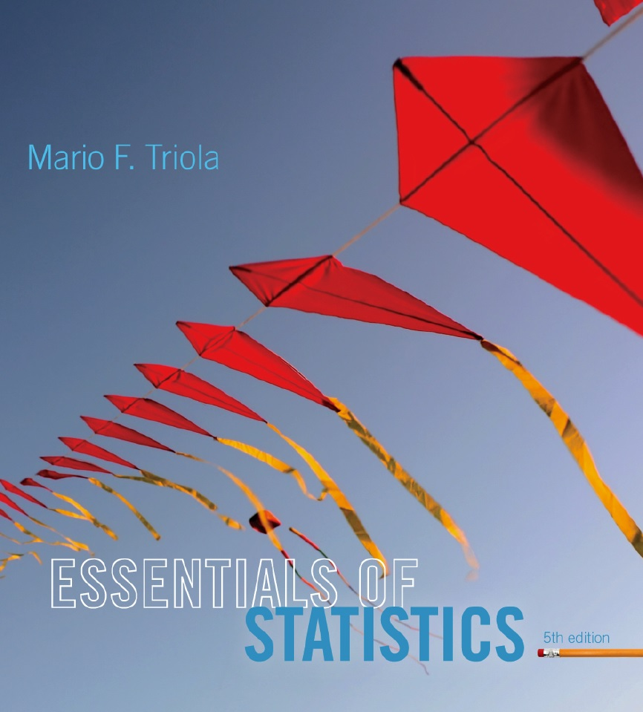
Lecture Slides
Essentials of Statistics
5th Edition
and the Triola Statistics Series
by Mario F. Triola

Slide 2
Chapter 2
Summarizing and Graphing Data
2-1 Review and Preview
2-2 Frequency Distributions
2-3 Histograms
2-4 Graphs that Enlighten and Graphs that Deceive

