Slide 1
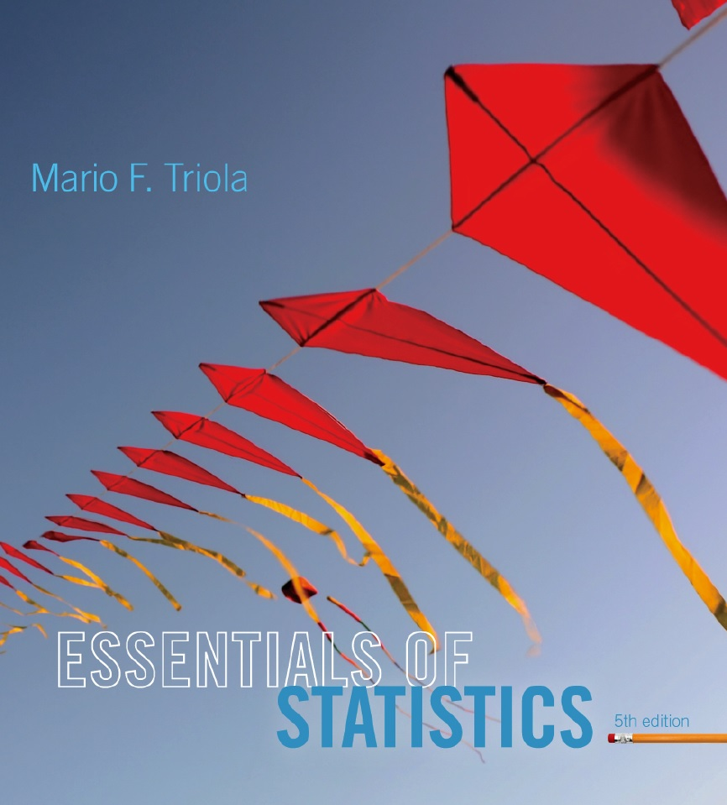
Lecture Slides
Essentials of Statistics
5th Edition
and the Triola Statistics Series
by Mario F. Triola

Slide 2
Chapter 2
Summarizing and Graphing Data
2-1 Review and Preview
2-2 Frequency Distributions
2-3 Histograms
2-4 Graphs that Enlighten and Graphs that Deceive

Slide 3
Preview
Characteristics of Data
1. Center: A representative value that indicates where the middle of the data set is located.
2. Variation: A measure of the amount that the data values vary.
3. Distribution: The nature or shape of the spread of data over the range of values (such as bell-shaped, uniform, or skewed).
4. Outliers: Sample values that lie very far away from the vast majority of other sample values.
5. Time: Changing characteristics of the data over time.

