Slide 1
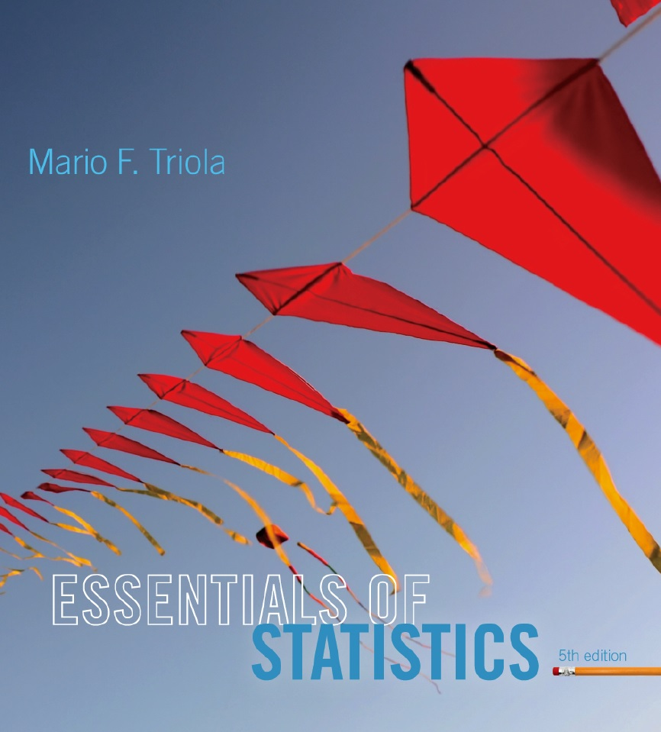
Lecture Slides
Essentials of Statistics
5th Edition
and the Triola Statistics Series
by Mario F. Triola

Slide 2
Chapter 2
Summarizing and Graphing Data
2-1 Review and Preview
2-2 Frequency Distributions
2-3 Histograms
2-4 Graphs that Enlighten and Graphs that Deceive

Slide 3
Key Concept
When working with large data sets, it is often helpful to organize and summarize data by constructing a table called a frequency distribution.
Because computer software and calculators can generate frequency distributions, the details of constructing them are not as important as what they tell us about data sets.

Slide 4
Definition
Frequency Distribution
(or Frequency Table)
shows how a data set is partitioned among all of several categories (or classes) by listing all of the categories along with the number (frequency) of data values in each of them.

Slide 5
IQ Scores of Low Lead Group
IQ Score | Frequency
50-69 | 2
70-89 | 33
90-109 | 35
110-129 | 7
130-149 | 1
Lower Class
Limits
are the smallest numbers that can actually belong to different classes.

Slide 6
IQ Scores of Low Lead Group
IQ Score | Frequency
50-69 | 2
70-89 | 33
90-109 | 35
110-129 | 7
130-149 | 1
Upper Class
Limits
are the largest numbers that can actually belong to different classes.

Slide 7
IQ Scores of Low Lead Group
IQ Score | Frequency
50-69 | 2
70-89 | 33
90-109 | 35
110-129 | 7
130-149 | 1
49.5
69.5
89.5
109.5
129.5
149.5
Class
Boundaries
are the numbers used to separate classes, but without the gaps created by class limits.

Slide 8
IQ Scores of Low Lead Group
IQ Score | Frequency
50-69 | 2
70-89 | 33
90-109 | 35
110-129 | 7
130-149 | 1
59.5
79.5
99.5
119.5
139.5
Class
Midpoints
are the values in the middle of the classes and can be found by adding the lower class limit to the upper class limit and dividing the sum by 2.

Slide 9
IQ Scores of Low Lead Group
IQ Score | Frequency
50-69 | 2
70-89 | 33
90-109 | 35
110-129 | 7
130-149 | 1
20
20
20
20
20
Class
Width
is the difference between two consecutive lower class limits or two consecutive lower class boundaries.

Slide 10
Reasons for Constructing
Frequency Distributions
1. Large data sets can be summarized.
2. We can analyze the nature of data.
3. We have a basis for constructing important graphs.

Slide 11

Constructing A Frequency Distribution
1. Determine the number of classes (should be between 5 and 20).
2. Calculate the class width (round up).
class width
(maximum value) – (minimum value)
number of classes
3. Starting point: Choose the minimum data value or a convenient value below it as the first lower class limit.
Using the first lower class limit and class width, proceed to list the other lower class limits.
5. List the lower class limits in a vertical column and proceed to enter the upper class limits.
6. Take each individual data value and put a tally mark in the appropriate class. Add the tally marks to get the frequency.

Slide 12
Relative Frequency Distribution
includes the same class limits as a frequency distribution, but the frequency of a class is replaced with a relative frequencies (a proportion) or a percentage frequency ( a percent)
class frequency
relative frequency =
sum of all frequencies
percentage
frequency
class frequency
=
× 100%
sum of all frequencies

Slide 13
Relative Frequency Distribution
IQ Score | Frequency | Relative Frequency
50-69 | 2 | 2.6%
70-89 | 33 | 42.3%
90-109 | 35 | 44.9%
110-129 | 7 | 9.0%
130-149 | 1 | 1.3%

Slide 14
Cumulative Frequency Distribution
IQ Score | Frequency | Cumulative Frequency
50-69 | 2 | 2
70-89 | 33 | 35
90-109 | 35 | 70
110-129 | 7 | 77
130-149 | 1 | 78
Cumulative Frequencies

Slide 15
Critical Thinking: Using Frequency Distributions to Understand Data
In later chapters, there will be frequent reference to data with a normal distribution. One key characteristic of a normal distribution is that it has a “bell” shape.
The frequencies start low, then increase to one or two high frequencies, and then decrease to a low frequency.
The distribution is approximately symmetric, with frequencies preceding the maximum being roughly a mirror image of those that follow the maximum.

Slide 16
Gaps
Gaps
The presence of gaps can show that we have data from two or more different populations.
However, the converse is not true, because data from different populations do not necessarily result in gaps.

Slide 17
Example
The table on the next slide is a frequency distribution of randomly selected pennies.
The weights of pennies (grams) are presented, and examination of the frequencies suggests we have two different populations.
Pennies made before 1983 are 95% copper and 5% zinc.
Pennies made after 1983 are 2.5% copper and 97.5% zinc.

Slide 18
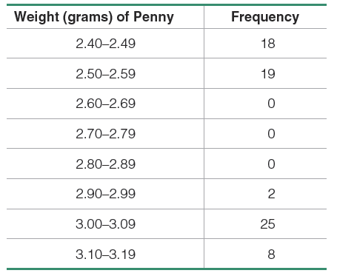
Example (continued)
The presence of gaps can suggest the data are from two or more different populations.

