Slide 1
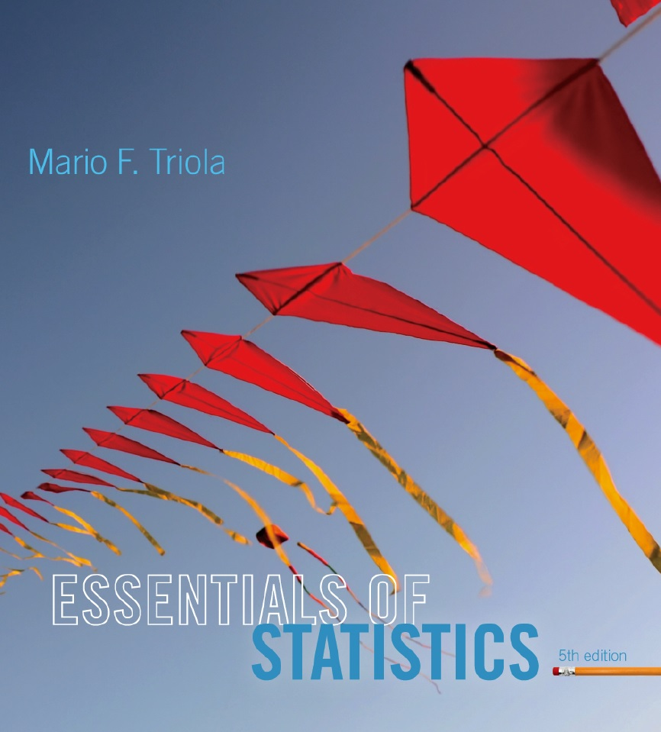
Lecture Slides
Essentials of Statistics
5th Edition
and the Triola Statistics Series
by Mario F. Triola

Slide 2
Chapter 2
Summarizing and Graphing Data
2-1 Review and Preview
2-2 Frequency Distributions
2-3 Histograms
2-4 Graphs that Enlighten and Graphs that Deceive

Slide 3
Key Concept
We use a visual tool called a histogram to analyze the shape of the distribution of the data.

Slide 4
Histogram
A graph consisting of bars of equal width drawn adjacent to each other (unless there are gaps in the data)
The horizontal scale represents the classes of quantitative data values and the vertical scale represents the frequencies.
The heights of the bars correspond to the frequency values.

Slide 5
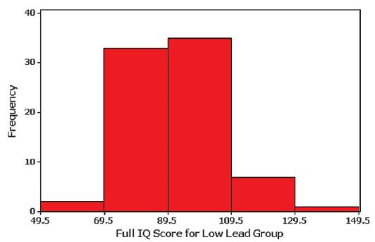
Example
IQ scores from children with low levels of lead.
IQ Score | Frequency
50-69 | 2
70-89 | 33
90-109 | 35
110-129 | 7
130-149 | 1

Slide 6
Histogram
A histogram is basically a graph of a frequency distribution.
Histograms can usually be generated using technology.

Slide 7
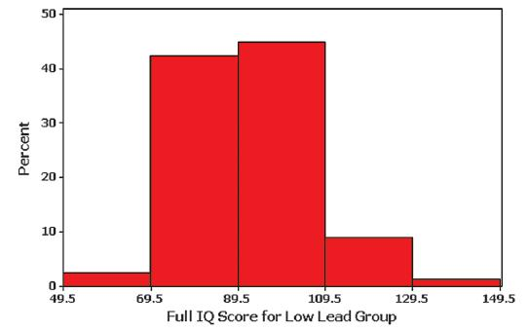
Relative Frequency Histogram
has the same shape and horizontal scale as a histogram, but the vertical scale is marked with relative frequencies instead of actual frequencies
IQ Score | Relative Frequency
50-69 | 2.6%
70-89 | 42.3%
90-109 | 44.9%
110-129 | 9.0%
130-149 | 1.3%

Slide 8
Critical Thinking
Interpreting Histograms
Objective is not simply to construct a histogram, but rather to understand something about the data.
When graphed, a normal distribution has a “bell” shape. Characteristic of the bell shape are
(1) The frequencies increase to a maximum, and then decrease, and
(2) symmetry, with the left half of the graph roughly a mirror image of the right half.
The histogram on the next slide illustrates this.

Slide 9
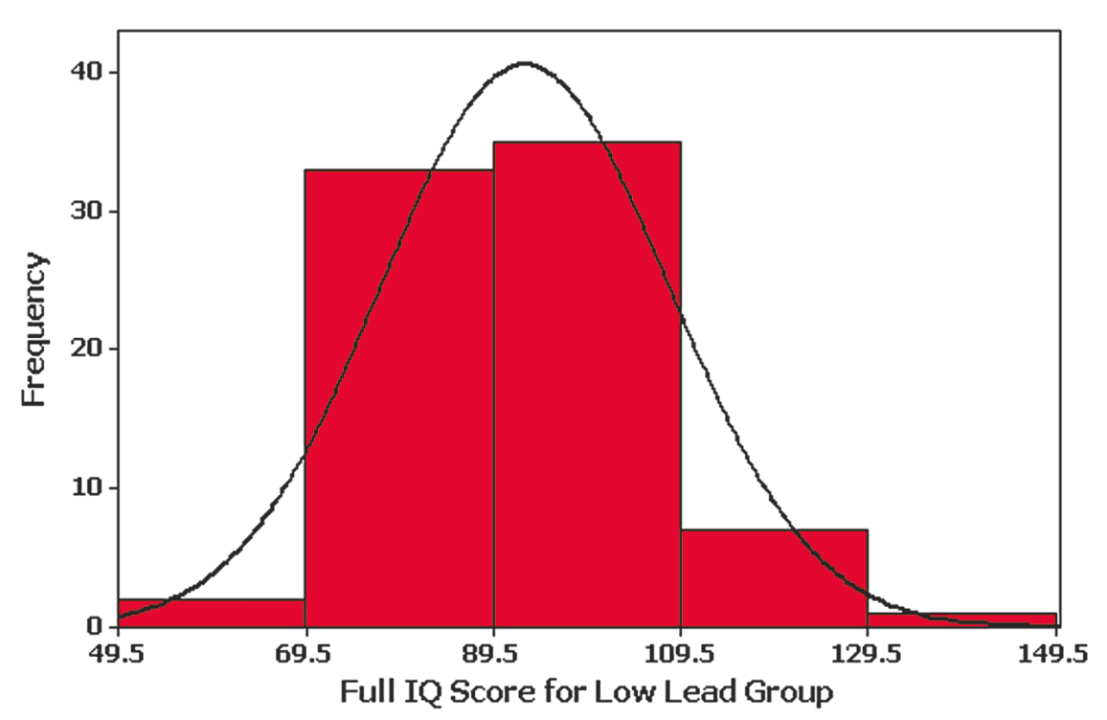
Example – IQ Scores
What is the shape of this distribution?
What is the center?
How much variation is in the data?
Are there any outliers?

Slide 10
Skewness
A distribution of data is skewed if it is not symmetric and extends more to one side to the other.
Data skewed to the right (positively skewed) have a longer right tail.
Data skewed to the left (negative skewed) have a longer left tail.

Slide 11
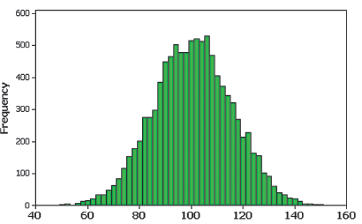
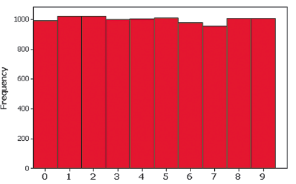
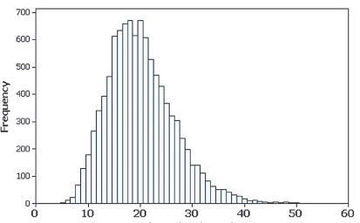
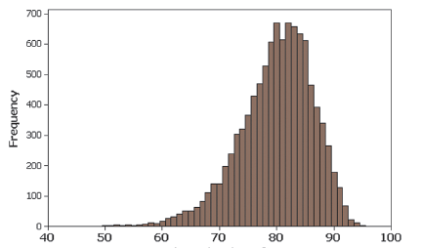
Example – Discuss the Shape

Slide 12
Assessing Normality with a Normal Quantile Plot
Many methods we will use later in the text require that the sample data must be from a population with a normal distribution.
A normal quantile plot can be interpreted on the following criteria:
  Normal Distribution: Points are reasonably close to a straight line
  Not a Normal Distribution: Points not reasonably close to a straight line or the points show some systemic pattern that is not straight

Slide 13
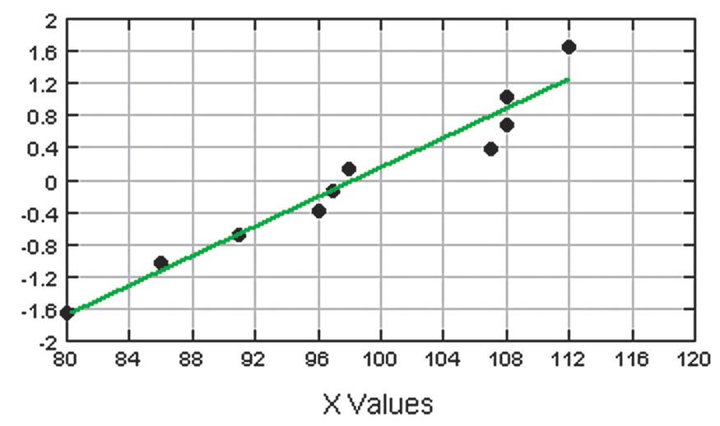
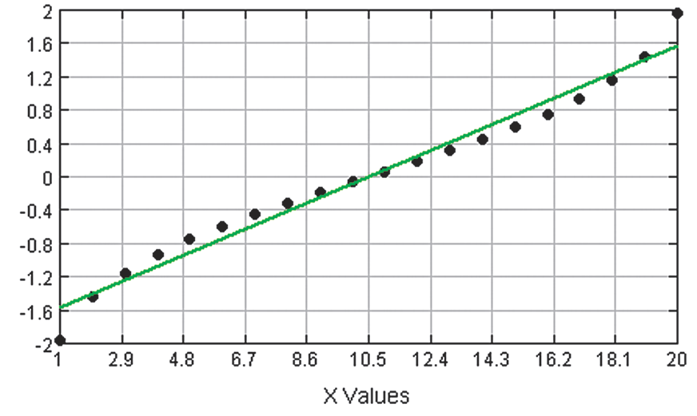
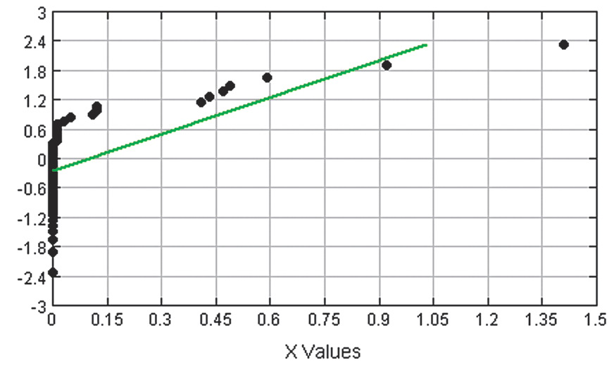
Assessing Normality with a Normal Quantile Plot

