Slide 1
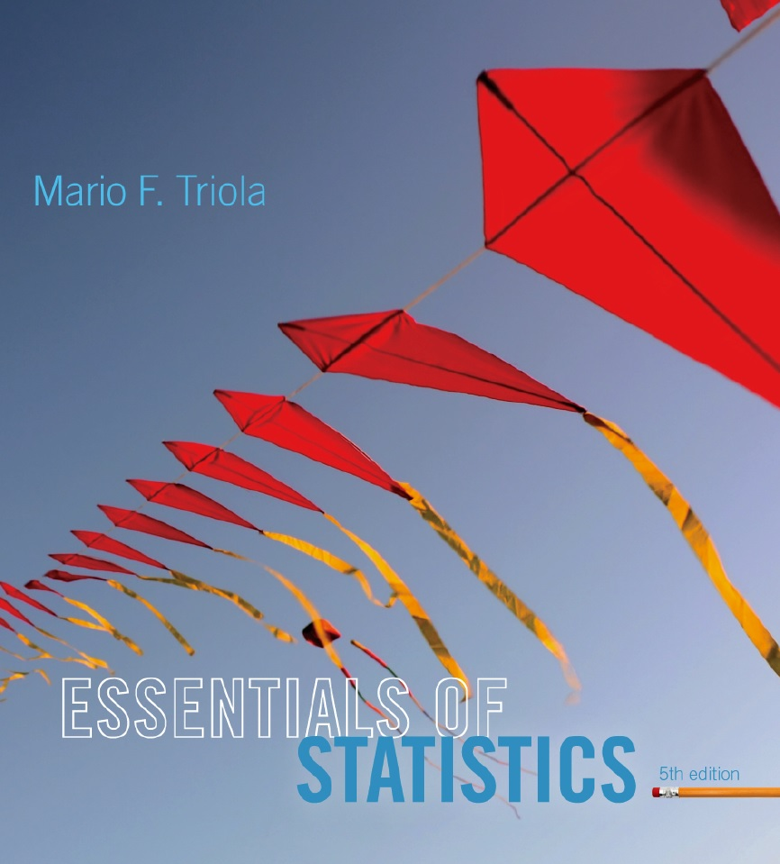
Lecture Slides
Essentials of Statistics
5th Edition
and the Triola Statistics Series
by Mario F. Triola

Slide 2
Chapter 2
Summarizing and Graphing Data
2-1 Review and Preview
2-2 Frequency Distributions
2-3 Histograms
2-4 Graphs that Enlighten and Graphs that Deceive

Slide 3
Key Concept
This section discusses other types of statistical graphs.
Our objective is to identify a suitable graph for representing the data set. The graph should be effective in revealing the important characteristics of the data.

Slide 4
Key Concept
Some graphs are bad in the sense that they contain errors.
Some are bad because they are technically correct, but misleading.
It is important to develop the ability to recognize bad graphs and identify exactly how they are misleading.

Slide 5
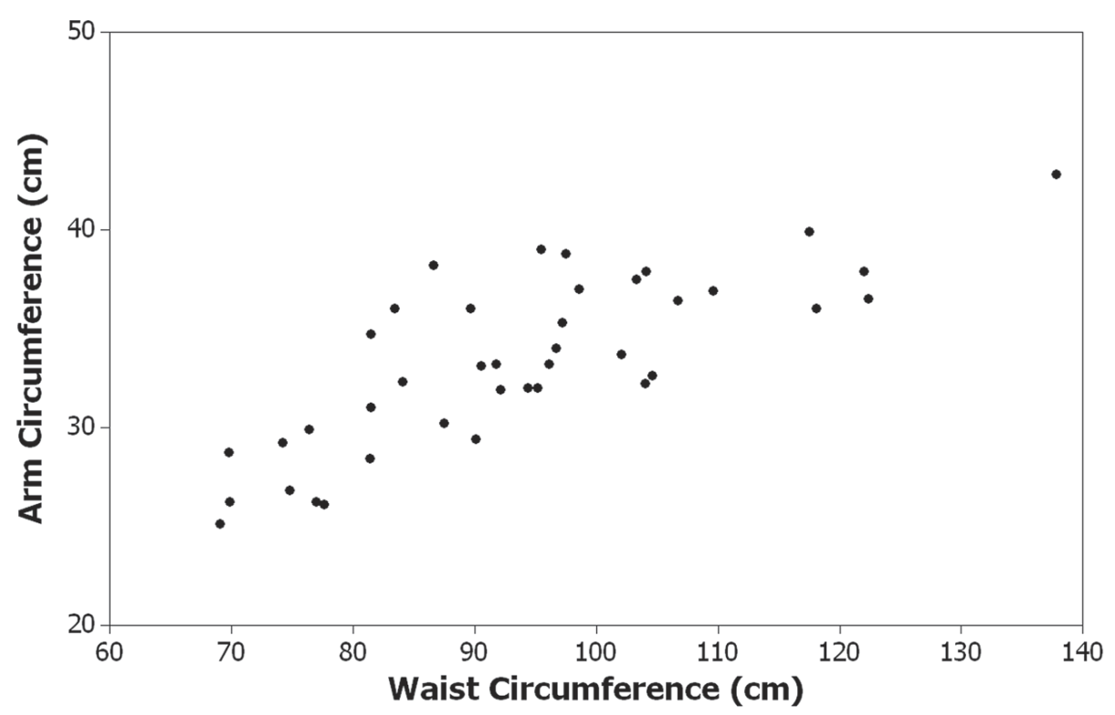
Scatterplot (or Scatter Diagram)
A plot of paired (x, y) quantitative data with a horizontal x-axis and a vertical y-axis. Used to determine whether there is a relationship between the two variables.
Randomly selected males – the pattern suggests there is a relationship.

Slide 6
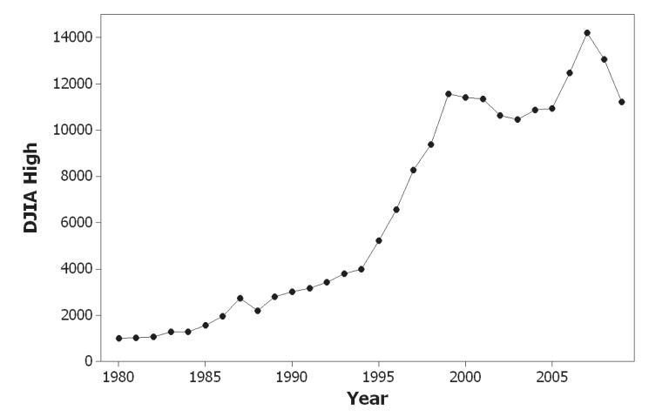
Time-Series Graph
Data that have been collected at different points in time: time-series data
Yearly high values of the Dow Jones Industrial Average

Slide 7
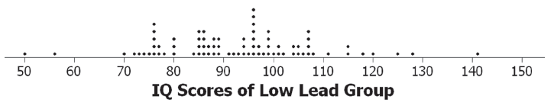
Dotplot
Consists of a graph in which each data value is plotted as a point (or dot) along a scale of values. Dots representing equal values are stacked.

Slide 8
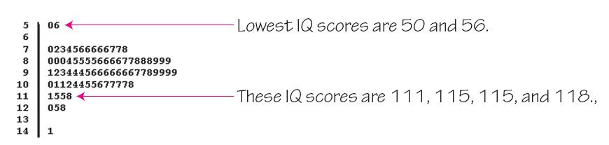
Stemplot (or Stem-and-Leaf Plot)
represents quantitative data by separating each value into two parts: the stem (such as the leftmost digit) and the leaf (such as the rightmost digit).

Slide 9
Bar Graph
Uses bars of equal width to show frequencies of categorical, or qualitative, data. Vertical scale represents frequencies or relative frequencies. Horizontal scale identifies the different categories of qualitative data.
A multiple bar graph has two or more sets of bars and is used to compare two or more data sets.

Slide 10
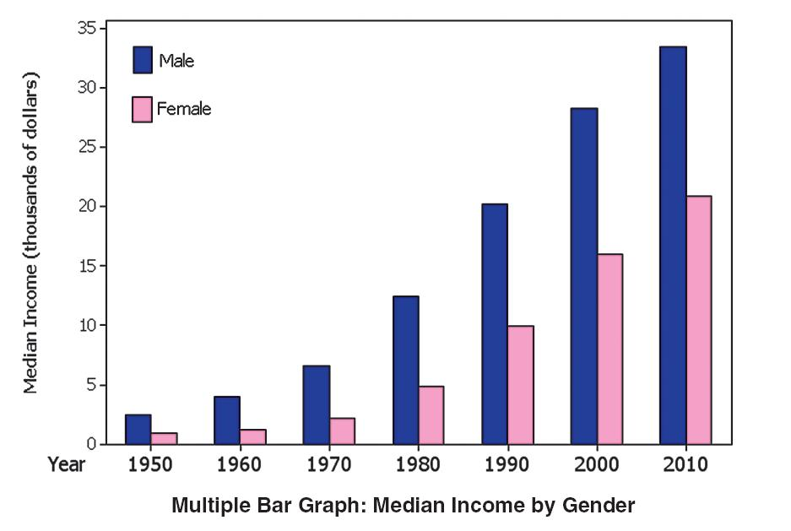
Multiple Bar Graph

Slide 11
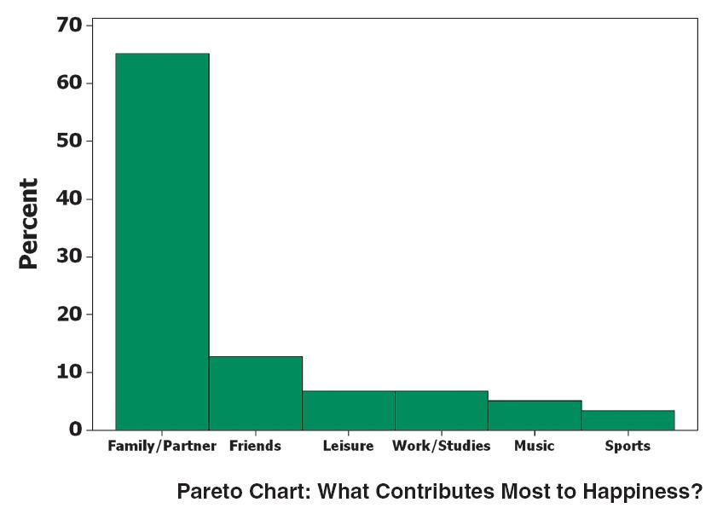
Pareto Chart
A bar graph for qualitative data, with the bars arranged in descending order according to frequencies

Slide 12
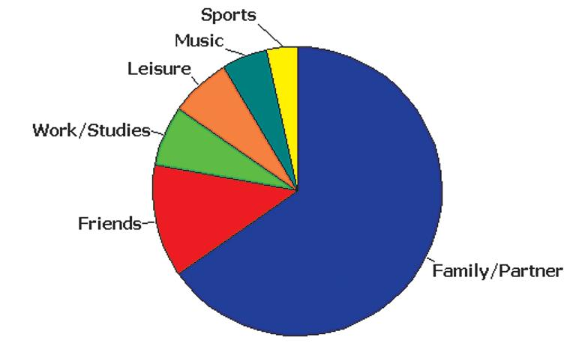
Pie Chart
A graph depicting qualitative data as slices of a circle, in which the size of each slice is proportional to frequency count

Slide 13
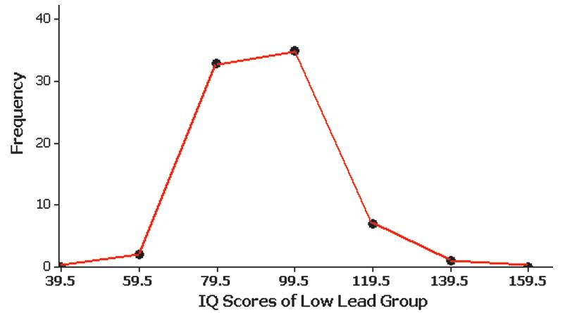
Frequency Polygon
uses line segments connected to points directly above class midpoint values.

Slide 14
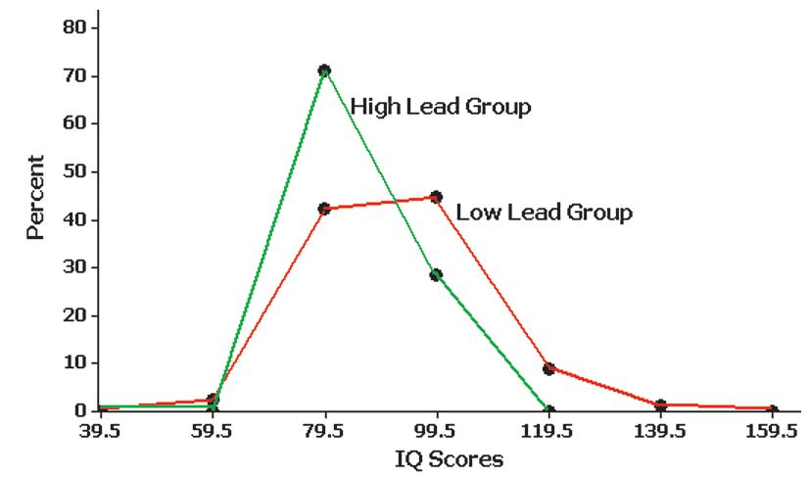
Relative Frequency Polygon
Uses relative frequencies (proportions or percentages) for the vertical scale.

Slide 15
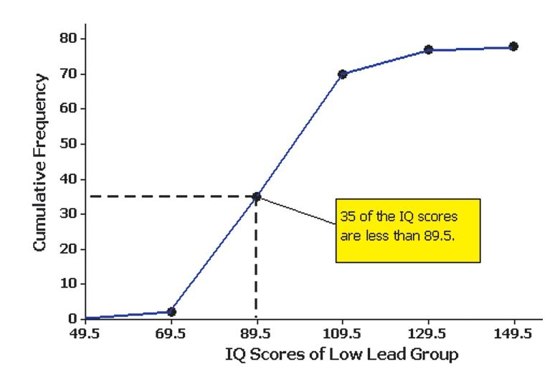
Ogive
A line graph that depicts cumulative frequencies

Slide 16
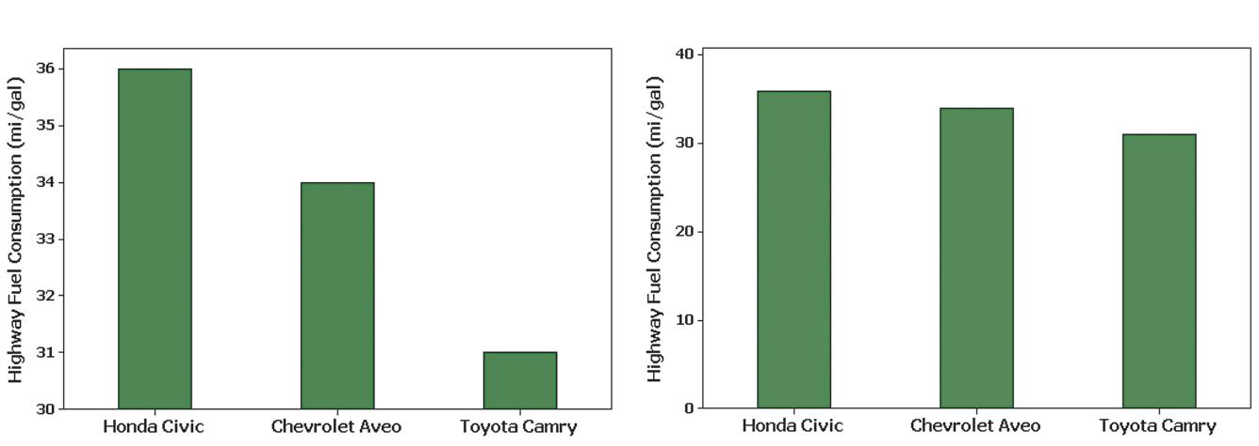
Graphs That Deceive
Nonzero Axis: Graphs can be misleading because one or both of the axes begin at some value other than zero, so that differences are exaggerated.

Slide 17
Pictographs
Drawings of objects. Three-dimensional objects - money bags, stacks of coins, army tanks (for army expenditures), people (for population sizes), barrels (for oil production), and houses (for home construction) are commonly used to depict data.
These drawings can create false impressions that distort the data.
If you double each side of a square, the area does not merely double; it increases by a factor of four; if you double each side of a cube, the volume does not merely double; it increases by a factor of eight.
Pictographs using areas and volumes can therefore be very misleading.

Slide 18
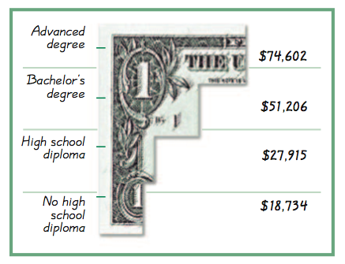
Example – Income and Education
Bars have same width, too busy, too difficult to understand.

Slide 19
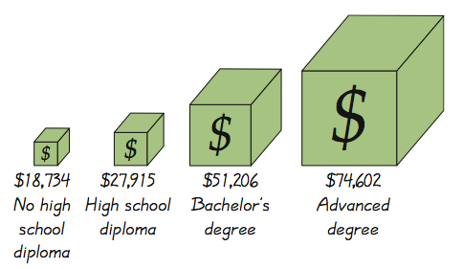
Example – Income and Education
Misleading. Depicts one-dimensional data with three-dimensional boxes. Last box is 64 times as large as first box, but income is only 4 times as large.

Slide 20
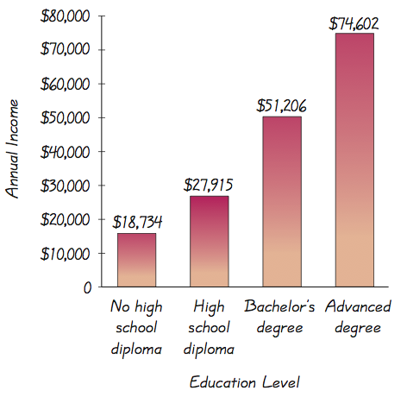
Example – Income and Education
Fair, objective, unencumbered by distracting features.

Slide 21
Important Principles
Suggested by Edward Tufte
For small data sets of 20 values or fewer, use a table instead of a graph.
A graph of data should make the viewer focus on the true nature of the data, not on other elements, such as eye-catching but distracting design features.
Do not distort data. Construct a graph to reveal the true nature of the data.
Almost all of the ink in a graph should be used for the data, not for the other design elements.

