Slide 1
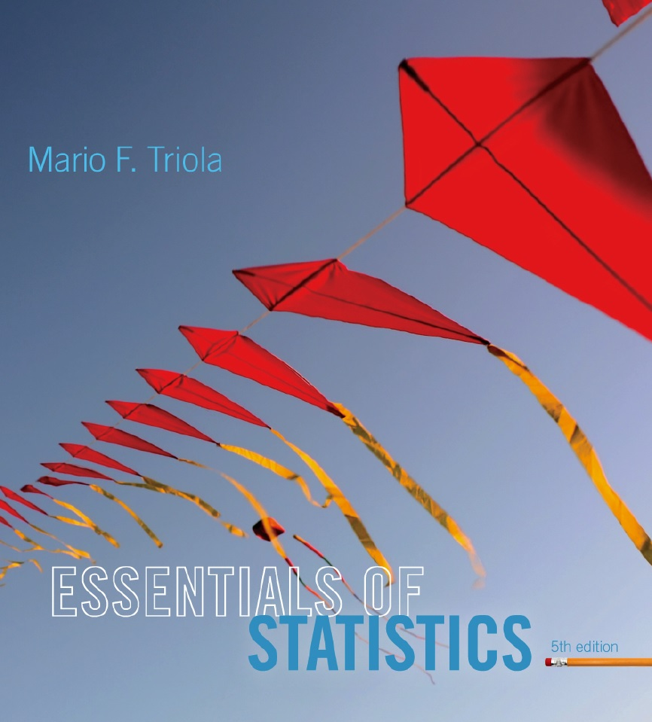
Lecture Slides
Essentials of Statistics
5th Edition
and the Triola Statistics Series
by Mario F. Triola

Slide 2
Chapter 3
Statistics for Describing, Exploring, and Comparing Data
3-1 Review and Preview
3-2 Measures of Center
3-3 Measures of Variation
3-4 Measures of Relative Standing and Boxplots

Slide 3
Review
Chapter 1
Distinguish between population and sample, parameter and statistic, good sampling methods: simple random sample, stratified sample, etc.
Chapter 2
Frequency distributions, summarizing data with graphs, describing the center, variation, distribution, outliers, and changing characteristics over time in a data set

Slide 4
Preview
Descriptive Statistics
In this chapter we’ll learn to summarize or describe the important characteristics of a data set (mean, standard deviation, etc.).
Inferential Statistics
In later chapters we’ll learn to use sample data to make inferences or generalizations about a population.

