Slide 1
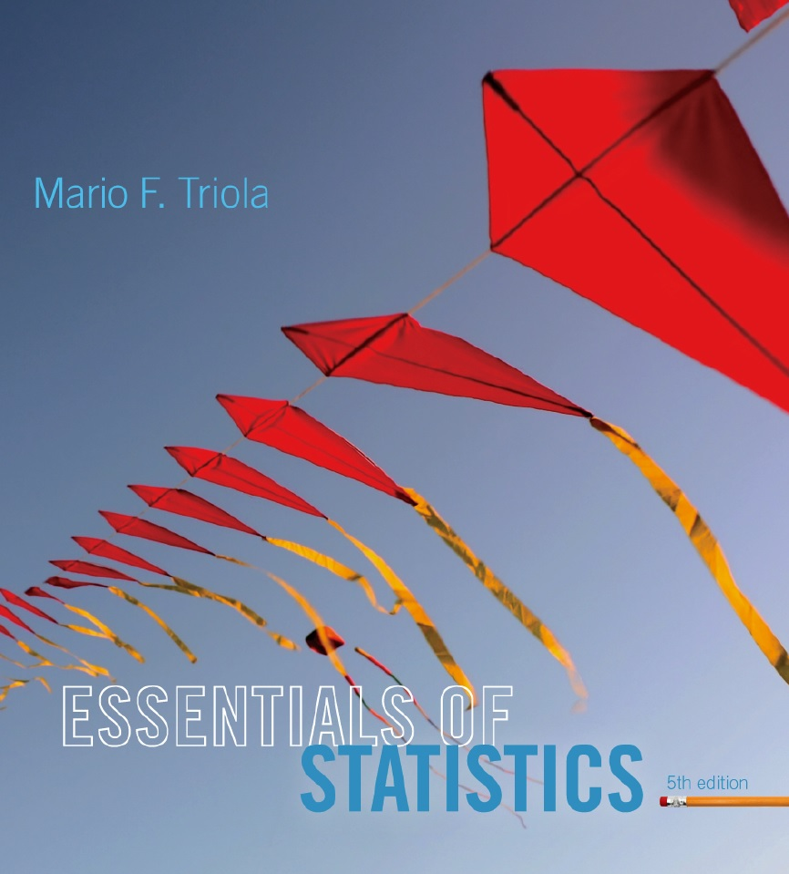
Lecture Slides
Essentials of Statistics
5th Edition
and the Triola Statistics Series
by Mario F. Triola

Slide 2
Chapter 3
Statistics for Describing, Exploring, and Comparing Data
3-1 Review and Preview
3-2 Measures of Center
3-3 Measures of Variation
3-4 Measures of Relative Standing and Boxplots

Slide 3
Key Concept
Characteristics of center of a data set.
Measures of center, including mean and median, as tools for analyzing data.
Not only determine the value of each measure of center, but also interpret those values.

Slide 4
Part 1
Basics Concepts of Measures of Center
Measure of Center
the value at the center or middle of a data set

Slide 5
Arithmetic Mean
Arithmetic Mean (Mean)
the measure of center obtained by adding the values and dividing the total by the number of values
What most people call an average.

Slide 6




Notation
denotes the sum of a set of values.
is the variable usually used to represent the individual data values.
represents the number of data values in a sample.
represents the number of data values in a population.

Slide 7

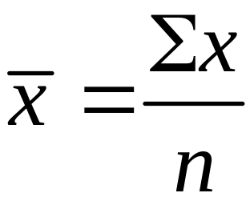

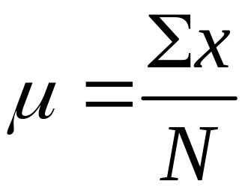
Notation
is pronounced ‘x-bar’ and denotes the mean of a set of sample values
is pronounced ‘mu’ and denotes the mean of all values in a population

Slide 8
Mean
Advantages
  Sample means drawn from the same population tend to vary less than other measures of center
  Takes every data value into account
Disadvantage
  Is sensitive to every data value, one extreme value can affect it dramatically; is not a resistant measure of center

Slide 9
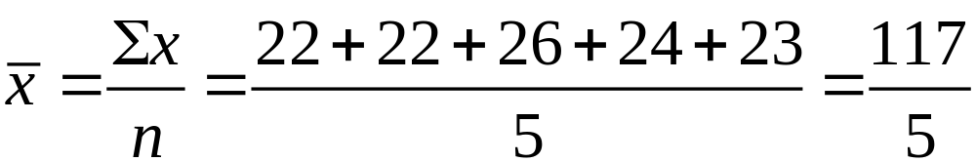
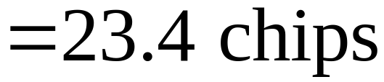
Example 1 - Mean
Table 3-1 includes counts of chocolate chips in different cookies. Find the mean of the first five counts for Chips Ahoy regular cookies: 22 chips, 22 chips, 26 chips, 24 chips, and 23 chips.
Solution
First add the data values, then divide by the number of data values.

Slide 10

Median
Median
the middle value when the original data values are arranged in order of increasing (or decreasing) magnitude
often denoted by (pronounced ‘x-tilde’)
is not affected by an extreme value - is a resistant measure of the center

Slide 11
Finding the Median
First sort the values (arrange them in order). Then –
1. If the number of data values is odd, the median is the number located in the exact middle of the list.
2. If the number of data values is even, the median is found by computing the mean of the two middle numbers.

Slide 12
Median – Odd Number of Values
5.40 1.10 0.42 0.73 0.48 1.10 0.66
Sort in order:
0.42 0.48 0.66 0.73 1.10 1.10 5.40
(in order - odd number of values)
Median is 0.73

Slide 13
Median – Even Number of Values
5.40 1.10 0.42 0.73 0.48 1.10
Sort in order:
0.42 0.48 0.73 1.10 1.10 5.40
(in order - even number of values – no exact middle
shared by two numbers)
0.73 + 1.10
Median is 0.915
2

Slide 14
Mode
Mode
the value that occurs with the greatest frequency
Data set can have one, more than one, or no mode
Bimodal two data values occur with the same greatest frequency
Multimodal more than two data values occur with the same greatest frequency
No Mode no data value is repeated
Mode is the only measure of central tendency that can be used with nominal data.

Slide 15
Mode - Examples
a. 5.40 1.10 0.42 0.73 0.48 1.10
b. 27 27 27 55 55 55 88 88 99
c. 1 2 3 6 7 8 9 10
Mode is 1.10
Bimodal - 27 & 55
No Mode

Slide 16
Definition
Midrange
the value midway between the maximum and minimum values in the original data set
Midrange =
maximum value + minimum value
2

Slide 17
Midrange
Sensitive to extremes
because it uses only the maximum and minimum values, it is rarely used
Redeeming Features
(1) very easy to compute
(2) reinforces that there are several ways to define the center
(3) avoid confusion with median by defining the midrange along with the median

Slide 18
Round-off Rule for
Measures of Center
Carry one more decimal place than is present in the original set of values

Slide 19
Critical Thinking
Think about whether the results are reasonable.
Think about the method used to collect the sample data.

Slide 20
Example
Identify the reason why the mean and median would not be meaningful statistics.
Rank (by sales) of selected statistics textbooks:
1, 4, 3, 2, 15
b. Numbers on the jerseys of the starting offense for the New Orleans Saints when they last won the Super Bowl: 12, 74, 77, 76, 73, 78, 88, 19, 9, 23, 25

Slide 21
Part 2
Beyond the Basics of Measures of Center

Slide 22
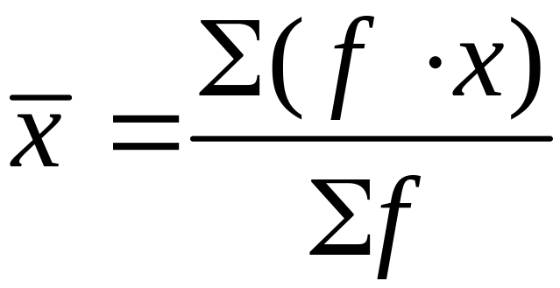
Calculating a Mean from
a Frequency Distribution
Assume that all sample values in each class are equal to the class midpoint.
Use class midpoint of classes for variable x.

Slide 23
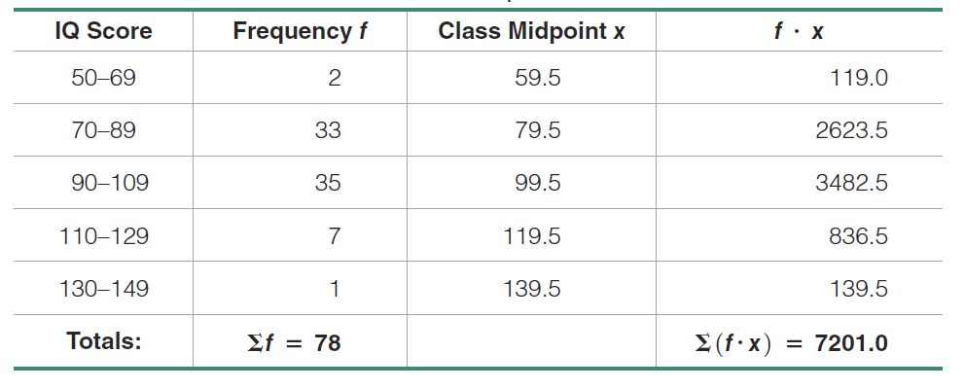
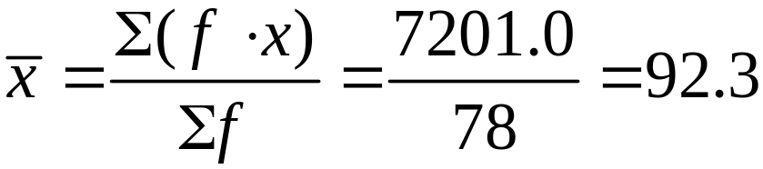
Example
Estimate the mean from the IQ scores in Chapter 2.

Slide 24
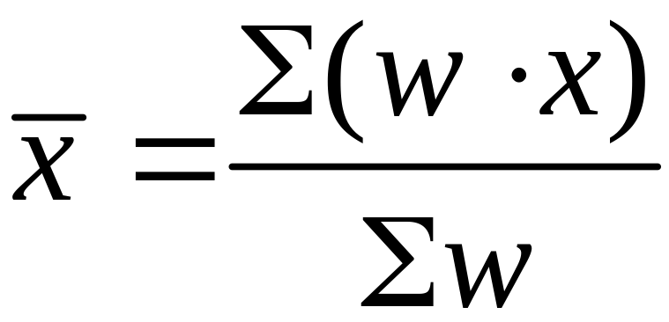
Weighted Mean
When data values are assigned different weights, w, we can compute a weighted mean.

Slide 25
Example – Weighted Mean
In her first semester of college, a student of the author took five courses.
Her final grades along with the number of credits for each course were A (3 credits), A (4 credits), B (3 credits), C (3 credits), and F (1 credit).
The grading system assigns quality points to letter grades as follows:
A = 4; B = 3; C = 2; D = 1; F = 0.
Compute her grade point average.
Solution
Use the numbers of credits as the weights: w = 3, 4, 3, 3, 1.
Replace the letters grades of A, A, B, C, and F with the corresponding quality points: x = 4, 4, 3, 2, 0.

Slide 26
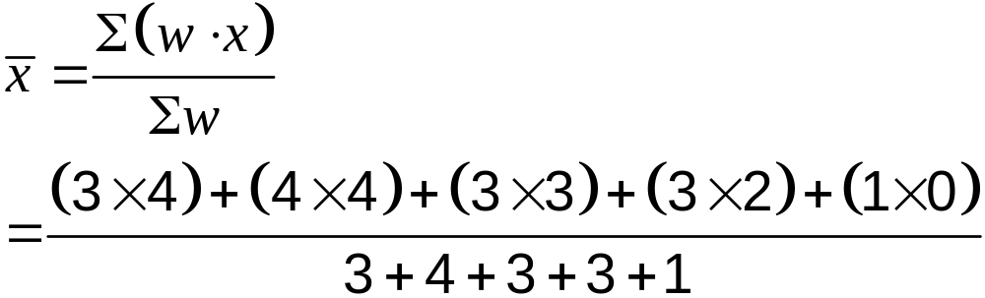
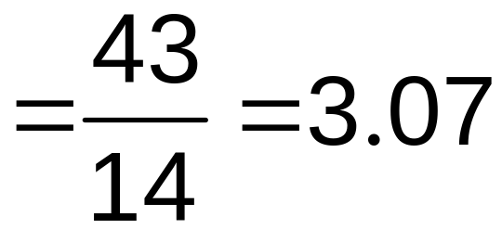
Example – Weighted Mean
Solution

