Slide 1
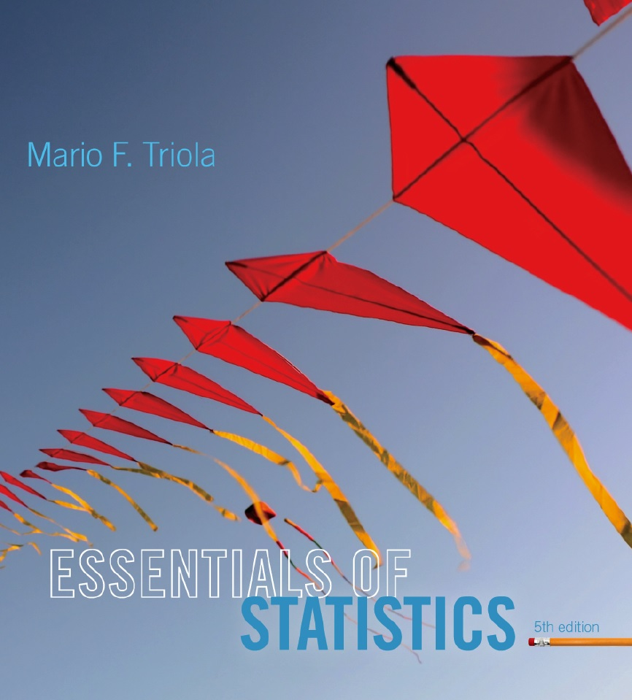
Lecture Slides
Essentials of Statistics
5th Edition
and the Triola Statistics Series
by Mario F. Triola

Slide 2
Chapter 3
Statistics for Describing, Exploring, and Comparing Data
3-1 Review and Preview
3-2 Measures of Center
3-3 Measures of Variation
3-4 Measures of Relative Standing and Boxplots

Slide 3
Key Concept
Discuss characteristics of variation, in particular, measures of variation, such as standard deviation, for analyzing data.
Make understanding and interpreting the standard deviation a priority.

Slide 4
Part 1
Basics Concepts of Variation

Slide 5
Definition
The range of a set of data values is the difference between the maximum data value and the minimum data value.
Range = (maximum value) – (minimum value)
It is very sensitive to extreme values; therefore, it is not as useful as other measures of variation.

Slide 6
Round-Off Rule for Measures of Variation
When rounding the value of a measure of variation, carry one more decimal place than is present in the original set of data.
Round only the final answer, not values in the middle of a calculation.

Slide 7
Definition
The standard deviation of a set of sample values, denoted by s, is a measure of how much data values deviate away from the mean.

Slide 8
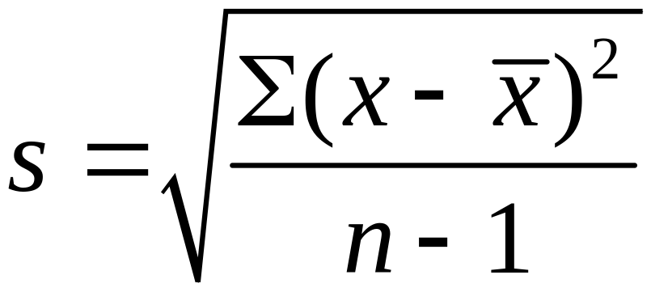
Sample Standard
Deviation Formula

Slide 9
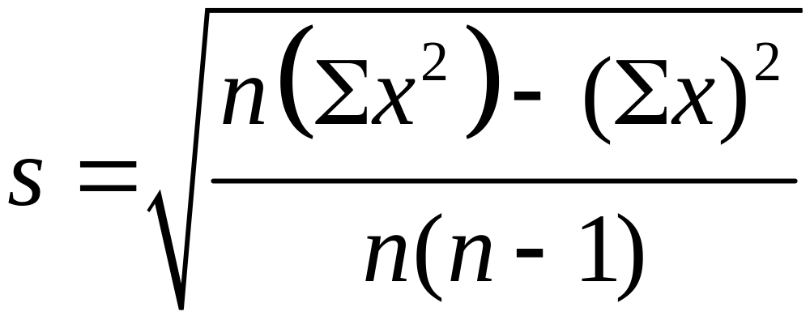
Sample Standard Deviation (Shortcut Formula)

Slide 10
Standard Deviation –
Important Properties
The standard deviation is a measure of variation of all values from the mean.
The value of the standard deviation s is usually positive (it is never negative).
The value of the standard deviation s can increase dramatically with the inclusion of one or more outliers (data values far away from all others).
The units of the standard deviation s are the same as the units of the original data values.

Slide 11
Example
Use either formula to find the standard deviation of these numbers of chocolate chips:
22, 22, 26, 24

Slide 12
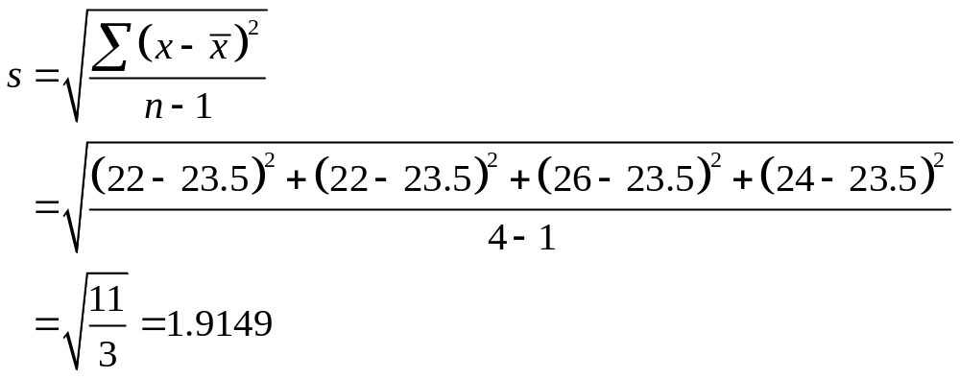
Example

Slide 13
Range Rule of Thumb for Understanding Standard Deviation
It is based on the principle that for many data sets, the vast majority (such as 95%) of sample values lie within two standard deviations of the mean.

Slide 14
Range Rule of Thumb for
Interpreting a Known Value of the Standard Deviation
Informally define usual values in a data set to be those that are typical and not too extreme. Find rough estimates of the minimum and maximum “usual” sample values as follows:
=
Minimum “usual” value (mean) – 2 × (standard deviation)
=
Maximum “usual” value (mean) + 2 × (standard deviation)

Slide 15
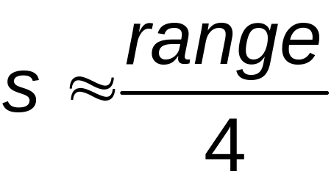
Range Rule of Thumb for
Estimating a Value of the
Standard Deviation s
To roughly estimate the standard deviation from a collection of known sample data use
where
range = (maximum value) – (minimum value)

Slide 16
Example
Using the 40 chocolate chip counts for the Chips Ahoy cookies, the mean is 24.0 chips and the standard deviation is 2.6 chips.
Use the range rule of thumb to find the minimum and maximum “usual” numbers of chips.
Would a cookie with 30 chocolate chips be “unusual”?

Slide 17
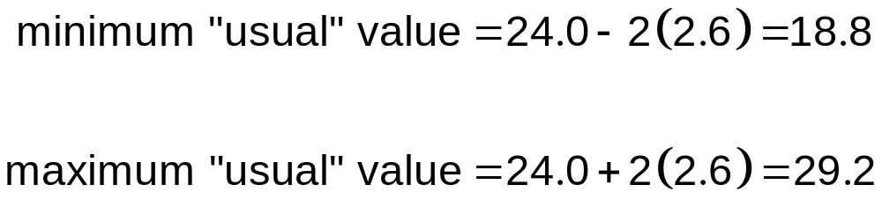
Example
*Because 30 falls above the maximum “usual” value, we can consider it to be a cookie with an unusually high number of chips.

Slide 18
Comparing Variation in
Different Samples
It’s a good practice to compare two sample standard deviations only when the sample means are approximately the same.
When comparing variation in samples with very different means, it is better to use the coefficient of variation, which is defined later in this section.

Slide 19
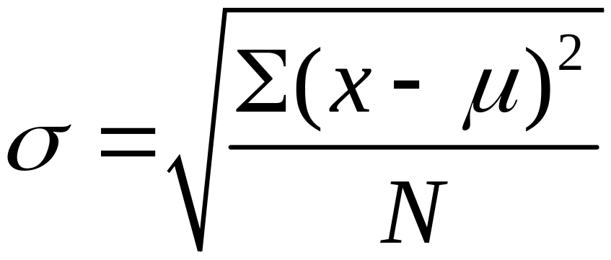
Population Standard
Deviation
This formula is similar to the previous formula, but the population mean and population size are used.

Slide 20
Variance
The variance of a set of values is a measure of variation equal to the square of the standard deviation.
Sample variance: s² - Square of the sample standard deviation s
Population variance: σ² - Square of the population standard deviation σ

Slide 21

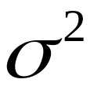
Variance - Notation
s = sample standard deviation
s² = sample variance
= population standard deviation
= population variance

Slide 22
Unbiased Estimator
The sample variance s² is an unbiased estimator of the population variance
, which means values of s² tend to target the value of instead of systematically tending to overestimate or underestimate .

Slide 23
Part 2
Beyond the Basics of Variation

Slide 24
Rationale for using (n – 1) versus n
There are only (n – 1) independent values. With a given mean, only (n – 1) values can be freely assigned any number before the last value is determined.
Dividing by (n – 1) yields better results than dividing by n. It causes s² to target whereas division by n causes s² to underestimate .

Slide 25
Empirical (or 68-95-99.7) Rule
For data sets having a distribution that is approximately bell shaped, the following properties apply:
About 68% of all values fall within 1 standard deviation of the mean.
About 95% of all values fall within 2 standard deviations of the mean.
About 99.7% of all values fall within 3 standard deviations of the mean.

Slide 26
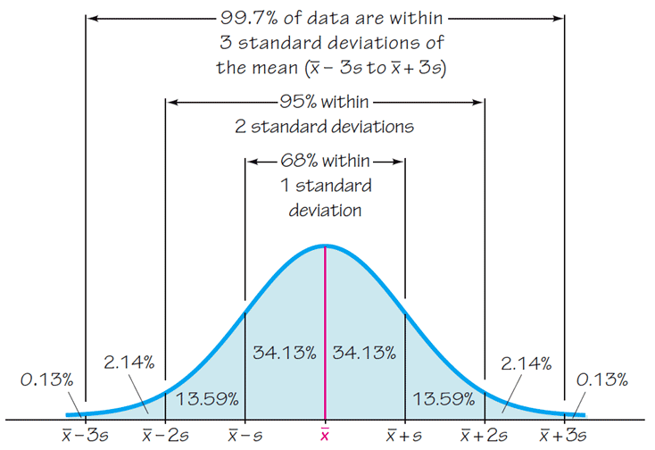
The Empirical Rule

Slide 27
Chebyshev’s Theorem
The proportion (or fraction) of any set of data lying within K standard deviations of the mean is always at least 1–1/K², where K is any positive number greater than 1.
For K = 2, at least 3/4 (or 75%) of all values lie within 2 standard deviations of the mean.
For K = 3, at least 8/9 (or 89%) of all values lie within 3 standard deviations of the mean.

Slide 28
Example
IQ scores have a mean of 100 and a standard deviation of 15. What can we conclude from Chebyshev’s theorem?
At least 75% of IQ scores are within 2 standard deviations of 100, or between 70 and 130.
At least 88.9% of IQ scores are within 3 standard deviations of 100, or between 55 and 145.

Slide 29
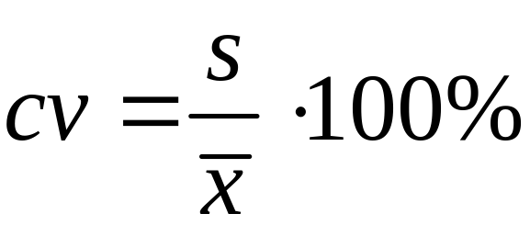
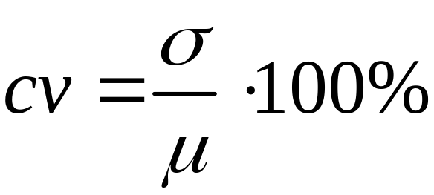
Coefficient of Variation
The coefficient of variation (or CV) for a set of nonnegative sample or population data, expressed as a percent, describes the standard deviation relative to the mean.
Sample
Population

