Slide 1
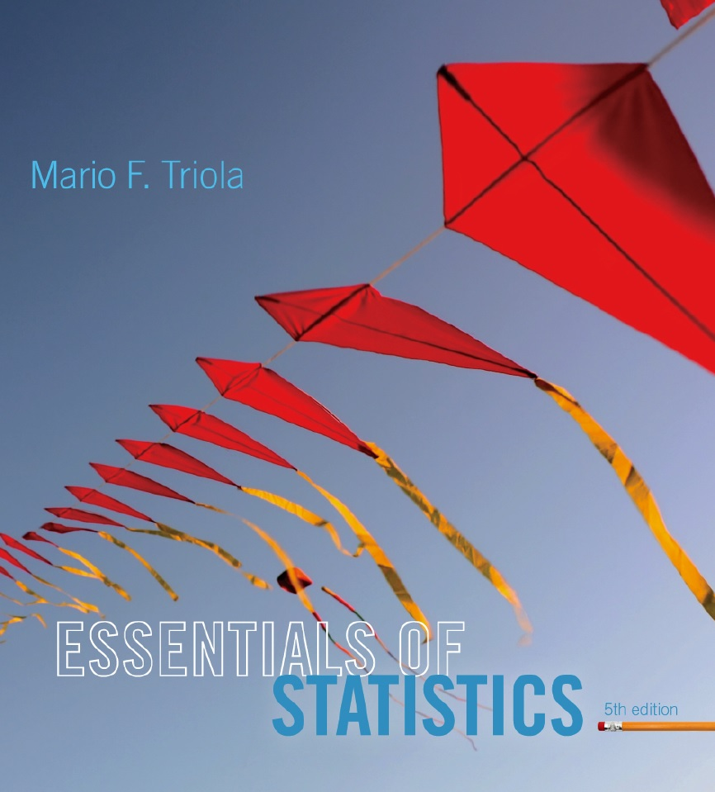
Lecture Slides
Essentials of Statistics
5th Edition
and the Triola Statistics Series
by Mario F. Triola

Slide 2
Chapter 3
Statistics for Describing, Exploring, and Comparing Data
3-1 Review and Preview
3-2 Measures of Center
3-3 Measures of Variation
3-4 Measures of Relative Standing and Boxplots

Slide 3
Key Concept
This section introduces measures of relative standing, which are numbers showing the location of data values relative to the other values within a data set.
They can be used to compare values from different data sets, or to compare values within the same data set.
The most important concept is the z score.
We will also discuss percentiles and quartiles, as well as a new statistical graph called the boxplot.

Slide 4
Part 1
Basics of z Scores, Percentiles, Quartiles, and Boxplots

Slide 5
z score
z Score (or standardized value)
the number of standard deviations that a given value x is above or below the mean

Slide 6
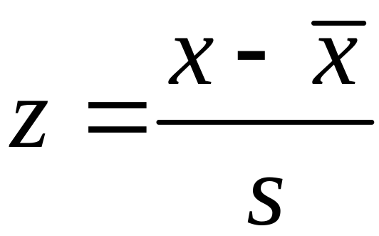
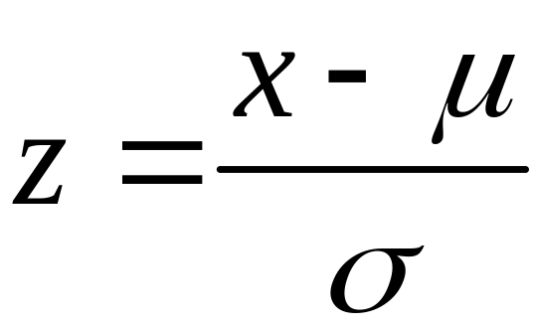
Measures of Position z Score
Sample
Population
Round z scores to 2 decimal places

Slide 7
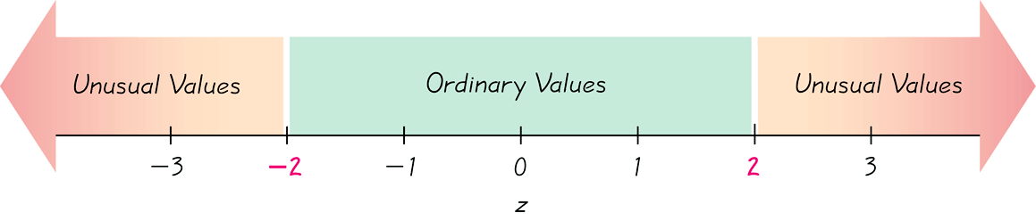

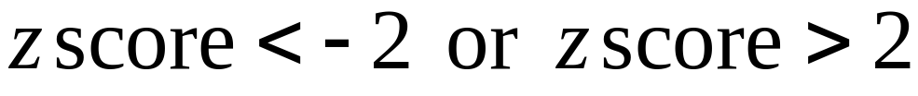
Interpreting Z Scores
Whenever a value is less than the mean, its corresponding z score is negative
Ordinary values:
Unusual Values:

Slide 8
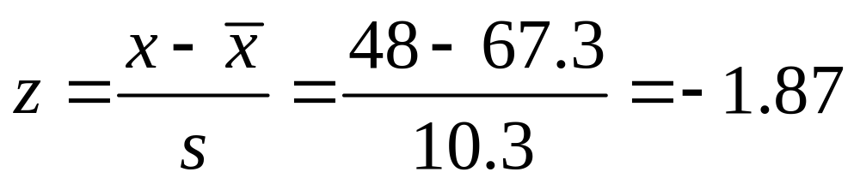
Example
The author of the text measured his pulse rate to be 48 beats per minute.
Is that pulse rate unusual if the mean adult male pulse rate is 67.3 beats per minute with a standard deviation of 10.3?
Answer: Since the z score is between – 2 and +2, his pulse rate is not unusual.

Slide 9
Percentiles
are measures of location. There are 99 percentiles denoted P₁, P₂, . . ., P₉₉, which divide a set of data into 100 groups with about 1% of the values in each group.

Slide 10
Finding the Percentile
of a Data Value
number of values less than x
Percentile of value x = • 100
total number of values

Slide 11
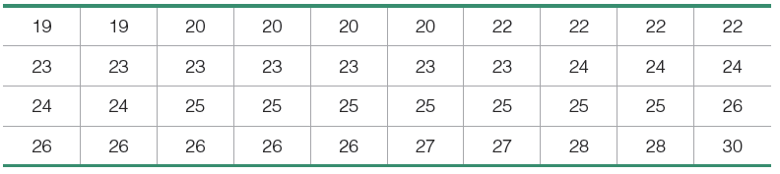
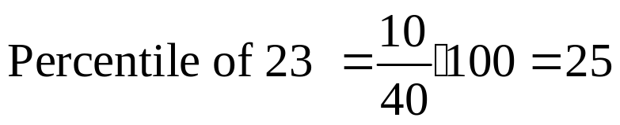
Example
For the 40 Chips Ahoy cookies, find the percentile for a cookie with 23 chips.
Answer: We see there are 10 cookies with fewer than 23 chips, so
A cookie with 23 chips is in the 25th percentile.

Slide 12
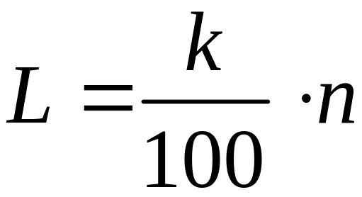
Converting from the kth Percentile to the Corresponding Data Value
Notation
n total number of values in the data set
k percentile being used
L locator that gives the position of a value
P_{k} kth percentile

Slide 13
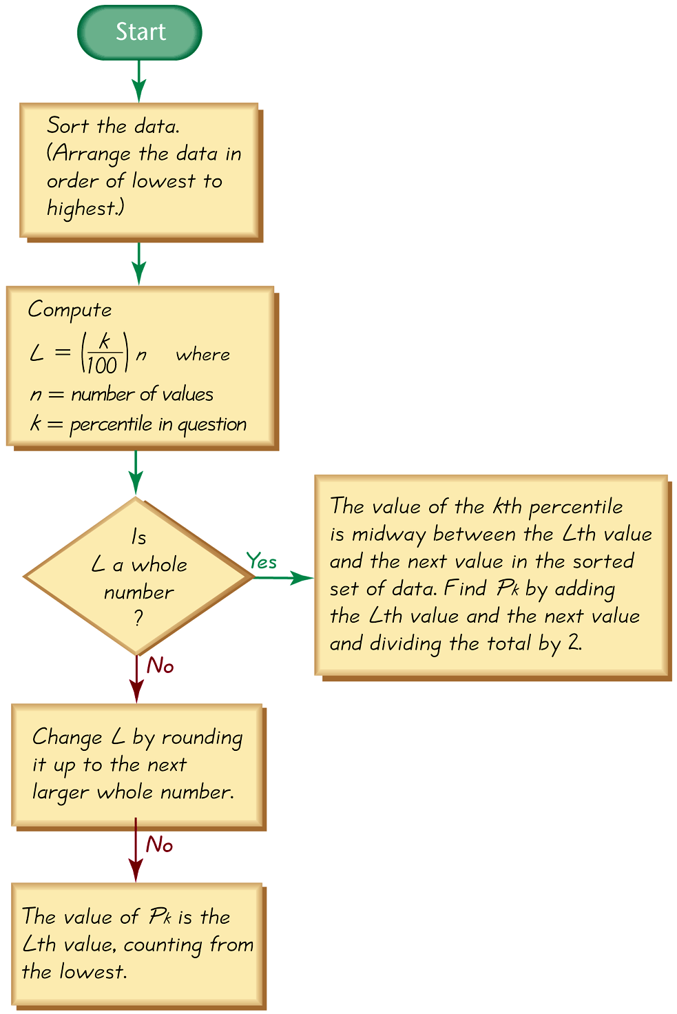
Converting from the
kth Percentile to the
Corresponding Data Value

Slide 14
Quartiles
Are measures of location, denoted Q₁, Q₂, and Q₃, which divide a set of data into four groups with about 25% of the values in each group.
Q₁ (First quartile) separates the bottom 25% of sorted values from the top 75%.
Q₂ (Second quartile) same as the median; separates the bottom 50% of sorted values from the top 50%.
Q₃ (Third quartile) separates the bottom 75% of sorted values from the top 25%.

Slide 15
Quartiles
Q₁, Q₂, Q₃
divide sorted data values into four equal parts
25%
25%
25%
25%
Q₁
Q₂
Q₃
(minimum)
(maximum)
(median)

Slide 16

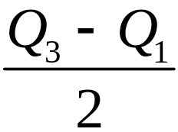
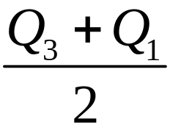
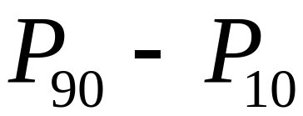
Other Statistics
Interquartile Range (or IQR):
Semi-interquartile Range:
Midquartile:
10 - 90 Percentile Range:

Slide 17
5-Number Summary
For a set of data, the 5-number summary consists of these five values:
1. Minimum value
2. First quartile Q₁
3. Second quartile Q₂ (same as median)
4. Third quartile, Q₃
5. Maximum value

Slide 18
Boxplot
A boxplot (or box-and-whisker-diagram) is a graph of a data set that consists of a line extending from the minimum value to the maximum value, and a box with lines drawn at the first quartile, Q₁, the median, and the third quartile, Q_{3.}

Slide 19
Boxplot - Construction
Find the 5-number summary.
Construct a scale with values that include the minimum and maximum data values.
Construct a box (rectangle) extending from Q1 to Q3 and draw a line in the box at the value of Q2 (median).
Draw lines extending outward from the box to the minimum and maximum values.

Slide 20
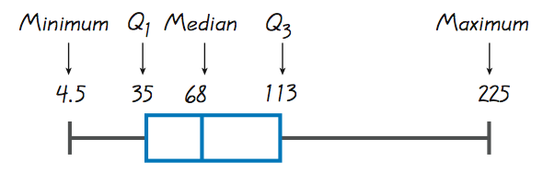
Boxplots

Slide 21
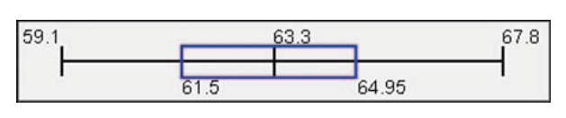
Boxplots - Normal Distribution
Normal Distribution:
Heights from a Simple Random Sample of Women

Slide 22
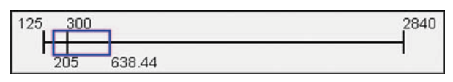
Boxplots - Skewed Distribution
Skewed Distribution:
Salaries (in thousands of dollars) of NCAA Football Coaches

Slide 23
Part 2
Outliers and
Modified Boxplots

Slide 24
Outliers
An outlier is a value that lies very far away from the vast majority of the other values in a data set.

Slide 25
Important Principles
An outlier can have a dramatic effect on the mean and the standard deviation.
An outlier can have a dramatic effect on the scale of the histogram so that the true nature of the distribution is totally obscured.

Slide 26
Outliers for Modified Boxplots
For purposes of constructing modified boxplots, we can consider outliers to be data values meeting specific criteria.
In modified boxplots, a data value is an outlier if it is:
above Q₃ by an amount greater than 1.5 × IQR
or
below Q₁ by an amount greater than 1.5 × IQR

Slide 27
Modified Boxplots
Boxplots described earlier are called skeletal (or regular) boxplots.
Some statistical packages provide modified boxplots which represent outliers as special points.

Slide 28
Modified Boxplot Construction
A modified boxplot is constructed with these specifications:
A special symbol (such as an asterisk) is used to identify outliers.
The solid horizontal line extends only as far as the minimum data value that is not an outlier and the maximum data value that is not an outlier.

Slide 29
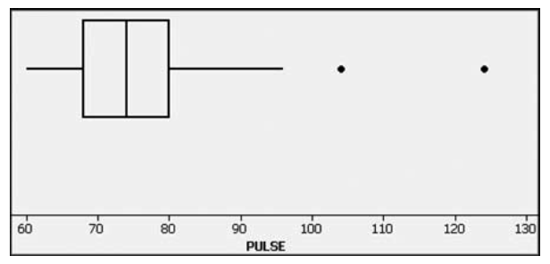
Modified Boxplots - Example

Slide 30
Putting It All Together
So far, we have discussed several basic tools commonly used in statistics –
  Context of data
  Source of data
  Sampling method
  Measures of center and variation
  Distribution and outliers
  Changing patterns over time
  Conclusions and practical implications
This is an excellent checklist, but it should not replace thinking about any other relevant factors.

