Slide 1
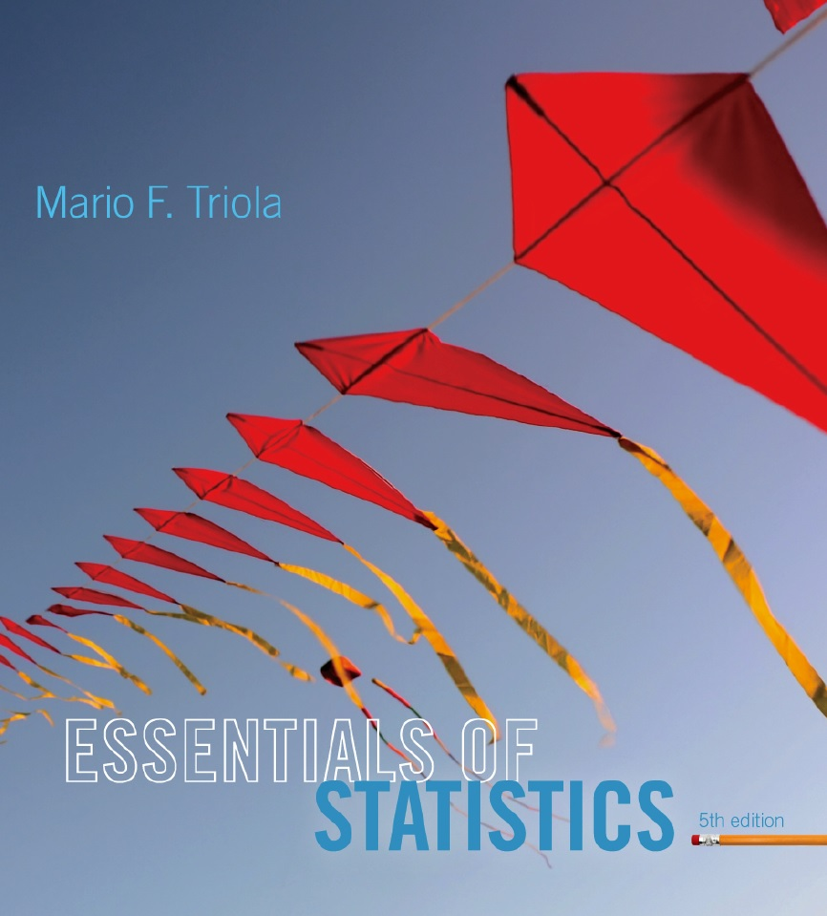
Lecture Slides
Essentials of Statistics
5th Edition
and the Triola Statistics Series
by Mario F. Triola

Slide 2
Chapter 4
Probability
4-1 Review and Preview
4-2 Basic Concepts of Probability
4-3 Addition Rule
4-4 Multiplication Rule: Basics
4-5 Multiplication Rule: Complements and Conditional Probability
4-6 Counting
4-7 Probabilities Through Simulations
4-8 Bayes' Theorem

Slide 3
Review
Necessity of sound sampling methods.
Common measures of characteristics of data, such as the mean and the standard deviation

Slide 4
Preview
Rare Event Rule for Inferential Statistics:
If, under a given assumption, the probability of a particular observed event is extremely small, we conclude that the assumption is probably not correct.
Statisticians use the rare event rule for inferential statistics.

