Slide 1

Lecture Slides
Essentials of Statistics
5th Edition
and the Triola Statistics Series
by Mario F. Triola

Slide 2
Chapter 4
Probability
4-1 Review and Preview
4-2 Basic Concepts of Probability
4-3 Addition Rule
4-4 Multiplication Rule: Basics
4-5 Multiplication Rule: Complements and Conditional Probability
4-6 Counting
4-7 Probabilities Through Simulations
4-8 Bayes’ Theorem

Slide 3
Key Concept
This section presents three approaches to finding the probability of an event.
The most important objective of this section is to learn how to interpret probability values.

Slide 4
Definitions
Event
any collection of results or outcomes of a procedure
Simple Event
an outcome or an event that cannot be further broken down into simpler components
Sample Space
for a procedure consists of all possible simple events; that is, the sample space consists of all outcomes that cannot be broken down any further

Slide 5
Example
In the following display, we use “b” to denote a baby boy and “g” to denote a baby girl.
Procedure | Example of Event | Sample Space
Single birth | 1 girl (simple event) | {b, g}
3 births | 2 boys and 1 girl (bbg, bgb, and gbb are all simple events) | {bbb, bbg, bgb, bgg, gbb, gbg, ggb, ggg}

Slide 6
Notation for
Probabilities
P - denotes a probability.
A, B, and C - denote specific events.
P(A) - denotes the probability of event A occurring.

Slide 7
Basic Rules for
Computing Probability
Rule 1: Relative Frequency Approximation of Probability
Conduct (or observe) a procedure, and count the number of times event A actually occurs. Based on these actual results, P(A) is approximated as follows:
P(A) =
# of times A occurred
# of times procedure was repeated

Slide 8
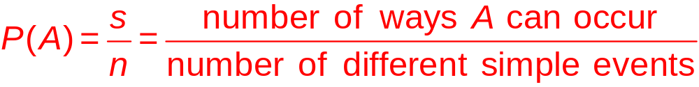
Basic Rules for
Computing Probability
Rule 2: Classical Approach to Probability (Requires Equally Likely Outcomes)
Assume that a given procedure has n different simple events and that each of those simple events has an equal chance of occurring. If event A can occur in s of these n ways, then

Slide 9
Basic Rules for
Computing Probability
Rule 3: Subjective Probabilities
P(A), the probability of event A, is estimated by using knowledge of the relevant circumstances.

Slide 10
Law of Large Numbers
As a procedure is repeated again and again, the relative frequency probability of an event tends to approach the actual probability.

Slide 11
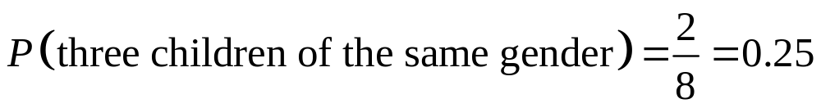
Example
When three children are born, the sample space is:
{bbb, bbg, bgb, bgg, gbb, gbg, ggb, ggg}
Assuming that boys and girls are equally likely, find the probability of getting three children of all the same gender.

Slide 12
Simulations
A simulation of a procedure is a process that behaves in the same ways as the procedure itself so that similar results are produced.

Slide 13

Probability Limits
Always express a probability as a fraction or decimal number between 0 and 1.
The probability of an impossible event is 0.
The probability of an event that is certain to occur is 1.
For any event A, the probability of A is between 0 and 1 inclusive.
That is, .

Slide 14
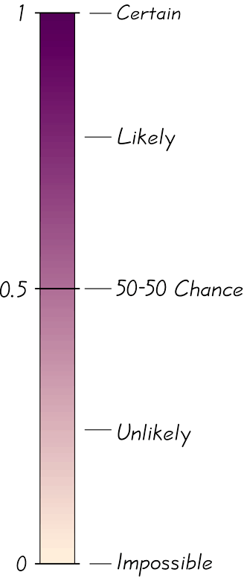
Possible Values for Probabilities

Slide 15

Complementary Events
The complement of event A, denoted by
, consists of all outcomes in which the event A does not occur.

Slide 16
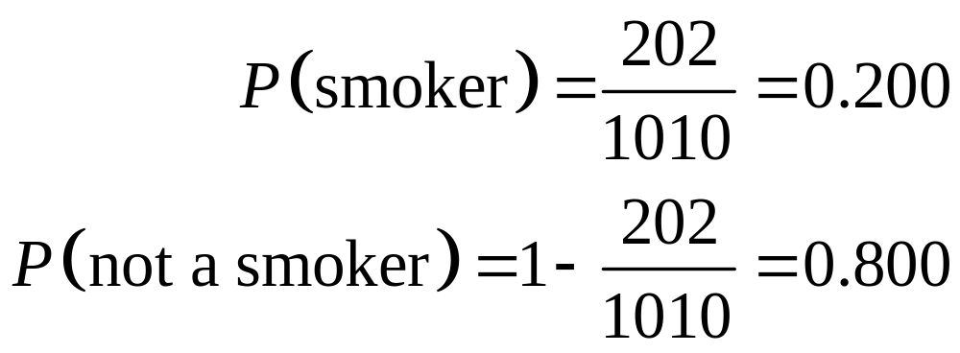
Example
1010 United States adults were surveyed and 202 of them were smokers.
It follows that:

Slide 17
Rounding Off Probabilities
When expressing the value of a probability, either give the exact fraction or decimal or round off final decimal results to three significant digits. (Suggestion: When a probability is not a simple fraction such as 2/3 or 5/9, express it as a decimal so that the number can be better understood.) All digits are significant except for the zeros that are included for proper placement of the decimal point.

Slide 18
Definition
An event is unlikely if its probability is very small, such as 0.05 or less.
An event has an usually low number of outcomes of a particular type or an unusually high number of those outcomes if that number is far from what we typically expect.

Slide 19


Odds
The actual odds against event A occurring are the ratio
, usually expressed in the form of a:b (or “a to b”), where a and b are integers having no common factors.
The actual odds in favor of event A occurring are the ratio , which is the reciprocal of the actual odds against the event. If the odds against A are a:b, then the odds in favor of A are b:a.
The payoff odds against event A occurring are the ratio of the net profit (if you win) to the amount bet.
payoff odds against event A = (net profit) : (amount bet)

Slide 20
Example
If you bet $5 on the number 13 in roulette, your probability of winning is 1/38 and the payoff odds are given by the casino at 35:1.
Find the actual odds against the outcome of 13.
How much net profit would you make if you win by betting on 13?

Slide 21
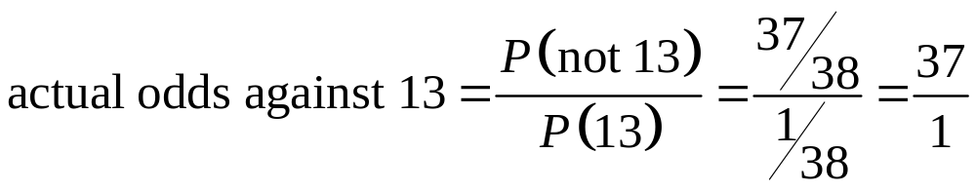
Example - continued
Find the actual odds against the outcome of 13.
With P(13) = 1/38 and P(not 13) = 37/38, we get:
, or 37:1.

Slide 22
Example - continued
Because the payoff odds against 13 are 35:1, we have:
$35 profit for each $1 bet. For a $5 bet, there is $175 net profit. The winning bettor would collect $175 plus the original $5 bet.

