Slide 1
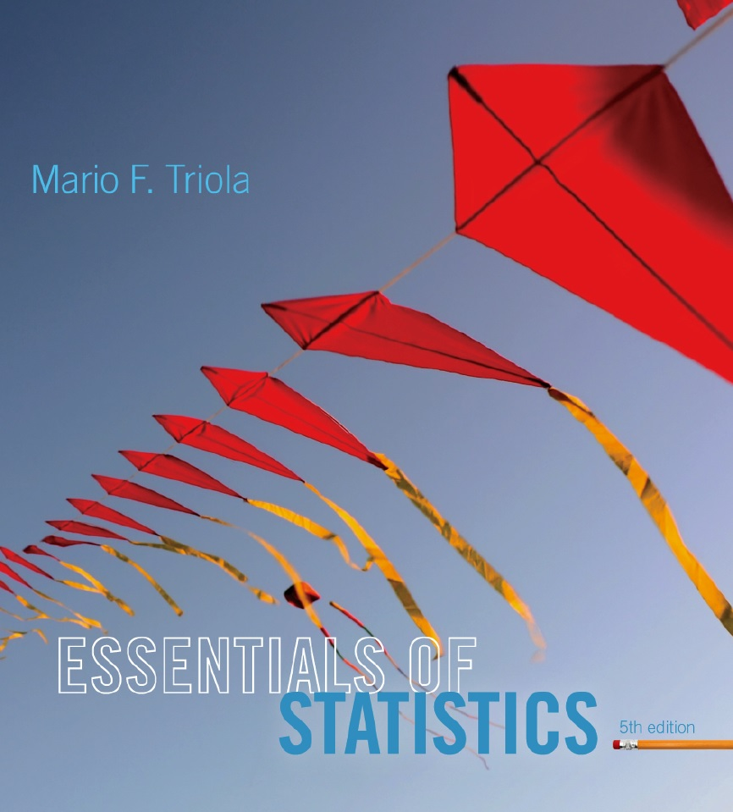
Lecture Slides
Essentials of Statistics
5th Edition
and the Triola Statistics Series
by Mario F. Triola

Slide 2
Chapter 4
Probability
4-1 Review and Preview
4-2 Basic Concepts of Probability
4-3 Addition Rule
4-4 Multiplication Rule: Basics
4-5 Multiplication Rule: Complements and Conditional Probability
4-6 Counting
4-7 Probabilities Through Simulations
4-8 Bayes Theorem

Slide 3
Key Concept
The basic multiplication rule is used for finding P(A and B), the probability that event A occurs in a first trial and event B occurs in a second trial.
If the outcome of the first event A somehow affects the probability of the second event B, it is important to adjust the probability of B to reflect the occurrence of event A.

Slide 4
Notation
P(A and B) =
P(event A occurs in a first trial and
event B occurs in a second trial)
P(B | A) represents the probability of event B occurring after event A has already occurred.
Notes:
To differentiate between the addition rule and the multiplication rule, the addition rule will use the word ‘or’ - P(A or B) - , and the multiplication rule will use the word ‘and’ - P(A and B).
Page 159 of Elementary Statistics, 10th Edition

Slide 5
Formal Multiplication Rule

Slide 6
Intuitive Multiplication Rule
When finding the probability that event A occurs in one trial and event B occurs in the next trial, multiply the probability of event A by the probability of event B, but be sure that the probability of event B takes into account the previous occurrence of event A.
Notes:
Many students find that they understand the multiplication rule more intuitively than by using the formal rule and formula.
Example on page 162 of Elementary Statistics, 10th Edition

Slide 7
Caution
When applying the multiplication rule, always consider whether the events are independent or dependent, and adjust the calculations accordingly.

Slide 8
Multiplication Rule for Several Events
In general, the probability of any sequence of independent events is simply the product of their corresponding probabilities.

Slide 9
Dependent and Independent
Two events A and B are independent if the occurrence of one does not affect the probability of the occurrence of the other.
(Several events are similarly independent if the occurrence of any does not affect the probabilities of the occurrence of the others.)
If A and B are not independent, they are said to be dependent.
Notes:
Page 162 of Elementary Statistics, 10th Edition

Slide 10
Dependent Events
Two events are dependent if the occurrence of one of them affects the probability of the occurrence of the other, but this does not necessarily mean that one of the events is a cause of the other.
Notes:
Page 162 of Elementary Statistics, 10th Edition

Slide 11
Treating Dependent Events as Independent
Some calculations are cumbersome, but they can be made manageable by using the common practice of treating events as independent when small samples are drawn from large populations. In such cases, it is rare to select the same item twice.
Notes:
Since independent events where the probability is the same for each event is much easier to compute (using exponential notation) than dependent events where each probability fraction will be different, the rule for small samples and large population is often used by pollsters.
Page 163 of Elementary Statistics, 10th Edition

Slide 12
The 5% Guideline for Cumbersome Calculations
If a sample size is no more than 5% of the size of the population, treat the selections as being independent (even if the selections are made without replacement, so they are technically dependent).
Notes:
Since independent events where the probability is the same for each event is much easier to compute (using exponential notation) than dependent events where each probability fraction will be different, the rule for small samples and large population is often used by pollsters.
Page 163 of Elementary Statistics, 10th Edition

Slide 13
Example
Suppose 50 drug test results are given from people who use drugs:
If 2 of the 50 subjects are randomly selected without replacement, find the probability that the first person tested positive and the second person tested negative.
Positive Test Results: | 44
Negative Test Results: | 6
Total Results: | 50
Notes:
Since independent events where the probability is the same for each event is much easier to compute (using exponential notation) than dependent events where each probability fraction will be different, the rule for small samples and large population is often used by pollsters.
Page 163 of Elementary Statistics, 10th Edition

Slide 14
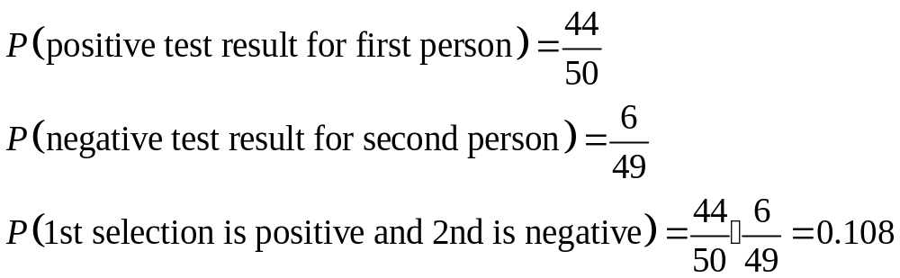
Example – continued
If 2 of the 50 subjects are randomly selected without replacement, find the probability that the first person tested positive and the second person tested negative.
Positive Test Results: | 44
Negative Test Results: | 6
Total Results: | 50
Notes:
Since independent events where the probability is the same for each event is much easier to compute (using exponential notation) than dependent events where each probability fraction will be different, the rule for small samples and large population is often used by pollsters.
Page 163 of Elementary Statistics, 10th Edition

Slide 15
Example
When two different people are randomly selected from those in your class, find the indicated probability by assuming birthdays occur on the same day of the week with equal frequencies.
Probability that two people are born on the same day of the week.
Probability that two people are both born on Monday.
Notes:
Since independent events where the probability is the same for each event is much easier to compute (using exponential notation) than dependent events where each probability fraction will be different, the rule for small samples and large population is often used by pollsters.
Page 163 of Elementary Statistics, 10th Edition

Slide 16
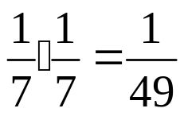
Example – continued
Probability that two people are born on the same day of the week.
Because no particular day is specified, the first person can be born on any day. The probability that the second person is born on the same day is 1/7, so the probability both are born on the same day is 1/7.
Probability that two people are both born on Monday.
The probability the first person is born on Monday is 1/7, and the same goes for the second person. The
probability they are both born on Monday is: .
Notes:
Since independent events where the probability is the same for each event is much easier to compute (using exponential notation) than dependent events where each probability fraction will be different, the rule for small samples and large population is often used by pollsters.
Page 163 of Elementary Statistics, 10th Edition

Slide 17
Tree Diagrams
A tree diagram is a picture of the possible outcomes of a procedure, shown as line segments emanating from one starting point. These diagrams are sometimes helpful in determining the number of possible outcomes in a sample space, if the number of possibilities is not too large.

Slide 18
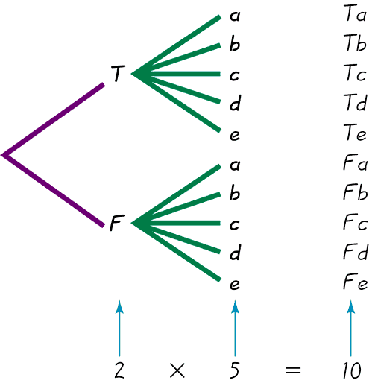
Tree Diagrams
This figure summarizes
the possible outcomes
for a true/false question followed
by a multiple choice question.
Note that there are 10 possible combinations.

Slide 19
Summary of Fundamentals
In the addition rule, the word “or” in P(A or B) suggests addition. Add P(A) and P(B), being careful to add in such a way that every outcome is counted only once.
In the multiplication rule, the word “and” in P(A and B) suggests multiplication. Multiply P(A) and P(B), but be sure that the probability of event B takes into account the previous occurrence of event A.

Slide 20
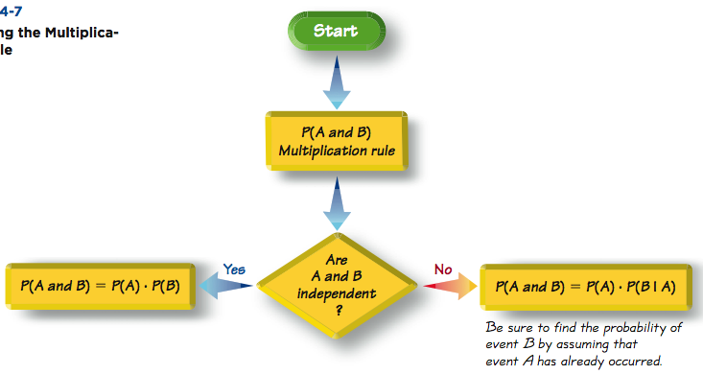
Applying the
Multiplication Rule

