Slide 1
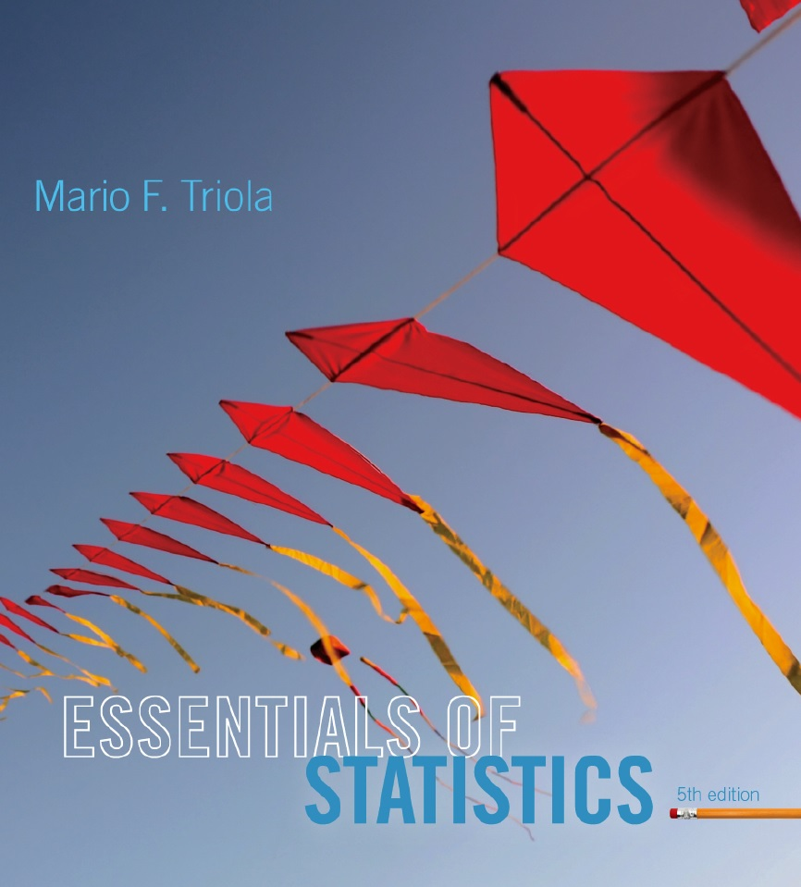
Lecture Slides
Essentials of Statistics
5th Edition
and the Triola Statistics Series
by Mario F. Triola

Slide 2
Chapter 4
Probability
4-1 Review and Preview
4-2 Basic Concepts of Probability
4-3 Addition Rule
4-4 Multiplication Rule: Basics
4-5 Multiplication Rule: Complements and Conditional Probability
4-6 Counting
4-7 Probabilities Through Simulations
4-8 Bayes’ Theorem

Slide 3
Key Concept
In many probability problems, the big obstacle is finding the total number of outcomes, and this section presents several methods for finding such numbers without directly listing and counting the possibilities.

Slide 4
Counterfeit Coin Problem
A king has 12 bags of gold coins.
Inside one bag of gold is a counterfeit coin.
Using only a balance which can tell which of two items is heavier or that they have the same weight how can you find the bag containing the counterfeit coin, without opening the bags?
Once you find the bag can you find the coin?
Notes:
Discuss article by Bilder – group testing

Slide 5

Notation
The factorial symbol ! denotes the product of decreasing positive whole numbers.
For example,
By special definition, 0! = 1.
Notes:
Demonstrate on calculator

Slide 6
Fundamental Counting Rule
For a sequence of two events in which the first event can occur m ways and the second event can occur n ways, the events together can occur a total of m⋅n ways.
Notes:
Example:
Byte is a sequence of 8 binary digits (bits). A bit is a 1 or 0. Therefore a byte may contain 2*2*2*2*2*2*2*2 combinations of digits or 2^256
See figure 4-7 page 163 (feathers / gold and quote )

Slide 7
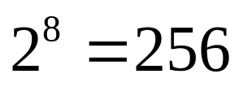
Example
A byte is a sequence of eight numbers, all either 0 or 1.
The number of possible bytes is .

Slide 8
Permutations versus Combinations
When different orderings of the same items are to be counted separately, we have a permutation problem.
When different orderings are not to be counted separately, we have a combination problem.
Notes:
Permutations: Order does count – passwords…….
Combinations: Order does not count -

Slide 9
Factorial Rule
Number of different permutations (order counts) of n different items can be arranged when all n of them are selected. (This factorial rule reflects the fact that the first item may be selected in n different ways, the second item may be selected in n – 1 ways, and so on.)
Notes:
Example: On a test you are asked to rank the following presidents of the US in chronological order:
Hayes
Taft
Polk
Taylor
Grant
Pierce
If you have no idea, how many different ways can they be arranged?
6! = 720
(Correct: 3, 4, 6, 5, 1, 2

Slide 10
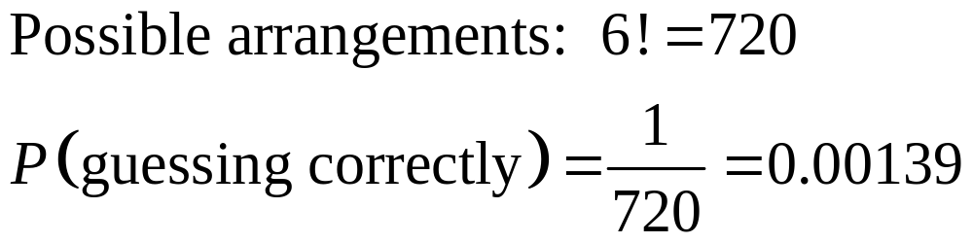
Example
A history pop quiz asks students to arrange the following presidents in chronological order: Hayes, Taft, Polk, Taylor, Grant, Pierce.
If an unprepared student totally guesses, what is the probability of guessing correctly?
Notes:
Example: On a test you are asked to rank the following presidents of the US in chronological order:
Hayes
Taft
Polk
Taylor
Grant
Pierce
If you have no idea, how many different ways can they be arranged?
6! = 720
(Correct: 3, 4, 6, 5, 1, 2

Slide 11
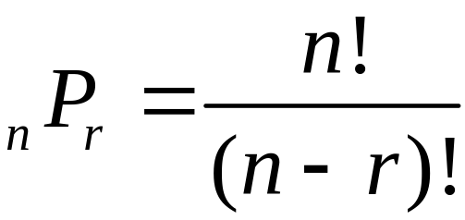
Permutations Rule
(when items are all different)
Requirements:
There are n different items available. (This rule does not apply if some of the items are identical to others.)
We select r of the n items (without replacement).
We consider rearrangements of the same items to be different sequences. (The permutation of ABC is different from CBA and is counted separately.)
If the preceding requirements are satisfied, the number of permutations (or sequences) of r items selected from n available items (without replacement) is
Notes:
Example: Horse race with 20 horses. Pick two for an exacta bet, what is the P(win).
𝑃(𝑤𝑖𝑛)=1/█(𝑝𝑜𝑠𝑠𝑖𝑏𝑙𝑒 𝑎𝑟𝑟𝑎𝑛𝑔𝑒𝑚𝑒𝑛𝑡𝑠@𝑃(𝑤𝑖𝑛)=1/(20 𝑃 2)@20 𝑃 2= 20!/(20−2)!=380@𝑃(𝑤𝑖𝑛)=□(64&1/380))

Slide 12
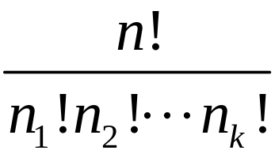
Permutations Rule
(when some items are identical to others)
Requirements:
There are n items available, and some items are identical to others.
We select all of the n items (without replacement).
We consider rearrangements of distinct items to be different sequences.
If the preceding requirements are satisfied, and if there are n₁ alike, n₂ alike, . . . n_{k} alike, the number of permutations (or sequences) of all items selected without replacement is
Notes:
Example in statistics:
Different surveys:
10 questions, 2 the same, and 3 others that are alike
10!/2!3!
Or the infamous bag of marbles 20 marbles, 10 red, 6 green, 4 blue
20!/10!6!4!

Slide 13
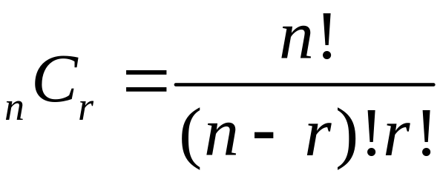
Combinations Rule
Requirements:
There are n different items available.
We select r of the n items (without replacement).
We consider rearrangements of the same items to be the same. (The combination of ABC is the same as CBA.)
If the preceding requirements are satisfied, the number of combinations of r items selected from n different items is
Notes:
FL Lottery 53 numbers choose 6 or 53C6 = 22957480
53!/(53−6)!6!

Slide 14
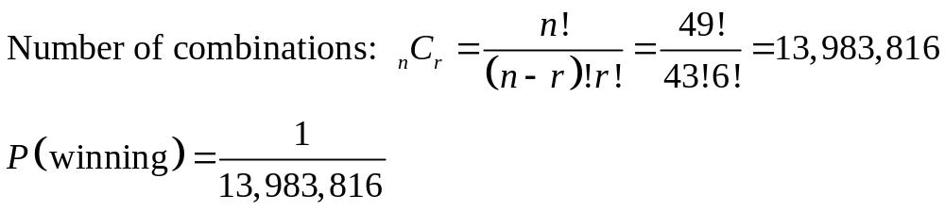
Example
In the Pennsylvania Match 6 Lotto, winning the jackpot requires you select six different numbers from 1 to 49. The winning numbers may be drawn in any order. Find the probability of winning if one ticket is purchased.
Notes:
FL Lottery 53 numbers choose 6 or 53C6 = 22957480
53!/(53−6)!6!

