Slide 1
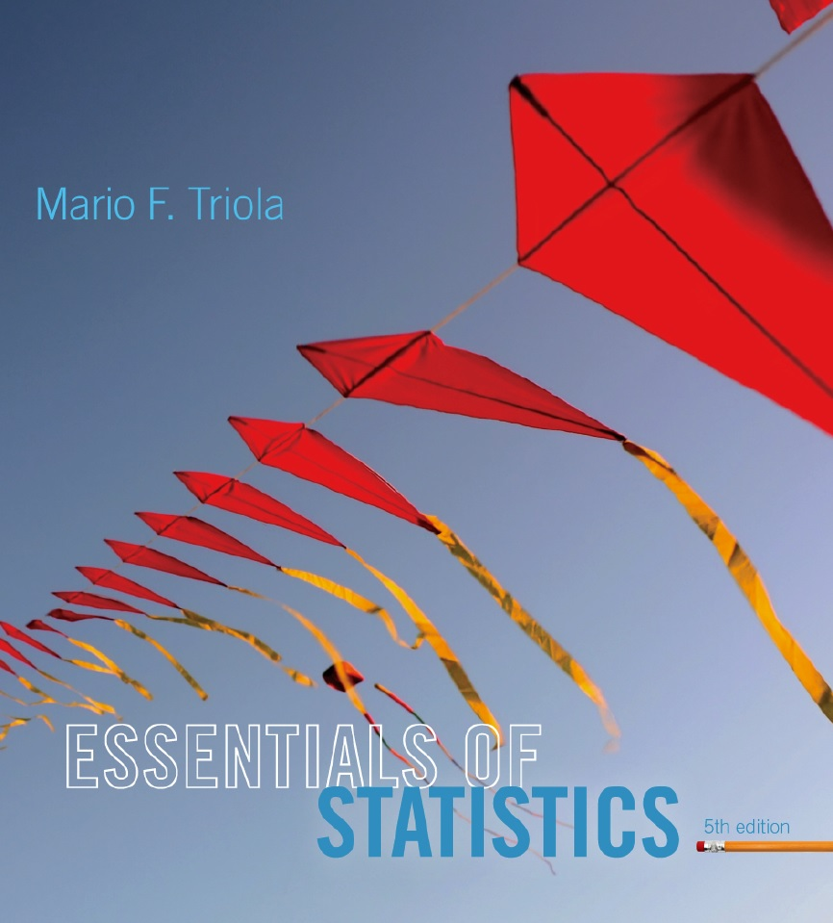
Lecture Slides
Essentials of Statistics
5th Edition
and the Triola Statistics Series
by Mario F. Triola

Slide 2
Chapter 4
Probability
4-1 Review and Preview
4-2 Basic Concepts of Probability
4-3 Addition Rule
4-4 Multiplication Rule: Basics
4-5 Multiplication Rule: Complements and Conditional Probability
4-6 Counting
4-7 Probabilities Through Simulations
4-8 Bayes’ Theorem

Slide 3
Key Concept
In this section we use simulations as an alternative approach to finding probabilities.
The advantage to using simulations is that we can overcome much of the difficulty encountered when using the formal rules discussed in the preceding sections.

Slide 4
Simulation
A simulation of a procedure is a process that behaves the same way as the procedure, so that similar results are produced.
Notes:
For students in a classroom with limited time, a simulation procedure is a convenient way to determine probabilities.
Page 174 of Elementary Statistics, 10th Edition

Slide 5
Simulation Example
Gender Selection In a test of the MicroSort method of gender selection developed by the Genetics & IVF Institute, 127 boys were born among 152 babies born to parents who used the YSORT method for trying to have a baby boy.
In order to properly evaluate these results, we need to know the probability of getting at least 127 boys among 152 births, assuming that boys and girls are equally likely.
Assuming that male and female births are equally likely, describe a simulation that results in the genders of 152 newborn babies.

Slide 6
Solution
One approach is simply to flip a fair coin 152 times, with heads representing females and tails representing males.
Another approach is to use a calculator or computer to randomly generate 152 numbers that are 0s and 1s, with 0 representing a male and 1 representing a female.
The numbers must be generated in such a way that they are equally likely.
Here are typical results:

Slide 7
Simulation Examples
Solution 1:
Flipping a fair coin 100 times where heads = female and tails = male
  H H T H T T H H H H
Generating 0’s and 1’s with a computer or calculator where 0 = male
  1 = female
  0 0 1 0 1 1 1 0 0 0
  female female male female male male male female female female
Solution 2:
  male male female male female female female male male male
Notes:
Page 174 of Elementary Statistics, 10th Edition

Slide 8
Random Numbers
In many experiments, random numbers are used in the simulation of naturally occurring events. Below are some ways to generate random numbers:
A table of random of digits
STATDISK
Minitab
Excel
TI-83/84 Plus calculator

Slide 9
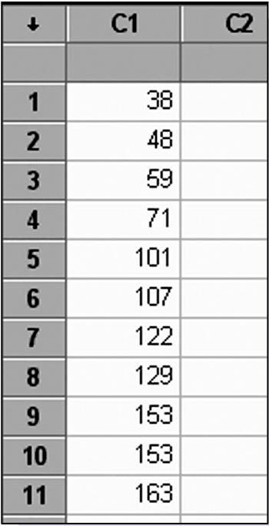
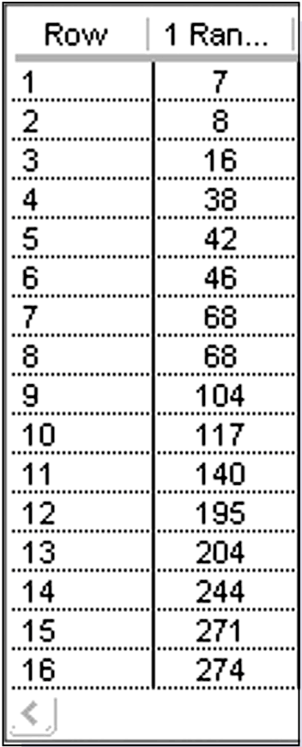
Random Numbers
STATDISK
Minitab

Slide 10
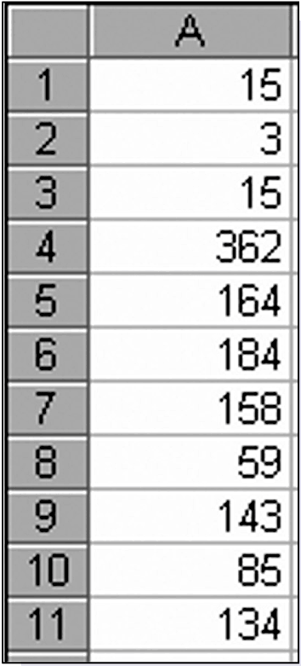
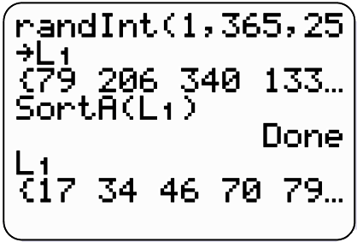
Random Numbers
Excel
TI-83/84 Plus calculator

