Slide 1
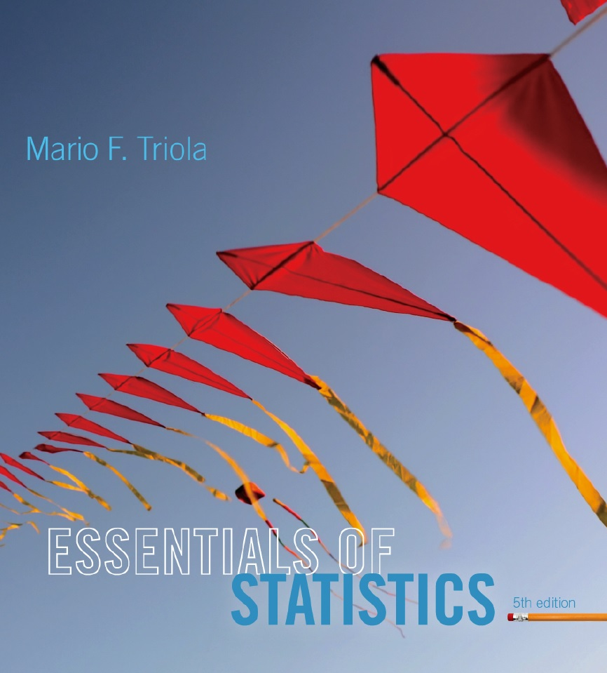
Lecture Slides
Essentials of Statistics
5th Edition
and the Triola Statistics Series
by Mario F. Triola

Slide 2
Chapter 4
Probability
4-1 Review and Preview
4-2 Basic Concepts of Probability
4-3 Addition Rule
4-4 Multiplication Rule: Basics
4-5 Multiplication Rule: Complements and Conditional Probability
4-6 Counting
4-7 Probabilities Through Simulations
4-8 Bayes’ Theorem

Slide 3
Definitions
A prior probability is an initial probability value originally obtained before any additional information is obtained.
A posterior probability is a probability value that has been revised using additional information that is later obtained.

Slide 4
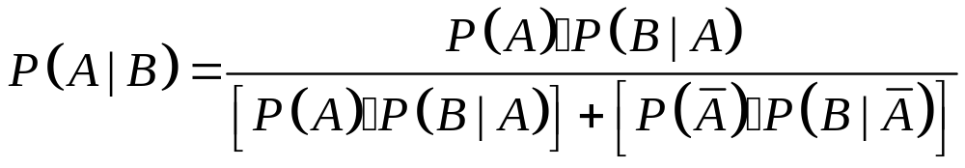
Bayes’ Theorem
The probability of event A, given that event B has subsequently occurred, is

Slide 5
Example
In Orange County, 51% are males and 49% are females.
One adult is selected at random for a survey involving credit card usage.
Find the prior probability that the selected person is male.
It is later learned the survey subject was smoking a cigar, and 9.5% of males smoke cigars (only 1.7% of females do). Now find the probability the selected subject is male.

Slide 6
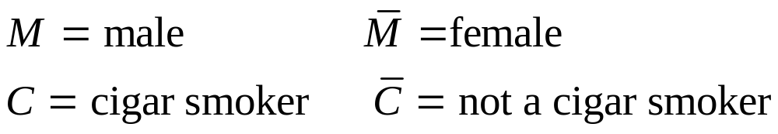
Example – continued
Notation:
a. Before the extra information obtained in part (b), we know 51% of the adults are male, so P(M) = 0.51.

Slide 7
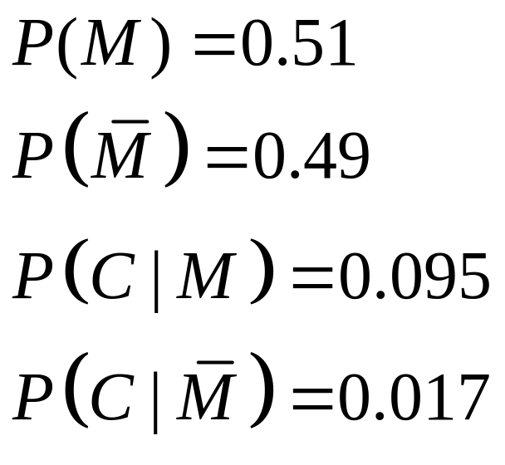
Example – continued
Based on the additional information:
We can now apply Bayes’ Theorem:

Slide 8
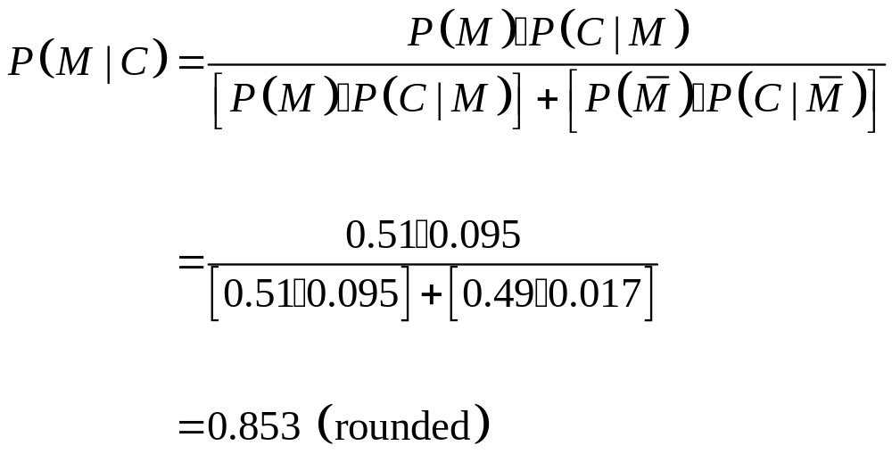
Example – continued

Slide 9
Bayes’ Theorem Generalized
The preceding formula used exactly two categories for event A, but the formula can be extended to include more than two categories.
We must be sure the multiple events satisfy two important conditions:
The events must be disjoint (with no overlapping).
The events must be exhaustive, which means they combine to include all possibilities.

