Slide 1
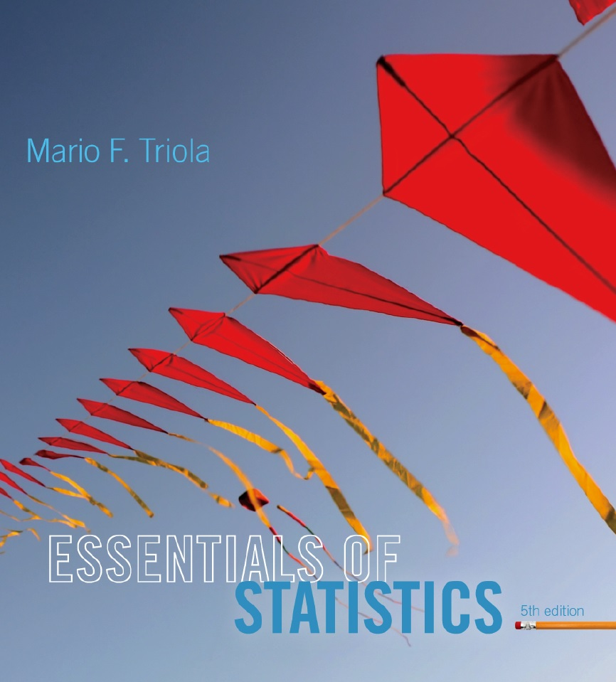
Lecture Slides
Essentials of Statistics
5th Edition
and the Triola Statistics Series
by Mario F. Triola

Slide 2
Chapter 5
Probability Distributions
5-1 Review and Preview
5-2 Probability Distributions
5-3 Binomial Probability Distributions
5-4 Parameters for Binomial Distributions

Slide 3
Review and Preview
This chapter combines the methods of descriptive statistics presented in Chapter 2 and 3 and those of probability presented in Chapter 4 to describe and analyze probability distributions.
Probability distributions describe what will probably happen instead of what actually did happen, and they are often given in the format of a graph, table, or formula.
Notes:
Emphasize the combination of the methods in Chapter 3 (descriptive statistics) with the methods in Chapter 4 (probability).
Chapter 3 one would conduct an actual experiment and find and observe the mean, standard deviation, variance, etc. and construct a frequency table or histogram
Chapter 4 finds the probability of each possible outcome
Chapter 5 presents the possible outcomes along with the relative frequencies we expect
Page 200 of Elementary Statistics, 10th Edition

Slide 4
Preview
In order to fully understand probability distributions, we must first understand the concept of a random variable, and be able to distinguish between discrete and continuous random variables. In this chapter we focus on discrete probability distributions. In particular, we discuss binomial and Poisson probability distributions.
Notes:
Emphasize the combination of the methods in Chapter 3 (descriptive statistics) with the methods in Chapter 4 (probability).
Chapter 3 one would conduct an actual experiment and find and observe the mean, standard deviation, variance, etc. and construct a frequency table or histogram
Chapter 4 finds the probability of each possible outcome
Chapter 5 presents the possible outcomes along with the relative frequencies we expect
Page 200 of Elementary Statistics, 10th Edition

Slide 5
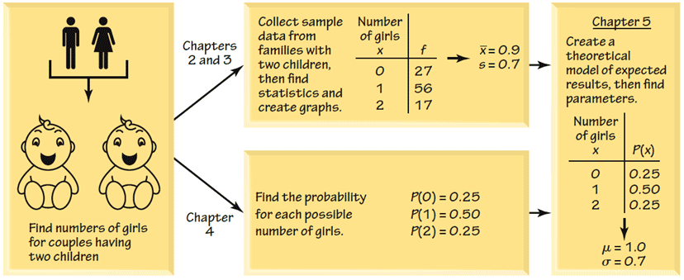
Combining Descriptive Methods
and Probabilities
In this chapter we will construct probability distributions by presenting possible outcomes along with the relative frequencies we expect.
Notes:
page 200 of Elementary Statistics, 10th Edition

