Slide 1
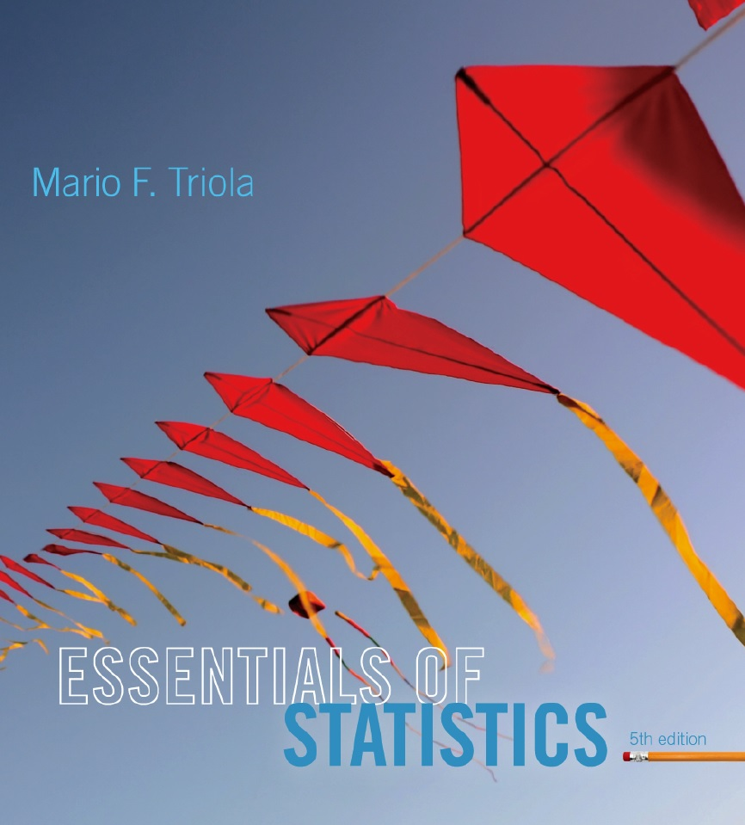
Lecture Slides
Essentials of Statistics
5th Edition
and the Triola Statistics Series
by Mario F. Triola

Slide 2
Chapter 5
Probability Distributions
5-1 Review and Preview
5-2 Probability Distributions
5-3 Binomial Probability Distributions
5-4 Parameters for Binomial Distributions

Slide 3
X | f
0 | 20
1 | 2
2 | 3
3 | 2
4 | 4
5 | 18
6 | 5
7 | 4
8 | 6
9 | 6
X | f
0 | 7
1 | 6
2 | 6
3 | 7
4 | 8
5 | 6
6 | 7
7 | 9
8 | 8
9 | 6
Notes:
Both samples are the last digits of recorded weights of people.
One sample is from measured weights and the other was obtained by asking people what they weigh (“how fat are you?”)
Which sample is from the measured, why. NOTE: It is ok to make conclusions based upon the distribution of the data.
What would the distribution for te entire state of Florida look like? What would be the population mean μ(4.5) and standard deviation σ (3).

Slide 4
Key Concept
This section introduces the important concept of a probability distribution, which gives the probability for each value of a variable that is determined by chance.
Give consideration to distinguishing between outcomes that are likely to occur by chance and outcomes that are “unusual” in the sense they are not likely to occur by chance.

Slide 5
Random Variable
Probability Distribution
Random Variable
a variable (typically represented by x) that has a single numerical value, determined by chance, for each outcome of a procedure
Probability Distribution
a description that gives the probability for each value of the random variable, often expressed in the format of a graph, table, or formula

Slide 6
Discrete and Continuous Random Variables
Discrete Random Variable
either a finite number of values or countable number of values, where “countable” refers to the fact that there might be infinitely many values, but that they result from a counting process
Continuous Random Variable
has infinitely many values, and those values can be associated with measurements on a continuous scale without gaps or interruptions.
Notes:
This chapter deals exclusively with discrete random variables - experiments where the data observed is a ‘countable’ value. Give examples.
Discrete values are countable:
Marbles in jar
Atoms in a molecule
Number of heads (integer values between 0 and + infinity but not 1.3)
Continuous are in a range:
Weights between 150-250
Following chapters will deal with continuous random variables.
Page 201 of Elementary Statistics, 10th Edition

Slide 7
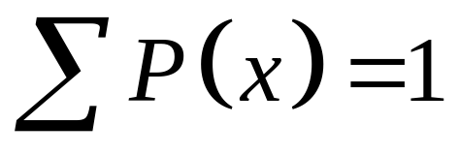
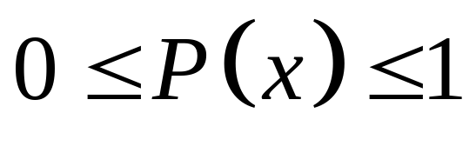
Probability Distribution: Requirements
There is a numerical random variable x and its values are associated with corresponding probabilities.
The sum of all probabilities must be 1.
Each probability value must be between 0 and 1 inclusive.
Notes:
This chapter deals exclusively with discrete random variables - experiments where the data observed is a ‘countable’ value. Give examples.
Following chapters will deal with continuous random variables.
Page 201 of Elementary Statistics, 10th Edition

Slide 8
Is This a Probability Distribution?
In a Pew Center Poll, subjects were asked if the use of marijuana should be made legal, and the results of that poll are as follows:
Response | P(x)
Yes | 0.41
No | 0.52
Don’t know | 0.27
Notes:
1) The response is not numerical so it fails the first test
2) The sum of the probabilities is 1
3) each probability is on the interval [0,1]

Slide 9
Is this a probability distribution?
Senior executives were asked when job applicants should discuss salary. Here are their responses (Accountemps survey)
Numb er of interviews | P(x)
1 | 0.30
2 | 0.26
3 | 0.10

Slide 10
Does P(x) describe a probability distribution?
P(x) = x/3 ; x = {0, 1, 2}

Slide 11
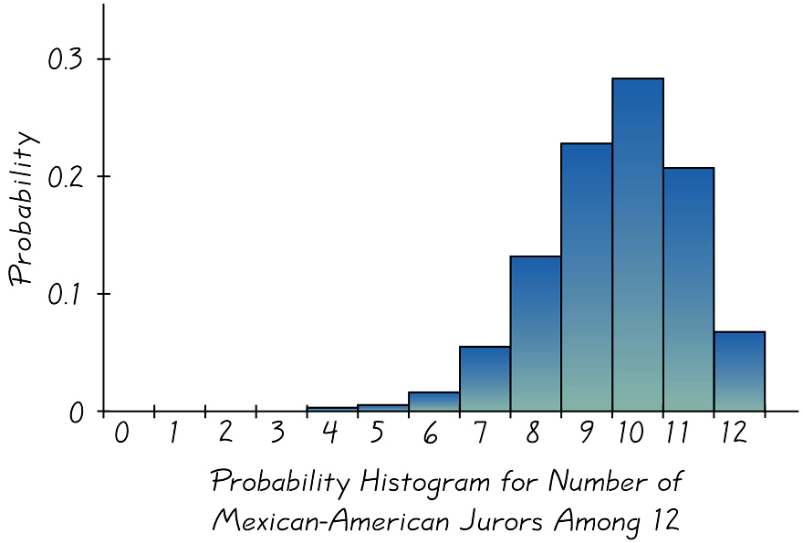
Graphs
The probability histogram is very similar to a relative frequency histogram, but the vertical scale shows probabilities.
Notes:
page 202 of Elementary Statistics, 10th Edition
Probability Histograms relate nicely to Relative Frequency Histograms of Chapter 2, but the vertical scale shows probabilities instead of relative frequencies based on actual sample results
Observe that the probabilities of each random variable is also the same as the AREA of the rectangle representing the random variable. This fact will be important when we need to find probabilities of continuous random variables - Chapter 6.

Slide 12
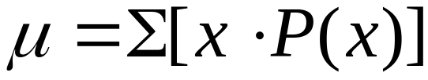
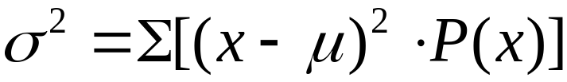
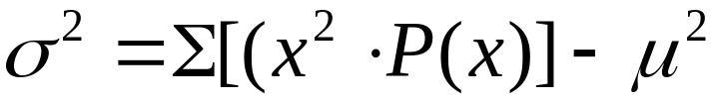
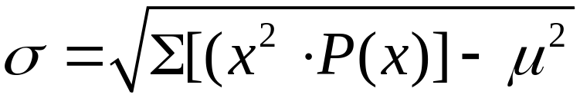
Mean, Variance and
Standard Deviation of a
Probability Distribution
Mean
Variance
 Variance (shortcut)
 Standard Deviation
Notes:
In Chapter 3, we found the mean, standard deviation,variance, and shape of the distribution for actual observed experiments.
The probability distribution and histogram can provide the same type information.
These formulas will apply to ANY type of probability distribution as long as you have have all the P(x) values for the random variables in the distribution.
In section 4 of this chapter, there will be special EASIER formulas for the special binomial distribution.
The TI-83 and TI-83 Plus calculators can find the mean, standard deviation, and variance in the same way that one finds those values for a frequency table.
With the TI-82, TI-81, and TI-85 calculators, one would have to multiply all decimal values in the P(x) column by the same factor so that there were no decimals and proceed as usual.
Page 204 of Elementary Statistics, 10th Edition

Slide 13
Round-off Rule for µ, σ, and σ² from a Probability Distribution
Round results at the END of the calculations, rounding in the middle can/will introduce errors.
Round results by carrying one more decimal place than the number used for the random variable x.
If the values of x are integers then round µ, σ, and σ² to one decimal place.

Slide 14
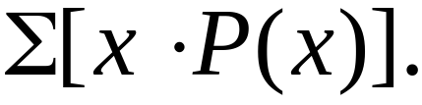
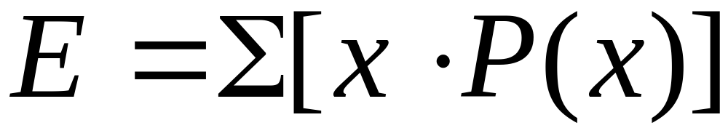
Expected Value
The expected value of a discrete random variable is denoted by E, and it represents the mean value of the outcomes. It is obtained by finding the value of
Notes:
Also called expectation or mathematical expectation
Plays a very important role in decision theory
page 208 of Elementary Statistics, 10th Edition
The expected value need not be a whole number even if your different values were whole numbers. E.g. the expected number of girls in 5 births is 2.5 even though it is impossible to get 2.5 births out of 5. if we survey we might expect the mean to be 2.5 out of 5.

Slide 15
Example
The following table describes the probability distribution for the number of girls in two births.
Find the mean, variance, and standard deviation.
x | P(x)
0 | 0.25
1 | 0.50
2 | 0.25
Total
Notes:
Also called expectation or mathematical expectation
Plays a very important role in decision theory
page 208 of Elementary Statistics, 10th Edition

Slide 16
Example
The following table describes the probability distribution for the number of girls in two births.
Find the mean, variance, and standard deviation.
x | P(x) | x·P(x) | (x-μ)²·P(x)
0 | 0.25 | 0.00 | 0.25
1 | 0.50 | 0.50 | 0.00
2 | 0.25 | 0.50 | 0.25
Total |  | 1.00 | 0.50
Notes:
Also called expectation or mathematical expectation
Plays a very important role in decision theory
page 208 of Elementary Statistics, 10th Edition
Explanation of table: The mean number of girls in two births is 1 girl. The variance 0.5 “girl squared”. Standard deviation is 0.7 girl. The expected number of girls in two births is one girl.

Slide 17
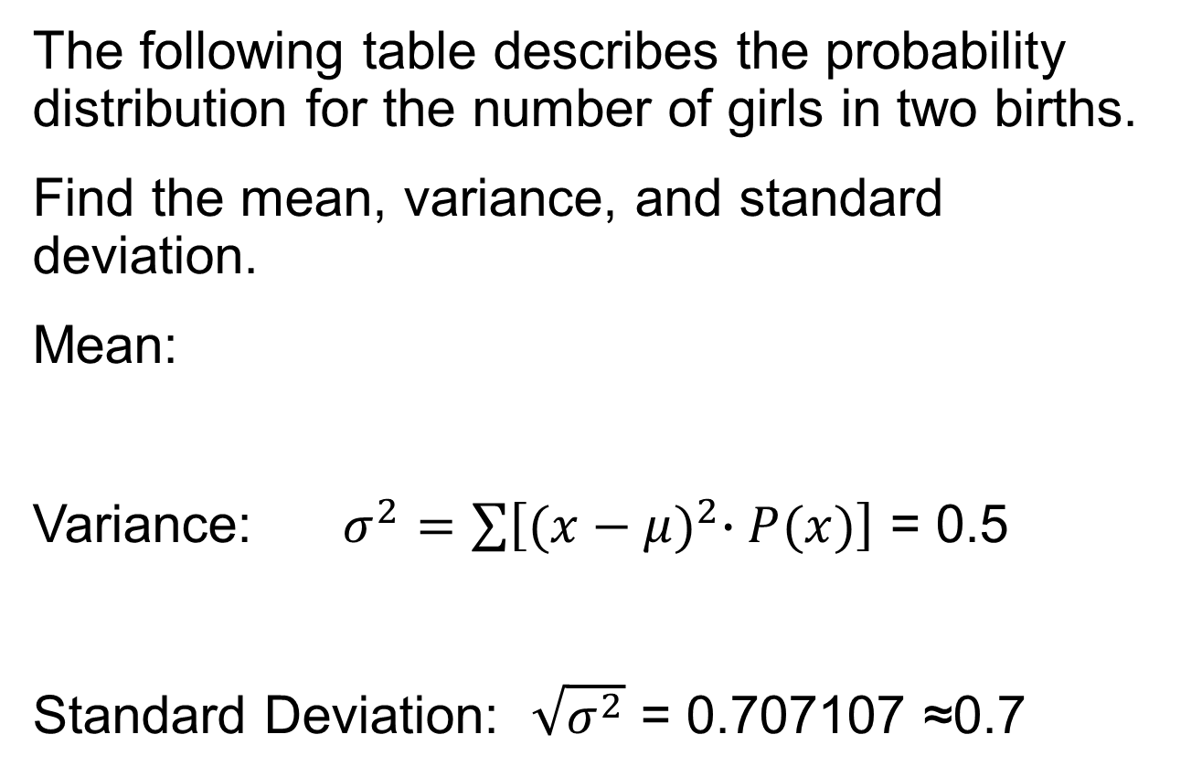
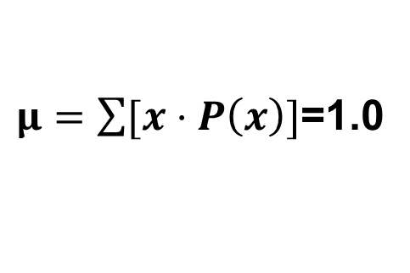
Example
Notes:
Also called expectation or mathematical expectation
Plays a very important role in decision theory
page 208 of Elementary Statistics, 10th Edition

Slide 18


Identifying Unusual Results
Range Rule of Thumb
According to the range rule of thumb, most values should lie within 2 standard deviations of the mean.
We can therefore identify “unusual” values by determining if they lie outside these limits:
Maximum usual value =
Minimum usual value =
Notes:
Page 205-206 of Elementary Statistics, 10th Edition

Slide 19
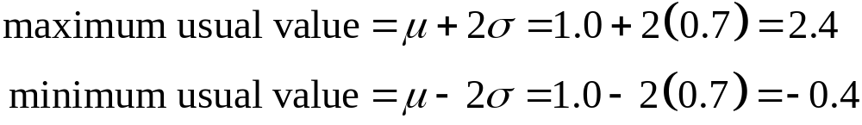
Example – continued
We found for families with two children, the mean number of girls is 1.0 and the standard deviation is 0.7 girls.
Use those values to find the maximum and minimum usual values for the number of girls.
Notes:
Page 205-206 of Elementary Statistics, 10th Edition

Slide 20
Identifying Unusual Results
Probabilities
Rare Event Rule for Inferential Statistics
If, under a given assumption (such as the assumption that a coin is fair), the probability of a particular observed event (such as 992 heads in 1000 tosses of a coin) is extremely small, we conclude that the assumption is probably not correct.
Notes:
The discussion of this topic in the text includes some difficult concepts, but it also includes an extremely important approach used often in statistics.
Page 207-208 of Elementary Statistics, 10th Edition

Slide 21


Identifying Unusual Results
Probabilities
Using Probabilities to Determine When Results Are Unusual
Unusually high: x successes among n trials is an unusually high number of successes if .
Unusually low: x successes among n trials is an unusually low number of successes if .
Notes:
The discussion of this topic in the text includes some difficult concepts, but it also includes an extremely important approach used often in statistics.
Page 207-208 of Elementary Statistics, 10th Edition
Reminder the purpose of this exercise is not to find a number, but to interpret the numbers we have.
Example: SAT question. 5 possible answers, if the question is so difficult that everyone has to guess, how many correct can we expect (200). In this case P(205) = 0.0289, is 205 correct an unlikely outcome? (yes) is it unusually high (NO P(205 or more) = 0.358)

Slide 22
Expected Value in Decision Theory
You get to bet $5 in the Golden Nugget casino in Las Vegas. You have two choices:
Roulette: bet on 7
Craps: bet on the “pass” line.
Which bet is better?
Roulette | X | P(x) | x·P(x)
Lose | -$5 | 37/38 | -$4.8684
Win(net) | $175 | 1/38 | $4.6053
Total |  |  | ≈-$0.26
Craps | X | P(x) | x·P(x)
Lose | -$5 | 251/495 | -$2.5354
Win(net) | $5 | 244/495 | $2.4646
Total |  |  | ≈-$0.07

