Slide 1
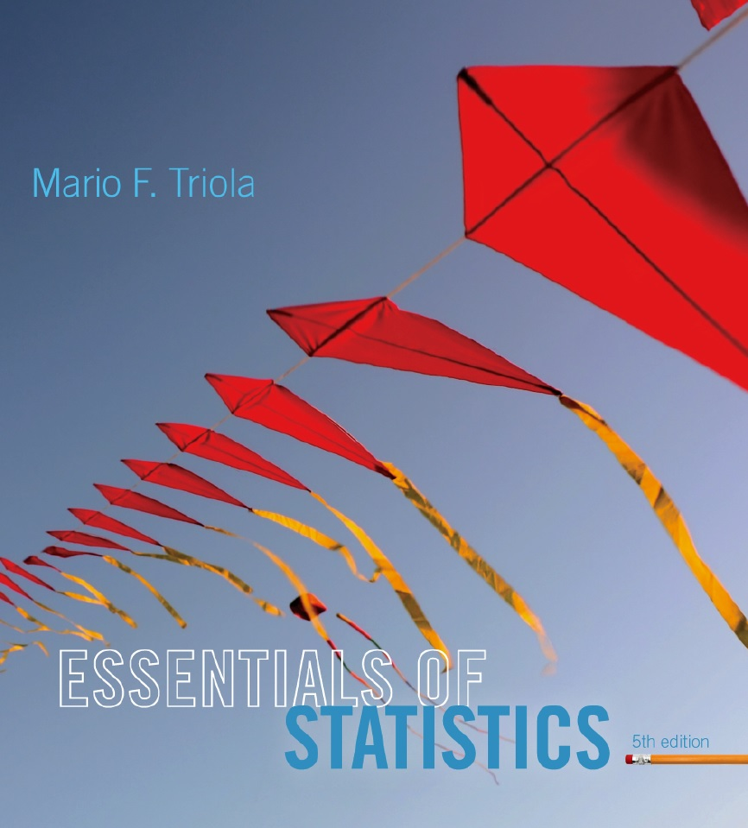
Lecture Slides
Essentials of Statistics
5th Edition
and the Triola Statistics Series
by Mario F. Triola

Slide 2
Chapter 5
Probability Distributions
5-1 Review and Preview
5-2 Probability Distributions
5-3 Binomial Probability Distributions
5-4 Parameters for Binomial Distributions

Slide 3
Key Concept
This section presents a basic definition of a binomial distribution along with notation and methods for finding probability values.
Binomial probability distributions allow us to deal with circumstances in which the outcomes belong to two relevant categories such as acceptable/defective or survived/died.

Slide 4
Binomial Probability Distribution
A binomial probability distribution results from a procedure that meets all the following requirements:
1. The procedure has a fixed number of trials.
2. The trials must be independent. (The outcome of any individual trial doesn’t affect the probabilities in the other trials.)
3. Each trial must have all outcomes classified into two categories (commonly referred to as success and failure).
4. The probability of a success remains the same in all trials.
Notes:
Binomial probability distributions are important because they allow us to deal with circumstances in which the outcomes belong to TWO categories, such as pass/fall, acceptable/defective, etc.
page 214 of Elementary Statistics, 10th Edition

Slide 5
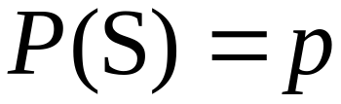
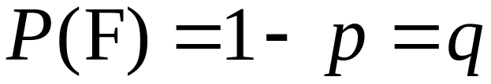
Notation for Binomial
Probability Distributions
S and F (success and failure) denote the two possible categories of all outcomes; p and q will denote the probabilities of S and F, respectively, so
(p = probability of success)
(q = probability of failure)
Notes:
The word success is arbitrary and does not necessarily represent something GOOD. If you are trying to find the probability of deaths from hang-gliding, the ‘success’ probability is that of dying from hang-gliding.
Remind students to carefully look at the probability (percentage or rate) provided and whether it matches the probability desired in the question. It might be necessary to determine the complement of the given probability to establish the ‘p’ value of the problem.
Page 214 of Elementary Statistics, 10th Edition.

Slide 6
Notation (continued)
n denotes the fixed number of trials.
x denotes a specific number of successes in n trials, so x can be any whole number between 0 and n, inclusive.
p denotes the probability of success in one of the n trials.
q denotes the probability of failure in one of the n trials.
P(x) denotes the probability of getting exactly x successes among the n trials.
Notes:
Page 214 of Elementary Statistics, 10th Edition.

Slide 7

Caution
Be sure that x and p both refer to the same category being called a success.
When sampling without replacement, consider events to be independent if .
Notes:
Page 214-215 of Elementary Statistics, 10th Edition.

Slide 8
Example
When an adult is randomly selected, there is a 0.85 probability that this person knows what Twitter is.
Suppose we want to find the probability that exactly three of five randomly selected adults know of Twitter.
Does this procedure result in a binomial distribution?
  Yes. There are five trials which are independent. Each trial has two outcomes and there is a constant probability of 0.85 that an adult knows of Twitter.
Notes:
Page 214-215 of Elementary Statistics, 10th Edition.

Slide 9
Methods for Finding
Probabilities
We will now discuss three methods for finding the probabilities corresponding to the random variable x in a binomial distribution.
Notes:
Page 216 of Elementary Statistics, 10th Edition.

Slide 10
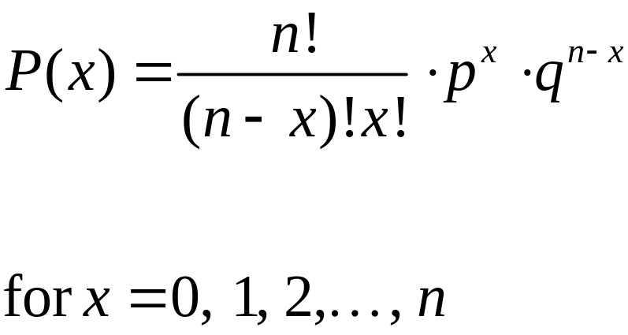
Method 1: Using the Binomial
Probability Formula
where
n = number of trials
x = number of successes among n trials
p = probability of success in any one trial
q = probability of failure in any one trial (q = 1 – p)
Notes:
page 216 of Elementary Statistics, 10th Edition

Slide 11
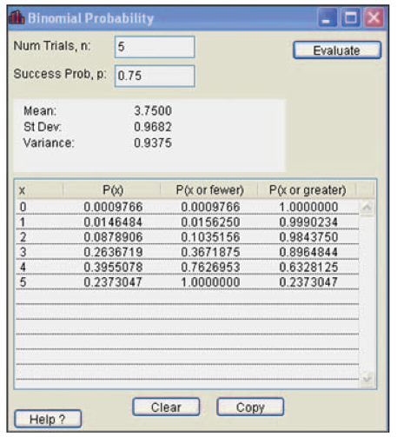
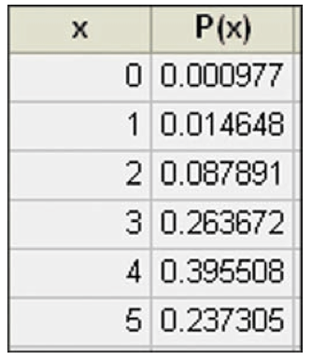
Method 2: Using Technology
STATDISK, Minitab, Excel, SPSS, SAS and the TI-83/84 Plus calculator can be used to find binomial probabilities.
STATDISK
MINITAB
Notes:
Page 218 of Elementary Statistics, 10th Edition.

Slide 12
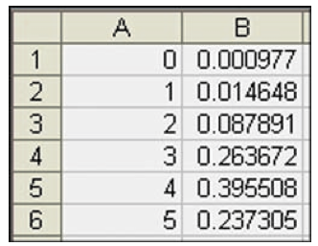
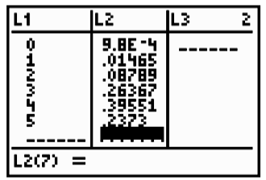
Method 2: Using Technology
STATDISK, Minitab, Excel and the TI-83 Plus calculator can all be used to find binomial probabilities.
EXCEL
TI-83 PLUS Calculator
Notes:
Page 218 of Elementary Statistics, 10th Edition.

Slide 13
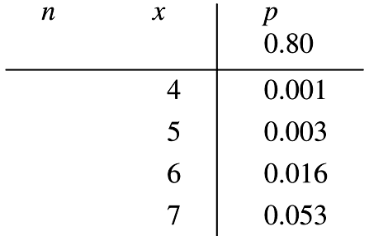
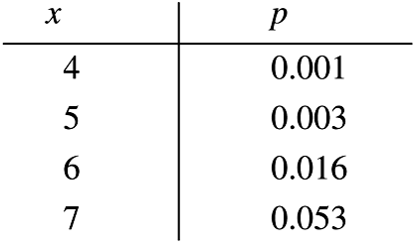
Method 3: Using
Table A-1 in Appendix A
Part of Table A-1 is shown below. With n = 12 and p = 0.80 in the binomial distribution, the probabilities of 4, 5, 6, and 7 successes are 0.001, 0.003, 0.016, and 0.053 respectively.
Notes:
Page 217 of Elementary Statistics, 10th Edition.

Slide 14
Strategy for Finding Binomial Probabilities
Use computer software or a TI-83/84 Plus calculator, if available.
If neither software nor the TI-83/84 Plus calculator is available, use Table A-1, if possible.
If neither software nor the TI-83/84 Plus calculator is available and the probabilities can’t be found using Table A-1, use the binomial probability formula.
Notes:
Page 219 of Elementary Statistics, 10th Edition

Slide 15
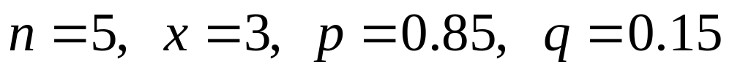
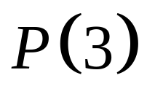
Example
Given there is a 0.85 probability that any given adult knows of Twitter, use the binomial probability formula to find the probability of getting exactly three adults who know of Twitter when five adults are randomly selected.
We have:
We want:
Notes:
Page 216 of Elementary Statistics, 10th Edition.

Slide 16
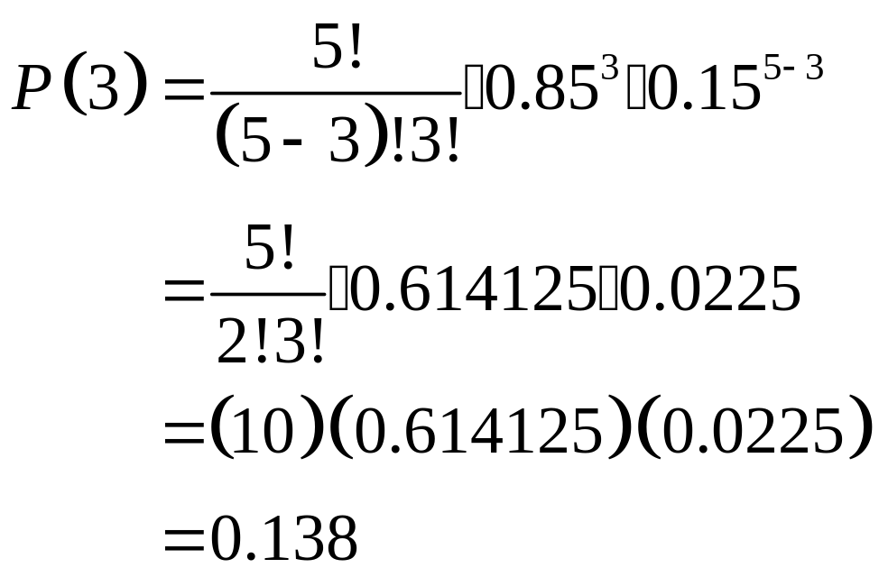
Example
We have:
Notes:
Page 216 of Elementary Statistics, 10th Edition.

Slide 17
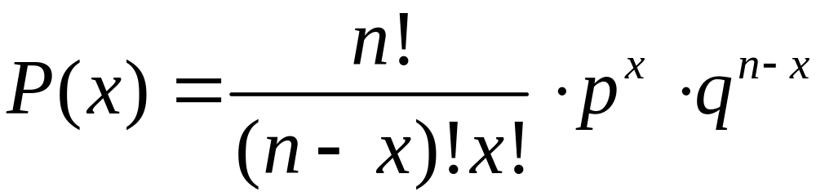
Rationale for the Binomial Probability Formula
The number of
outcomes with exactly x successes among n trials
Notes:
The ‘counting’ factor of the formula counts the number of ways the x successes and (n-x) failures can be arranged - i.e.. the number of arrangements (Review section 4-7, page 181).
Discussion is on page 219 of Elementary Statistics, 10th Edition.

Slide 18
Rationale for the Binomial Probability Formula
Number of
outcomes with exactly x successes among n trials
The probability of x successes among n trials for any one particular order
Notes:
The remaining two factors of the formula will compute the probability of any one arrangement of successes and failures. This probability will be the same no matter what the arrangement is.
The three factors multiplied together give the correct probability of ‘x’ successes.

