Slide 1
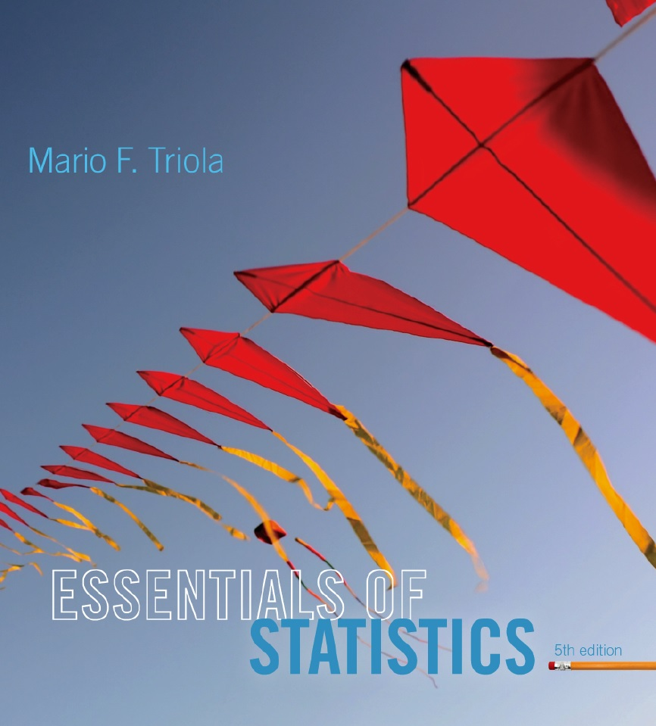
Lecture Slides
Essentials of Statistics
5th Edition
and the Triola Statistics Series
by Mario F. Triola

Slide 2
Chapter 5
Probability Distributions
5-1 Review and Preview
5-2 Probability Distributions
5-3 Binomial Probability Distributions
5-4 Parameters for Binomial Distributions

Slide 3
Key Concept
In this section we consider important characteristics of a binomial distribution including center, variation and distribution. That is, given a particular binomial probability distribution we can find its mean, variance and standard deviation.
A strong emphasis is placed on interpreting and understanding those values.

Slide 4

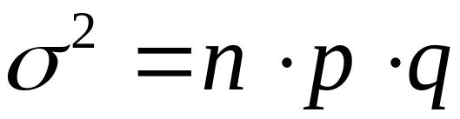
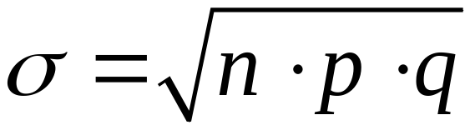
Binomial Distribution: Formulas
Mean
Variance
Std. Dev.
Where
n = number of fixed trials
p = probability of success in one of the n trials
q = probability of failure in one of the n trials
Notes:
The obvious advantage to the formulas for the mean, standard deviation, and variance of a binomial distribution is that you do not need the values in the distribution table. You need only the n, p, and q values.
A common error students tend to make is to forget to take the square root of (n)(p)(q) to find the standard deviation, especially if they used L1 and L2 lists in a graphical calculator to find the standard deviation with non-binomial distributions. The square root is built into the programming of the calculator and students do not have to remember it. These formulas do require the student to remember to take the square root of the three factors.
Page 225 of Elementary Statistics, 10th Edition

Slide 5


Interpretation of Results
It is especially important to interpret results. The range rule of thumb suggests that values are unusual if they lie outside of these limits:
maximum usual value =
minimum usual value =
Notes:
Page 225 of Elementary Statistics, 10th Edition.

Slide 6
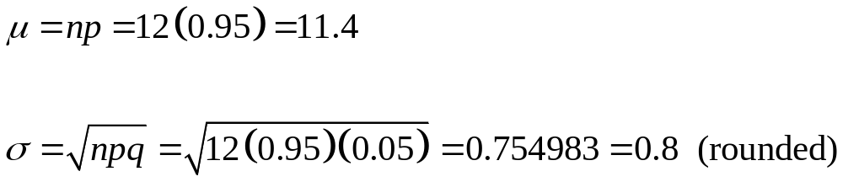
Example
McDonald’s has a 95% recognition rate. A special focus group consists of 12 randomly selected adults.
For such a group, find the mean and standard deviation.
Notes:
Page 225 of Elementary Statistics, 10th Edition.

Slide 7
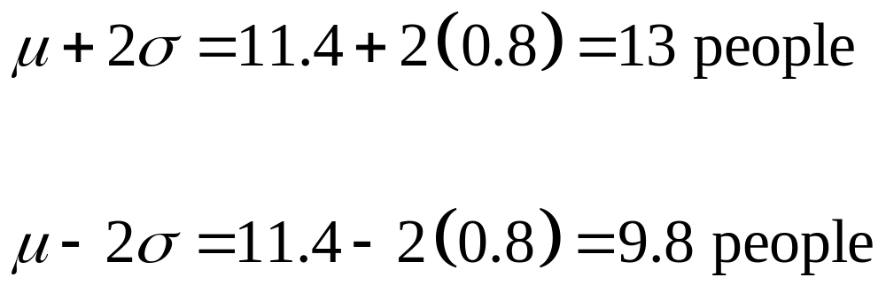
Example - continued
Use the range rule of thumb to find the minimum and maximum usual number of people who would recognize McDonald’s.
If a particular group of 12 people had all 12 recognize the brand name of McDonald’s, that would not be unusual.
Notes:
Page 225 of Elementary Statistics, 10th Edition.

