Slide 1

Lecture Slides
Essentials of Statistics
5th Edition
and the Triola Statistics Series
by Mario F. Triola

Slide 2
Chapter 6
Normal Probability Distributions
6-1 Review and Preview
6-2 The Standard Normal Distribution
6-3 Applications of Normal Distributions
6-4 Sampling Distributions and Estimators
6-5 The Central Limit Theorem
6-6 Assessing Normality
6-7 Normal as Approximation to Binomial

Slide 3
Key Concept
The Central Limit Theorem tells us that for a population with any distribution, the distribution of the sample means approaches a normal distribution as the sample size increases.
The procedure in this section forms the foundation for estimating population parameters and hypothesis testing.

Slide 6
Central Limit Theorem
Given:
1. The random variable x has a distribution (which may or may not be normal) with mean μ and standard deviation σ.
2. Simple random samples all of size n are selected from the population. (The samples are selected so that all possible samples of the same size n have the same chance of being selected.)

Slide 7



Central Limit Theorem – cont.
Conclusions:
1. The distribution of sample will, as the sample size increases, approach a normal distribution.
2. The mean of the sample means is the population mean .
3. The standard deviation of all sample means
is .

Slide 8
Practical Rules Commonly Used
1. For samples of size n larger than 30, the distribution of the sample means can be approximated reasonably well by a normal distribution. The approximation becomes closer to a normal distribution as the sample size n becomes larger.
2. If the original population is normally distributed, then for any sample size n, the sample means will be normally distributed (not just the values of n larger than 30).

Slide 9
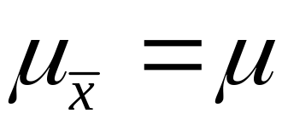
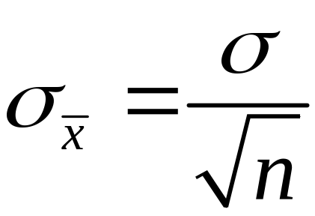
Notation
The mean of the sample means
The standard deviation of sample mean
(often called the standard error of the mean)

Slide 10
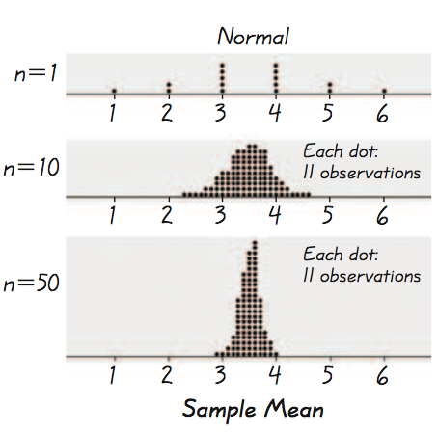
Example - Normal Distribution
As we proceed from n = 1 to n = 50, we see that the distribution of sample means is approaching the shape of a normal distribution.

Slide 11
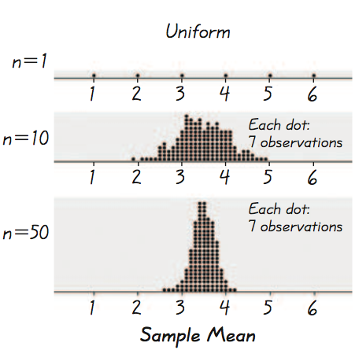
Example - Uniform Distribution
As we proceed from n = 1 to n = 50, we see that the distribution of sample means is approaching the shape of a normal distribution.

Slide 12
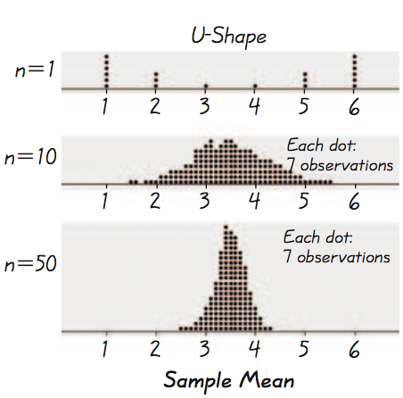
Example - U-Shaped Distribution
As we proceed from n = 1 to n = 50, we see that the distribution of sample means is approaching the shape of a normal distribution.

Slide 13
Important Point
As the sample size increases, the sampling distribution of sample means approaches a normal distribution.
Notes:
Result of example on p 282 of Elementary Statistics, 10th Edition

Slide 14


Slide 15
Weights of Adults
 | Males | Females
μ | 182.9lb | 165.0lb
σ | 40.8 | 45.6
Distrbution | Normal | Normal

Slide 16
Example – Elevators
Suppose an elevator has a maximum capacity of 16 passengers with a total weight of 2500 lb.
Assuming a worst case scenario in which the passengers are all male, what are the chances the elevator is overloaded?
Assume male weights follow a normal distribution with a mean of 182.9 lb and a standard deviation of 40.8 lb.
a. Find the probability that 1 randomly selected male has a weight greater than 156.25 lb.
b. Find the probability that a sample of 16 males have a mean weight greater than 156.25 lb (which puts the total weight at 2500 lb, exceeding the maximum capacity).

Slide 17
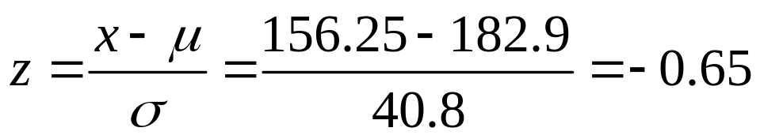
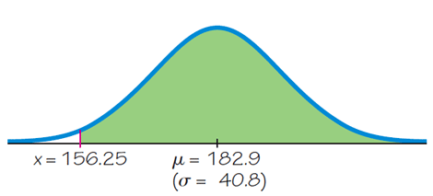
Example – Elevators
a. Find the probability that 1 randomly selected male has a weight greater than 156.25 lb.
Use the methods presented in Section 6.3. We can convert to a z score and use Table A-2.
Using Table A-2, the area to the right is 0.7422.

Slide 18
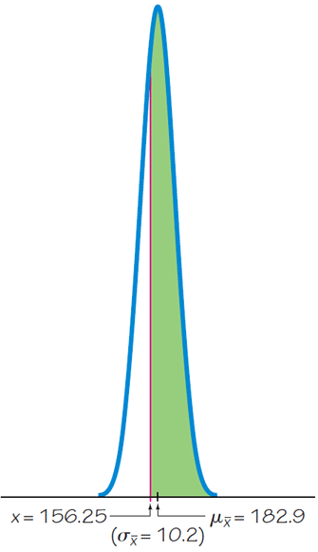
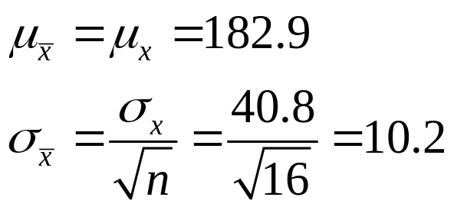
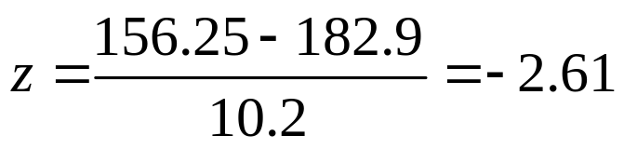
Example – Elevators
b. Find the probability that a sample of 16 males have a mean weight greater than 156.25 lb.
Since the distribution of male weights is assumed to be normal, the sample mean will also be normal.
Converting to z:

Slide 19
Example – Elevators
b. Find the probability that a sample of 16 males have a mean weight greater than 156.25 lb.
While there is 0.7432 probability that any given male will weigh more than 156.25 lb, there is a 0.9955 probability that the sample of 16 males will have a mean weight of 156.25 lb or greater.
If the elevator is filled to capacity with all males, there is a very good chance the safe weight capacity of 2500 lb. will be exceeded.

Slide 20
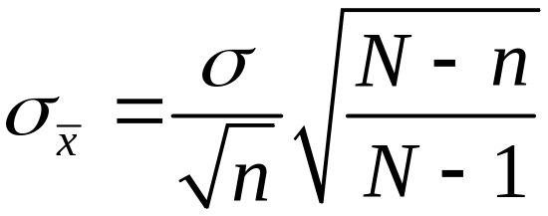
Correction for a Finite Population
When sampling without replacement and the sample size n is greater than 5% of the finite population of size N (that is, n > 0.05N), adjust the standard deviation of sample means by multiplying it by the finite population correction factor:
finite population
correction factor

