Slide 1
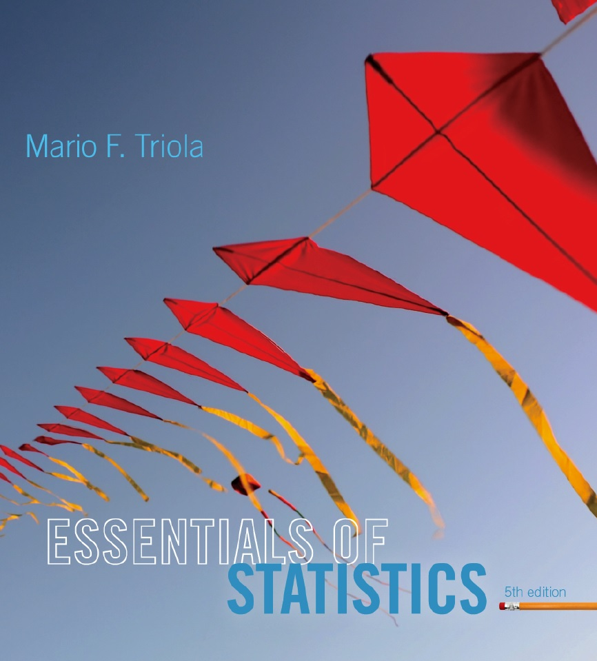
Lecture Slides
Essentials of Statistics
5th Edition
and the Triola Statistics Series
by Mario F. Triola

Slide 2
Chapter 7
Estimates and Sample Sizes
7-1 Review and Preview
7-2 Estimating a Population Proportion
7-3 Estimating a Population Mean
7-4 Estimating a Population Standard Deviation or
Variance

Slide 3
Key Concept
This section we introduce the chi-square probability distribution so that we can construct confidence interval estimates of a population standard deviation or variance.
We also present a method for determining the sample size required to estimate a population standard deviation or variance.

Slide 4
Chi-Square Distribution
In a normally distributed population with variance σ² , assume that we randomly select independent samples of size n and, for each sample, compute the sample variance s² (which is the square of the sample standard deviation s).
The sample statistic χ² (pronounced chi-square) has a sampling distribution called the chi-square distribution.
Notes:
The requirement of a normal distribution is critical with this test.
Use of non-normal distributions can lead to gross errors.
Use the methods discussed in Section 6-7, Assessing Normality, to verify a normal distribution before proceeding with this procedure.

Slide 5
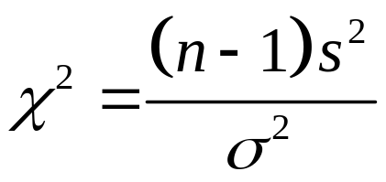
Chi-Square Distribution
where
s = sample size
s² = sample variance
σ² = population variance
df = n – 1 degrees of freedom
Notes:
One place where students tend to make errors with this formula is switching the values for s and σιγμα. Careful reading of the problem should eliminate this difficulty.
page 364 of Elementary Statistics, 10th Edition

Slide 6
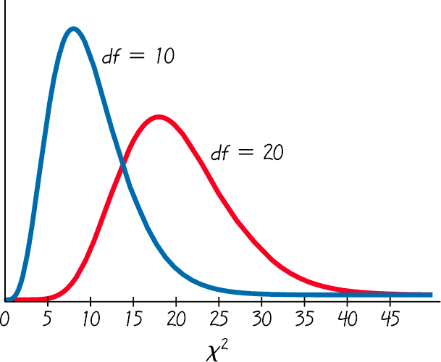
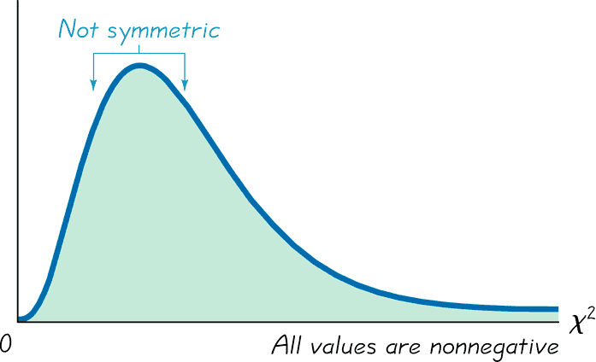
Properties of the Distribution of the Chi-Square Statistic
1. The chi-square distribution is not symmetric, unlike the normal and Student t distributions. As the number of degrees of freedom increases, the distribution becomes more symmetric.
Chi-Square Distribution
Chi-Square Distribution for
df = 10 and df = 20
Notes:
Different degrees of freedom produce different shaped chi-square distributions.

Slide 7
Properties of the Distribution of the Chi-Square Statistic
2. The values of chi-square can be zero or positive, but it cannot be negative.
3. The chi-square distribution is different for each number of degrees of freedom, which is df = n – 1. As the number of degrees of freedom increases, the chi-square distribution approaches a normal distribution.
In Table A-4, each critical value of χ² corresponds to an area given in the top row of the table, and that area represents the cumulative area located to the right of the critical value.

Slide 8
Example
A simple random sample of 22 IQ scores is obtained. Construction of a confidence interval for the population standard deviation σ requires the left and right critical values of χ² corresponding to a confidence level of 95% and a sample size of n = 22.
Find the critical χ² values corresponding to a 95% level of confidence.

Slide 9
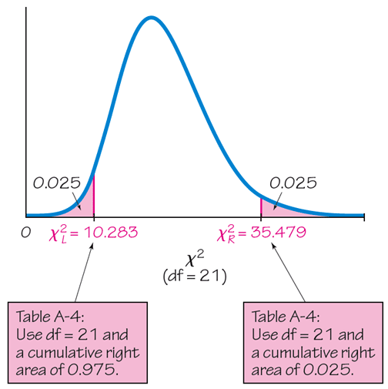
Example - Continued
Critical Values of the Chi-Square Distribution

Slide 10
Estimators of σ²
The sample variance s² is the best point estimate of the population variance σ².

Slide 11
Estimator of σ
The sample standard deviation s is a commonly used point estimate of σ (even though it is a biased estimate).

Slide 12



Confidence Interval for Estimating a Population Standard Deviation or Variance
σ = population standard deviation
σ² = population variance
s = sample standard deviation
s² = sample variance
n = number of sample values
E = margin of error
= left-tailed critical value of
= right-tailed critical value of
Notes:
Remind students that we have started with the variance which is the square of the standard deviation. Therefore, taking the square root of the variance formula will produce the standard deviation formula.

Slide 13
Confidence Interval for Estimating a Population Standard Deviation or Variance
Requirements:
1. The sample is a simple random sample.
2. The population must have normally distributed values (even if the sample is large).
Notes:
Remind students that we have started with the variance which is the square of the standard deviation. Therefore, taking the square root of the variance formula will produce the standard deviation formula.

Slide 14
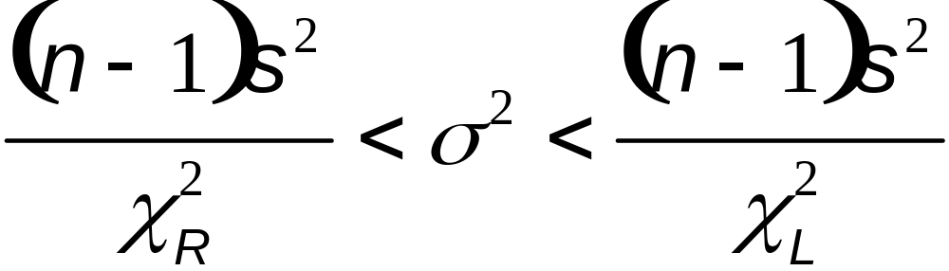
Confidence Interval for Estimating a Population Standard Deviation or Variance
Confidence Interval for the Population Variance σ²
Notes:
Remind students that we have started with the variance which is the square of the standard deviation. Therefore, taking the square root of the variance formula will produce the standard deviation formula.

Slide 15
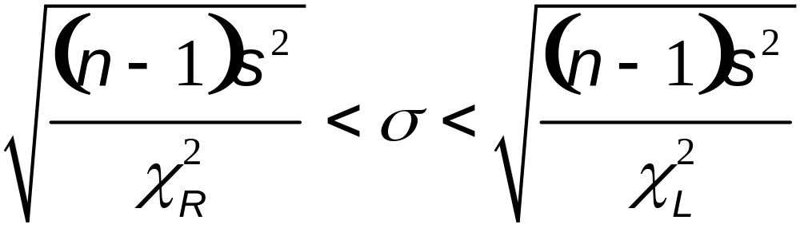
Confidence Interval for Estimating a Population Standard Deviation or Variance
Confidence Interval for the Population
Standard Deviation σ
Notes:
Remind students that we have started with the variance which is the square of the standard deviation. Therefore, taking the square root of the variance formula will produce the standard deviation formula.

Slide 16


Procedure for Constructing a Confidence Interval for σ or σ²
1. Verify that the required assumptions are satisfied.
2. Using n – 1 degrees of freedom, refer to Table A-4 or use technology to find the critical values
and that correspond to the desired confidence level.
3. Evaluate the upper and lower confidence interval limits using this format of the confidence interval:

Slide 17
Procedure for Constructing a Confidence Interval for σ or σ²
4. If a confidence interval estimate of σ is desired, take the square root of the upper and lower confidence interval limits and change σ² to σ.
5. Round the resulting confidence level limits. If using the original set of data to construct a confidence interval, round the confidence interval limits to one more decimal place than is used for the original set of data. If using the sample standard deviation or variance, round the confidence interval limits to the same number of decimal places.

Slide 18
Caution
Confidence intervals can be used informally to compare the variation in different data sets, but the overlapping of confidence intervals should not be used for making formal and final conclusions about equality of variances or standard deviations.

Slide 19
Example
A group of 22 subjects took an IQ test during part of a study. The subjects had a standard deviation IQ score of 14.3.
Construct a 95% confidence interval estimate of σ, the standard deviation of the population from which the sample was obtained.

Slide 20
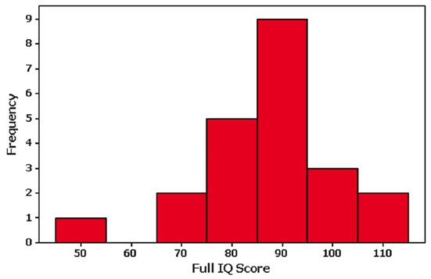
Example - Continued
We must first verify the requirements are met.
We can treat the sample as a simple random sample.
The following display shows a histogram of the data and the normality assumption can be reasonably met.

Slide 21
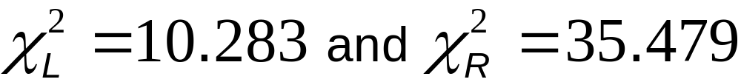
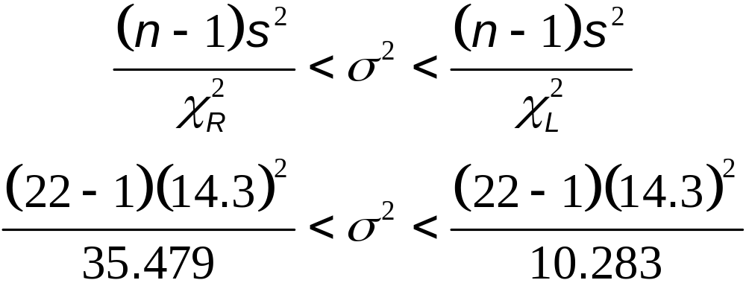
Example - Continued
n = 22 so df = 22 – 1 = 21
Use table A-4 to find:

Slide 22
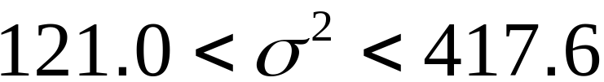

Example - Continued
Evaluation of the preceding expression yields:
Finding the square root of each part (before rounding), then rounding to two decimal places, yields this 95% confidence interval estimate of the population standard deviation:
Based on this result, we have 95% confidence that the limits of 11.0 and 20.4 contain the true value of σ.

Slide 23
Determining Sample Sizes
The procedures for finding the sample size necessary to estimate σ² are much more complex than the procedures given earlier for means and proportions. Instead of using very complicated procedures, we will use Table 7-2.
STATDISK also provides sample sizes. With STATDISK, select Analysis, Sample Size Determination, and then Estimate St Dev.
Minitab, Excel, and the TI-83/84 Plus calculator do not provide such sample sizes.
Notes:
Instead of presenting the much more complex procedures for determining sample size necessary to estimate the population variance, this table will be used.

Slide 24
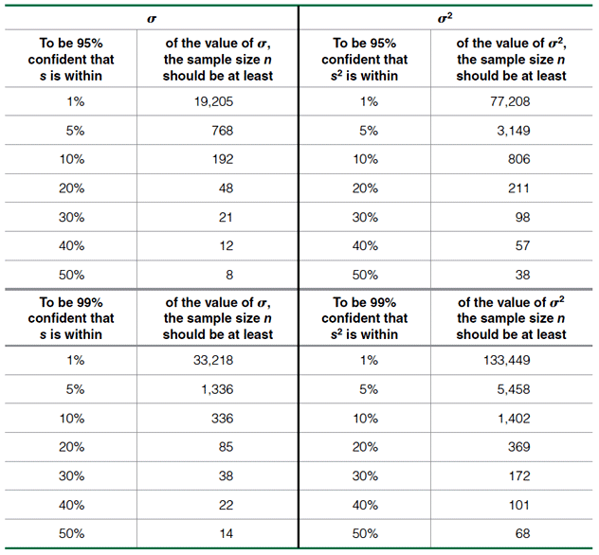
Determining Sample Sizes
Notes:
Instead of presenting the much more complex procedures for determining sample size necessary to estimate the population variance, this table will be used.

Slide 25
We want to estimate the standard deviation σ of all voltage levels in a home. We want to be 95% confident that our estimate is within 20% of the true value of σ.
How large should the sample be? Assume that the population is normally distributed.
Example
From Table 7-2, we can see that 95% confidence and an error of 20% for σ correspond to a sample of size 48.
We should obtain a simple random sample of 48 voltage levels form the population of voltage levels.

