Slide 1
Meeting Medical Accessibility Needs
ASA DATAFEST 2026
TEAM: BIGFOOT
By: Katy Adcox, Dean Callahan, Devon Walker, Jonathan David Juarez

Slide 2

This Project != Generative AI
No use of generative Artificial Intelligence was used during the process of this competition.
Data For Good!

Slide 3
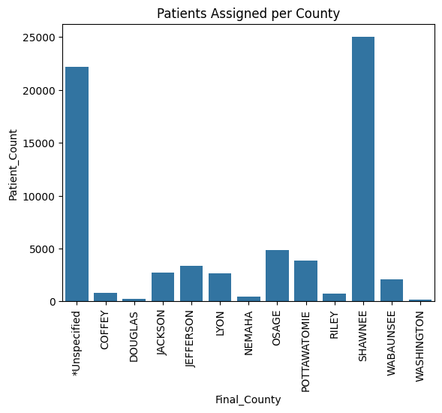
What We Found
Infrastructure should be improved in areas with low scores
  Additional locations should be added
  Northern region (Jackson, Pottawatomie, Nemaha) should be prioritized
We believe that places with lower scores would have worse outcomes for patients
Although some areas obtained a high score, patient provider ratio is still of concern

Slide 4
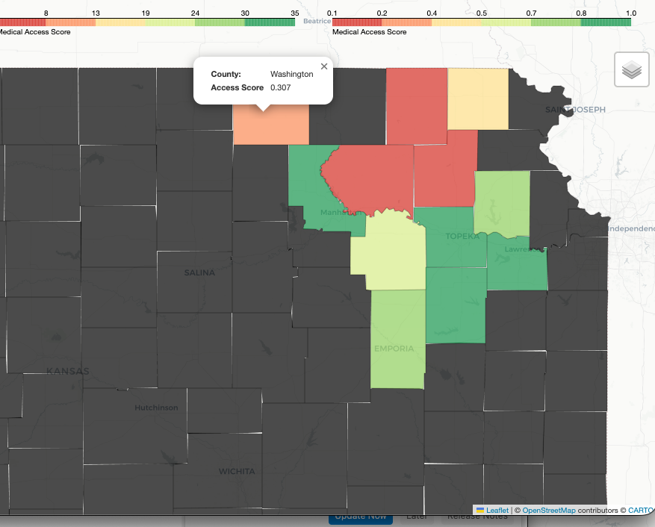
Medical_Access_Score=50*(num_locations/p)+20*(num_transport/p)+20*(num_financial/p)+10*(social/p)
Let: p = number of unique patients in that county
Nemaha
0.077
Brown
0.477
Riley
0.886
Pottawatomie
0.216
Jackson
0.138
Jefferson
0.728
Wabaunsee
0.569
Shawnee
0.946
Douglas
0.957
Osage
0.998
Lyon
0.726

