Slide 1
Chef

Slide 2
About Chef
Chef is Configuration Management tool which automates the Infrastructure in form of code.
Its Infrastructure automation Tool
On-Premise or In Cloud
It Integrated with Existing Infrastructure Environment
Its Automation Platform from Opscode for developer/System admins to Continously define,build and manage the infrastructure

Slide 3
Chef
Its Versionable
Repeatable
Testable

Slide 4
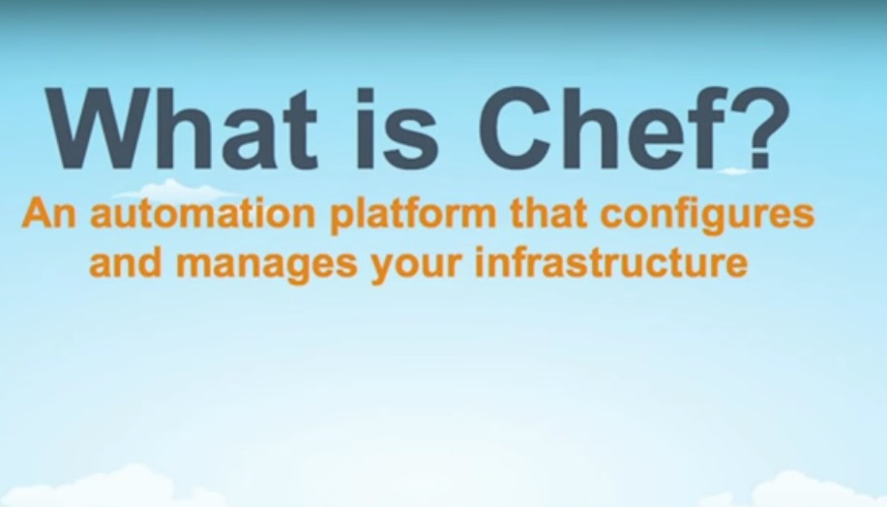

Slide 5
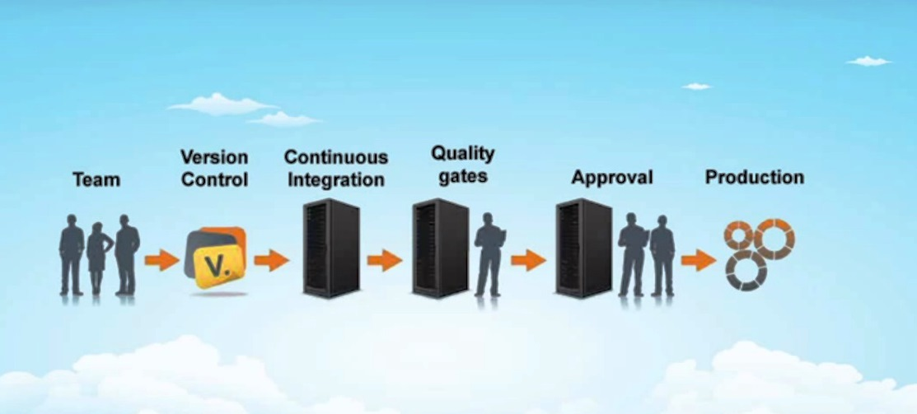
Chef across Continuous Pipeline

Slide 6
Configuration Management
Configuration Management in IT is set of Engineering Practice for Managing
Hardware
Software
Infrastructure
People(Teams)
Process

Slide 7
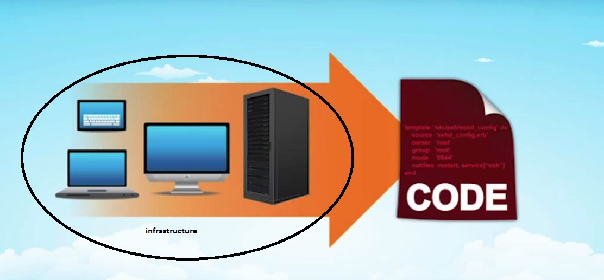
Infrastructure as Code

Slide 8
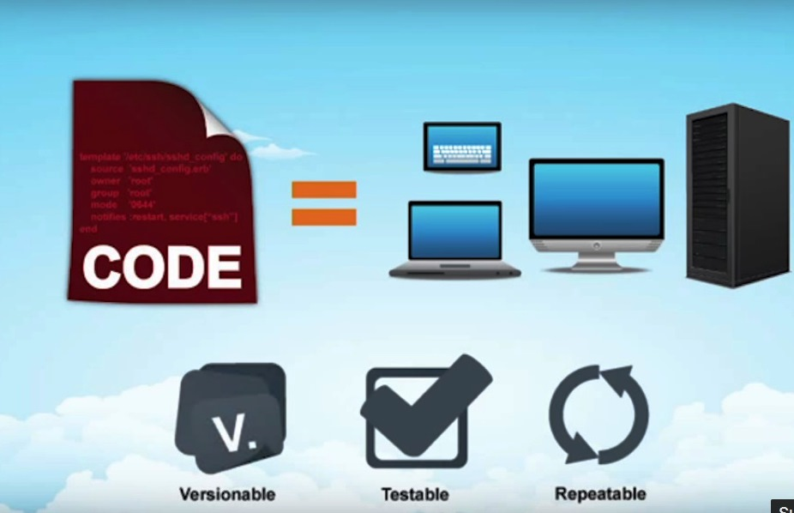
Chef Versionable,Testable,Repeatable

Slide 9
What Chef can do?
Install Applications
Define Services
Start/stop the services(server,applications,resources)
Configure/Auto Configure the whole applications/servers
Share configuration among servers/ different machines

Slide 10
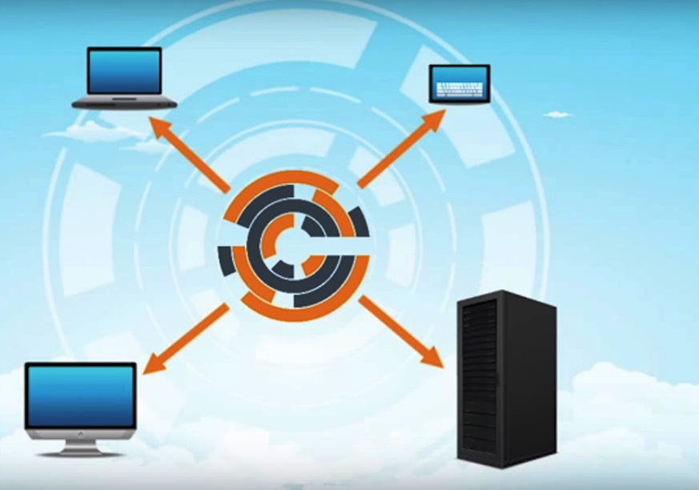
Chef

Slide 11
Chef
For Chef, No Need to start the Infrastructure from Scratch.
Chef Supports and Integrated with Existing Tools like Jenkins…. It comes with Predefined Cookbooks for existing the Infrastructure.

Slide 12
Types of Chef
Chef is available in three different versions:
Private chef - an enterprise version which supports multi-tenancy and runs in-house behind a firewall.
Hosted Chef - a Saas managed cloud service hosted by Opscode.
open source Chef - a free download that requires that each instance of Chef to be configured and managed locally.

Slide 13

Chef

Slide 14
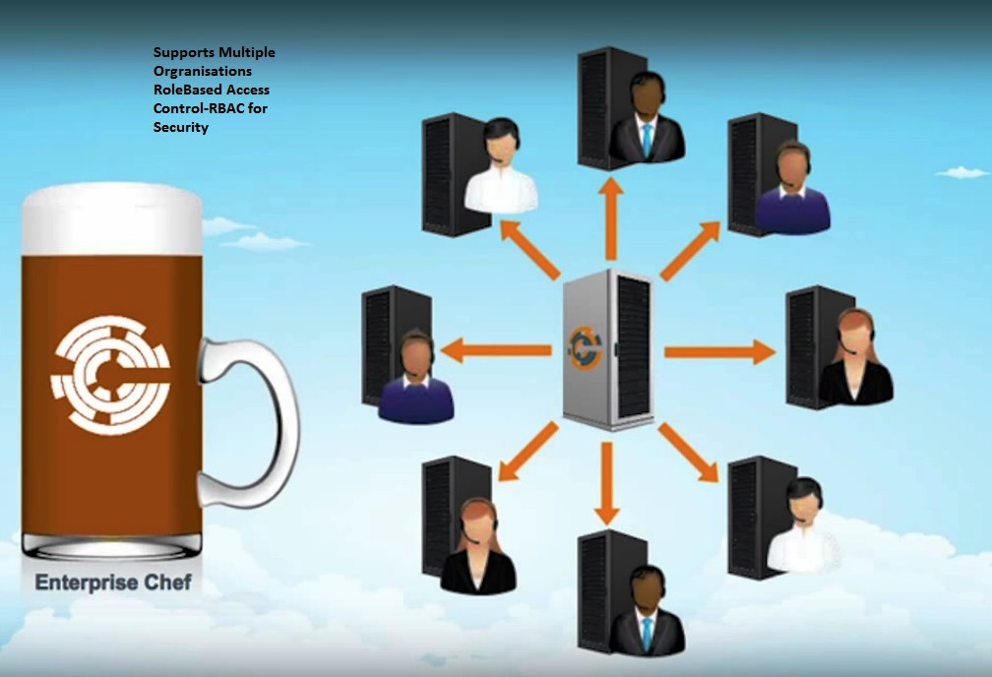
Enterprise Chef-Multi Organizations, RBAC Security, Integrates with Active Directory to Supports Identity Management, Professional Service

Slide 15
Enterprise Chef
Enterprise Chef
Supports Multi Organizations
Enabled with RBAC Security
Integrates with Active Directory to Supports Identity Management
Professional Service Support from Chef Team

Slide 16
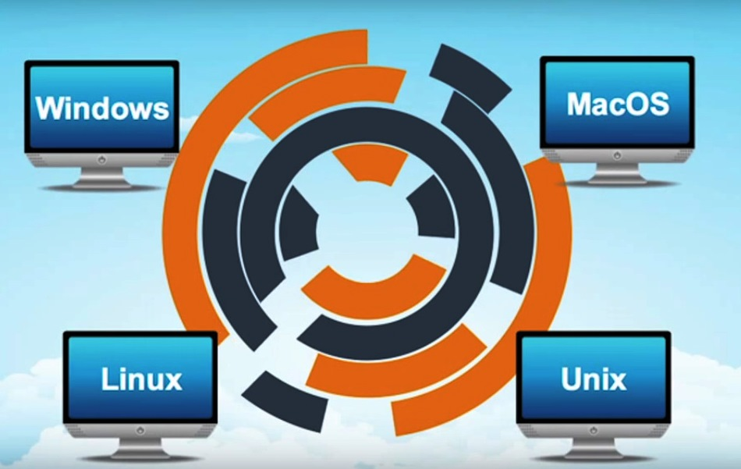
Chef Platform Supports

Slide 17
Chef Components
Components of Chef are
Chef Server
Chef Workstation
Chef Node

Slide 18
Chef Server
Chef Server acts as hub for configuration data
It stores cookbooks, receipes,policies,runlist that are applied on nodes.
Chef nodes talk to chef server using chef client

Slide 19
Chef Node
Chef Nodes are Target Machine where infrastructure will be implemented through Chef Server(code)
Chef Node which installed with Chef Client which talk to Chef server and pull all the configurations etc…
Chef Client in Chef Node has component called OHAI which discover RAM,CPU,Ipaddress etc.
The chef-client uses shared secret encryption; an encrypted file can only be decrypted by a node or a user with the same shared secret

Slide 20
Chef Workstation
Chef workstation is the machine where chef admin will work
Create receipes,cookbooks,roles environments using knife tool(cmd tool)
Test and upload the receipes,cookbooks to chef server
Chef nodes cannot communicate directly with work station

Slide 21
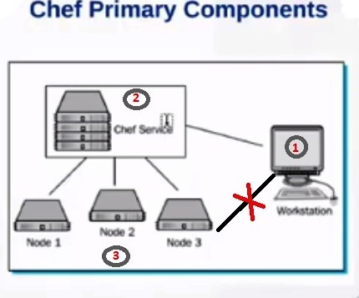
Chef Components

Slide 22
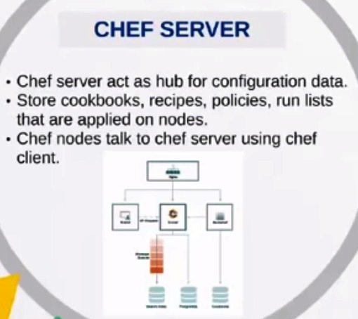
Chef Server

Slide 23
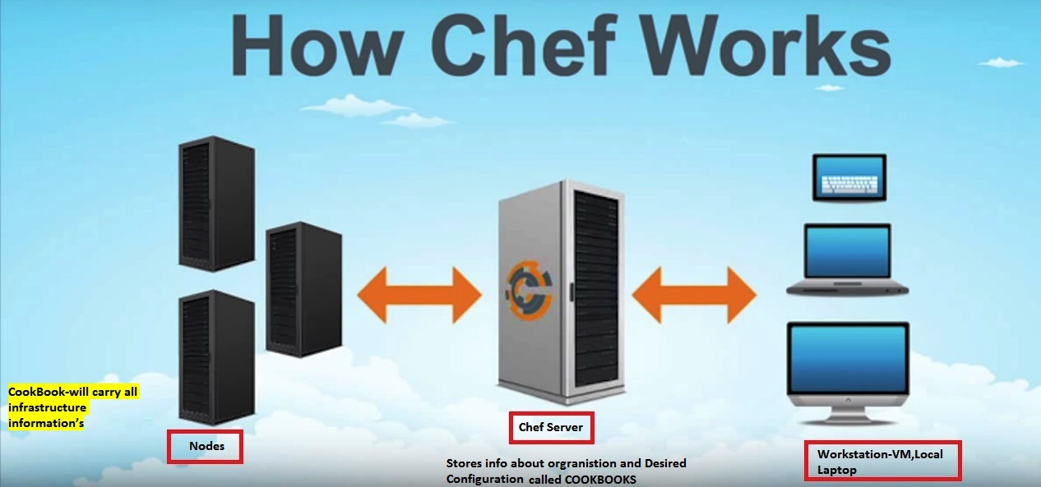
Chef WorkFlow

Slide 24
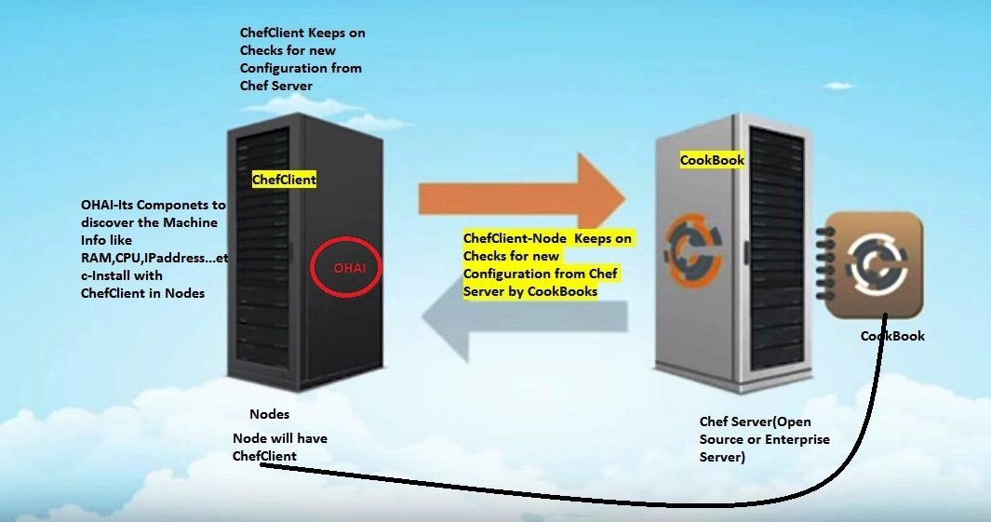
How Chef works -CookBook

Slide 25
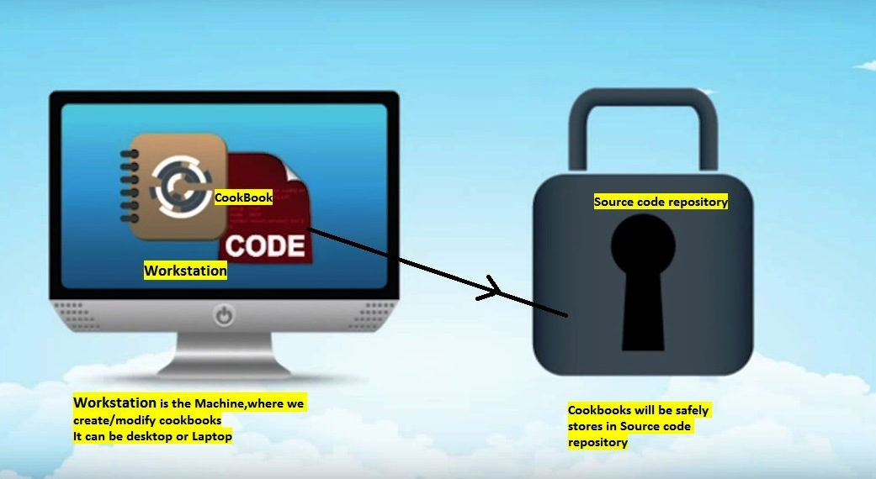
Chef WorkStation

Slide 26
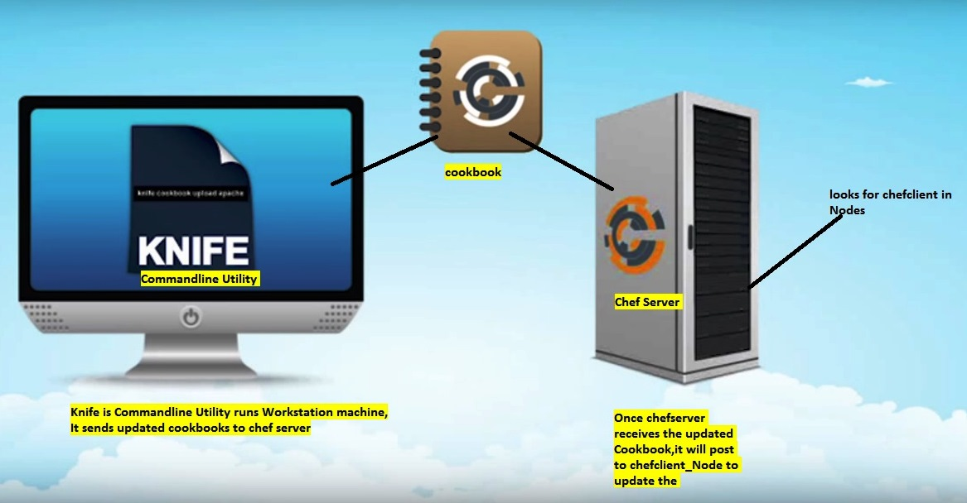
Chef WorkStation-knife

Slide 27
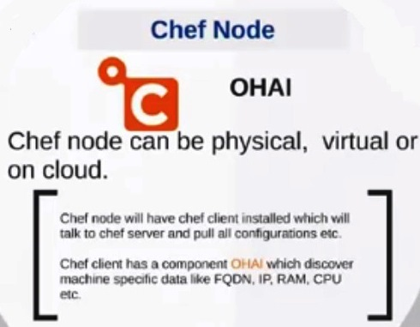
Chef Node-Infra Machines

Slide 28
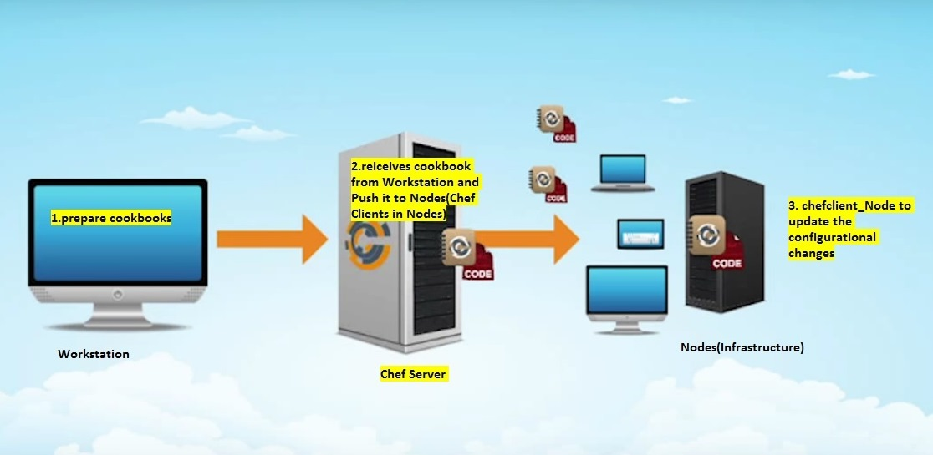
Chef workflow between the components

