Slide 1
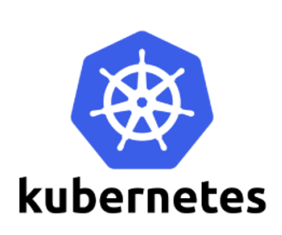
Kubernetes
Course

Slide 2
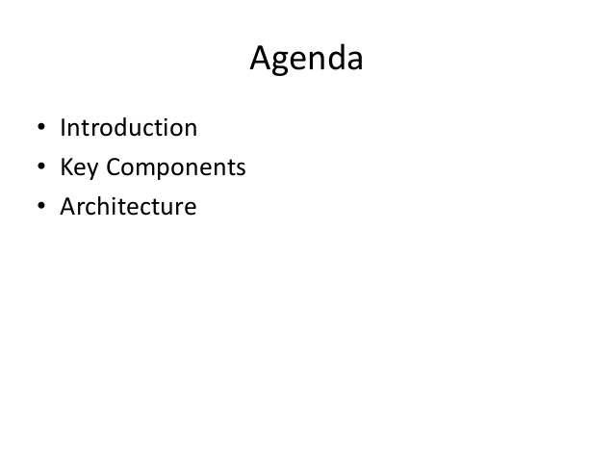

Slide 3
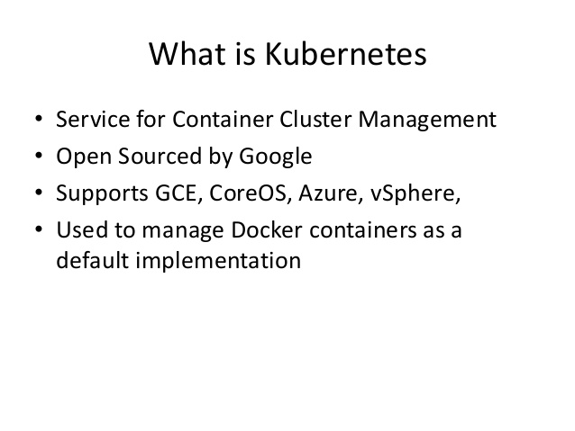

Slide 4
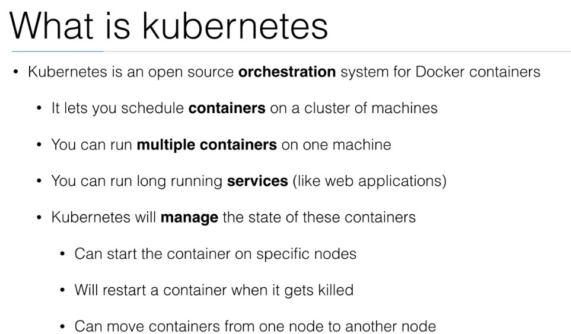

Slide 5
Kubernetes Release
Kubernetes Initial release 7 June 2014;
4 years ago Stable release 1.11/
June 28, 2018; 33 days ago
Written in Go
Type: Cluster management software and container orchestration
License Apache License 2.0Website kubernetes.io
Support: https://cloud.google.com/kubernetes-engine/docs/support

Slide 6
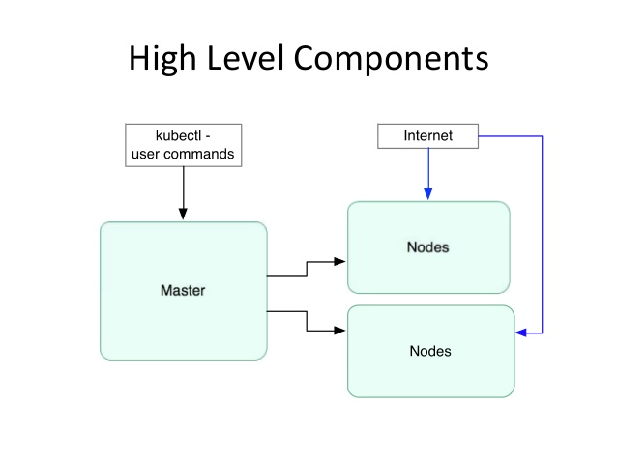

Slide 7
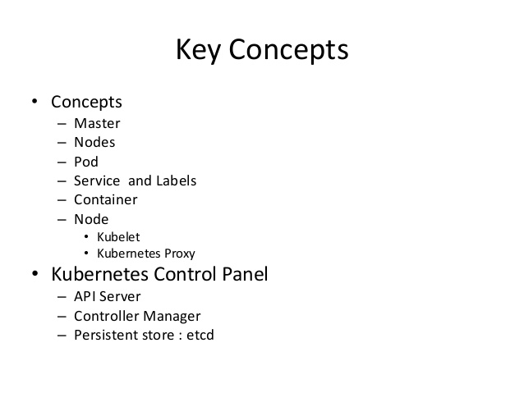

Slide 8
What Does Kubernetes do?
Kubernetes is an open-source system for automating deployment, scaling, and management of containerized applications.
Improves reliability
Continuously monitors and manages your containers
Will scale your application to handle changes in load
Better use of infrastructure resources
Helps reduce infrastructure requirements by gracefully scaling up and down your entire platform
Coordinates what containers run where and when across your system
How do all the different types of containers in a system talk to each other?
Easily coordinate deployments of your system
Which containers need to be deployed
Where should the containers be deployed

Slide 9
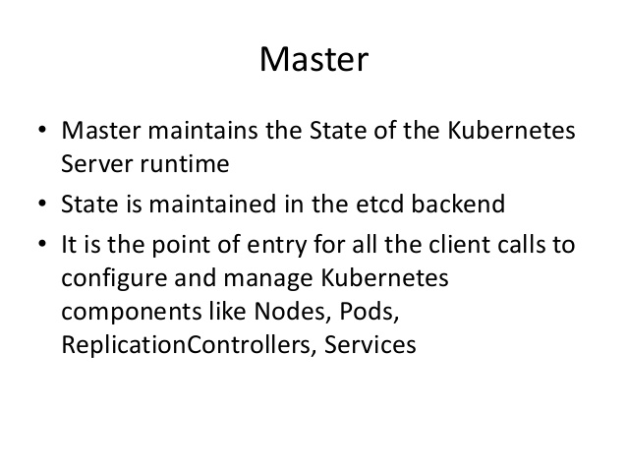

Slide 10
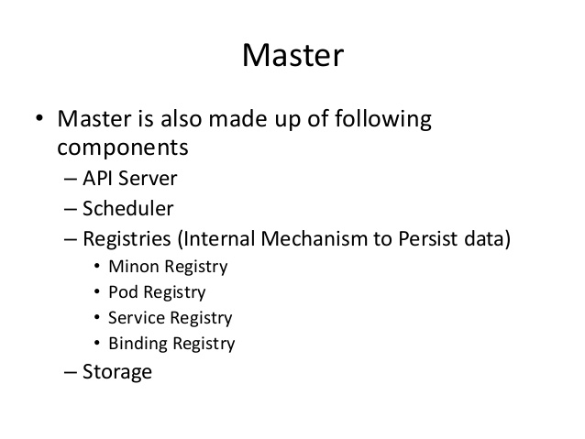

Slide 11
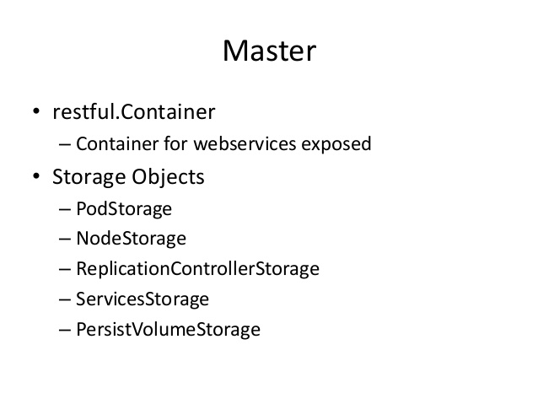

Slide 12
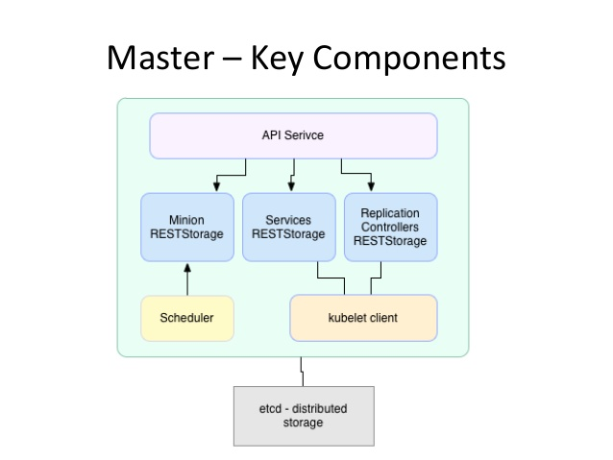

Slide 13
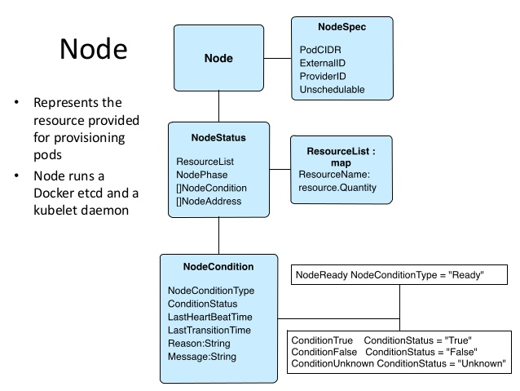

Slide 14
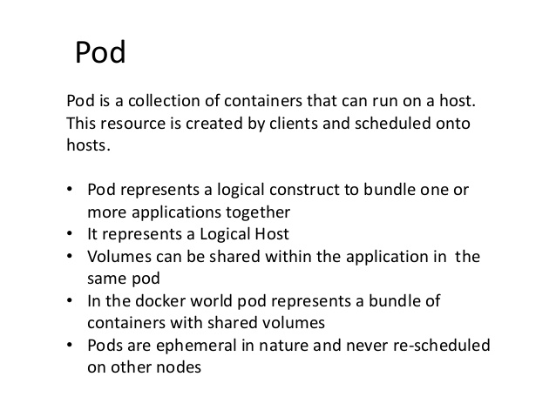

Slide 15
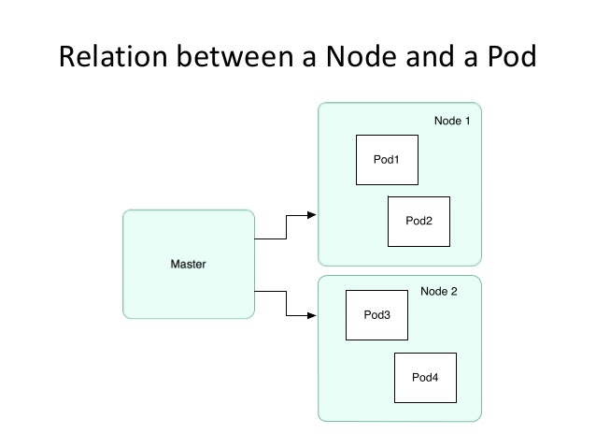

Slide 16
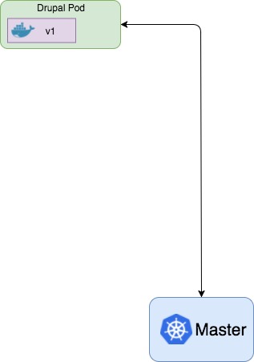
The Pod is the core Kubernetes Component
The Pod is the core component of Kubernetes
Collection of 1 or more containers
Each pod should focus on one container, however sidecar containers can be added to enhance features of the core container
spec: template: spec: containers: - name: tomcat image: tomcat:v1

Slide 17
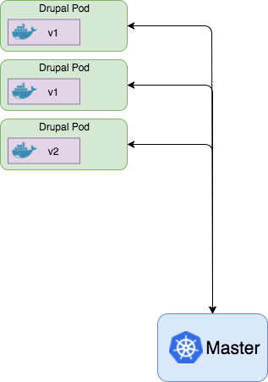
Pods can Handle Scaling and Deployments
Once Kubernetes understands what is in a pod, multiple management features are available:
System Performance
Scale up/down the number of pods based on CPU load or other criteria
System Monitoring
Probes to check the health of each pod
Any unhealthy ones get killed and new pod is put into service
Deployments
Deploy new versions of the container
Control traffic to the new pods to test the new version
Blue/Green deployments
Rolling deployments

Slide 18
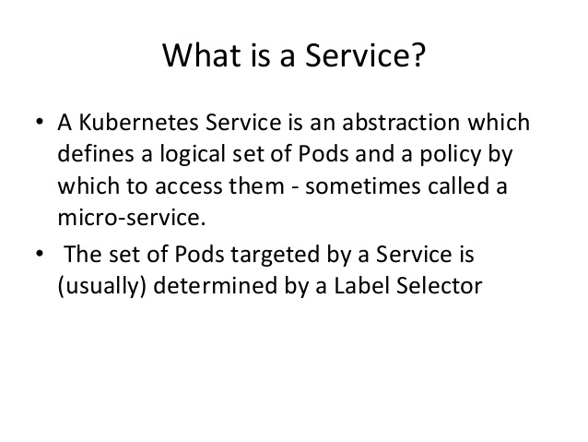

Slide 19
What Does Kubernetes do?
Kubernetes is an open-source system for automating deployment, scaling, and management of containerized applications.
Improves reliability
Continuously monitors and manages your containers
Will scale your application to handle changes in load
Better use of infrastructure resources
Helps reduce infrastructure requirements by gracefully scaling up and down your entire platform
Coordinates what containers run where and when across your system
How do all the different types of containers in a system talk to each other?
Easily coordinate deployments of your system
Which containers need to be deployed
Where should the containers be deployed

Slide 20
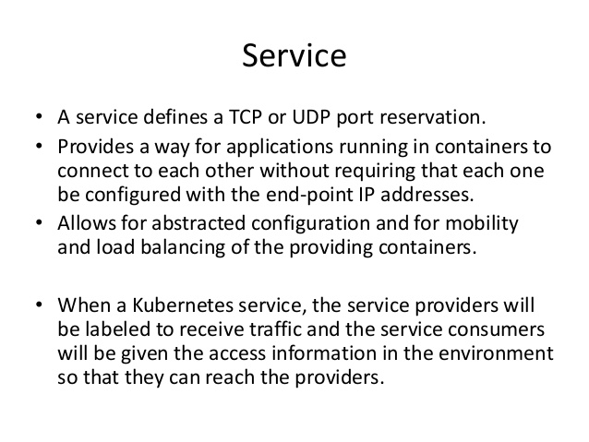

Slide 21
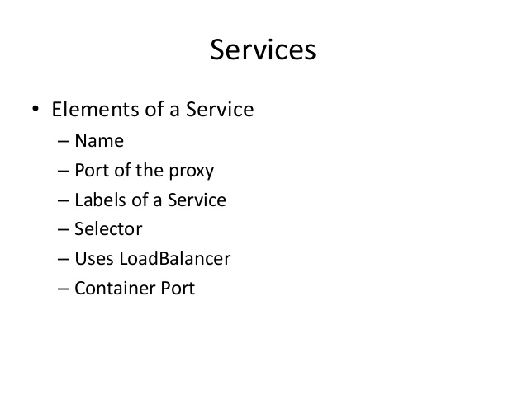

Slide 22
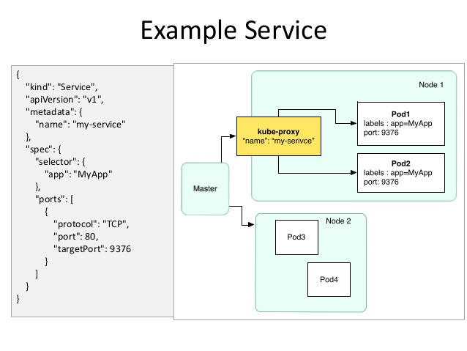

Slide 23
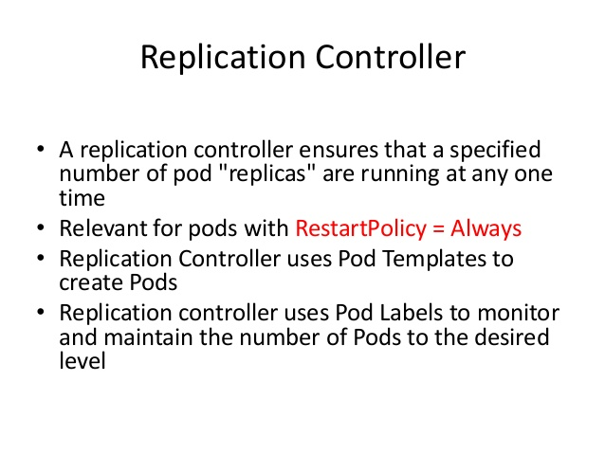

Slide 24
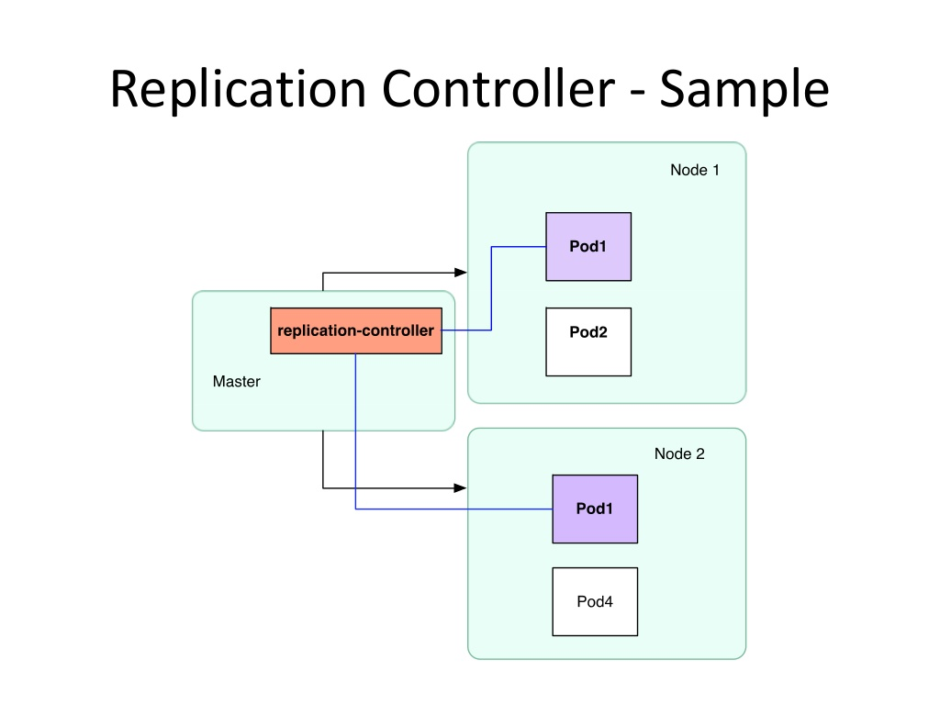

Slide 25
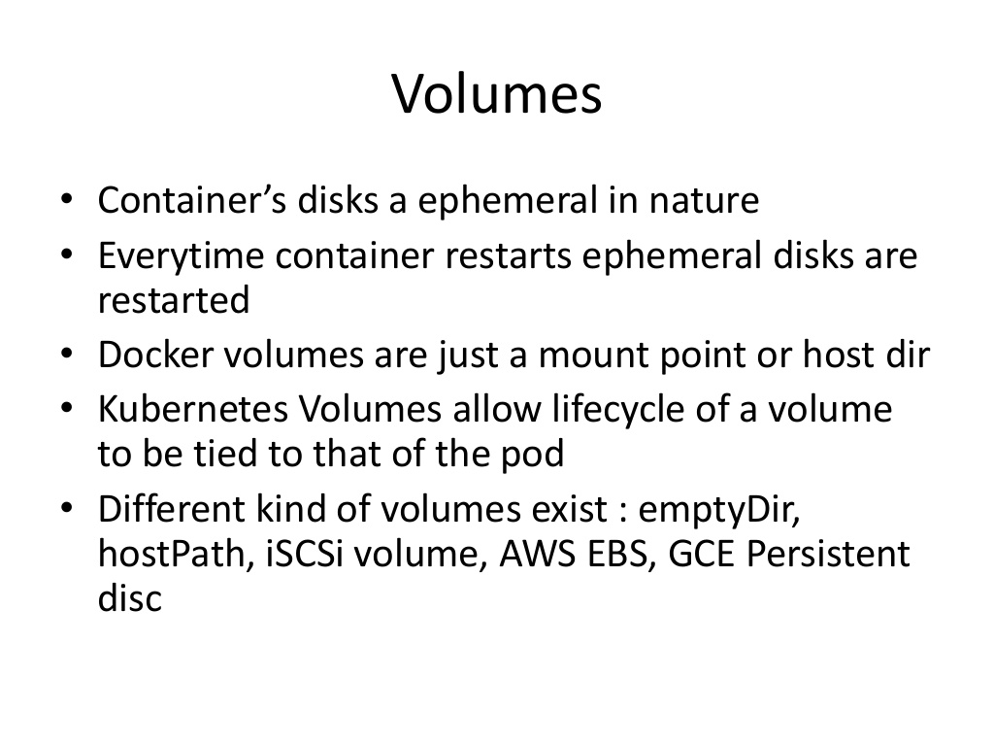

Slide 26
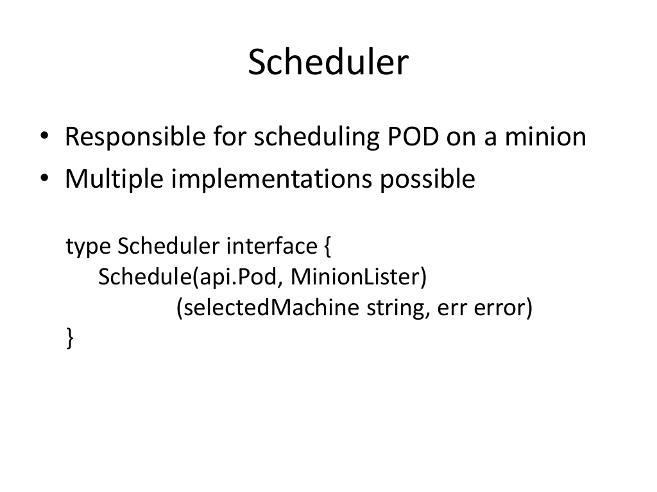

Slide 27
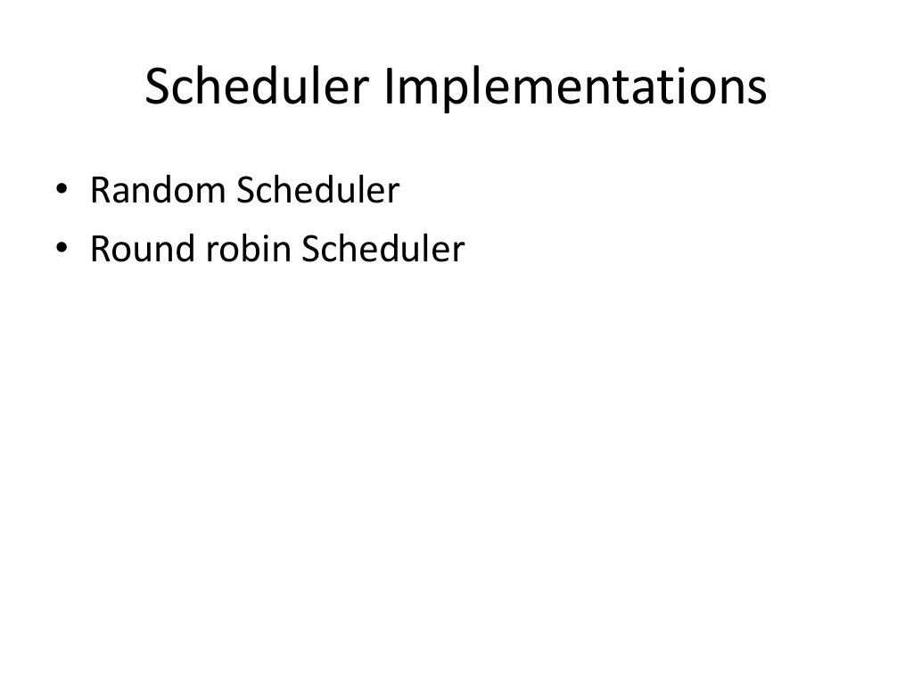

Slide 28
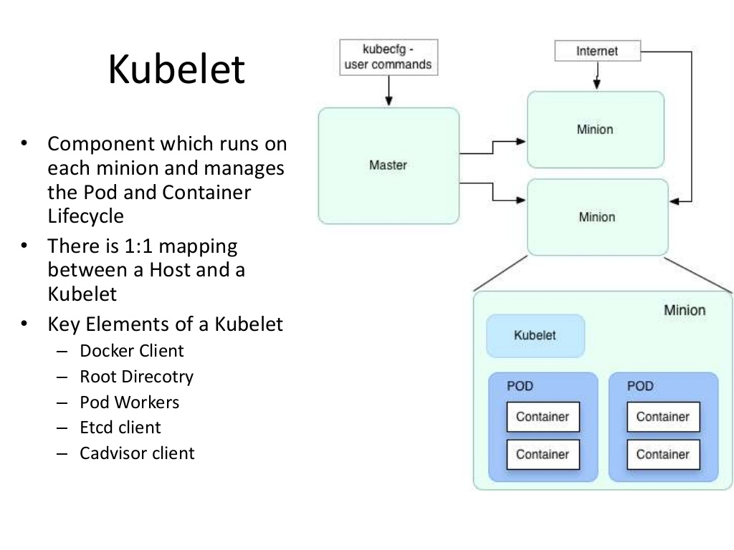

Slide 29
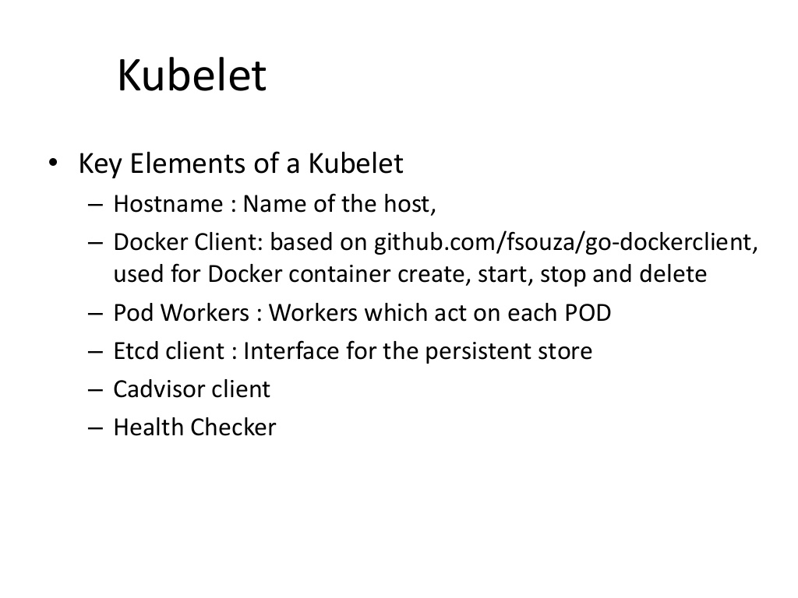

Slide 30
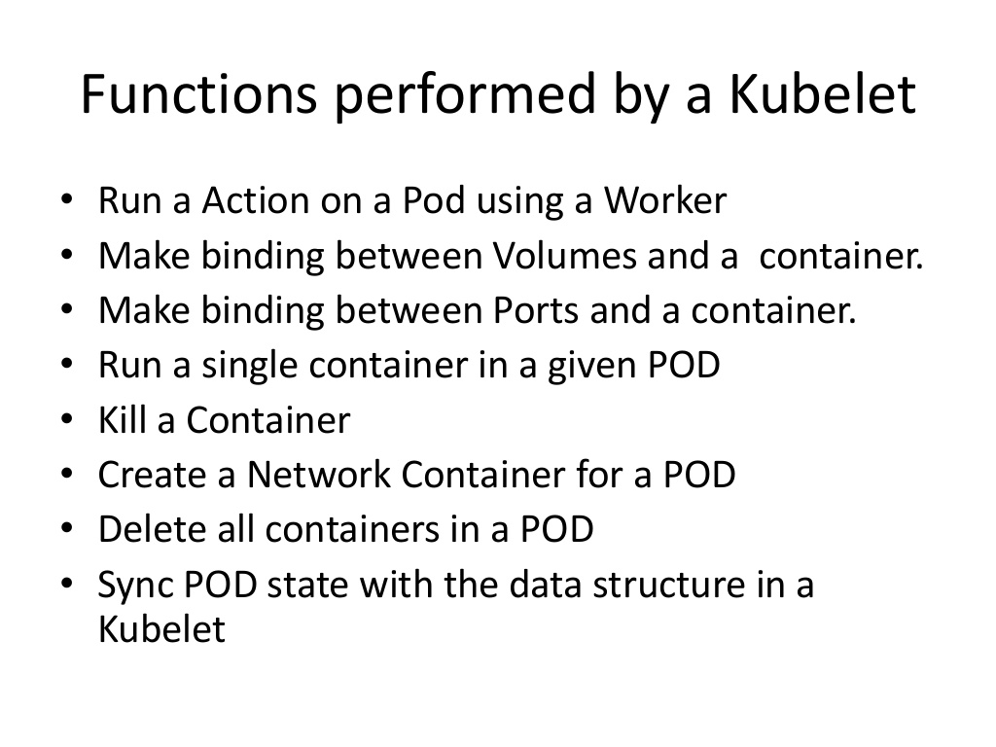

Slide 31
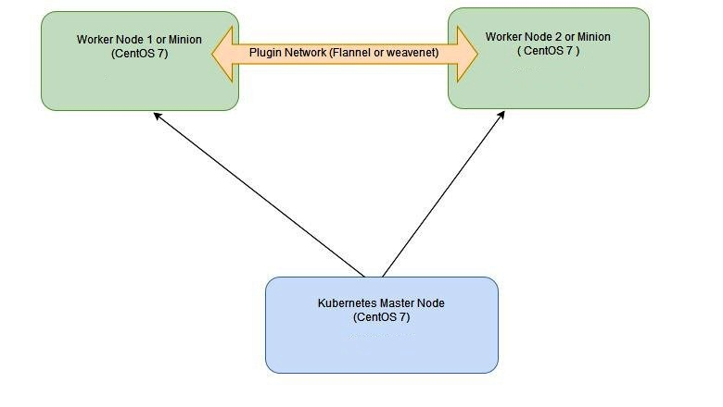
Kubernetes Lab Setup

Slide 32
Kubernetes Labs

