Slide 1


Automated test 2

Slide 2
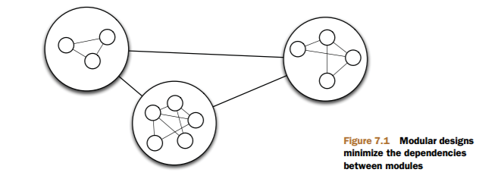
Designing for testability
A modular design is composed of separate modules, each serving a particular purpose in the design
SOLID principles and TDD can help you keep your code modular and testable
Source: Effective Unit Testing by Lasse Koskela

Slide 3
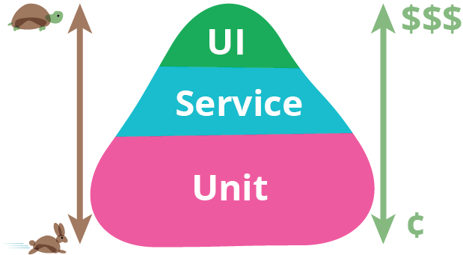
What to test?
The test pyramid shows that you should have many more low-level unit tests than high level end-to-end tests running through a GUI.

Slide 4
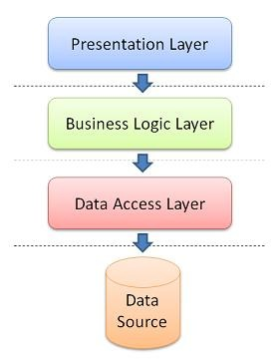
Testing at Service Level
A layered application often has a frontend to handle the presentation and a backend to execute the business logic.
Tests can verify that a request passes through the frontend and returns an appropriate response from the backend.

Slide 5
Integration Testing
We test connection to services such as database, file system or any other external resource or device:

Slide 6
Integration Test Demo
Test how Data Access Layer communicates with a database – demo!
MySQL database
JDBC code
Notes:
DataMapperAlltheWay

Slide 7
Considerations when testing the data access layer
Test database vs. production database
demo
Designing for testability
demo
Clearing and setting up a database
Notes:
Demo of test database : in-memory database (data structure): DataMapperStubbed
DataMapperAlltheWay Problem: Mapper has DB embedded = the bad encapsulation. We cannot do DI
Demo of design for testability: DataMapperTestable

Slide 8
Mocking
Setting up a fictive environment to test only one part of the system
Is much faster than testing the real database
Has focus on testing behavior and is useful when doing TDD (you can mock dependencies that you haven’t implemented yet)
This is hard!!!! -> so if you really do this it leads to a better structure of your program. It becomes more robust and better structured.
Mockito is a mocking framework

Slide 9
Mocking the Data Access Layer
Demo: Mocking the data mapper class
Communication to data access layer happens through a facade
mock

Slide 10
Stubs vs mocks?
Rule of thumb:
Stub queries; mock actions
Stubs
Pros:
Fast and lightweight
Easy to write and understand
Cons:
Specialized methods are required to verify state
They don’t test behavior of faked objects
Mocks
Pros:
They can track domain logic behavior
Cons:
You need to learn a mocking framework
You need to know how the mocked API works

Slide 11
How to manage dependencies
Use Maven to handle dependencies in Netbeans project
Pom.xml file:
<dependencies>
<dependency>
<groupId>junit</groupId>
<artifactId>junit</artifactId>
<version>4.12</version>
<scope>test</scope>
</dependency>
<dependency>
<groupId>org.hamcrest</groupId>
<artifactId>hamcrest-core</artifactId>
<version>1.3</version>
<scope>test</scope>
</dependency>
<dependency>
<groupId>org.mockito</groupId>
<artifactId>mockito-all</artifactId>
<version>1.9.5</version>
</dependency>
<dependency>
<groupId>mysql</groupId>
<artifactId>mysql-connector-java</artifactId>
<version>5.1.23</version>
</dependency>
</dependencies>

Slide 12
JDBC hint
The try-with-resources Statement
https://docs.oracle.com/javase/tutorial/essential/exceptions/tryResourceClose.html

