Slide 1
BUSINESS WEEK - PROGRAM
Today: Groups and start requirements (using UML)
Tuesday: Presentation of the examen-case by FOG A/S
  Be avare that all classes meet in room 2.62 at 8.45!
  After the presentation we continue with requirements (using UML)
  Wednesday: we continue with requirements (using UML)
  Thursday: working with requirements on the examen-case
  Friday: individual SP-assignment

Slide 2
Today:
Motivation/needs
Groups/teams
  What to consider creating groups
    Same academic level
  Formal requirements
    Groups of 4 students
GOAL OF THE DAY
  All students are organized in groups at the end of the day.
  The groups will work together all semester, and be responsible for handing in exam-project!

Slide 3
Maslow’s Hierarchy of Needs
What motivates us to do what we do, eg . study, work , play soccer , go to a bar?
Important knowledge when planning work, especially work in teams!
Self-Actualization
Esteem
Love
Safety
Physiological

Slide 4
Maslow’s Hierarchy of Needs
MOST NEEDS HAVE TO DO WITH
SURVIVAL PHYSICALLY AND
PSYCHOLOGICALLY
PHYSIOLOGICAL OR SURVIVAL NEEDS
Notes:
5

Slide 5
Maslow’s Hierarchy of Needs
ON THE WHOLE AN INDIVIDUAL
CANNOT SATISFY ANY LEVEL
UNLESS NEEDS BELOW ARE
SATISFIED
SAFETY NEEDS
PHYSIOLOGICAL OR SURVIVAL NEEDS

Slide 6
Maslow’s Hierarchy of Needs
LOVE, AFFECTION, AND
BELONGINGNESS NEEDS
SAFETY NEEDS
PHYSIOLOGICAL OR SURVIVAL NEEDS
Notes:
7

Slide 7
Maslow’s Hierarchy of Needs
ESTEEM NEEDS
LOVE, AFFECTION, AND
BELONGINGNESS NEEDS
SAFETY NEEDS
PHYSIOLOGICAL OR SURVIVAL NEEDS
Notes:
8

Slide 8
Maslow’s Hierarchy of Needs
NEED
FOR
SELF-
ACTUALIZATION
SELF-ACTUALIZATION MEANS ACTUALIZING
ONE’S POTENTIAL BECOMING ALL ONE IS
CAPABLE OF BECOMING
Notes:
10

Slide 9
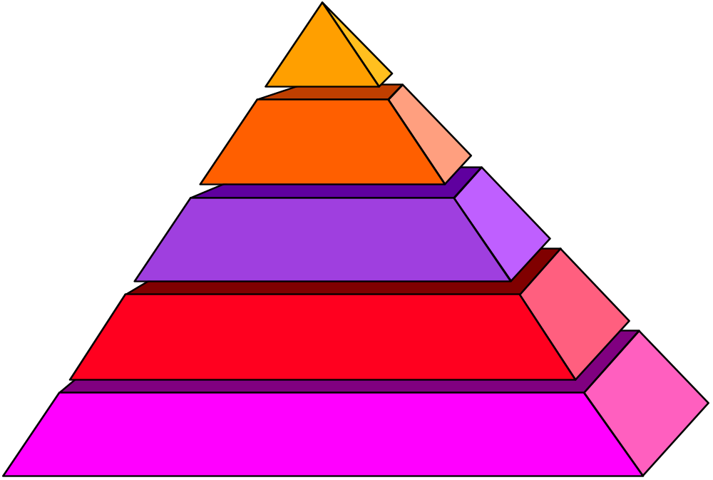
Maslow’s Hierarchy of Needs
NEED
SELF-
ACTUALIZATION
ESTEEM NEEDS
LOVE, AFFECTION, AND
BELONGINGNESS NEEDS
SAFETY NEEDS
PHYSIOLOGICAL OR SURVIVAL NEEDS
Notes:
11

Slide 10
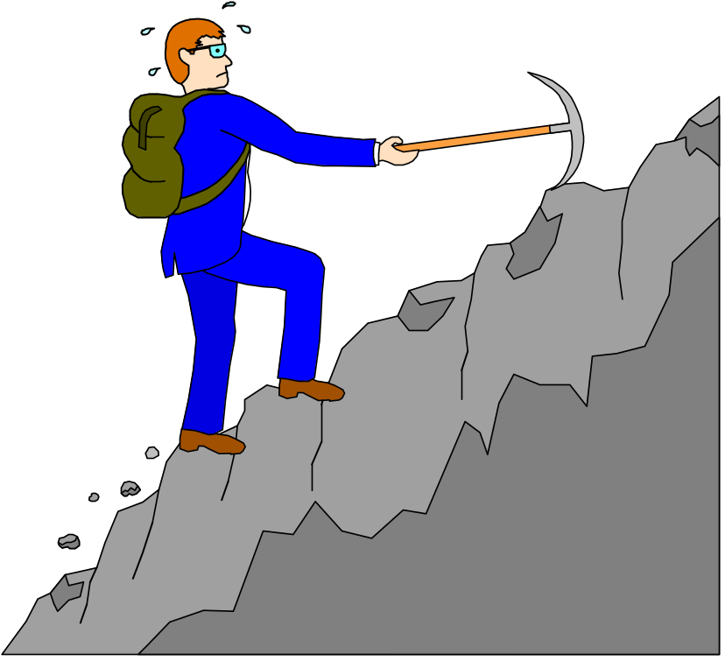
Nobody can do everything,
but we can nearly all do more than we think we can
Remember this for the next couple of months ☺

Slide 11
Groups/teams
  What to consider creating groups
    Same academic level
      GREEN, YELLOW, RED – ring a bell?
    Skills
      Analysing
      UML
      Programming
      DB
      Cooperation/group-skills
      Writing report
      Presentation

Slide 12
GROUPS/TEAMS
Complementary Skills
“Getting along" is not the most important feature of a team.
  While it's true that team members must work together, being friends is not the key issue.
In contrast, great teams accomplish their work largely because the teams bring together the right mix of different skills and understandings

Slide 13
Development of a group
Forming
  Forming is the stage when the group first comes together. Everybody is very polite and very dull. Conflict is seldom voiced directly, mainly personal and definitely destructive. Since the grouping is new, the individuals will be guarded in their own opinions and generally reserved. This is particularly so in terms of the more nervous and/or subordinate members who may never recover. The group tends to defer to a large extent to those who emerge as leaders (poor fools!).
Storming
  Storming is the next stage, when all Hell breaks loose and the leaders are lynched. Factions form, personalities clash, no-one concedes a single point without first fighting tooth and nail. Most importantly, very little communication occurs since no one is listening and some are still unwilling to talk openly. True, this battle ground may seem a little extreme for the groups to which you belong - but if you look beneath the veil of civility at the seething sarcasm, invective and innuendo, perhaps the picture come more into focus.
Norming
  Then comes the Norming. At this stage the sub-groups begin to recognize the merits of working together and the in-fighting subsides. Since a new spirit of co-operation is evident, every member begins to feel secure in expressing their own view points and these are discussed openly with the whole group. The most significant improvement is that people start to listen to each other. Work methods become established and recognized by the group as a whole.
Performing
  And finally: Performing. This is the culmination, when the group has settled on a system which allows free and frank exchange of views and a high degree of support by the group for each other and its own decisions. In terms of performance, the group starts at a level slightly below the sum of the individuals' levels and then drops abruptly to its nadir until it climbs during Norming to a new level of Performing which is (hopefully) well above the start. It is this elevated level of performance which is the main justification for using the group process rather than a simple group of staff.

Slide 14
High Performance Teams Have…..
Commitment and desire to achieve results
Well-developed identity as a team, with shared vision and goals
Competence as individuals
Complementary skills
Mutual trust and interdependence. Trust is based on honesty, openness, consistency, and respect.
Effective Communication
Small size, 4-7 members (consider number of communication links)
High level of enjoyment
REMEMBER THAT THE MOST IMPORTANT GOAL FOR A GROUP IN THIS PROJECT IS LEARNING

Slide 15
Conflicts in teams
Conflict needs to be addressed
  Careful not to smooth over
  Could conflict be both positive and negative?
Personal conflict versus team objectives
  Consensus versus “disagree and commit”
Agreement on norms crucial before teams can perform
Consider above mentioned potential conflicts and ”high performance teams” and make:
GROUP-CONTRACT!

Slide 16

Belbin test

Slide 17
TEAM-ROLE CONTRIBUTION
ALLOWABLE WEAKNESSES
PLANT:
Creative, Solves difficult problems
Loses touch with everyday realities
RESOURCE INVESTIGATOR:
Enterprising, Quick to explore opportunities
Weak in follow through
CO-ORDINATOR:
Makes good use of group activities
Manipulative
SHAPER:
Driving and challenging
Provocative, Aggressive
COMPLETER FINISHER:
Painstaking, Conscientious
Anxious, Reluctant to delegate
TEAMWORKER:
Co-operative, Averts friction
Indecisive
MONITOR EVALUATOR:
Discerning and Objective
Uninspiring, Slow-moving
IMPLEMENTER:
Disciplined, Efficient, Practical
Slow to see new possibilities
SPECIALIST:
Single-minded, Professionally dedicated
Limited in Interests

Slide 18
Action-oriented roles -
SHAPER, IMPLEMENTER & COMPLETER FINISHER
People-oriented roles -
CO-ORDINATOR, TEAMWORKER & RESOURCE INVESTIGATOR
Cerebral roles -
PLANT, MONITOR EVALUATOR & SPECIALIST
TEAM ROLE OPPOSITES
MONITOR
EVALUATOR -
judges impartially
PLANT -
theorises
CO-ORDINATOR -
generalises
COMPLETER
FINISHER -
perfects established
systems
SHAPER -
drives
RESOURCE
INVESTIGATOR -
recognises opportunities
TEAMWORKER -
supports
SPECIALIST - specifies
IMPLEMENTER - applies

Slide 19
Exercise 1
Consider the different Belbin-roles regarding yourself
  What is my primary role and what is my secondary role?

Slide 20
Exercise 2
Consider the different Belbin-roles regarding yourself
  What is your primary role and what is your secondary role?
Talk with one or more fellow students and get their opinion on
    What is your primary role and what is your secondary role?

Slide 21
Exercise 3
Consider the different Belbin-roles regarding yourself
  What is your primary role and what is your secondary role?
Talk with one or more fellow students and get their opinion on
    What is your primary role and what is your secondary role?
  Do the test: Belbin-test (on Github)

Slide 22
Exercise 4
Consider the different Belbin-roles regarding yourself
  What is your primary role and what is your secondary role?
Talk with one or more fellow students and get their opinion on
    What is your primary role and what is your secondary role?
  Do the test: Belbin-test (on fronter)
  Consider the results – match or not?

Slide 23
Before you leave today
Send mail to Palle pab@cphbusiness.dk with the group members.
  Remember class (a, b or cos) and names!
  If you are not in a group, write this in the mail!

