Slide 1
Object-Oriented Software Engineering
Practical Software Development using UML and Java
Chapter 9:
Architecting and Designing Software
Edited and modified by Kasper

Slide 2
9.1 The Process of Design
Definition:
  Design is a problem-solving process whose objective is to find and describe a way:
    To implement the system’s functional requirements...
    While respecting the constraints imposed by the non-functional requirements...
      including the budget
    And while adhering to general principles of good quality
© Lethbridge/Laganière 2001
Chapter 9: Architecting and designing software

Slide 3
Design as a series of decisions
A designer is faced with a series of design issues
  These are sub-problems of the overall design problem.
  Each issue normally has several alternative solutions:
    design options.
  The designer makes a design decision to resolve each issue.
    This process involves choosing the best option from among the alternatives.
For the novice, this can not be done up front as finding just one solution can be hard.
Later, one can then consider if alternatives should be put in place.
© Lethbridge/Laganière 2001
Chapter 9: Architecting and designing software

Slide 4
Making decisions
To make each design decision, the software engineer uses:
  Knowledge of
    the requirements
    the design as created so far (by others earlier)
    the technology available
    software design principles and ‘best practices’
    what has worked well in the past
© Lethbridge/Laganière 2001
Chapter 9: Architecting and designing software

Slide 5
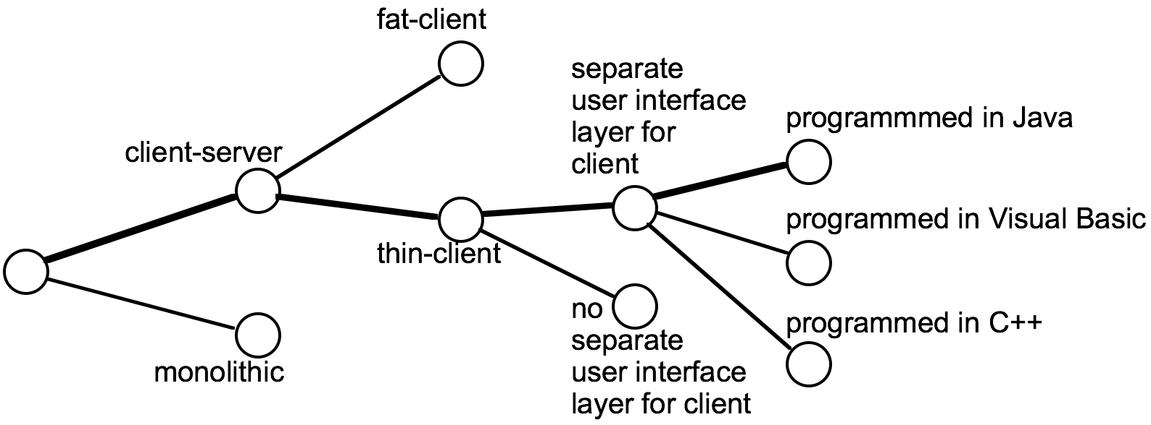
Design space
The space of possible designs that could be achieved by choosing different sets of alternatives is often called the design space
  For example:
Notice – such a graph can be useful in a report
© Lethbridge/Laganière 2001
Chapter 9: Architecting and designing software

Slide 6
Component
Any piece of software or hardware that has a clear role.
  A component can be isolated, allowing you to replace it with a different component that has equivalent functionality.
  Many components are designed to be reusable.
  Conversely, others perform special-purpose functions.
In your projects I expect most components are special-purpose
© Lethbridge/Laganière 2001
Chapter 9: Architecting and designing software

Slide 7
Module
A component that is defined at the programming language level
  For example, methods, classes and packages are modules in Java.
Many developers will not be able to tell a Module from a Component.
The problem is that these two words are used differently by different people.
© Lethbridge/Laganière 2001
Chapter 9: Architecting and designing software

Slide 8
System
A logical entity, having a set of definable responsibilities or objectives, and consisting of hardware, software or both.
  A system can have a specification which is then implemented by a collection of components.
  A system continues to exist, even if its components are changed or replaced.
  The goal of requirements analysis is to determine the responsibilities of a system.
  Subsystem:
    A system that is part of a larger system, and which has a definite interface
© Lethbridge/Laganière 2001
Chapter 9: Architecting and designing software

Slide 9
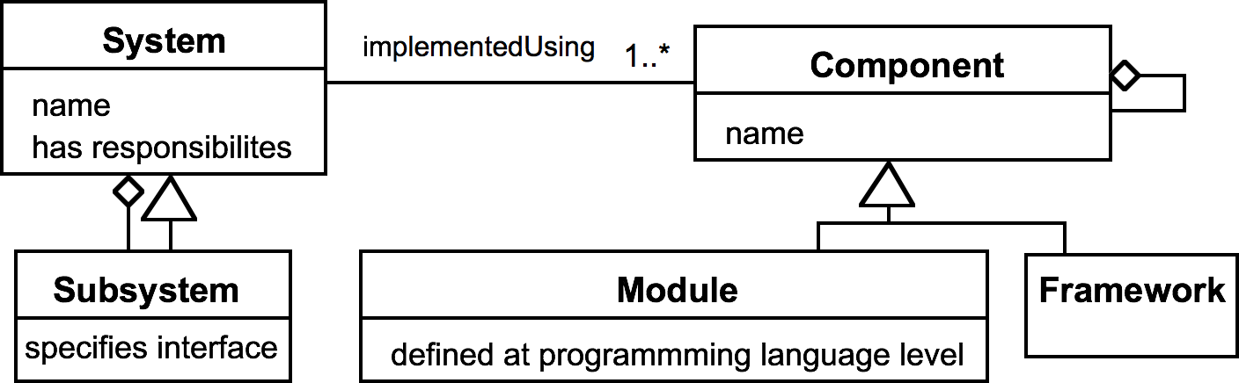
UML diagram of system parts
This notation here is called ”Class diagrams”. It is also used for domain modeling.
You can also use packages in such diagrams
© Lethbridge/Laganière 2001
Chapter 9: Architecting and designing software

Slide 10
Top-down and bottom-up design
Top-down design
  First design the very high level structure of the system.
  Then gradually work down to detailed decisions about low-level constructs.
  Finally arrive at detailed decisions such as:
    the format of particular data items;
    the individual algorithms that will be used.
© Lethbridge/Laganière 2001
Chapter 9: Architecting and designing software

Slide 11
Top-down and bottom-up design
Bottom-up design
  Make decisions about reusable low-level utilities.
  Then decide how these will be put together to create high-level constructs.
A mix of top-down and bottom-up approaches are normally used:
  Top-down design is almost always needed to give the system a good structure.
  Bottom-up design is normally useful so that reusable components can be created.
Which part did you do first?
© Lethbridge/Laganière 2001
Chapter 9: Architecting and designing software

Slide 12
Different aspects of design
√
  Architecture design:
    The division into subsystems and components,
      How these will be connected.
      How they will interact.
      Their interfaces.
  Class design:
    The various features of classes.
  User interface design
  Algorithm design:
    The design of computational mechanisms.
  Protocol design:
    The design of communications protocol.
√
√
Not important in our project (I think?)
Not used in our project
© Lethbridge/Laganière 2001
Chapter 9: Architecting and designing software

Slide 13
9.2 Principles Leading to Good Design
Overall goals of good design:
  Increasing profit by reducing cost and increasing revenue
  Ensuring that we actually conform with the requirements
  Accelerating development
  Increasing qualities such as
    Usability
    Efficiency
    Reliability
    Maintainability
    Reusability
Which of these have been an issue in the project?
Any principles you feel mising?
© Lethbridge/Laganière 2001
Chapter 9: Architecting and designing software

Slide 14
Design Principle 1: Divide and conquer
Trying to deal with something big all at once is normally much harder than dealing with a series of smaller things
  Separate people can work on each part.
  An individual software engineer can specialize.
  Each individual component is smaller, and therefore easier to understand.
  Parts can be replaced or changed without having to replace or extensively change other parts.
Divide and conquer is also used as a strategy for smaller problems. Breaking user stories into tasks.
© Lethbridge/Laganière 2001
Chapter 9: Architecting and designing software

Slide 15
Ways of dividing a software system
  A distributed system is divided up into clients and servers
  A system is divided up into subsystems
  A subsystem can be divided up into one or more packages
  A package is divided up into classes
  A class is divided up into methods
A method is broken up into smaller methods
© Lethbridge/Laganière 2001
Chapter 9: Architecting and designing software

Slide 16
Design Principle 2:
Increase cohesion where possible
A subsystem or module has high cohesion if
it keeps together things that are related to each other,
and keeps out other things
This makes the system as a whole easier to understand and change
  Type of cohesion:
    Functional,
    Layer,
    Communicational
Det danske ord for cohesion
er sammenhængskraft
© Lethbridge/Laganière 2001
Chapter 9: Architecting and designing software

Slide 17
Functional cohesion
This is achieved when all the code that computes a particular result is kept together - and everything else is kept out
  i.e. when a module only performs a single computation, and returns a result, without having side-effects.
© Lethbridge/Laganière 2001
Chapter 9: Architecting and designing software

Slide 18
Layer cohesion
All the facilities for providing or accessing a set of related services are kept together, and everything else is kept out
  The layers should form a hierarchy
    Higher layers can access services of lower layers,
    Lower layers do not access higher layers
  The set of procedures through which a layer provides its services is the application programming interface (API)
  You can replace a layer without having any impact on the other layers
    You just replicate the API
The facade is an example of layered cohesion
© Lethbridge/Laganière 2001
Chapter 9: Architecting and designing software

Slide 19
Communicational cohesion
All the modules that access or manipulate certain data are kept together (e.g. in the same class) - and everything else is kept out
  A class would have good communicational cohesion
    if all the system’s facilities for storing and manipulating its data are contained in this class.
    if the class does not do anything other than manage its data.
  Main advantage: When you need to make changes to the data, you find all the code in one place
The database acces classes is an example of communicationa cohesion – it is the only thing talking to the database
© Lethbridge/Laganière 2001
Chapter 9: Architecting and designing software

Slide 20
Utility cohesion
When related utilities which cannot be logically placed in other cohesive units are kept together
  A utility is a procedure or class that has wide applicability to many different subsystems and is designed to be reusable.
  For example, the java.lang.Math class.
I believe many of you have used utility cohesion to handle SVG
© Lethbridge/Laganière 2001
Chapter 9: Architecting and designing software

Slide 21
List of project examples of cohesion:
© Lethbridge/Laganière 2001
Chapter 9: Architecting and designing software

Slide 22
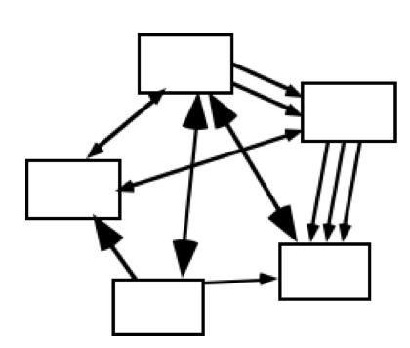
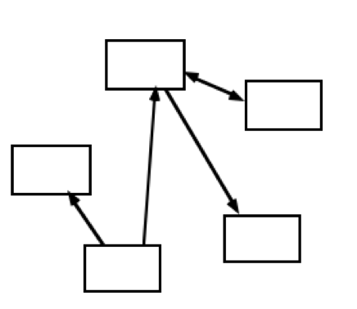
Design Principle 3:
Reduce coupling where possible
Coupling occurs when there are interdependencies between one module and another
  When interdependencies exist, changes in one place will require changes somewhere else.
  A network of interdependencies makes it hard to see at a glance how some component works.
© Lethbridge/Laganière 2001
Chapter 9: Architecting and designing software

Slide 23
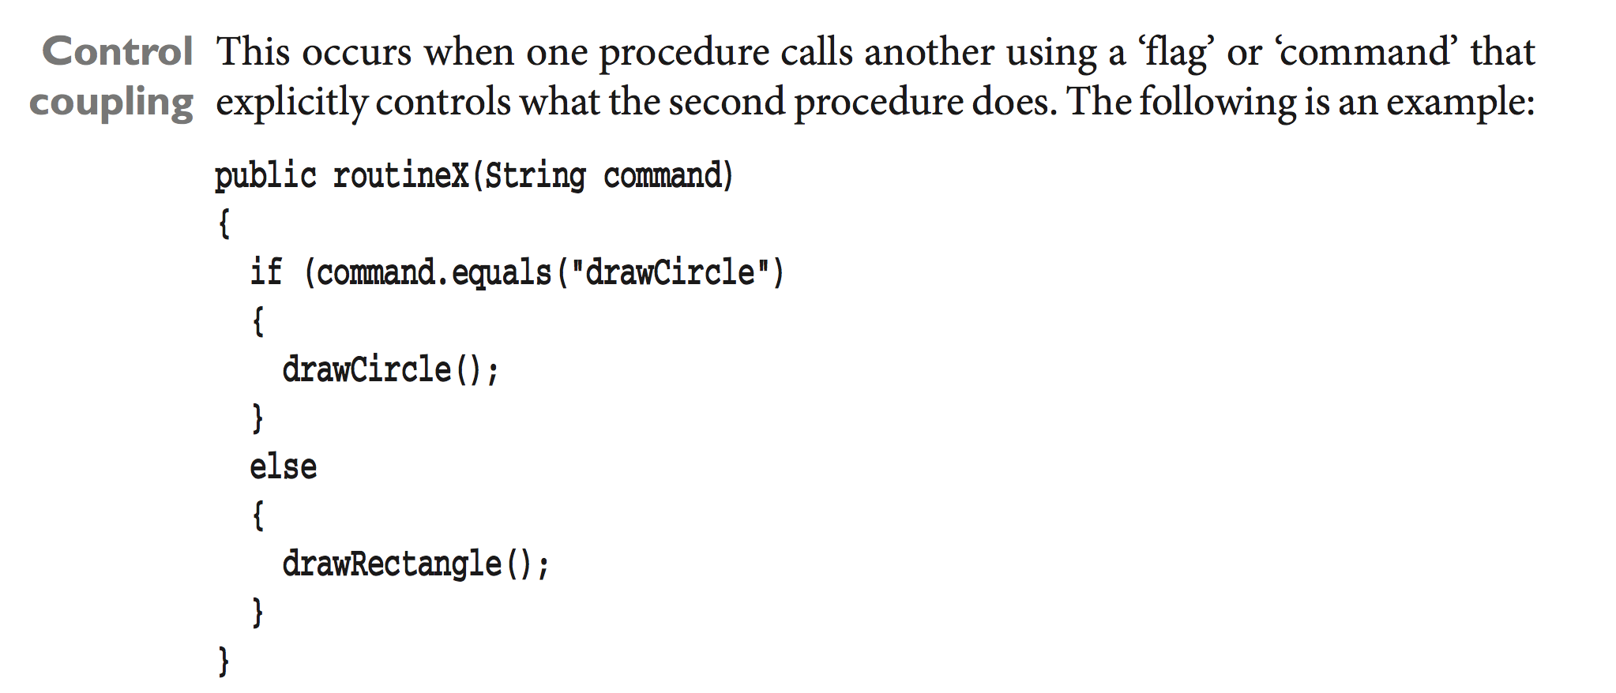
Type of coupling:
  Type of coupling:
    Content is modified in an other module (lack of private),
    Common or shared data (e.g. public static fields),
    Control using ”command paramters”
    Stamp or unnecessary generality in paramters,
    Data or lack of encapsulation (the opposite of stamp),
    Routine Call or lack of small methods,
    Type use or use interfaces over classes,
    Inclusion/Import or include only what you need,
    External or isolate external dependencies (os, db,...)
© Lethbridge/Laganière 2001
Chapter 9: Architecting and designing software

Slide 24
Content coupling:
Examples of techniques which reduce coupling:
The facade pattern
Usage of interfaces
Private fields and methods
Package level classes
Proper exception handling
Making components testable
© Lethbridge/Laganière 2001
Chapter 9: Architecting and designing software

Slide 25
Design Principle 4:
Keep the level of abstraction as high as possible
Ensure that your designs allow you to hide or defer consideration of details, thus reducing complexity
  A good abstraction is said to provide information hiding
  Abstractions allow you to understand the essence of a subsystem without having to know unnecessary details
© Lethbridge/Laganière 2001
Chapter 9: Architecting and designing software

Slide 26
Abstraction and classes
Classes are data abstractions that contain procedural abstractions
  Abstraction is increased by defining all variables as private.
  The fewer public methods in a class, the better the abstraction
  Superclasses and interfaces increase the level of abstraction
  Attributes and associations are also data abstractions.
  Methods are procedural abstractions
    Better abstractions are achieved by giving methods fewer parameters
© Lethbridge/Laganière 2001
Chapter 9: Architecting and designing software

Slide 27
Design Principle 6:
Reuse existing designs and code where possible
Design with reuse is complementary to design for reusability
  Actively reusing designs or code allows you to take advantage of the investment you or others have made in reusable components
    Cloning should not be seen as a form of reuse
© Lethbridge/Laganière 2001
Chapter 9: Architecting and designing software

Slide 28
Design Principle 10: Design for Testability
Take steps to make testing easier
© Lethbridge/Laganière 2001
Chapter 9: Architecting and designing software

Slide 29

Break before patterns & architecture
© Lethbridge/Laganière 2001
Chapter 9: Architecting and designing software

Slide 30
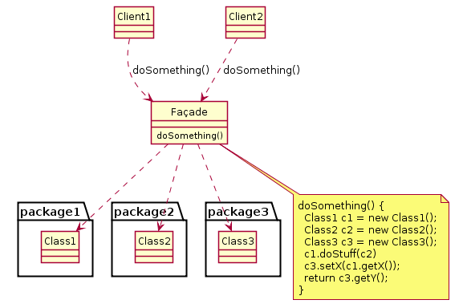
The Façade pattern
How do you simplify the view that programmers have of a complex package?
© Lethbridge/Laganière 2001
Chapter 9: Architecting and designing software

Slide 31
The Read-Only Interface pattern
How do you create a situation where some classes see a class as read-only
Create a class User as you would create any other class. You pass instances of this class to methods that need to make changes.
Then create a public interface we will call the ReadOnlyUser, that has only the read-only operations of Building– that is, only operations that get its values.
Great for controlling coupling
© Lethbridge/Laganière 2001
Chapter 9: Architecting and designing software

Slide 32
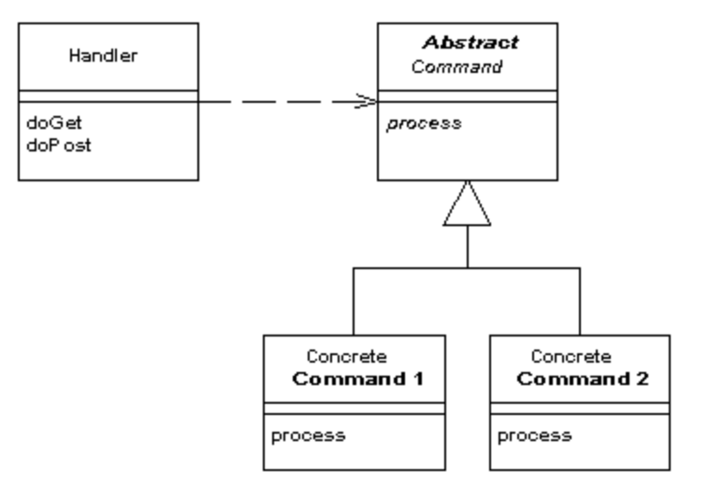
Front controller
Handle security, internationalization, and providing particular views for certain users in a uniform manner.
The Front Controller consolidates all request handling by channeling requests through a single handler object.
© Lethbridge/Laganière 2001
Chapter 9: Architecting and designing software

Slide 33
9.5 Architectural Patterns
The notion of patterns can be applied to software architecture.
  These are called architectural patterns or architectural styles.
  Each allows you to design flexible systems using components
    The components are as independent of each other as possible.
© Lethbridge/Laganière 2001
Chapter 9: Architecting and designing software

Slide 34
The Multi-Layer architectural pattern
In a layered system, each layer communicates only with the layer immediately below it.
  Each layer has a well-defined interface used by the layer immediately above.
    The higher layer sees the lower layer as a set of services.
  A complex system can be built by superposing layers at increasing levels of abstraction.
    It is important to have a separate layer for the UI.
    Layers immediately below the UI layer provide the application functions determined by the use-cases.
    Bottom layers provide general services.
      e.g. network communication, database access
© Lethbridge/Laganière 2001
Chapter 9: Architecting and designing software

Slide 35
Example of multi-layer systems
Application programs
Screen display
facilities
Dealing with
application protocols
User account
User
management
Dealing with
interface
connections
File
Application
system
Dealing with
logic
packets
Kernel
Operating system
Database
Network
(handling processes
Transmitting
access
access
communication
and swapping)
and receiving
a) Typical layers in an
b) Typical layers in an
c) Simplified view of layers
application program
operating system
in a communication system
© Lethbridge/Laganière 2001
Chapter 9: Architecting and designing software

Slide 36
The multi-layer architecture and design principles
Notice – these are the arguments for why we use the tree level architecture
  1. Divide and conquer: The layers can be independently designed.
  2. Increase cohesion: Well-designed layers have layer cohesion.
  3. Reduce coupling: Well-designed lower layers do not know about the higher layers and the only connection between layers is through the API.
  4. Increase abstraction: you do not need to know the details of how the lower layers are implemented.
  5. Increase reusability: The lower layers can often be designed generically.
Domain classes are a special case and is seen from layers above and below
© Lethbridge/Laganière 2001
Chapter 9: Architecting and designing software

Slide 37
The multi-layer architecture and design principles
  6. Increase reuse: You can often reuse layers built by others that provide the services you need.
  7. Increase flexibility: you can add new facilities built on lower-level services, or replace higher-level layers.
  8. Anticipate obsolescence: By isolating components in separate layers, the system becomes more resistant to obsolescence.
  9. Design for portability: All the dependent facilities can be isolated in one of the lower layers.
  10. Design for testability: Layers can be tested independently.
  11. Design defensively: The APIs of layers are natural places to build in rigorous assertion-checking.
© Lethbridge/Laganière 2001
Chapter 9: Architecting and designing software

Slide 38
The Model-View-Controller (MVC) architectural pattern
An architectural pattern used to help separate the user interface layer from other parts of the system
  The model contains the underlying classes whose instances are to be viewed and manipulated
  The view contains objects used to render the appearance of the data from the model in the user interface
  The controller contains the objects that control and handle the user’s interaction with the view and the model
© Lethbridge/Laganière 2001
Chapter 9: Architecting and designing software

Slide 39
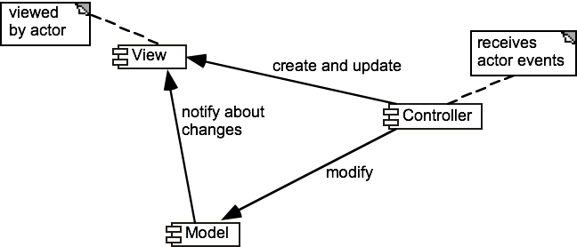
Example of the MVC architecture for the UI
MVC in web architectures
Web architectures generally use MVC as follows:
The View component (JSP) generates html for display by the browser.
There is a component that interprets http ‘post’ transmissions coming back from the browser (Servlet) – this is the Controller.
There is an underlying system for managing the information – this is the Model.
© Lethbridge/Laganière 2001
Chapter 9: Architecting and designing software

Slide 40
The MVC architecture and design principles
  1. Divide and conquer: The three components can be somewhat independently designed.
  2. Increase cohesion: The components have stronger layer cohesion than if the view and controller were together in a single UI layer.
  3. Reduce coupling: The communication channels between the three components are minimal.
  6. Increase reuse: The view and controller normally make extensive use of reusable components for various kinds of UI controls.
  7. Design for flexibility: It is usually quite easy to change the UI by changing the view, the controller, or both.
  10. Design for testability: You can test the application separately from the UI.
© Lethbridge/Laganière 2001
Chapter 9: Architecting and designing software

Slide 41
9.6 Writing a Good Design Document
Design documents as an aid to making better designs
  They force you to be explicit and consider the important issues before starting implementation.
  They allow a group of people to review the design and therefore to improve it.
  Design documents as a means of communication.
    To those who will be implementing the design.
    To those who will need, in the future, to modify the design.
    To those who need to create systems or subsystems that interface with the system being designed.
© Lethbridge/Laganière 2001
Chapter 9: Architecting and designing software

Slide 42
Structure of a design document
  A. Purpose:
    What system or part of the system this design document describes.
    Make reference to the requirements that are being implemented by this design (traceability) .
  B. General priorities:
    Describe the priorities used to guide the design process.
  C. Outline of the design:
    Give a high-level description of the design that allows the reader to quickly get a general feeling for it.
  D. Major design issues:
    Discuss the important issues that had to be resolved.
    Give the possible alternatives that were considered, the final decision and the rationale for the decision.
  E. Other details of the design:
    Give any other details the reader may want to know that have not yet been mentioned.
© Lethbridge/Laganière 2001
Chapter 9: Architecting and designing software

Slide 43
When writing the document
  Avoid documenting information that would be readily obvious to a skilled peer programmer or designer.
  Avoid writing details in a design document that would be better placed as comments in the code.
  Avoid writing details that can be extracted automatically from the code, such as the list of public methods.
© Lethbridge/Laganière 2001
Chapter 9: Architecting and designing software

