Slide 1
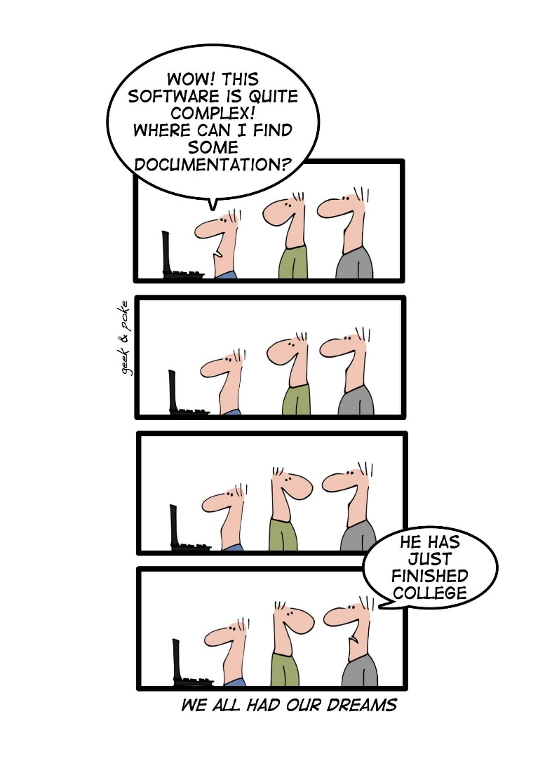

17-03-2017
By end of today
Vision
Goals
Feature list
Activity Diagram
Domain model

Slide 2
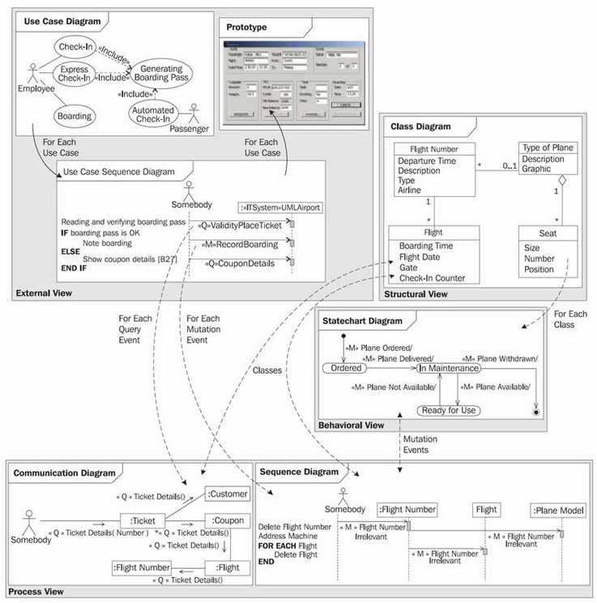
Different views of an IT system
External View—Use case diagram and Use Case Sequence diagram
Structural View—Class diagram
Interaction View—Sequence diagram and Communication diagram
Behavioral View—Statechart diagram

Slide 3
Requirements
Functional
Non-functional
A requirement specifies a function that a system or component must be able to perform.
Can be formulated in various ways:
SCRUM & XP: User stories
UP: Use cases
Features list
A non-functional requirement is a statement of how a system must behave, it is a constraint upon the systems behavior.
Non-functional requirements specify all the remaining requirements not covered by the functional requirements
They specify criteria that judge the operation of a system, rather than specific behaviors
"Display of the students satisfaction level must appear within 2 milliseconds."

Slide 4
Traceability of requirements
Purpose / Vision Through the introduction of a new order management system to ensure:
Goals
Features
F.1: Ordering by web
F.2: Online stock update
F.3: Online-help for users
F.4:
F.X:
Goal1: Customer satisfaction rises min. 0.5 at next satisfaction survey Goal 2: Resale to existing customers increased by 10% the first year after installation of the system.
Goal 3: 70% of all customers should be able to use systems without problems
Goal X:
V.1: Increased customer satisfaction V.2: Increase turnover V.3: Higher efficiency

Slide 5

Creating SMART goals
S-pecific
M-easurable
A-ttainable
R-ealistic
T-imely

Slide 6
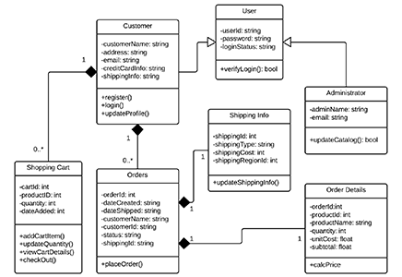
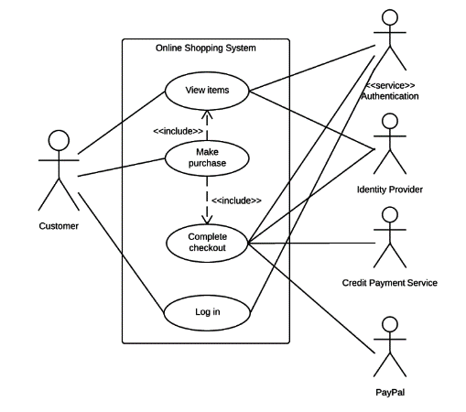
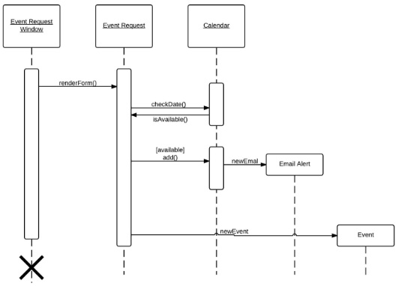
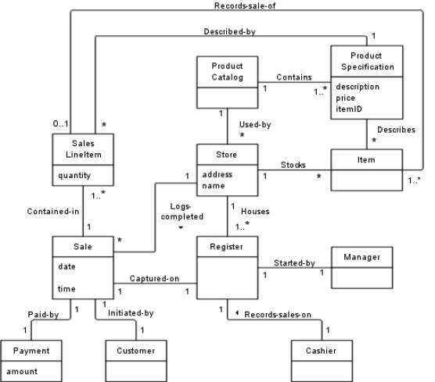
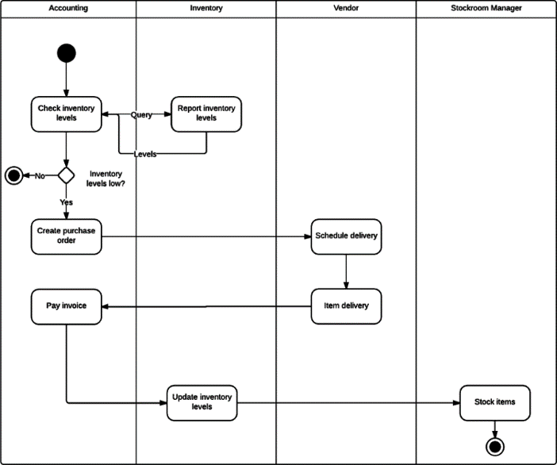
UML Diagrams
Class diagram
Use case diagram
Sequence diagram
Domain model
Activity diagram

