Slide 1
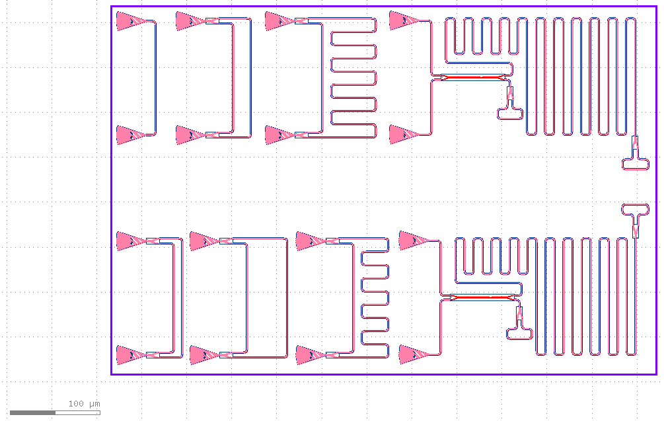







MIB, , $ΔL=4576.6μ$m
loopback
50 $μ$m MZI
500 $μ$m MZI
30 $μ$m MZI
100 $μ$m MZI
300 $μ$m MZI
MIA, $ΔL=4301.1 μ$m

