Slide 1
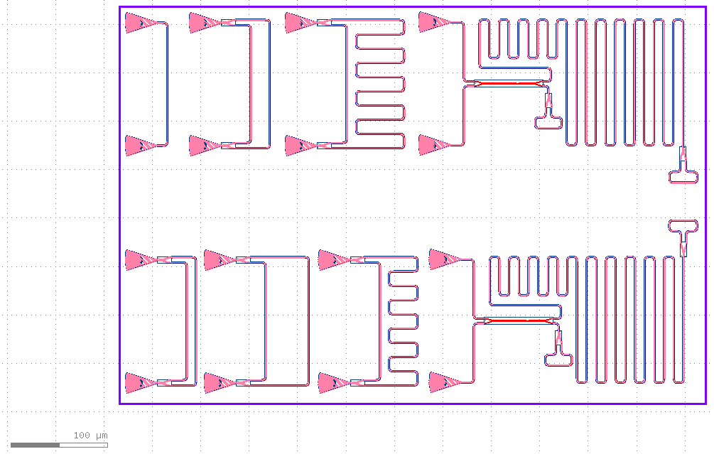





Michelson Interferometer 2
GC de-embedding
50 $μ$m MZI
500 $μ$m MZI
Michelson Interferometer 1
30 $μ$m MZI
100 $μ$m MZI
300 $μ$m MZI

