Slide 1

Swiggy Case Analysis
Key Insights from Swiggy's Data Analysis

Slide 2
Agenda
Introduction
Menu Pricing Analysis
Restaurant Performance Evaluation
Revenue Trends and Growth
Highest Repeat Patronage

Slide 3

Introduction
Dive into Swiggy's data-driven narrative. Analyze operational strategies, customer behavior, and financial performance to unveil insights driving its success in the competitive food delivery landscape. Discover key metrics shaping its trajectory and unearth actionable recommendations for sustained growth.
3

Slide 4
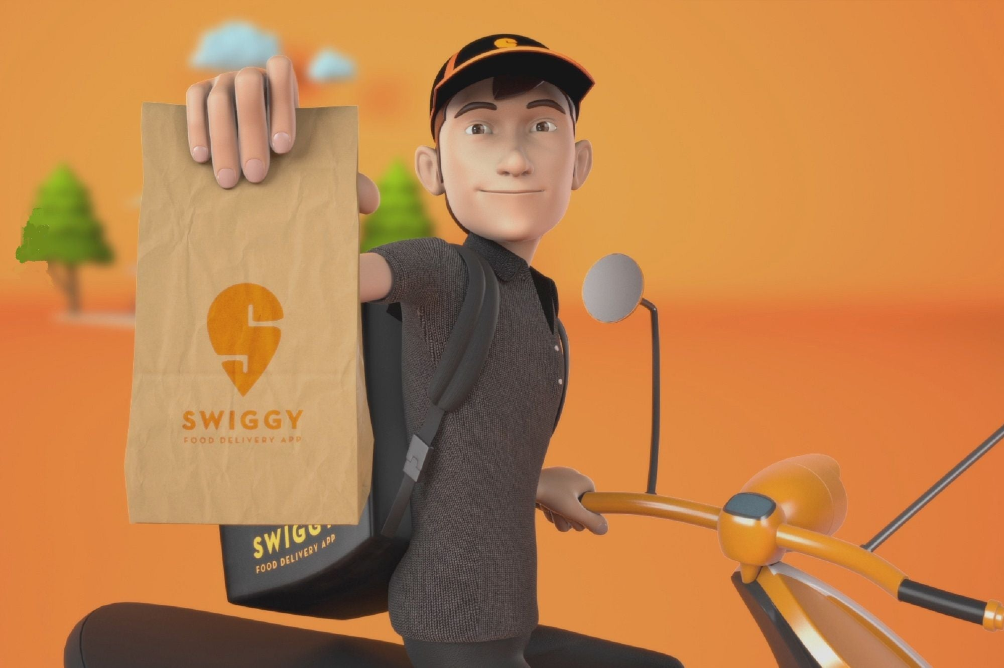
Menu Pricing Analysis

Slide 5
Average Dish Price
5

Slide 6



Insights
Price Analysis
Non-Veg Pizza and Pizza command higher average prices, suggesting potential for premium offerings.
Choco Lava Cake, with its lower average price, could attract budget-conscious customers seeking dessert options
Customer Preferences
Choco Lava Cake's lower average price suggests it may appeal to customers with a sweet tooth.
Masala Dosa and Veg Manchurian, moderately priced, are likely preferred options for budget-conscious diners seeking fulfilling meals.
Popular Picks
Chicken Wings and Chicken Popcorn, moderately priced, likely serve as popular snack choices.
Masala Dosa and Veg Manchurian, with average prices, cater to customers seeking familiar and satisfying meals.
6

Slide 7
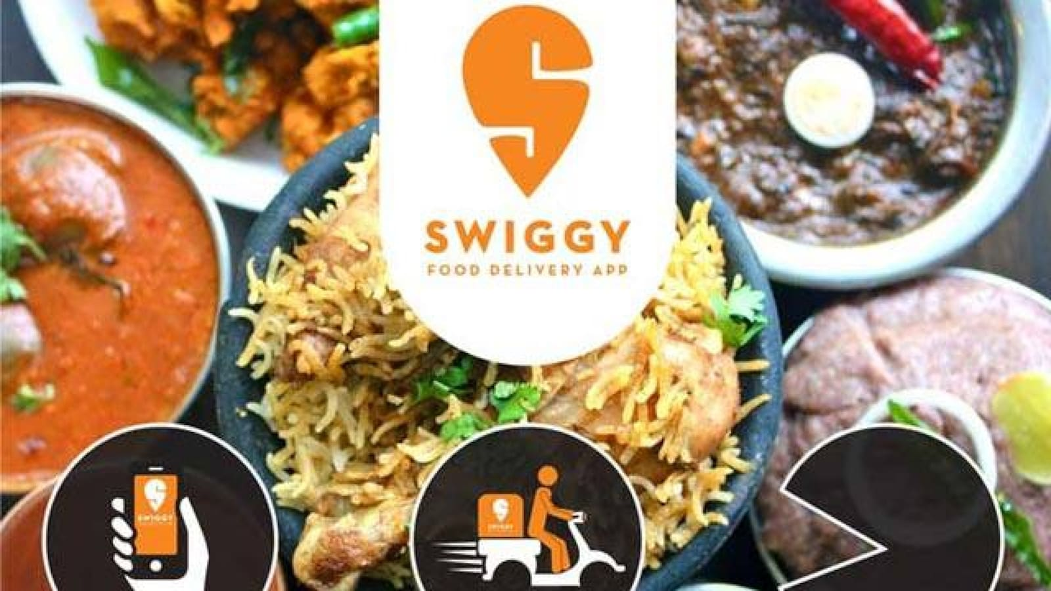
Restaurant Performance Evaluation ( June 2022 )

Slide 8
Insights
Performance Variation
KFC leads in the number of orders for June, indicating strong customer demand and brand loyalty.
Box8 closely follows KFC, suggesting a competitive position and effective customer engagement strategies.
Strong Revenue Performance
Dominos achieved a remarkable monthly sales figure of 950 units, while KFC closely followed with 990 units.
This indicates a high level of customer demand and effective sales strategies implemented by both restaurants.
With such high sales volumes, these restaurants hold a competitive edge over others in the industry, leveraging their brand reputation and customer loyalty to drive revenue.
8

Slide 9

Restaurants with the Highest Repeat Patronage

Slide 10
Insights
Repeat Business
Box8, KFC, and Dosa Plaza stand out as restaurants with the highest number of repeated customers.
This indicates a strong level of customer loyalty and satisfaction, as customers continue to patronize these establishments for their dining needs.
Retention Strategies
These restaurants likely implement effective customer retention strategies, such as loyalty programs, personalized offers, or consistent quality of service and food.
By prioritizing customer satisfaction and fostering long-term relationships, they successfully encourage customers to return for multiple visits.
10

Slide 11
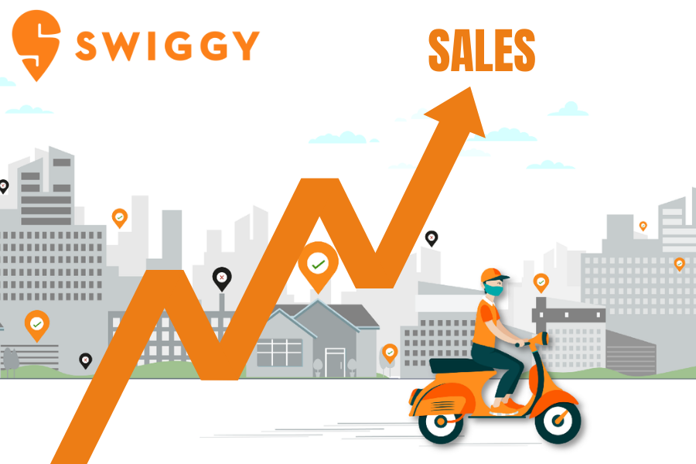
Revenue Trends and Growth

Slide 12
Revenue Growth
Time period | Total Sales | Growth %
May | 2425 | -
June | 3220 | 32.78
July | 4845 | 50.47
Swiggy's revenue showed steady month-over-month growth, rising from May to July.
The revenue increased by 32.78% from May to June and by 50.47% from June to July.
12

Slide 13
Revenue Growth
Revenue spikes suggest potential seasonal trends or shifts in consumer demand.
13

Slide 14

Meet our team
Vaibhav Kumar
14

Slide 15
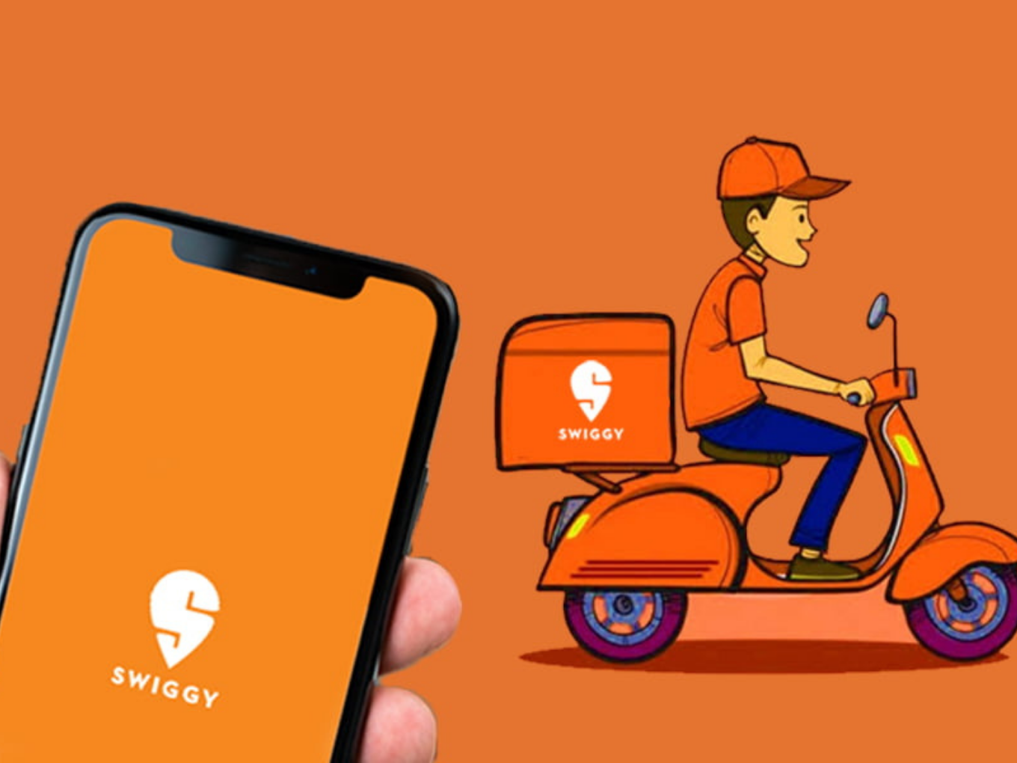
Summary
Swiggy's data reveals insights crucial to its success. From identifying restaurants with high order volumes to understanding customer preferences, every aspect contributes to its growth. Consistent revenue increases highlight effective operational strategies, while insights into repeat customers and top-performing months provide valuable direction for future initiatives. Swiggy's ability to leverage data for actionable insights underscores its position as a leader in the food delivery industry, poised for continued expansion and innovation.
15

Slide 16
Thank you
Vaibhav Kumar

