Slide 1


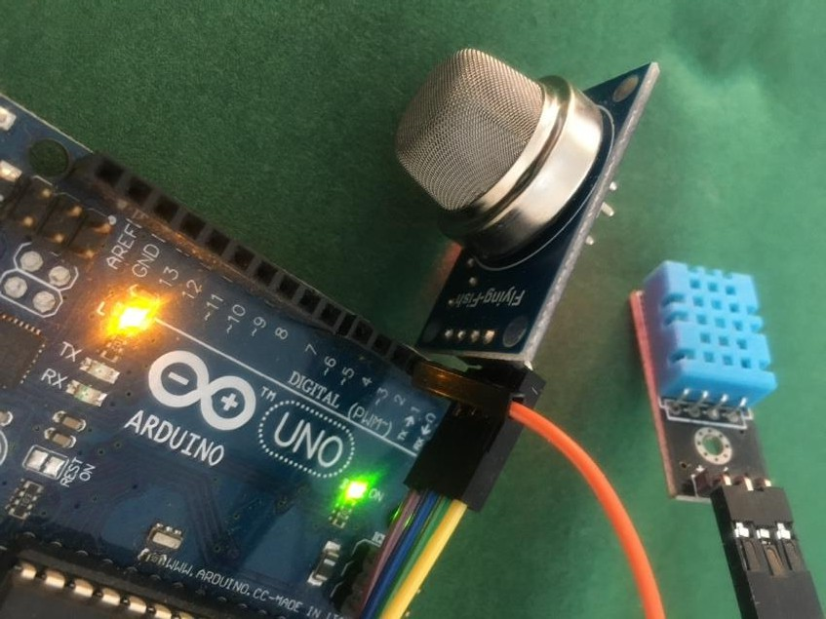
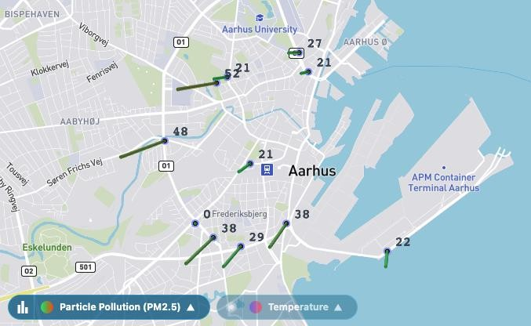
DATA ENGINEERING

Slide 2
API tooling
Web
Dev
Web
Scrape
Recap
Logning
TryCatch
bilbasen
Rscript
books
….

Slide 3

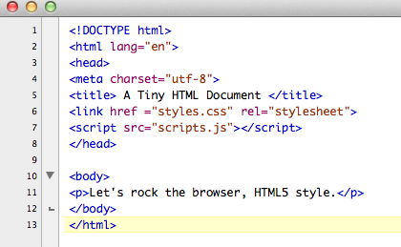



Slide 4
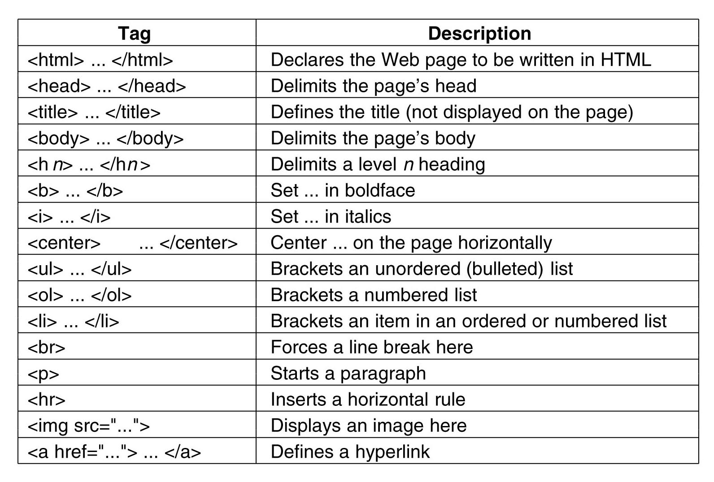

Slide 5
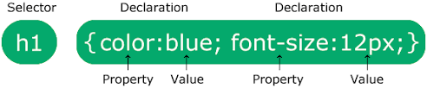
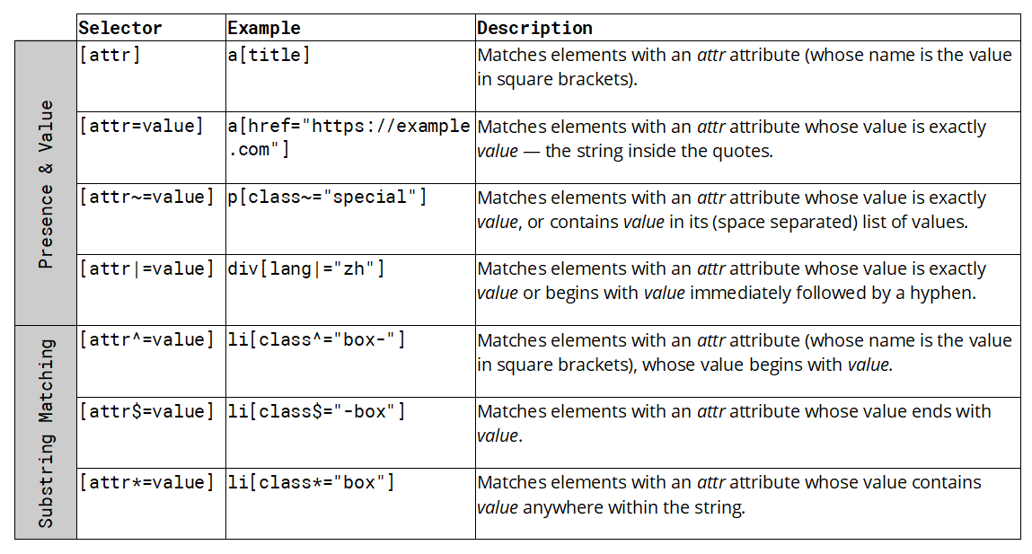
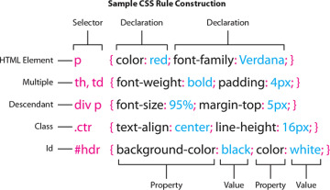

Slide 6
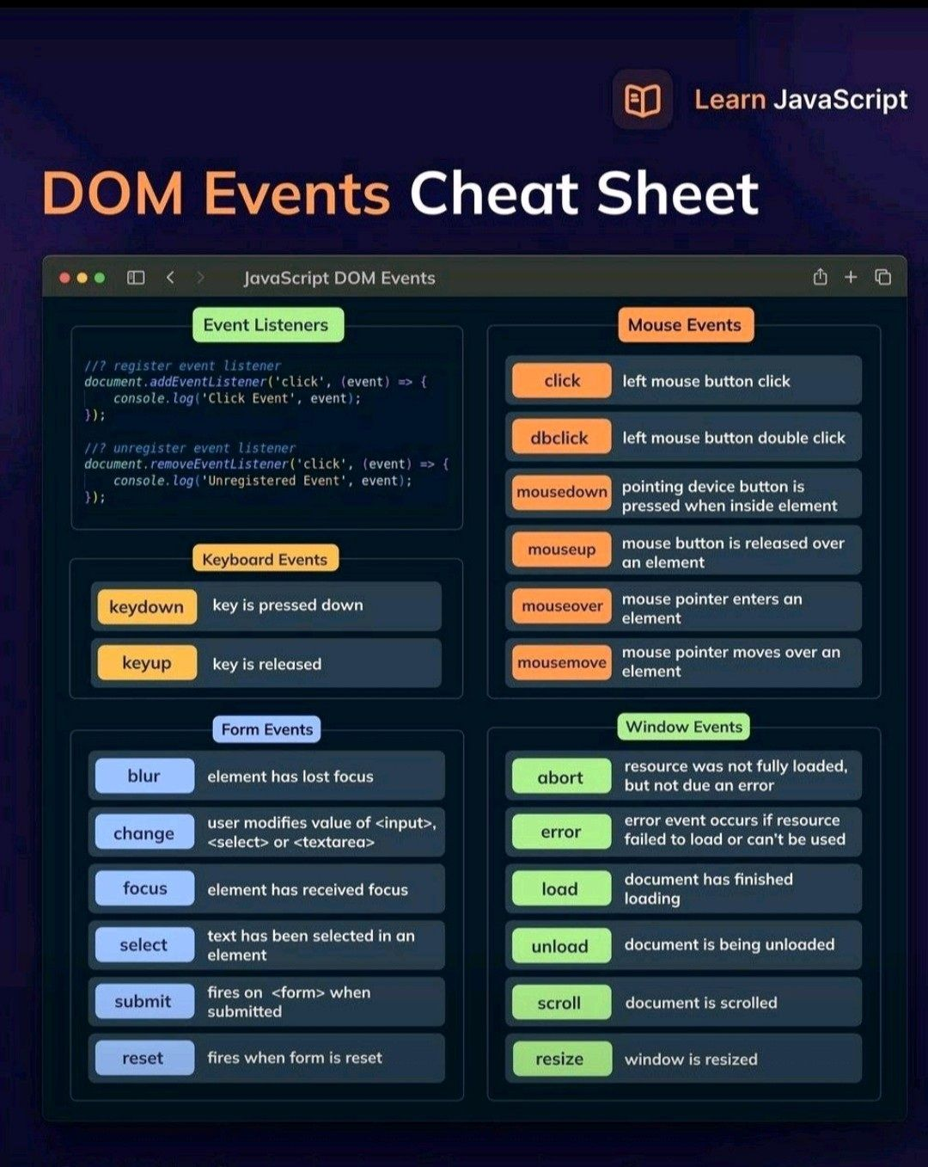
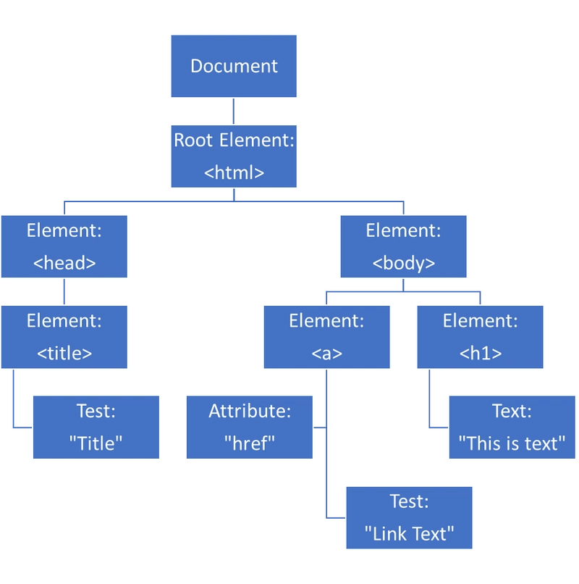
+

Slide 7
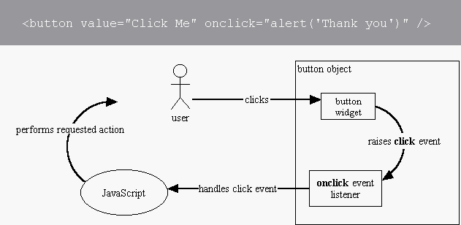
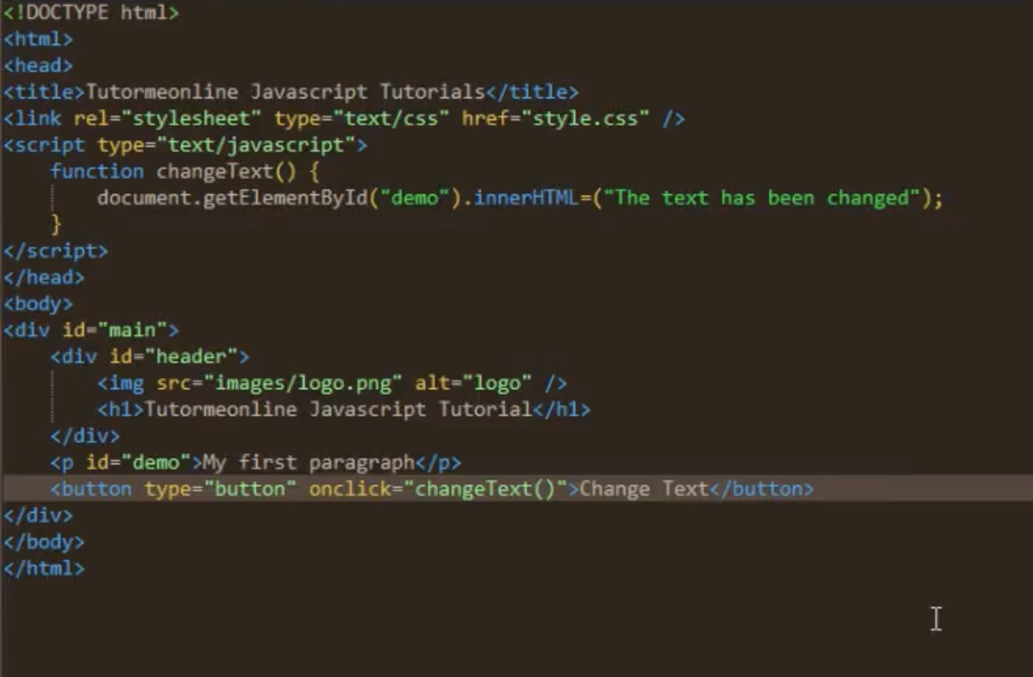

+

Slide 8

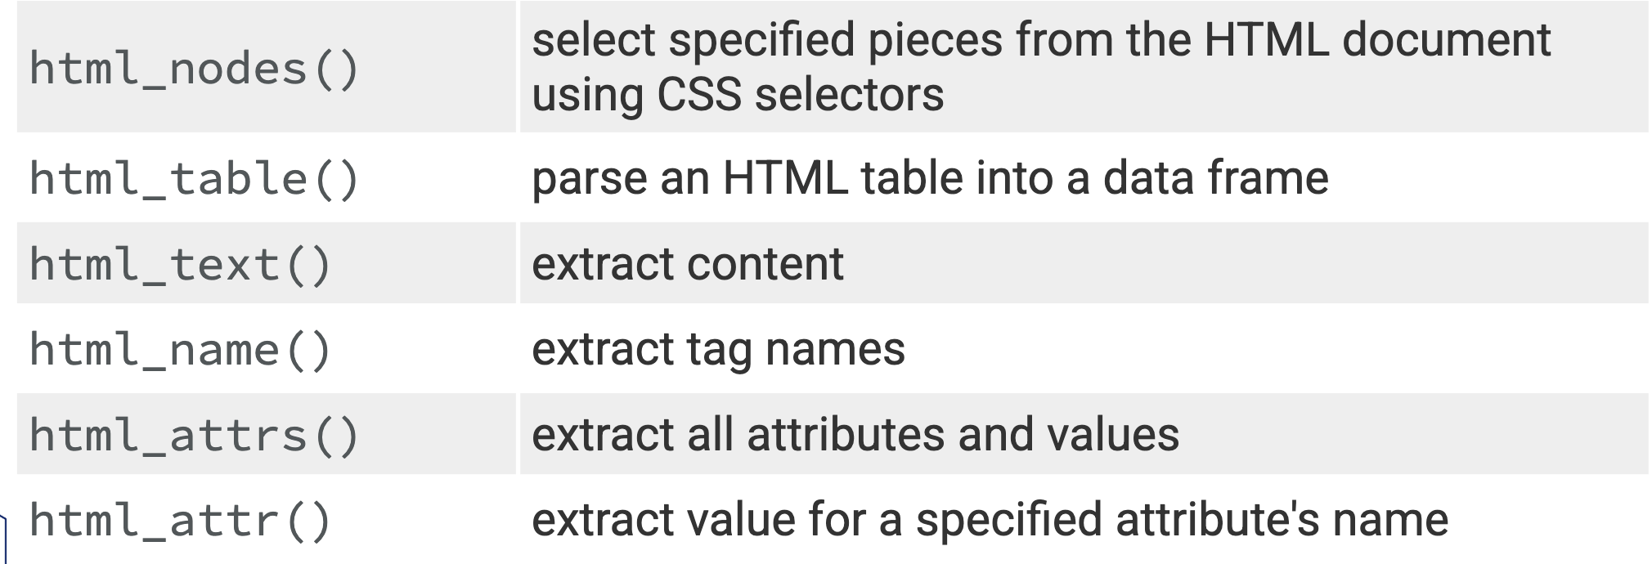
Select
Extract
Read
read_html
html_elements
html_attr
html_text
Webscrape

Slide 9


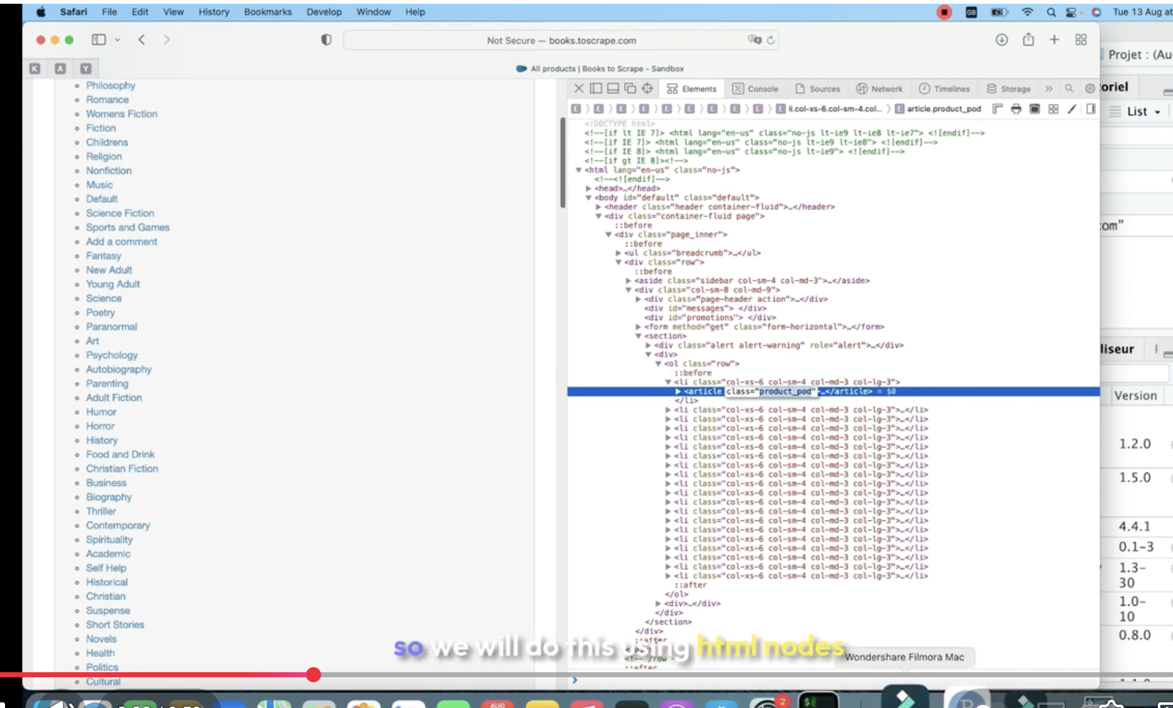
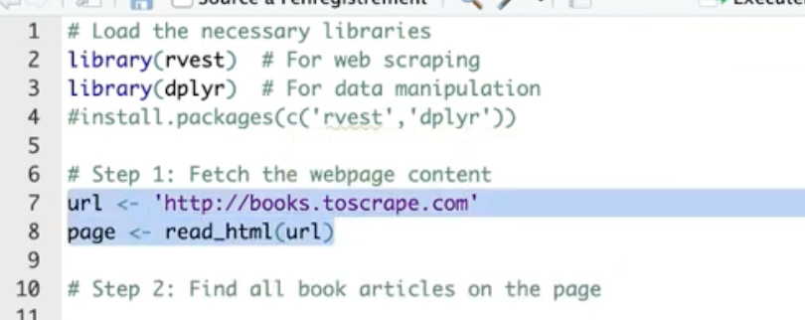
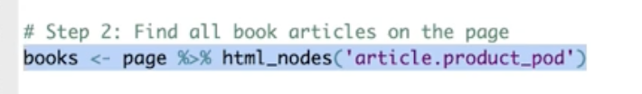
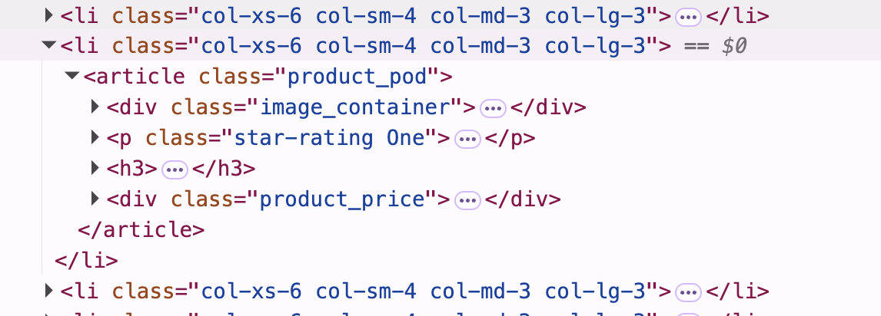
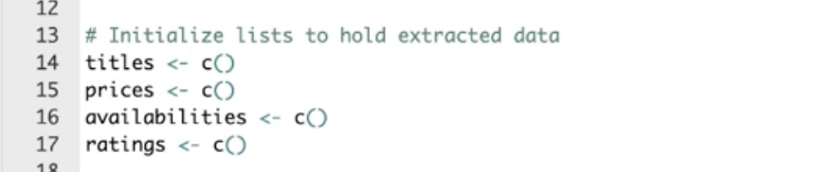
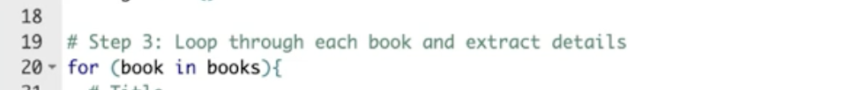
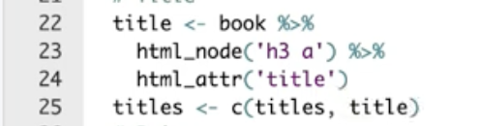
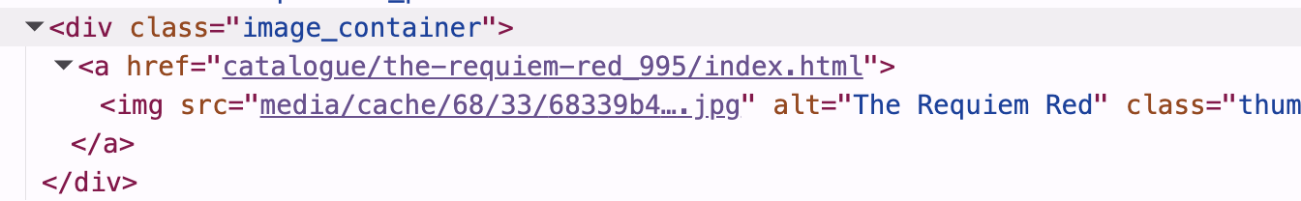
Ibtissam

Slide 10
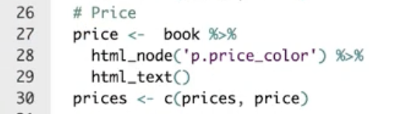

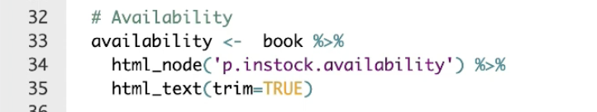
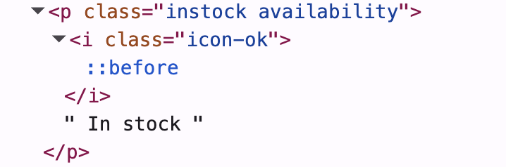
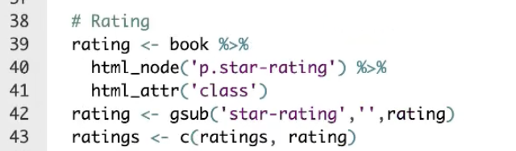
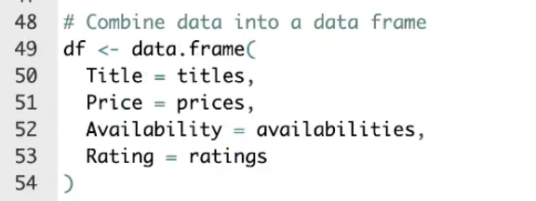
Ibtissam

Slide 11
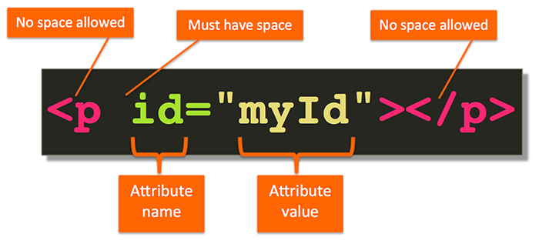
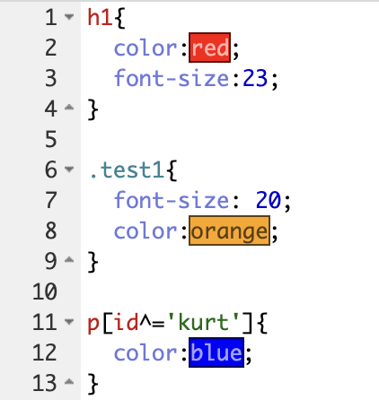
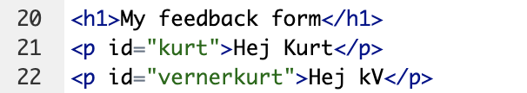
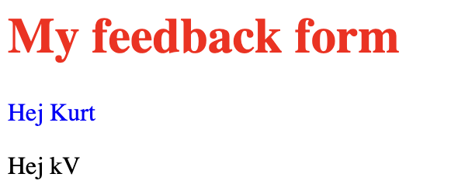


Ibtissam

Slide 12
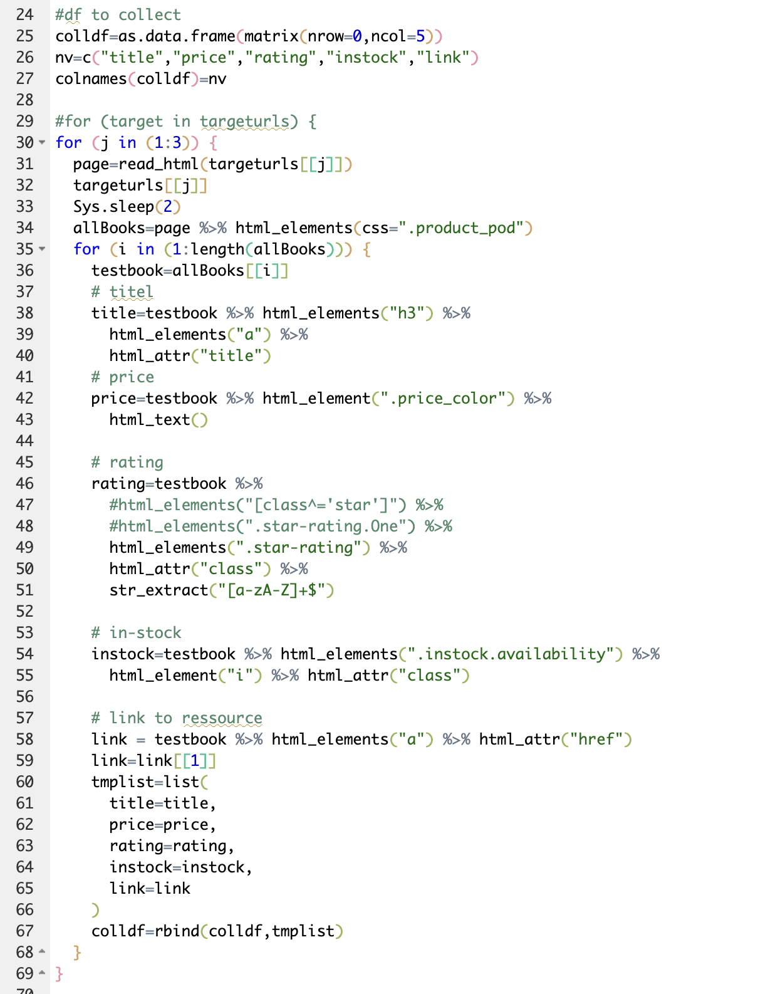
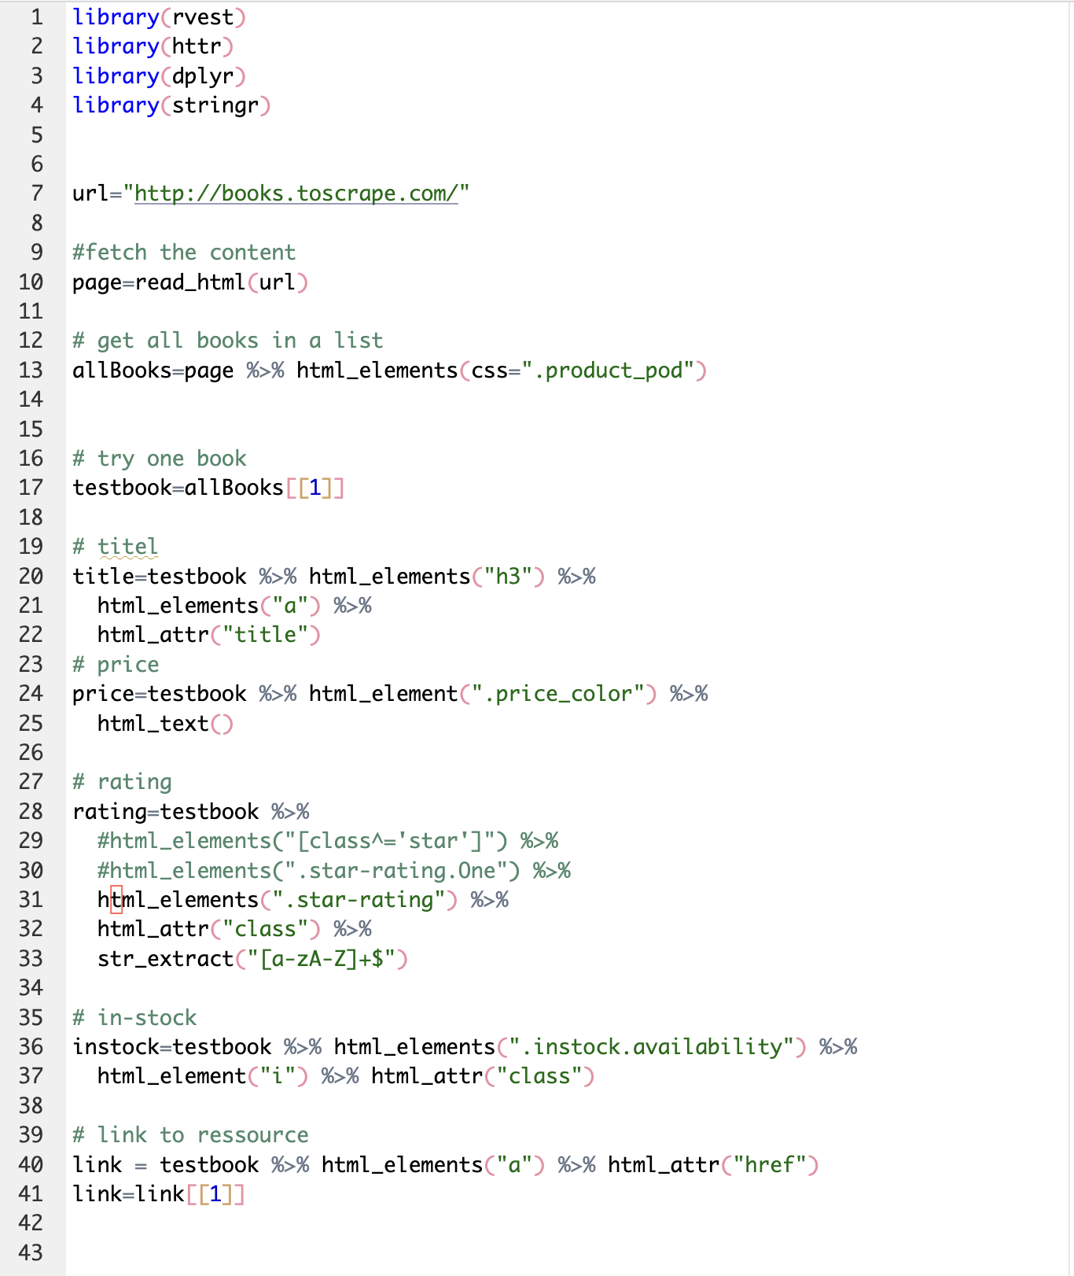
Ibtissam

Slide 13






Webscrape – flow
Analyse webpage structure
Find the start-link
read_html(link) select elements
extract data
load into data-frame
save to data-base
paging process - (rselenium)

Slide 14
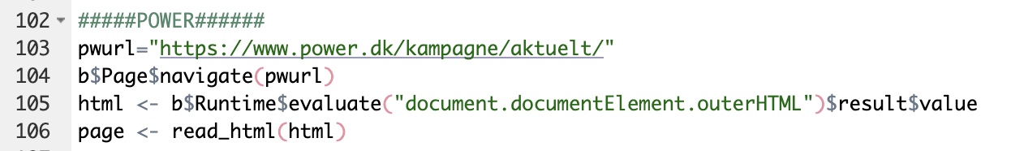

Webscrape – flow
Analyse webpage structure
Find the start-link
read_html(link) get outerHTML
Read outer html
….
save to data-base
paging process - (rselenium)
Navigate to page with chrome

Slide 15
Bilbasen
Read link with read_html(link)
Select parts of a document
  CSS selectors: html_nodes(doc, "table td")
  XPath selectors: html_nodes(doc, xpath = "//table//td")).
Extract components with
  html_name() (the name of the tag),
  html_text() (all text inside the tag),
  html_attr() (contents of a single attribute) and
  html_attrs() (all attributes).
Parse tables into data frames with html_table().

Slide 16
Bilbasen
Read
read_html
Select
html_nodes
Extract
html_attr
html_text

Slide 17
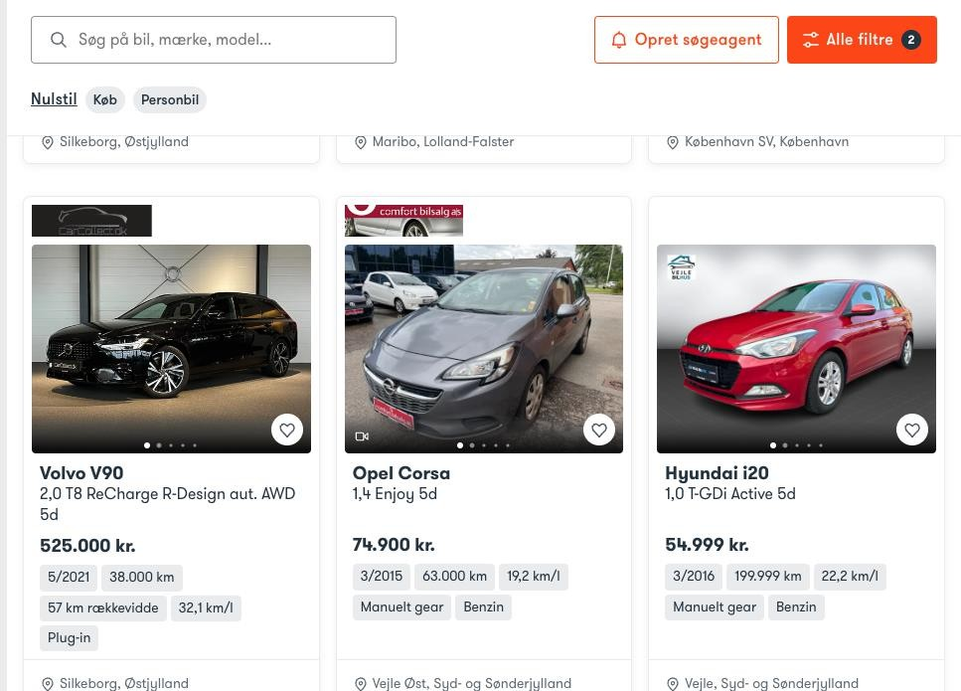

Slide 18
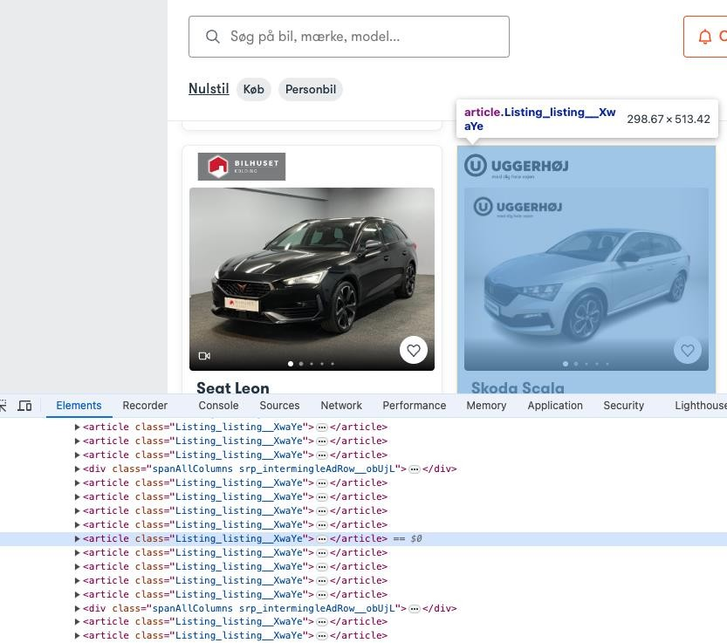
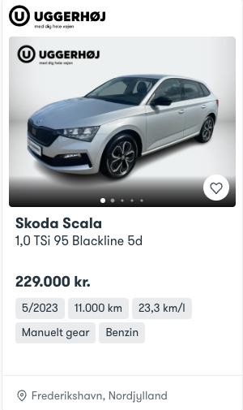

Slide 19

Forhandler
Make
Type
Displ
Description
Price
Milage
Year
Fuel
Seller
Region

Slide 20
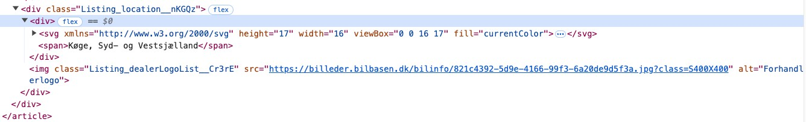
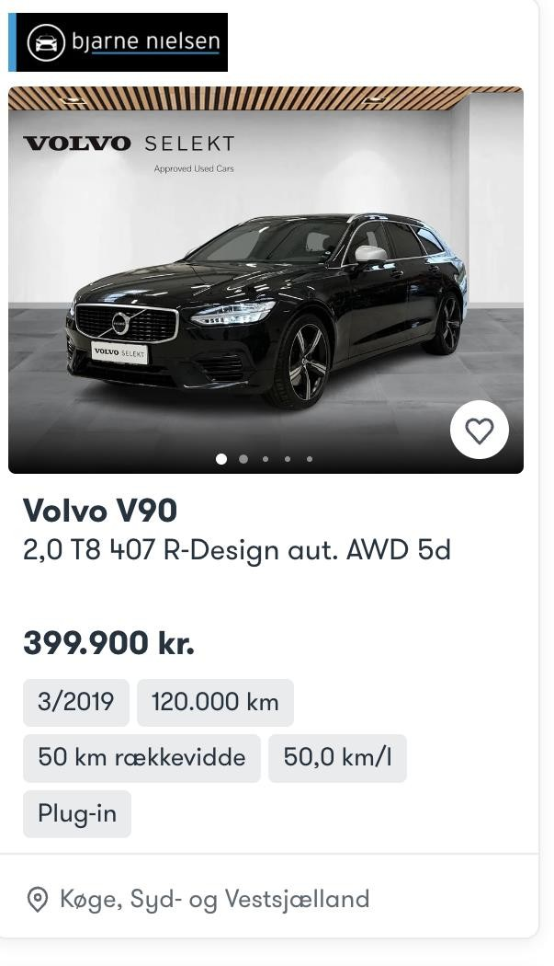
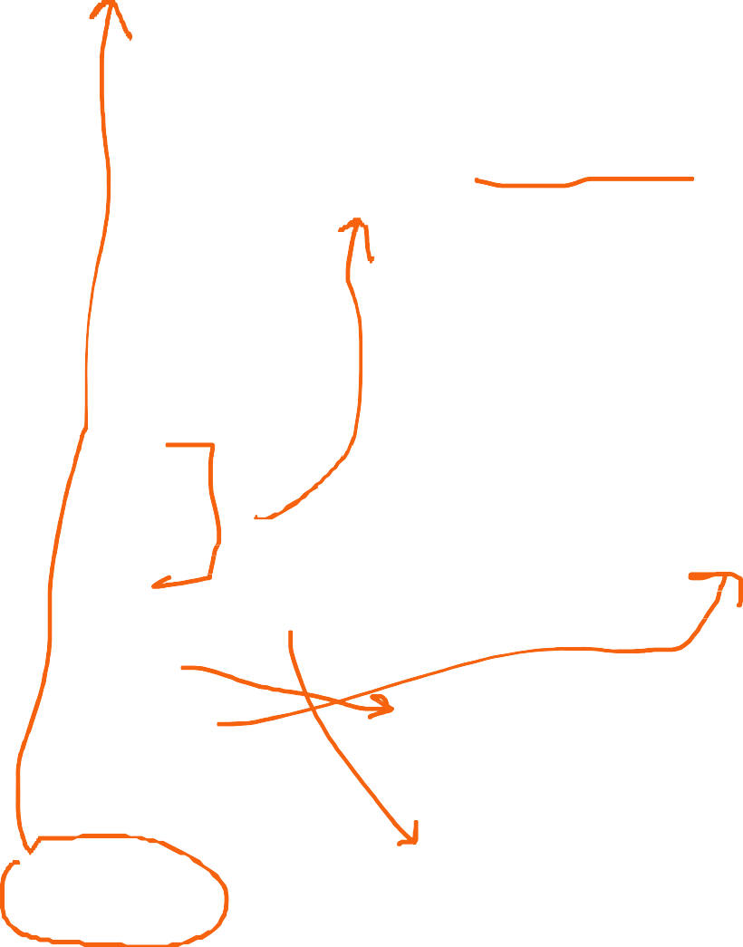
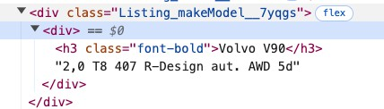
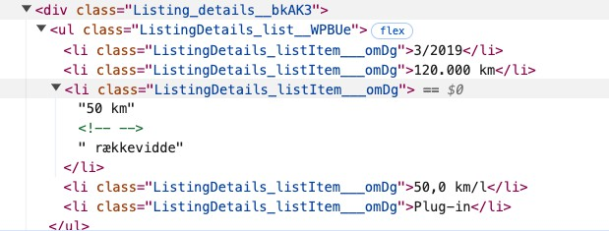
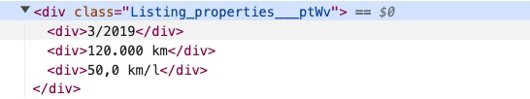

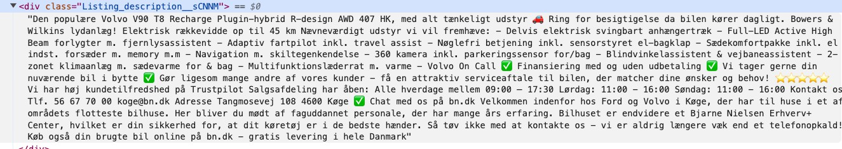
Forhandler
Make
Type
Displ
Description
Price
Milage
Year
Fuel
Seller
Region

Slide 22

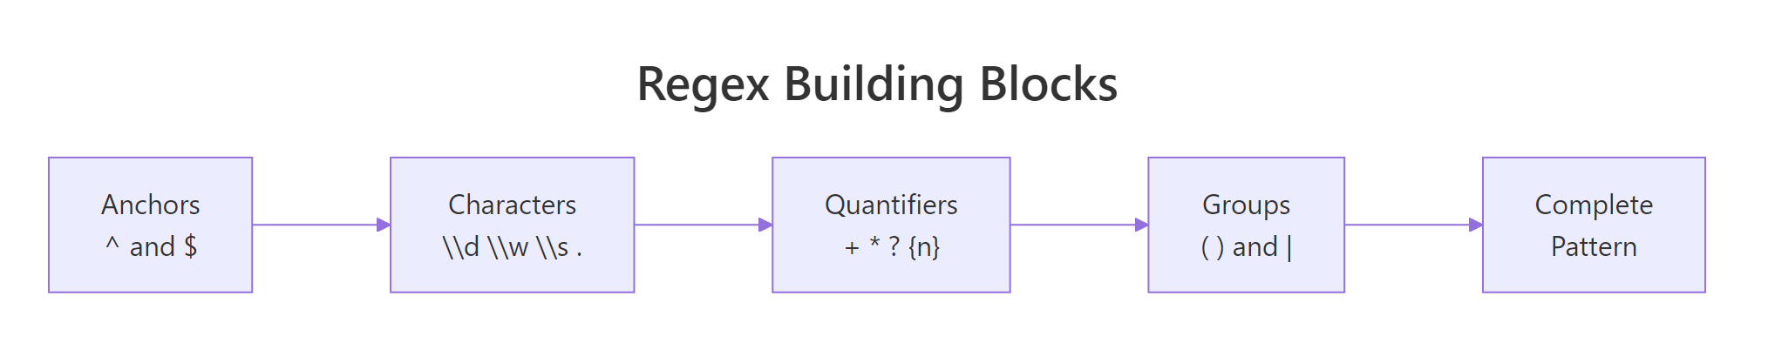
Bilbasen

Slide 23
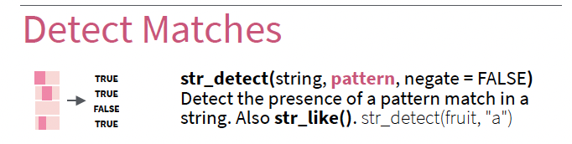
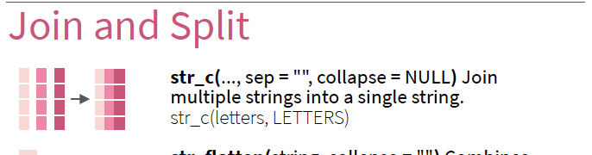
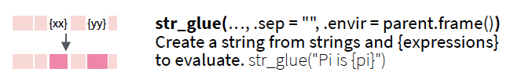

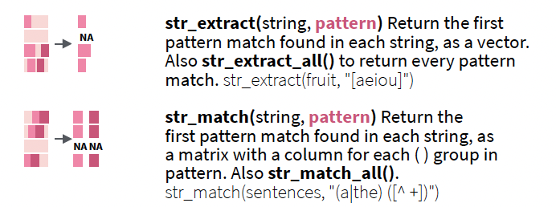
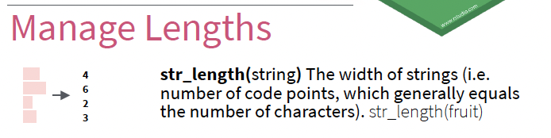
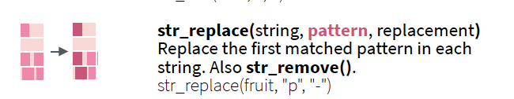
Bilbasen

Slide 25
Biler – opgaver
Se github

Slide 26
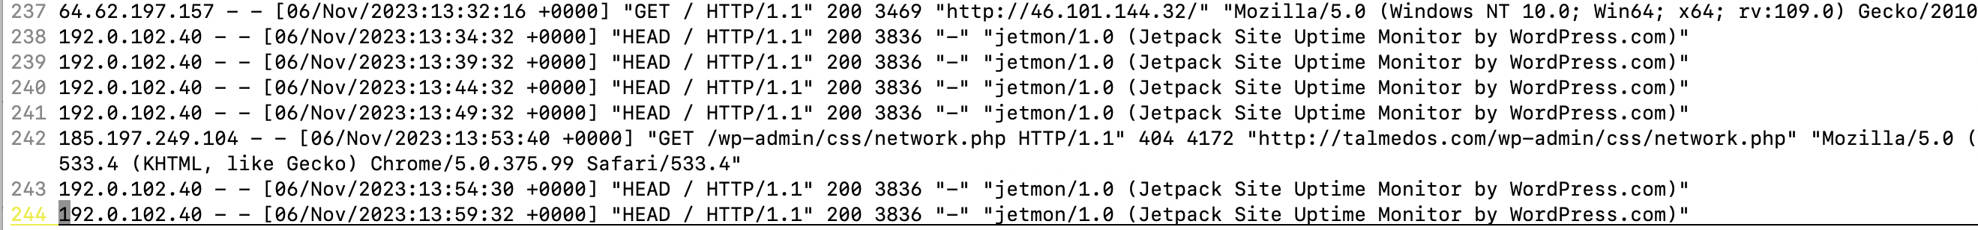
Logfiler – opgaver
When?
Success?
What?
What detail?
Who
ipadresse
I skal lave en døgnrapport.
Hvor mange ip-adresser?
  Hvor mange besøg pr. adresse?
Hvor mange requests (GET,POST,HEAD ..)
Hvor mange fra ikke-browser?
Hvor mange hacker-forsøg?
  Antal & type

