Slide 1
An Introduction to Git
For K-State Android Development Club

Slide 2
What is Git?
Git is an open source, distributed revision control and source code management system.
Created in 2005 by Linus Torvalds.

Slide 3
Set Up Git
Start a free account at GitHub.com
Download Git at http://git-scm.com/download - Install GitBash as option
Download TortoiseGit(GUI) - http://code.google.com/p/tortoisegit/
Using GitBash go to a directory where you will access your project.
In GitBash type “git clone https://GitHub.com/cpiggott/AndroidClub.git” – This will clone the project and create a local repository on your computer.
Or in your Directory, right-click then choose “Git create repository here…” TortoiseGit then Right Click and Clone from https://GitHub.com/cpiggott/AndroidClub.git

Slide 4
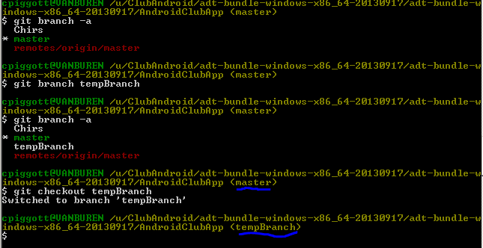
How to Start A Branch

Slide 5
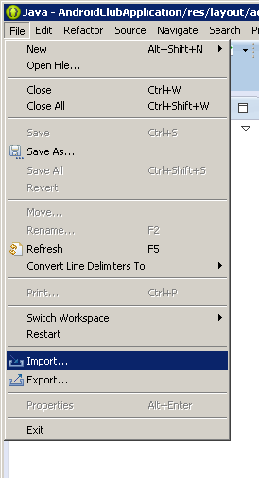
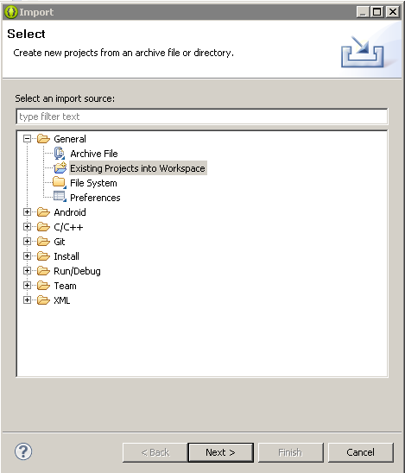
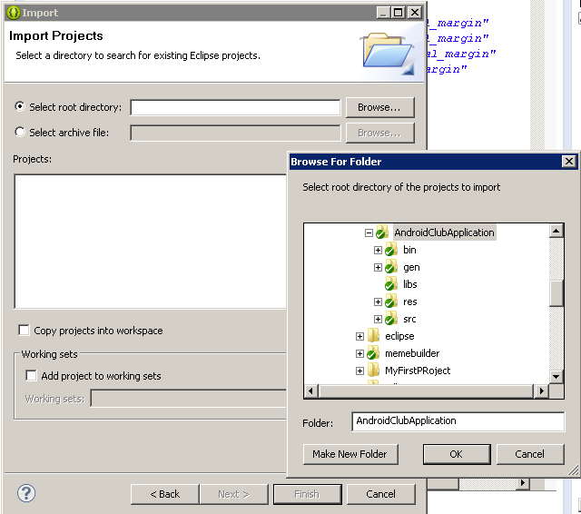
Opening the Project in Eclipse
Click OK, Select the Project, Click Finish.

Slide 6
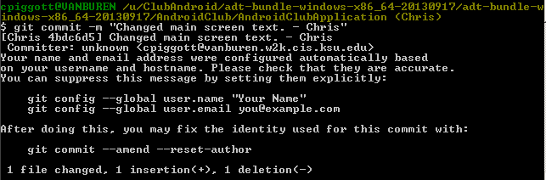
Commit Early, Commit Often
Committing is a “screenshot” of your code. It allows you to save anything you have done without the risk of losing it.

Slide 7
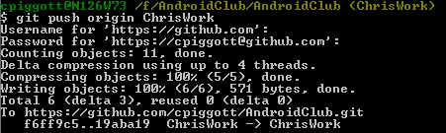
Pushing Using Git-Bash

Slide 8
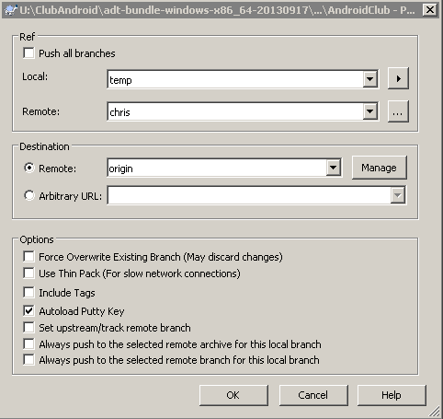
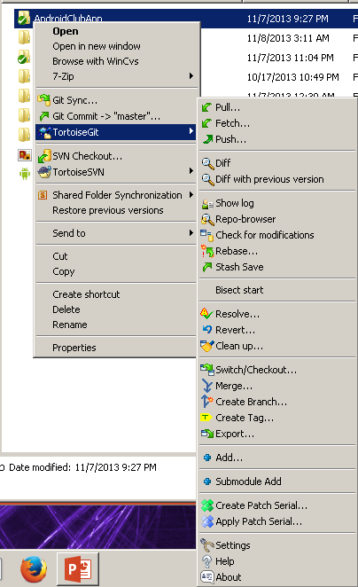
Pushing to a Remote Repository

