Slide 1
Benchmarking the Power Usage of Network Devices
Carlos Pignataro
NC State University
Romain Jacob
ETH Zürich
IETF 118
Prague, Nov. 4 - 10, 2023

Slide 2
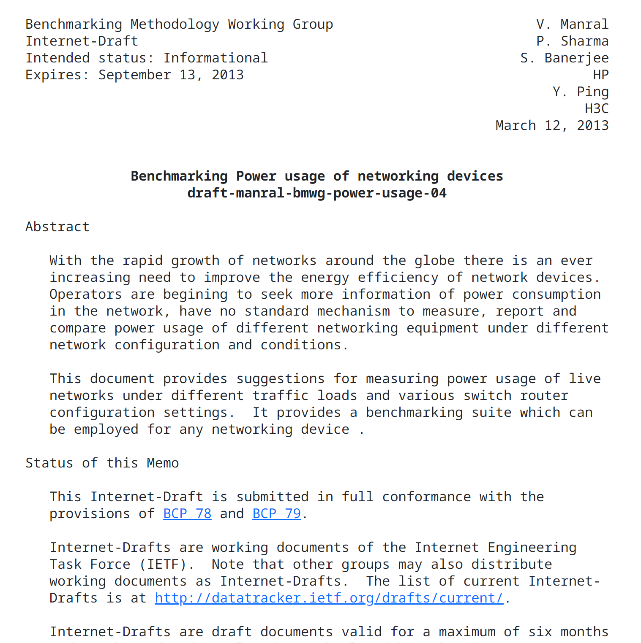
We started a draft 10 years ago, it’s high time we finish it!
The only data we get from manufacturers is usually “max power”
Hardly any device runs at its maximum capacity
Few measurements are available, Most are 10+ years old
We have a poor understanding of the “typical” power usage today
Defining this is non-trivial!
That’s why we need a benchmark...

Slide 3
The high-level goal is to model power usage better. The challenge lies in the details...
What are the useful loads to measure?
What approach is best suited?
100% idle
Black-box measurement of the entire device
Some in-between loads
Additive measurement of logical modules
Fully loaded
Mix of both
What does “idle” mean w.r.t.
The benchmark must strike a trade-off between
Port configuration?
Feasibility of the measurements
Control plane state?
Generality of the method
Accuracy of the resulting model

Slide 4
Feedback and contributors are more than welcome!
Which benchmarking approach do you think is best?
Do you think such a benchmark is useful for the e-impact work?

Help welcome!
Do you you have ideas / data / time to contribute to this project?

Slide 5
Benchmarking the Power Usage of Network Devices
1850
2018
Carlos Pignataro
→
cpignata@gmail.com
Romain Jacob
→
jacobr@ethz.ch
IETF 118
Prague, Nov. 4 - 10, 2023
Climate stripes.
Ed Hawkins, 2018
portrays the increase of average global temperature

