Slide 1
Network sustainability, green metrics, data models, and instrumentation
IETF 118, Prague, Czech Republic
November 2023
Alexander Clemm ludwig@clemm.org & Marisol Palmero mpalmero@cisco.com

Slide 2
Approaches to improve sustainability
Plenty of opportunities to explore: pollution-aware traffic steering, energy-aware VNF placement, schemes to retire idling resources, ...
Structuring Challenges and Opportunities – draft-irtf-nmrg-green-ps
Architecture
Management
Protocol
Network
Equipment
What is actionable for us? Which areas promise the greatest impact? What are the enablers?

Slide 3
The relevance of data
“You cannot manage what you cannot measure” (Peter Drucker)
Compare effectiveness of alternatives
Quantify impact (cost/benefit analysis)
Enable control loops
Foundational requirement hence: data that can be used to observe, assess, quantify “environmental impact”
This happens to also be actionable in IETF
Everybody will need this
Standardized data will facilitate solutions
Hence a priority for E-Impact (we hope)
Determine Actions
Monitor &
Observe
Configure
Network

Slide 4
Metrics vs Data Models vs Instrumentation
Metrics
What are the metrics that matter: for control loops, to assess and compare effectiveness
Data Models
How do we represent and organize metrics
How to relate them to different entities
Instrumentation
How do we implement software to provide actual data instances
May involve internal instrumentation on a device, but also measurements & supporting protocols
Define
Represent
Implement

Slide 5
Metrics
Green Networking Metrics: https://datatracker.ietf.org/doc/html/draft-cx-green-metrics-02
Traffic
level
Packets,
Flows
Paths
Physical
level
Equipment/ Device
Network as a whole
“Singular”
“Collective”
can be obtained on a per-entity basis
needs to be aggregated across multiple entities

Slide 6
Metrics
Green Networking Metrics: https://datatracker.ietf.org/doc/html/draft-cx-green-metrics-02
Advanced, more speculative
topics
Traffic
level
Packets,
Flows
Paths
Physical
level
Equipment/ Device
Network as a whole
The natural starting point
“Singular”
“Collective”
The end outcome of interest
can be obtained on a per-entity basis
needs to be aggregated across multiple entities

Slide 7
Metrics space
Equipment/ Device
Energy consumption, energy utilization efficiency
Examples
Power consumption absolute / normalized, per chassis/line card/port, etc
Consumption ratings (datasheet stuff)
But it is not just about equipment power but about greenhouse gas emissions
Account for sources (e.g. energy mix), deployment context (e.g. HVAC)
Conversion factors between “power” and “carbon”

Slide 8
Conversion is a choice?
Energy<unit>
CO2eq
$$
?
emission factor
location
power factor
energy source
lifetime
time of the day: min/hourly/season
who has to pay?
GHG Protocol*:
Scope 3 vs Scope 2 & 1
Not an inclusive list of possible factors: e.g. deployment context (e.g. HVAC / “building tax”), amortization of embedded carbon
Reference Green House Gas Protocol* https://ghgprotocol.org/
Notes:
the model should be open enough to alleviate the assumption...
avoiding assumptions, or reducing assumptions

Slide 9
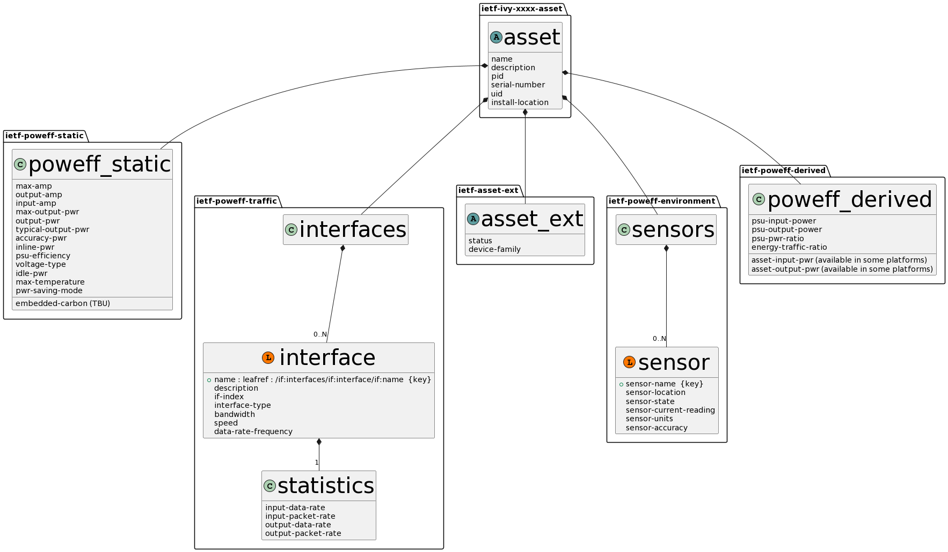
POWEFF Data Model

Slide 10
Metrics under POWEFF-derived
Metric | Description
Energy consumption (kWh) | This represents the energy consumed by the device. Represented by the Power Draw
Power to traffic ratio (watts/Gbps) | Power measure on device (watts) / Traffic throughput (Kbps)
Extrapolated CO2 emissions (g CO2eq) | Use current energy consumption (kwh) and the device geo-location (e.g. -34.6037°, -58.3816°) to query carbon factor (ie from Electricy Maps) and calculate extrapolated CO2 emissions
PSU ratio (%) | Power supply efficiency (offered powered vs consumed power)

Slide 11








Sustainability Insights Framework
PROCESSOR
Visualization
Data Standardization
Where?
AGGREGATOR
COLLECTOR
COLLECTOR
PROVIDER
NON-YANG SYS
PROVIDER
NON-YANG SYS
PROVIDER
NON-YANG SYS

Slide 12
Sustainability Insights Framework
PROCESSOR
Visualization
Circularity
materials, R’s, packaging, transport, etc...=> YANG or any other language defining semantic is required
AGGREGATOR
COLLECTOR
COLLECTOR
PROVIDER
NON-YANG SYS
PROVIDER
NON-YANG SYS
PROVIDER
NON-YANG SYS

Slide 13
Sustainability Insights Framework
AGGREGATOR
Optimization
What to Optimize?
Reduce CO2eq emissions
Reduce e-Waste
Reduce embedded carbon
Accuracy of the measurements
Simulated vs Real metrics
Cross Domain (Ex: Traffic Path Optimization based on energy constraints)
COLLECTOR
COLLECTOR
PROVIDER
NON-YANG SYS
PROVIDER
NON-YANG SYS
PROVIDER
NON-YANG SYS

Slide 14
Metrics space (contd.)
Flows
Relate carbon footprint to flows and service instances
Function of volume and duration
Additional considerations for packet replication, loss, etc.
Carbon flow statistics, enable carbon-based accounting
Examples: Energy consumption / carbon footprint over duration of flow
Paths
Assess carbon intensity of paths and route alternatives
Energy-/ Carbon-/ Pollution-Aware Networking
Examples: Path energy/carbon ratings (function of carbon ratings of hops)
Network- at-large
Totality of the picture aggregated across network-at-large
Consider also HVAC, hidden / non-instrumented devices
Examples: Total energy consumption (MWh), Network energy efficiency (MWh/PB)

Slide 15
Individual Metrics Controversies
Do traffic-level metrics even matter
Non-linearity of energy consumption
Idle power very close to power at max capacity
Traffic volume is subject to many tradeoffs – e.g. efficient encoding may incur cost in compute
Verdict is out, non-linearity may not change, more research is needed that is enabled by such metrics
Holistic metrics vs discount factors
Energy consumption – CO2 equivalents – greenhouse gas equivalents
Formulas and discount factors may introduce inaccuracies; how far do we go
Need to clearly document & maintain separately assumptions and conversion factors vs base metrics
Relating sustainability cost to utility being derived as measures of efficiency
E.g. power consumption relative to traffic volume
Input needs to be put in relationship with utility that is being derived
Volume of traffic (e.g. W/GB)is a flawed measure of utility, but better alternatives are lacking
Any one metric can paint a distorted picture and can be gamed
It’s the holistic picture that counts

Slide 16
Selected Open Issues
Data and metrics, specifically beyond device-level
Consistently applied and broadly supported
Energy consumed ≠ greenhouse gas emissions
Which conversion factors are needed & how are they precisely defined
Energy mix, deployment factors, embedded carbon tax, CO2/GG equivalents
Dealing with imprecision and uncertainty
Specify ranges vs absolute values in some cases (e.g. power consumption of links)
Measuring of utility delivered for efficiency measures
Can we do better than traffic volume
Virtualization – do we need virtual energy metrics
Compliance and certification
Including incentive structure for accurate instrumentation
Instrumentation of legacy equipment
+ on a practical level in IETF/IRTF, landing spots are not always clear

Slide 17
Backup

Slide 18
Context
Reducing greenhouse gas emissions to address climate change is one of mankind’s “grand challenges”
This challenge also extends to network technology
How to reduce environmental impact of networks?
How to make them more sustainable & what can we do at IETF?
E-Impact Program sponsored by the IAB
Following several earlier activities: E-Impact workshop, side meetings at IETF 115-117
Several Internet Drafts have begun to appear, loosely coordinated here
Landing spots for those drafts are not always clear e.g. https://datatracker.ietf.org/doc/html/draft-cx-green-metrics-02: opsawg? ippm? somewhere else?

