Slide 1
Internet Handprint &
Earth Systems Science
- a research outlook
IETF 117 – “Sustainable Networking” Side Meeting
24 July 2023 – San Francisco
Ali Rezaki, Nokia

Slide 2
Sustainability: the global context
We are experiencing an environmental emergency today!
There are disadvantaged, excluded populations worldwide!
Businesses, especially SMEs, are squeezed between sustainability/net-zero targets and achieving growth!

Slide 3
Sustainability: all about feedback loops!
Human – nature, human – human disconnect: inability to link actions with their impact to others – broken environmental and societal feedback loops!
Against this backdrop, while the Internet environmental footprint must be minimized, society is also demanding our technology to help with the global emergency -> Internet as a sustainability enabler, Internet handprint!
How can ICTs in general, and Internet in particular, help the reconciliation – restoring the feedback loops?

Slide 4
Internet for Sustainability: Handprint Impact in Verticals
How can the Internet enable vertical sectors like energy, transport, manufacturing, construction, agriculture, etc. to decarbonize and become holistically sustainable?
How can the Internet promote circularity in verticals?
How can the Internet help with climate change adaptation through building resilience?

Slide 5
Internet Handprint Research: a highly complex endeavor!
Optimization of a few parameters will likely not produce desired outcomes: in complex systems, “all else being equal” doesn’t work!
Optimizations in some aspects could drive undesired outcomes for other parameters: the rebound effect!
Social and economic constraints could prevent the take-up of technological advancements!
A complex systems approach is needed!

Slide 6
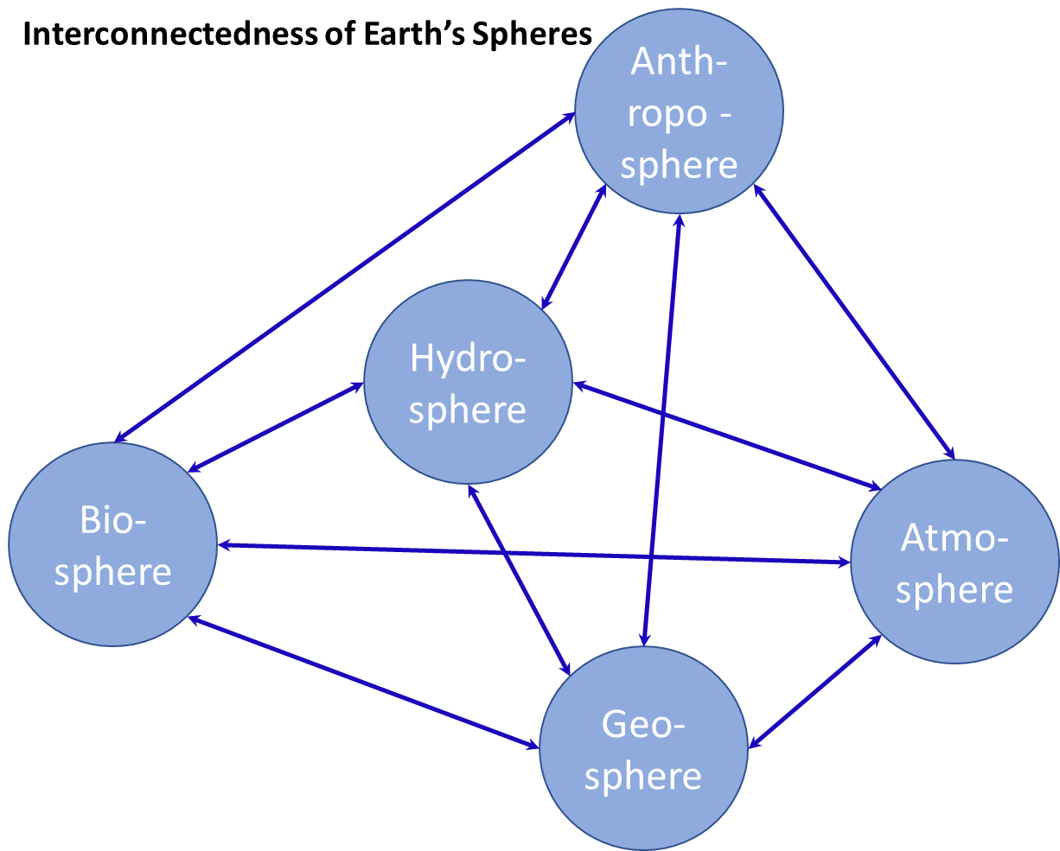
Earth Systems Science (ESS)
Holistic & interdisciplinary
Earth is a complex system of systems.
ESS explores how negative feedback loops, material and energy flows among its spheres created stability on earth.
These stable conditions support life.
ESS also covers how human impact on earth is pushing stable systems towards their tipping points, endangering life.
We need to understand our impact (positive and negative) in all spheres, learning from ESS methods, to have a reasonable chance of reaching our sustainability targets.
Re-interpreted from “Report on Tomorrow’s Science. Earth System Science –
Discovery, Diagnosis, and Solutions in Times of Global Change”, German
National Academy of Sciences Leopoldina (2022): Halle (Saale), June 2022.

Slide 7
Earth Systems Science (ESS) & Internet Sustainability
Our focus as an industry has been on understanding the interactions between the anthroposphere and the atmosphere (mostly footprint), to tackle the climate emergency.
Interactions of ICTs with the other spheres are covered to a lesser degree!
Efforts to tackle climate change could be negatively affected by our inability to mitigate our impact to the biosphere, geosphere, or the hydrosphere since these systems are interconnected.
We also need to make sure solutions are implementable in the anthroposphere: individual and society take up.
Re-interpreted from “Report on Tomorrow’s Science. Earth System Science –
Discovery, Diagnosis, and Solutions in Times of Global Change”, German
National Academy of Sciences Leopoldina (2022): Halle (Saale), June 2022.

Slide 8
Earth Systems Science (ESS)
Data – driven and analytical
Like all human activity, we operate in the anthroposphere.
We are present in the feedback loops, and flows within the anthroposphere and between the anthroposphere and the others.
If you will, like a network slice or like a flow in aggregate data pipes.
Similar to ESS, we would benefit from a data-driven approach, using observations, measurements and assessments.
Like ESS, we can tackle complexity through modelling and simulations, e.g. digital twins!
Re-interpreted from “Report on Tomorrow’s Science. Earth System Science –
Discovery, Diagnosis, and Solutions in Times of Global Change”, German
National Academy of Sciences Leopoldina (2022): Halle (Saale), June 2022.

Slide 9
Adoptions from Earth Systems Science (ESS)
We need to:
Determine what can be measured (like energy consumption) and what can be assessed and estimated based on standardized secondary data (biodiversity loss or resource depletion impact),
Create and agree on assumptions and measurement criteria (to ensure same conditions apply each time)
Collect and share data continuously,
Use AI/ML for data analysis and developments of insights
Develop an interdisciplinary, experimental research community!
Re-interpreted from “Report on Tomorrow’s Science. Earth System Science –
Discovery, Diagnosis, and Solutions in Times of Global Change”, German
National Academy of Sciences Leopoldina (2022): Halle (Saale), June 2022.

Slide 10





Thank you!
Key Take aways
Holistic environmental impact research
Data-driven methodology (ESS)
Mitigation
Adaptation
Climate change
Biodiversity loss
Geodiversity loss
Standardized metrics, measurement & assessment methods,
modelling & simulations
Internet as enabler for all sectors to:
Reduce, Reuse,
Refurbish, Recycle
Build resilience through ICTs

