Slide 1
Hockey Database
Cameron Pilarski | Bob Doser

Slide 2


Overview
Hockey Database
Stores current and historical data from players and teams active and retired
Tracks team and player information and statistics
Valuable information for any dedicated fan
Capable of storing data across multiple leagues
This makes our database flexible
Ideal access to data for any super fan of hockey at all levels:
Youth to Professional

Slide 3

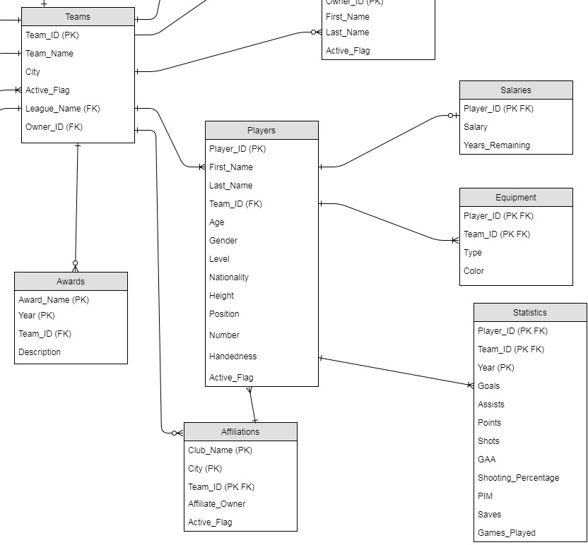
ER/Schema
Teams (Team_ID, Team_Name, City, Active_Flag, League_Name, Owner_ID)
Players (Player_ID, First_Name, Last_Name, Team_ID, Age, Gender, Level, Nationality, Height, Position, Number, Handedness, Active_Flag)
Statistics(Player_ID, Team_ID, Year, Goals, Assists, Points, Shots, GAA, Shooting_Percentage, PIM, Saves, Games_Played)

Slide 4

FD/MVD Analysis
Statistics (Player_ID, Team_ID, Year, Goals, Assists, Points, Shots, GAA, Shooting_Percentage, PIM, Saves, Games_Played)
{Player_ID, Team_ID, Year} → {Goals, Assists, Points, Shots, GAA, Shooting_Percentage, PIM, Saves, Games_Played}
Left side is superkey and is in BCNF and 4NF
Players (Player_ID, Player_First, Player_Last, Team_ID, Age, Gender, Level, Nationality, Height, Position, Number, Handedness, Active_Flag)
{Player_ID} → {Player_First, Player_Last, Team_ID, Age, Gender, Level, Nationality, Height, Position, Number, Handedness, Active_Flag}
Player_ID uniquely identifies each row therefore Player_ID is a superkey so BCNF and 4NF

Slide 5

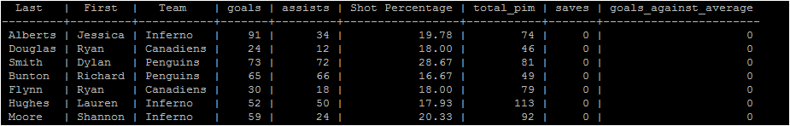
Query Example
Stats for a player career:
with x as ( Select last_Name , first_Name, Team_id, sum(goals) as Goals, sum(assists) as Assists, sum(shooting_percentage)/count(shooting_percentage) as shot_percentage,sum(PIM) as Total_PIM, sum(saves) as Saves, sum(GAA) as Goals_Against_Average From players natural join statistics Where Active_flag = True Group by last_name, first_name, Team_id)
Select last_Name as "Last", first_Name as "First", Team_Name as "Team", Goals, Assists, round(cast(shot_percentage as numeric), 2) as "Shot Percentage", Total_PIM, Saves, Goals_Against_Average
from x natural join teams;

Slide 6

Summary
Room for expansion:
Game Statistics Player Awards Media/News
Database is ideal for:
Youth leagues
College leagues
Semi-Pro leagues
Professional leagues

