Slide 1
StockFix
App Navigation Guide
A screen-by-screen walkthrough — including exactly where to click and every dropdown available
Powered by Meridian Group

Slide 2
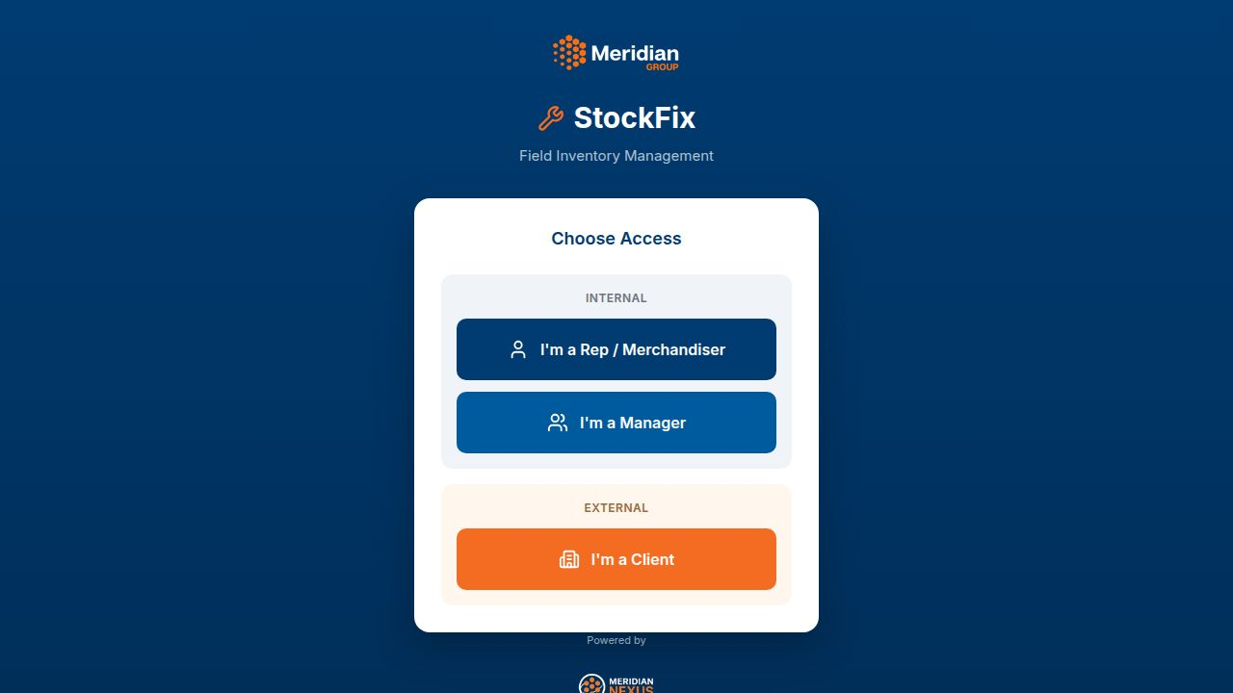
STEP 1 · ENTRY POINT
Choose Access
The landing screen for StockFix. Every user starts here and picks the role that matches how they'll use the app.
HOW TO GET HERE
1
Open the StockFix app URL
2
Choose "I'm a Rep / Merchandiser" for field task capture
3
Choose "I'm a Manager" for oversight & reporting
4
Choose "I'm a Client" for the external client view

Slide 3
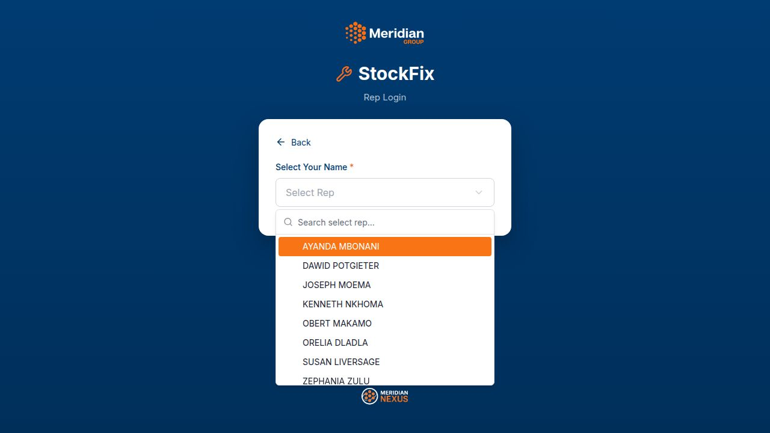
STEP 2 · REP LOGIN
Select Your Name (dropdown open)
Tapping the "Select Rep" field opens a searchable dropdown of every rep name. This is the first dropdown a rep will use.
HOW TO GET HERE
1
From Choose Access, tap "I'm a Rep / Merchandiser"
2
Tap the "Select Rep" field to open this dropdown
3
Type to search, or scroll and tap your name
4
The dropdown closes and your name is filled in
DROPDOWNS / FILTERS ON THIS SCREEN
Select Rep: Searchable list of every rep name in the system

Slide 4
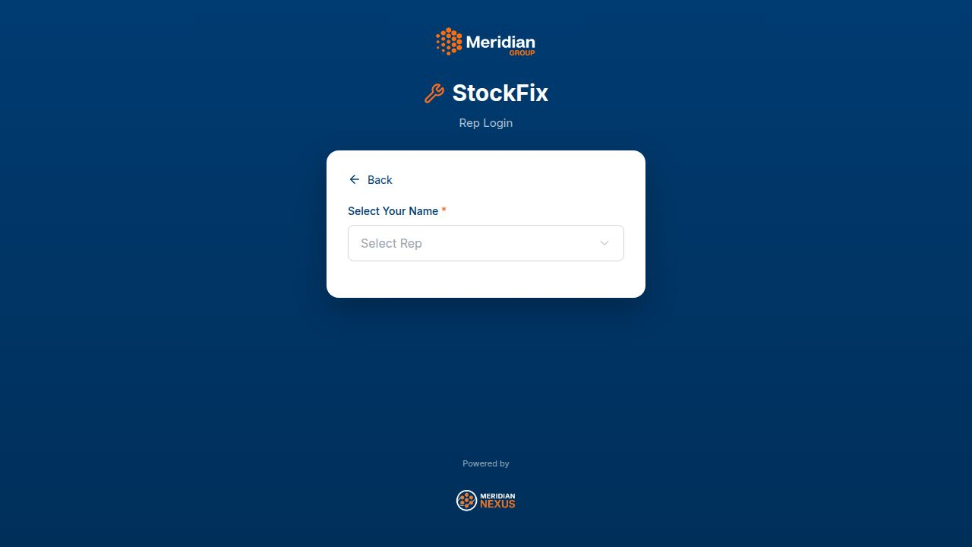
STEP 3 · REP LOGIN
Select Your Store
After picking a name, a second dropdown appears for choosing the store to visit — plus two buttons for what to do next.
HOW TO GET HERE
1
With your name selected, the "Select Store" dropdown appears
2
Tap it and choose the store you're visiting today
3
Tap "START VISIT" to begin capturing tasks at that store
4
Or tap "My Dashboard" to see your own task progress instead
DROPDOWNS / FILTERS ON THIS SCREEN
Select Store: Searchable list of stores assigned to the selected rep

Slide 5
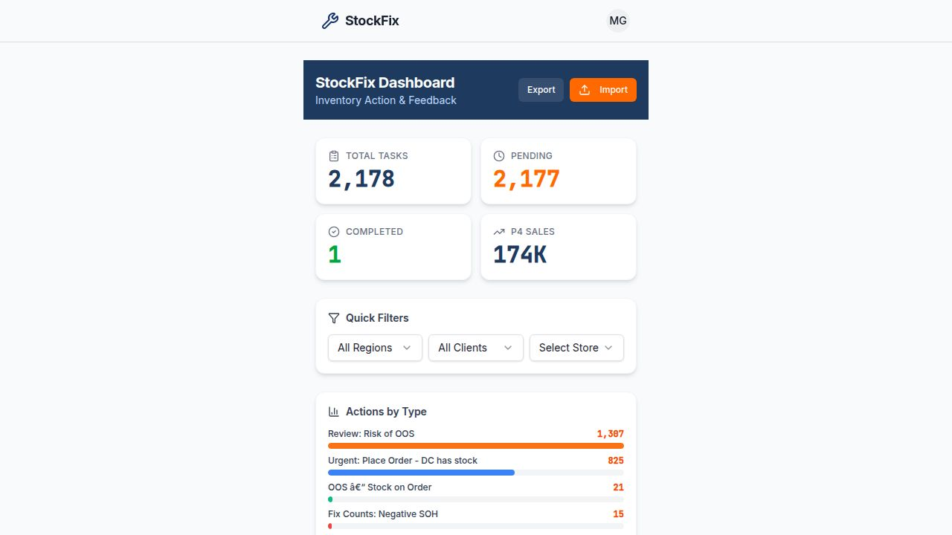
STEP 4 · MAIN HUB · WHERE TO SEE TASKS
StockFix Dashboard
This is the main hub. To see the full task list, tap the "Total Tasks", "Pending", or "Completed" card — each one opens the Tasks screen, optionally pre-filtered.
HOW TO GET HERE
1
Tap the "Total Tasks" card to see ALL tasks
2
Tap "Pending" to jump straight to open tasks only
3
Tap "Completed" to see tasks already actioned
4
Or tap "Tasks" in the bottom nav bar at any time
DROPDOWNS / FILTERS ON THIS SCREEN
Region: Filter dashboard totals by region
Client: Filter dashboard totals by client
Store: Jump straight into a specific store's summary

Slide 6
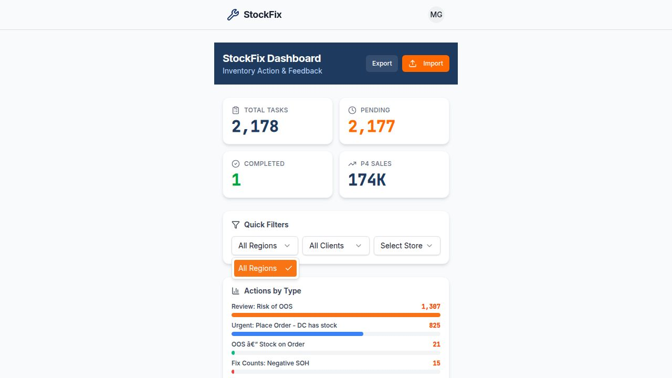
STEP 4B · QUICK FILTERS
Dashboard — Region Dropdown Open
The Quick Filters section has three dropdowns side by side. Here the Region dropdown is open, showing the list of available regions plus "All Regions".
HOW TO GET HERE
1
On the Dashboard, find the "Quick Filters" card
2
Tap the "Region" dropdown to filter by area
3
Tap "Client" to filter by client instead
4
Tap "Select Store" to jump directly into one store
DROPDOWNS / FILTERS ON THIS SCREEN
Region: Currently open — shows "All Regions" plus each region
Client: Filters KPIs and charts to one client
Store: Navigates straight to that store's summary page

Slide 7
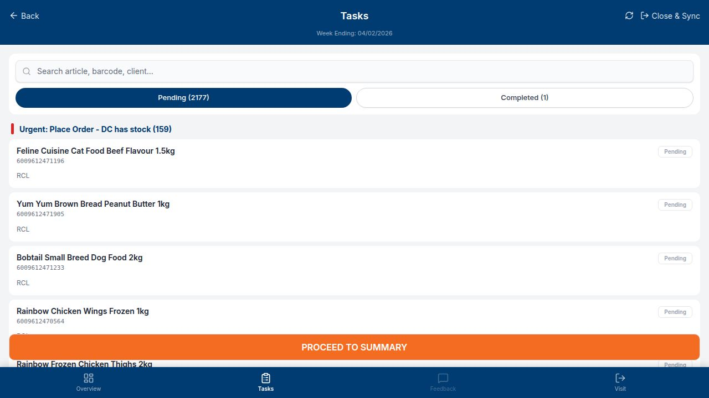
STEP 5 · TASK LIST — WHERE REPS WORK
Tasks Screen
This is where a rep actually sees and works their tasks — grouped by action type (e.g. "Urgent: Place Order"), with search and Pending/Completed tabs.
HOW TO GET HERE
1
Reached by tapping any KPI card, or the "Tasks" icon in the bottom nav
2
Use the search bar to find a task by article, barcode, or client
3
Switch between "Pending" and "Completed" tabs
4
Tap any task card to open it and capture feedback
DROPDOWNS / FILTERS ON THIS SCREEN
Pending / Completed: Tab toggle, not a dropdown — switches which tasks are listed
Search: Free-text search across article, barcode and client

Slide 8
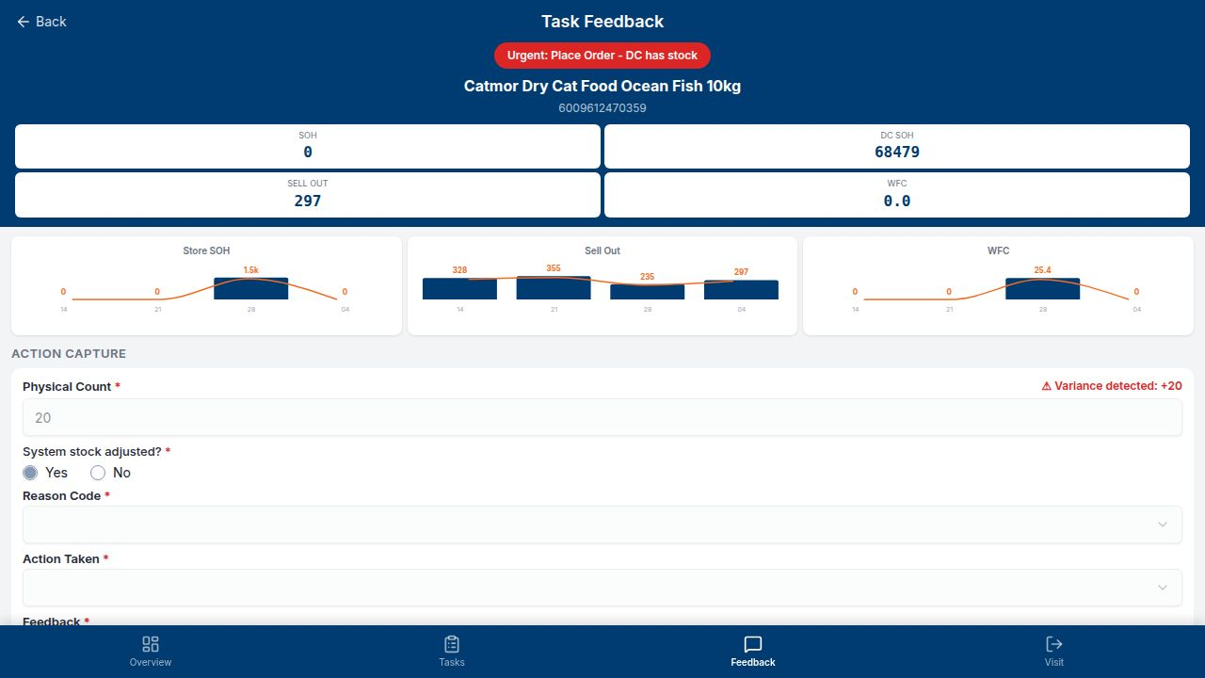
STEP 6 · TASK DETAIL
Task Feedback
Opening a task shows stock metrics (SOH, DC stock, sell-out, WFC) with trend charts, plus the action capture form the rep fills in.
HOW TO GET HERE
1
From the Tasks screen, tap any task card
2
Review SOH, DC SOH, Sell Out and WFC figures and trends
3
Enter the Physical Count and confirm if stock was adjusted
4
Open the Reason Code and Action Taken dropdowns (next slides)

Slide 9
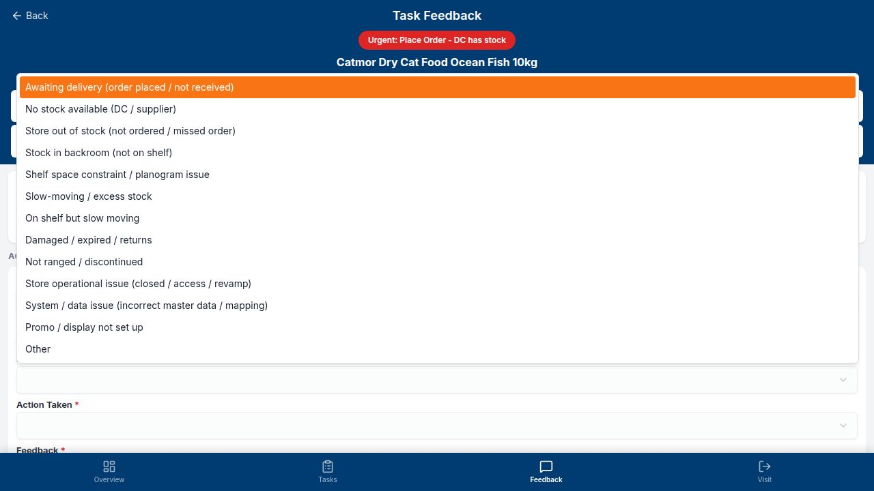
STEP 6B · TASK FEEDBACK
Reason Code Dropdown Open
Every task requires a Reason Code before it can be submitted. This dropdown lists the standard reasons for the stock issue.
HOW TO GET HERE
1
On the Task Feedback screen, tap "Reason Code"
2
Scroll or tap to pick the reason that matches the issue
DROPDOWNS / FILTERS ON THIS SCREEN
Reason Code: Awaiting delivery, No stock available, Store out of stock, Stock in backroom, Shelf space issue, Slow-moving, Damaged/expired, Not ranged, Store operational issue, System/data issue, Promo not set up, Other

Slide 10
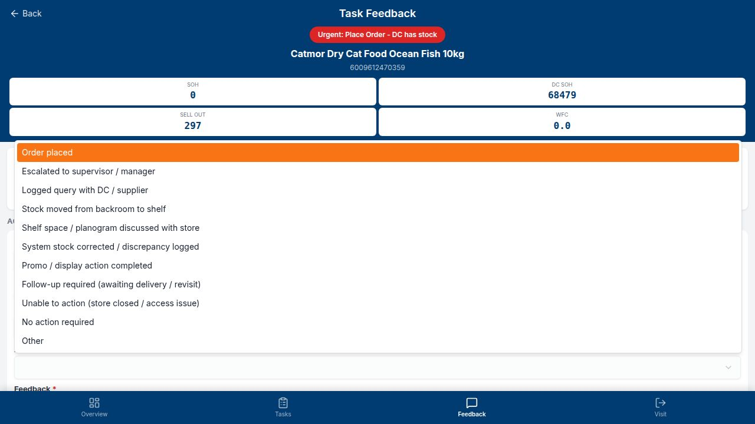
STEP 6C · TASK FEEDBACK
Action Taken Dropdown Open
After the Reason Code, the rep must also select the Action Taken — what they actually did to resolve or escalate the issue.
HOW TO GET HERE
1
On the Task Feedback screen, tap "Action Taken"
2
Pick the action that matches what was done in-store
3
Add any free-text Feedback notes below
4
Scroll down and tap Submit to save the task
DROPDOWNS / FILTERS ON THIS SCREEN
Action Taken: Order placed, Escalated to supervisor, Logged query with DC, Stock moved to shelf, Shelf/planogram discussed, System stock corrected, Promo/display completed, Follow-up required, Unable to action, No action required, Other

Slide 11
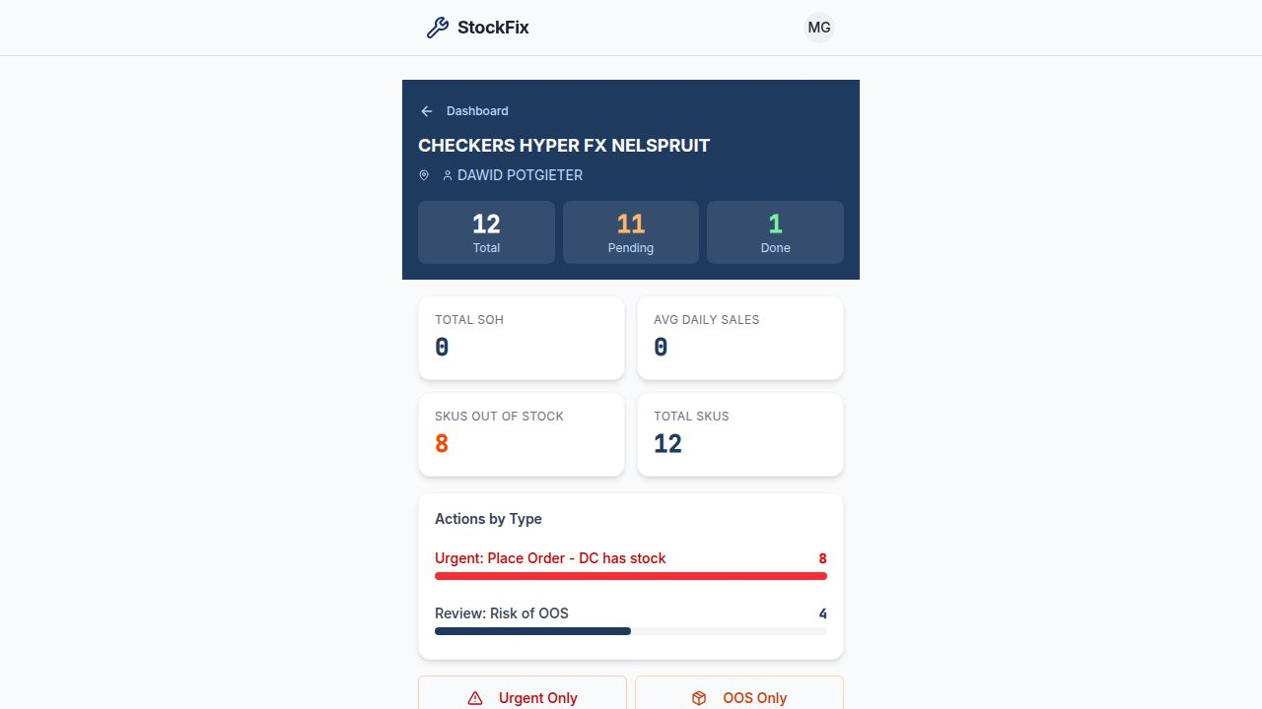
STEP 7 · STORE VIEW
Store Summary
A store-level rollup showing total/pending/done task counts, SOH and sales stats, SKUs out of stock, and quick filter chips for urgent/OOS tasks.
HOW TO GET HERE
1
Tap a store name/tile from the Dashboard, or the Store dropdown
2
Review store-level totals and stock health
3
Tap "Urgent Only" or "OOS Only" to filter that store's tasks
4
Scroll down and tap any task to open it
DROPDOWNS / FILTERS ON THIS SCREEN
Urgent Only / OOS Only: Quick filter chips — narrow the store's task list by severity

Slide 12
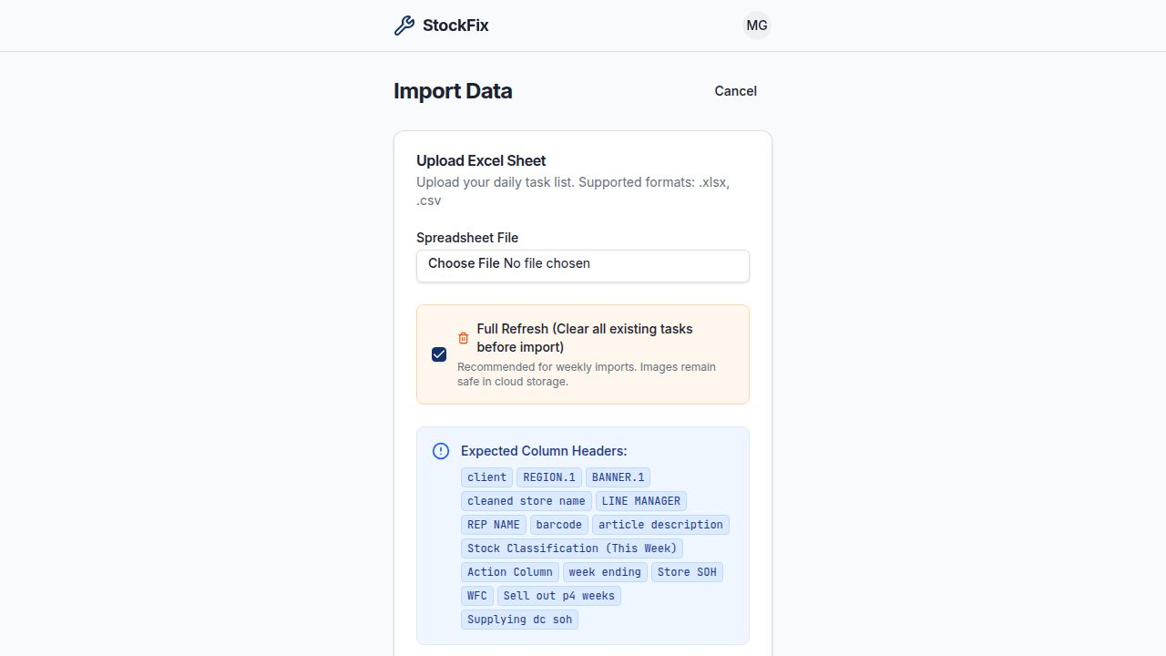
STEP 8 · MANAGER TOOLS
Import Data
Managers bulk-load the day's or week's task list by uploading an Excel or CSV file with the expected column headers.
HOW TO GET HERE
1
From the Dashboard, tap "Import" (managers only)
2
Choose your spreadsheet file (.xlsx or .csv)
3
Optionally tick "Full Refresh" to clear old tasks first
4
Confirm the column headers match, then upload

Slide 13
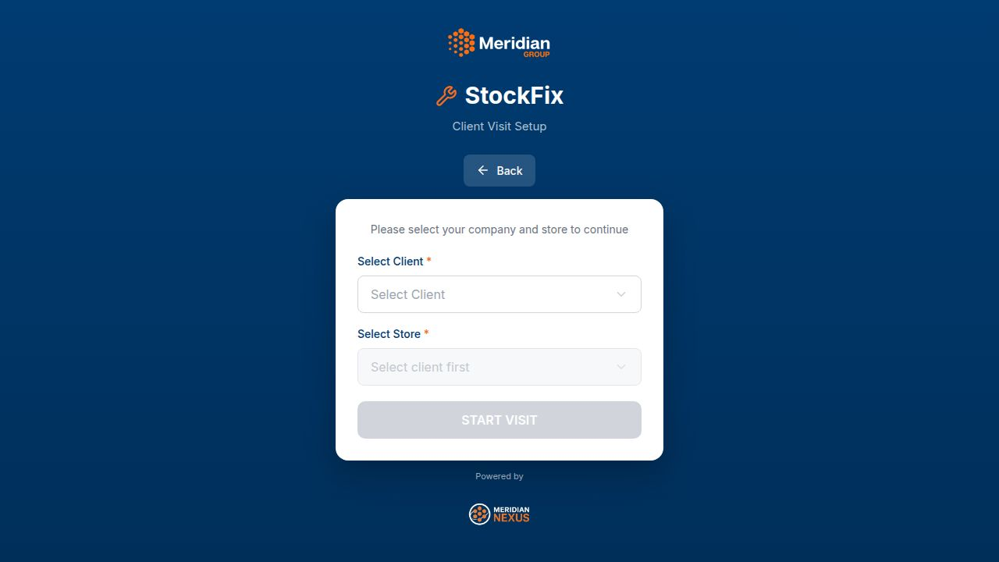
STEP 9 · CLIENT ACCESS
Client Visit Setup
External clients select their company and store to start a locked-down visit view scoped to just their own data.
HOW TO GET HERE
1
From Choose Access, tap "I'm a Client"
2
Select your company from the Client dropdown
3
Select your store from the Store dropdown
4
Tap "Start Visit" to view your store's task data
DROPDOWNS / FILTERS ON THIS SCREEN
Select Client: List of client companies
Select Store: Enabled only after a client is chosen

Slide 14
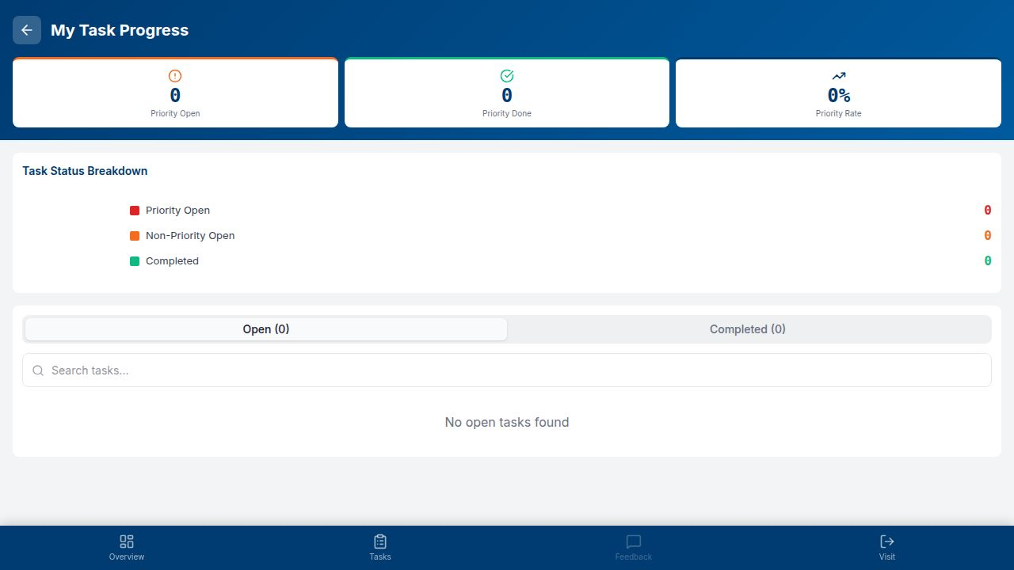
STEP 10 · REP SELF-TRACKING
My Task Progress
Reps can check their own completion stats — priority tasks open vs done, and a searchable list of open/completed tasks.
HOW TO GET HERE
1
From Select Rep/Store, tap "My Dashboard"
2
Review Priority Open / Done / Rate cards
3
Switch between "Open" and "Completed" tabs
4
Search tasks by name to find a specific one quickly

Slide 15
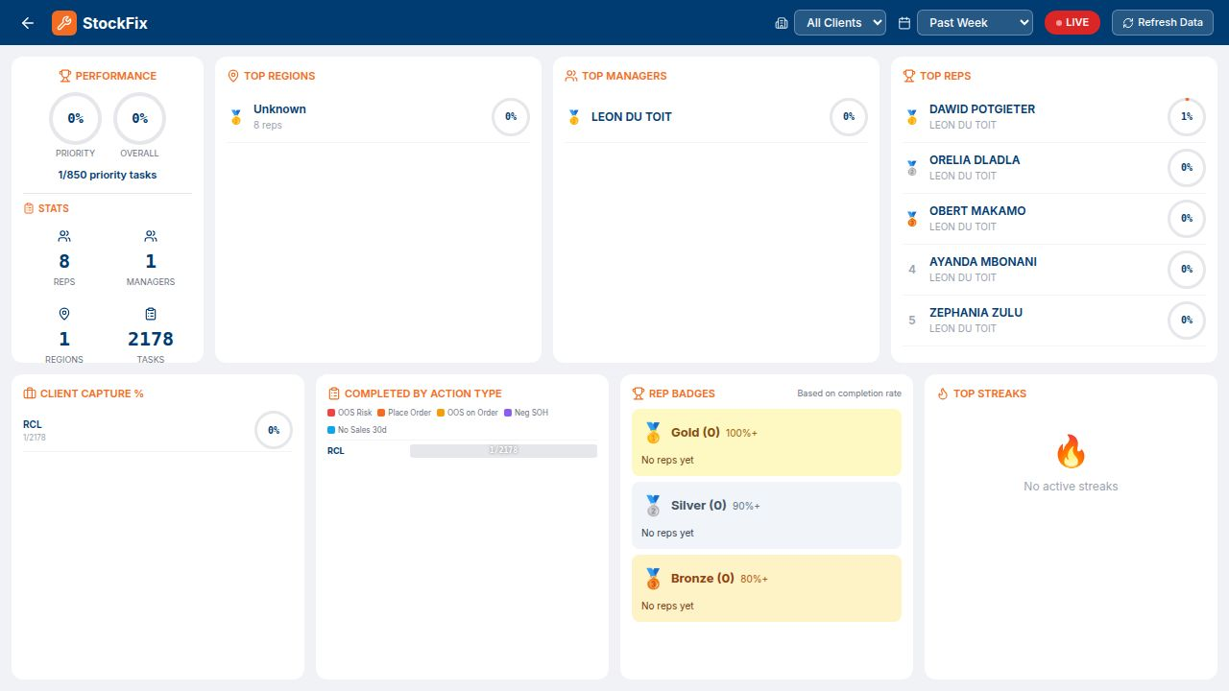
STEP 11 · MANAGER REPORTING
Admin Leaderboard
A live performance leaderboard for managers: top regions, top managers, top reps, completion by action type, badges, and streaks — filterable by client and time period.
HOW TO GET HERE
1
Log in as a Manager, then open "Leaderboard"
2
Filter by Client and time period
3
Review Top Reps, Top Managers, and Top Regions
4
Check Rep Badges and Top Streaks for recognition
DROPDOWNS / FILTERS ON THIS SCREEN
All Clients: Filter the whole leaderboard by client
Past Week / etc.: Choose the reporting time window

Slide 16
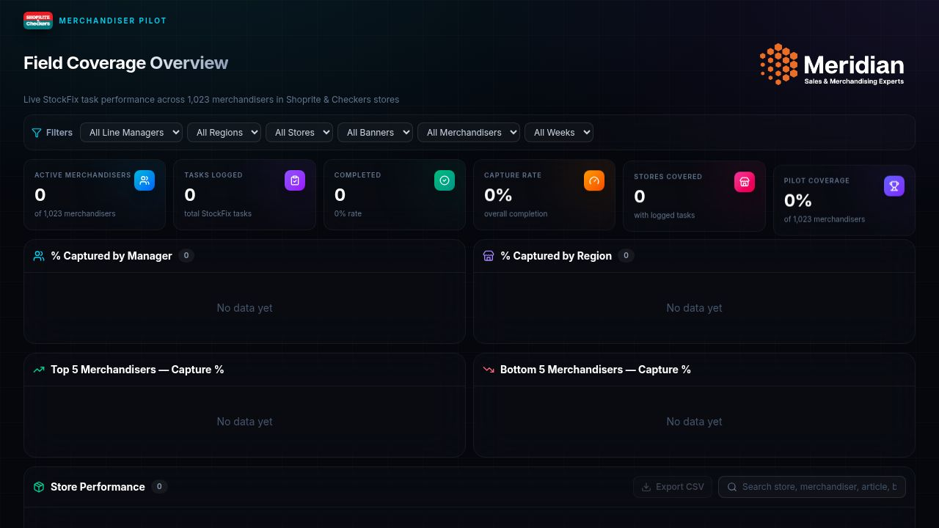
BONUS · EXECUTIVE VIEW
Merchandiser Pilot Dashboard
A branded, dark-themed executive dashboard tracking the Shoprite & Checkers merchandiser pilot: capture rate, coverage, and store performance across 1,023 field reps.
HOW TO GET HERE
1
Navigate to the /merchandiser-pilot URL
2
Use the filter bar to narrow by manager, region, store, banner, merchandiser or week
3
Review KPI cards: Active Merchandisers, Tasks Logged, Capture Rate
4
Scroll to Store Performance for detailed drill-down and CSV export
DROPDOWNS / FILTERS ON THIS SCREEN
Line Manager / Region / Store / Banner / Merchandiser / Week: Six independent filters across the top of the dashboard

